Slide 1

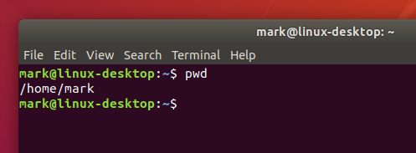
Workshop: command line and bash
13.10.2025

Slide 2
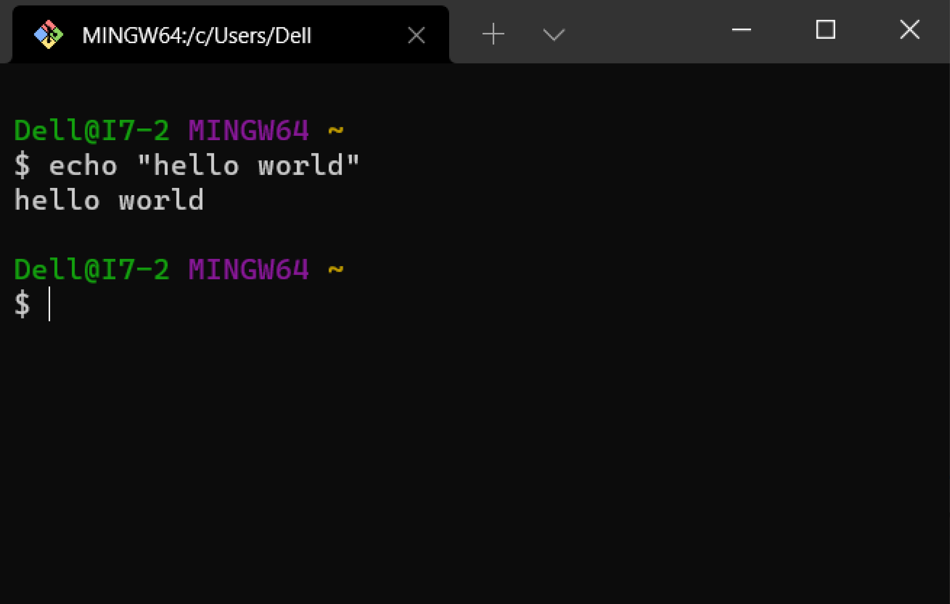
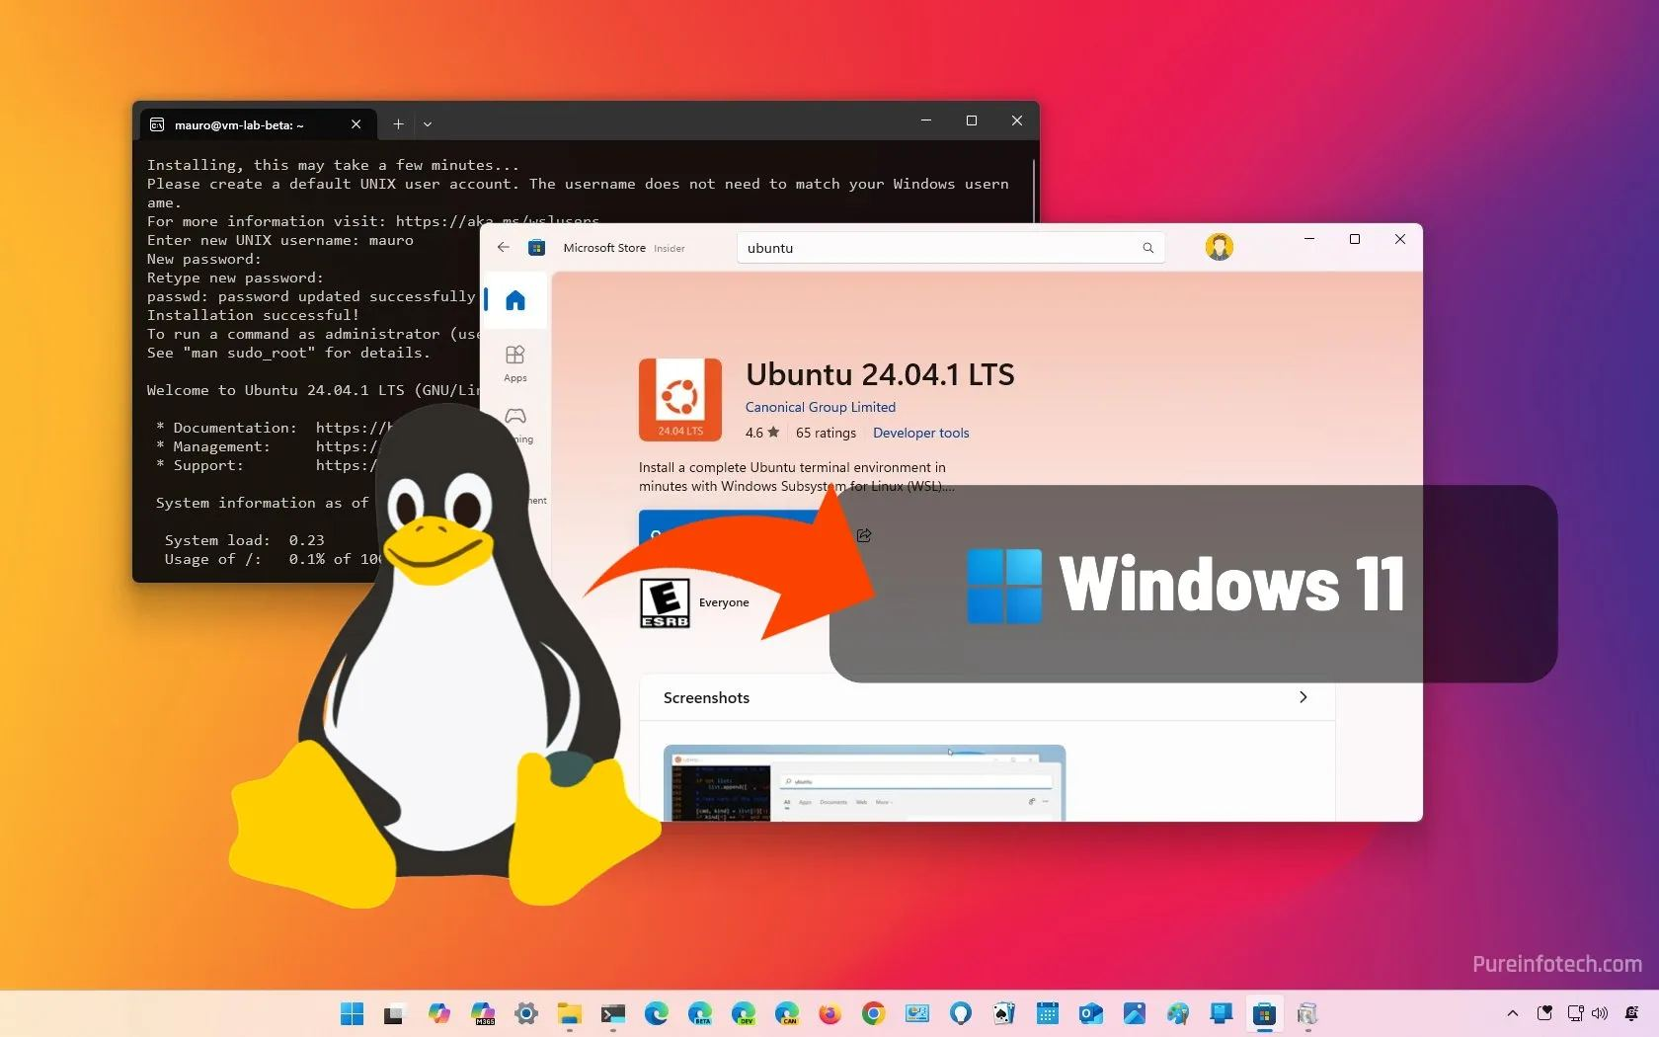
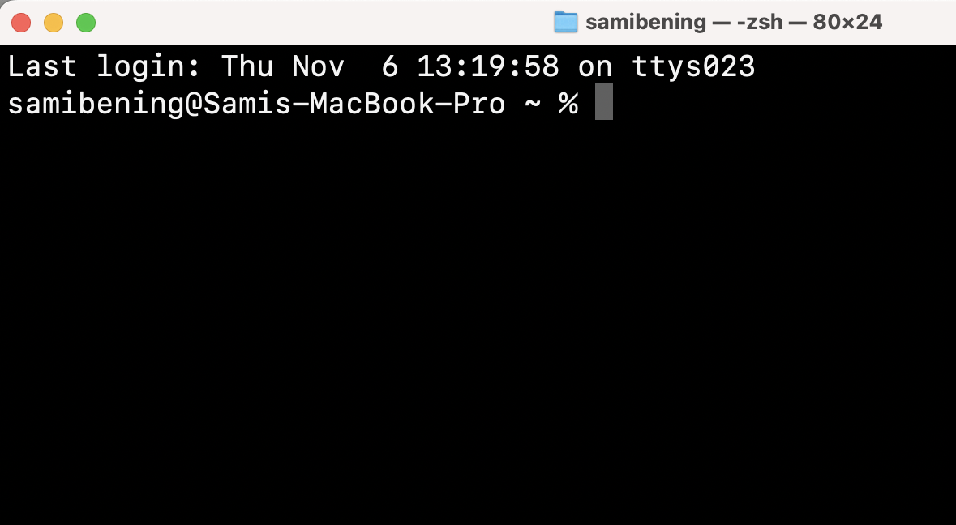
Requirements
Mac: regular command line
Windows: git bash or WSL
https://learn.microsoft.com/en-us/windows/wsl/install
https://git-scm.com/install/windows

Slide 3
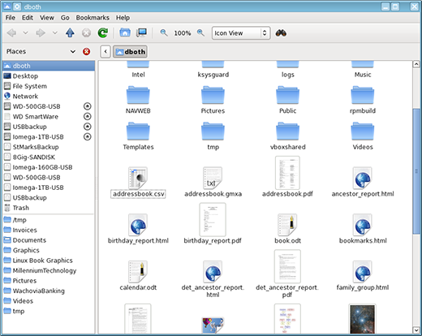
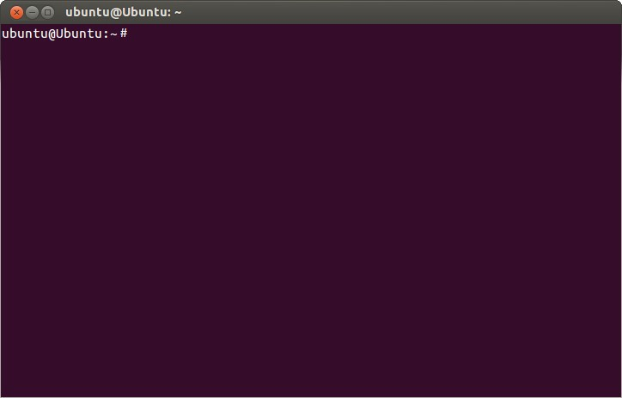
What is the command line?
Main idea: interface between the user and computer
Graphical User Interface (GUI)
Command line
Notes:
Motivation – why would we use the command line instead of an easy, pretty GUI?
Faster
More efficient
Portable – remote connections sometimes only on command line

Slide 4
Directory structure
bin
User home directory
home
~
. .
YOU ARE HERE
a
Parent directory
b
Working directory
c
.
Downloads
Documents
Projects
Lyrics
Absolute path:
/home/c/Documents/CompBioSoc/
~/c/Documents/CompBioSoc/
CompBioSoc
Music
Relative path:
tmp
Documents/CompBioSoc/

Slide 5
Syntax of commands
<Command> <Flags> <Argument>
Name
Options
Input
Example:
ls -la
●
ls lists files in the working directory
-la = Combination of –l and -a
●
●
-l = Option for list format
●
-a = Option for hidden files (“all”)
●
Argument empty: default is the working directory

Slide 6
Important commands – file system
pwd | Print what directory you are currently in | print working directory
cd | Move to another specified directory | change directory
ls | Show the contents of the current working directory | list
cp | Copy files/directories | copy
mv | Move or rename files/directories | move
ln | Create link | link
touch | Create file
mkdir | Create directory | make directory
rm | Delete file (no trash can, it’s gone!) | remove
rmdir | Delete directory (again, it’s gone!) | remove directory
chmod | Change permissions to access file/directory | change file mode
find | Search for file in path

Slide 7
Important commands – working with text
less | Display input in single page format | Alternative “more”
nano | Simple text editor within the command line
vim | Complex but powerful text editor within the command line
grep | Search in input for text or regular expression | globally search regex and print
wc | Print word count of input | word count
cat | Concatenate input (used mostly for printing input) | concatenate
sort | Sort input
uniq | Show input without duplicates or show which are duplicates | unique
cut | Show input with “cut” sections
head | Show start (“head”) of the input
tail | Show end (“tail”) of the input
diff | Show difference in two inputs line by line | difference
echo | Print input string in the command line (literally “echo” the input)
Input = contents of a file or command output

Slide 8
Important commands – other stuff
man | Information/support about a command | manual
apropos | Search for specific command with keywords
tar | Create/maintain files in an archive | tape archiver
gzip | Compress files/data | GNU zip
wget | Download files/data | WWW get
ssh | Remote access a different computer | secure shell
scp | Copy to/from remote computer using SSH protocol | secure copy
history | List recently used commands

Slide 9
File permissions
read
Read, print, copy ...
write Edit, rename, create, delete, ...
execute Run file as program/script
WHAT?
- r w x r w - r - -
example.txt
file type:
user
group
other
WHO?
●
- → file
d → directory
l → link
●
all
●
Notes:
Group: think of like a shared onedrive folder for a group project where you have to specify which users have access
Other: all users not the owner or part of the group

Slide 10
Change file permissions
chmod <permission> <file>
[ugoa][-+=][rwx]
a
- r w x r w - r - -
Example:
- r w x r w - r - -
chmod o+wx
u g
Permissions...
- → remove
+ → add
= → set equal to
o
- r w x r w - r w x
chmod g=x
- r w x - - x r w x

Slide 11
Change file permissions – Octal mode
chmod <permission> <file>
<n><n><n>
Example:
- r w x r w - r - -
u g o
---
--x
-w-
2+1=3 -wx
4 r--
4+1=5 r-x
4+2=6 rw-
4+2+1=7 rwx
chmod 767
- r w x r w - r w x
chmod 717
11
- r w x - - x r w x

Slide 12
Pipes and output redirection
Pipe: |
Use output from one command as the input for the next
Redirect output: > and >>
Redirect output from command to a file
>: Overwrite contents of the file
>>: Append to contents of the file
grep YDL223C yeast.gtf | cut -f 2
grep YDL223C yeast.gtf > some_file

Slide 13
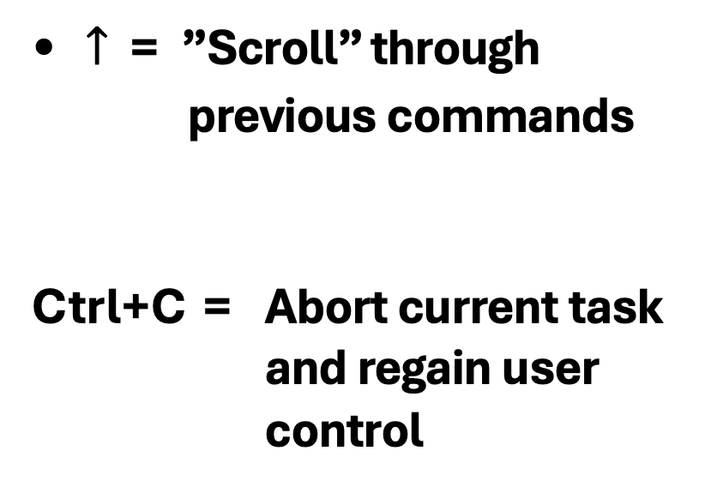
Tips and Tricks
TAB = Autocompletion!!!
$↑$ = ”Scroll” through previous commands
Ctrl+C = Abort current task and regain user control
sacch
TAB!
saccharomyces_cerivisae.gff
…and so much more!!! Practice, practice, practice

Slide 14
Bash Scripting
Automate!!!!
Script: sequence of commands in a file
Bash reads the file and processes the commands in order
Any commands that can be used in the command line can also be used in a script
We can add things like variables, loops, and if-statements to scripts for complex automation

Slide 15
Structure of a script
#!/bin/bash
Determines with which shell the script should be executed (copy exactly this for now!)
apple=$1 pear=$2
echo "I will compare $apple with $pear"
Comments with #
# Here we compare the two variables
if [[ $apple = $pear ]];
then result=equal
else result="not equal"
fi
echo "$apple and $pear are $result"

Slide 16
What sorts of things can we use in a script?
Variables
$apple
Arguments
$1 $2 $@
Arrays
demoArray=(one two three four)
Command Substitution
$(<command>)
Arithmetic expressions
$(($1 + $2))$
If-else blocks
if [[ <Condition> ]]
then <Do something>
fi
Switch case
case $1 in
"A") echo ”Apple";;
"B") echo ”Banana";;
"C") echo "Cashew";;
*) echo "A, B or C.";;
esac
While loop
while <Command>
do <Something>
Done
For-each loop
for <Word> in <String>
do <Something>
done
C-Style loops
for ((i=0; i<=n; i++)) do
echo $i
done

Slide 17
Arguments
All arguments referenced by $@
$@
bash myScript.sh "dummy input" dummy2 ...
$3
$1
$2
N-th argument referenced by $n

Slide 18

Exercise
https://tinyurl.com/CompBioSocBash

Slide 19


Slide 20
Appendix: Vim
A powerful but complex text editor inside the command line
High learning curve!
Introduction to Vim: read this
If you want to practice your Vim skills in a fun way, check out this game: https://vim-adventures.com/

Slide 21
References and resources
Slides content partly from: Bioinformatik Tutorium “Einführung in die Shell” and “Bash Scripting” Slides from Thomas Mauermeier (2020), Ludwig-Maximilians-Universität München
Command Line Cheat Sheet
Bash Scripting Cheat Sheet
Bash Guide
Vim Cheat Sheet

