Slide 1
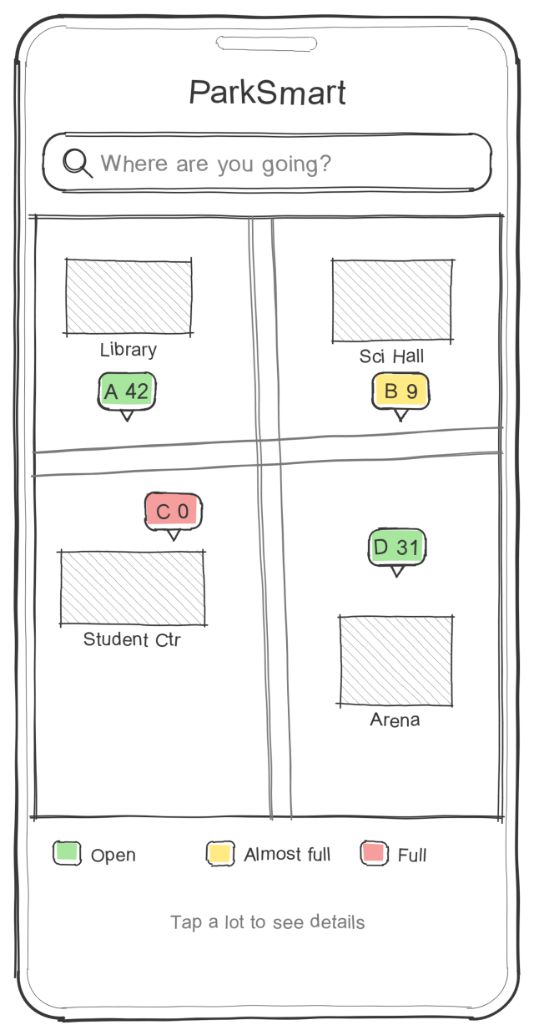
ParkSmart
College Parking Finder
Milestone 1: rough lo-fi paper prototype with mini-specs
Yellow boxes = mini-specs (what each element shows and what happens when you tap it). Blue dots mark the element being described.
CSCI 4250 Human-Computer Interaction | Fall 2026
Nicholas Palmgren

Slide 2
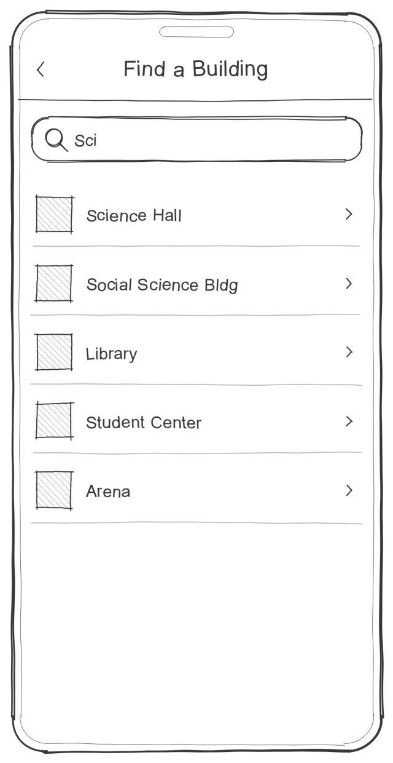
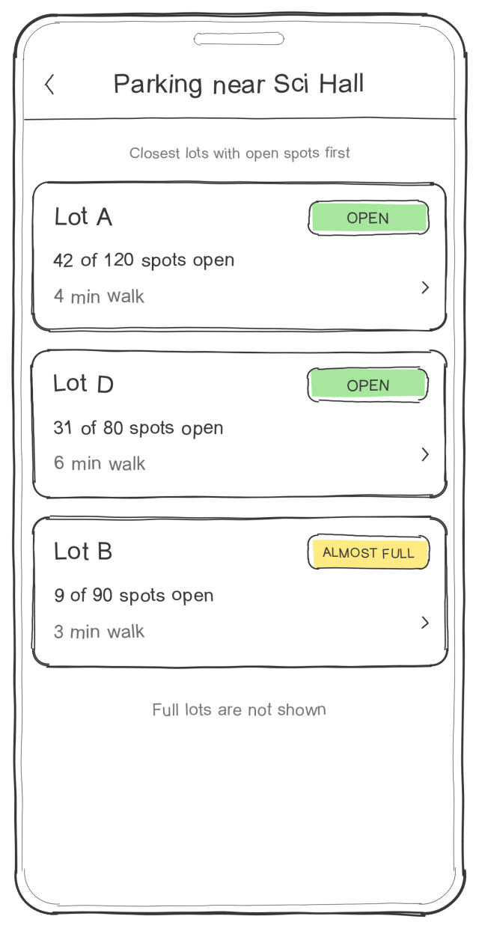
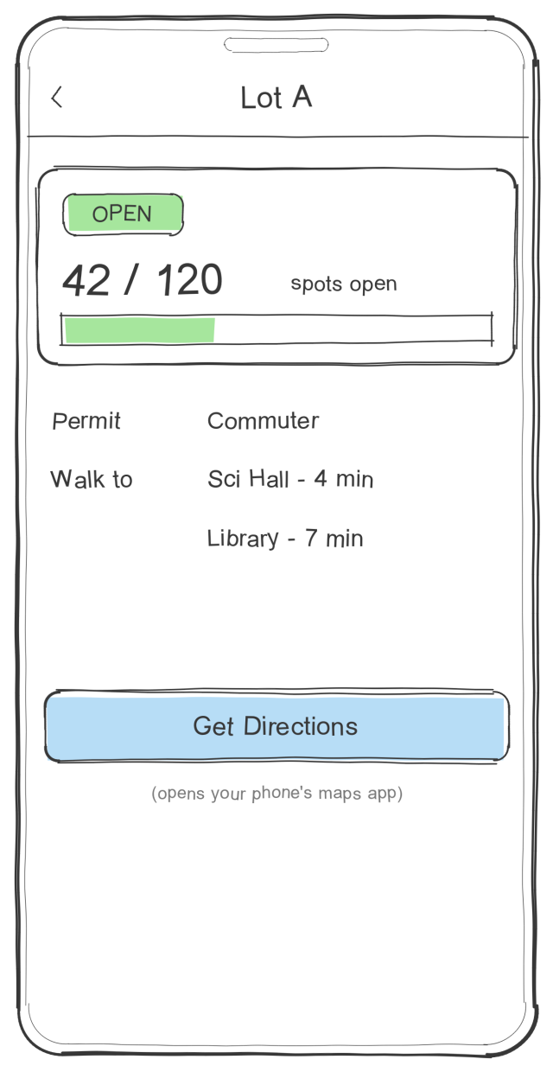
Screen flow
Four screens: choose where you're going, see the best lots, check one, and head there.
tap search bar
pick a building
tap a lot
1. Campus Map
2. Find a Building
3. Best Lots
4. Lot Info
Shortcut
Tapping a lot marker on the Campus Map goes straight to Lot Info.
Back
Every screen after the map has a back arrow to the previous screen.

Slide 3
1. Campus Map (home)
Purpose: Landing screen. Shows the campus parking lots on a map and how full each one is.
App title
ParkSmart name at the top of the home screen.
Search bar
Tap to go to Find a Building. This is how users get lot suggestions.
Lot markers
One marker per lot showing its letter and number of open spots. Tap a marker to open Lot Info.
Legend
Green = open, yellow = almost full, red = full. Colors are labeled with words too.

Slide 4
2. Find a Building
Purpose: The student picks the building they're going to.
Back
Returns to the Campus Map.
Search field
Typing filters the building list below ("Sci" shows Science Hall).
Building list
All campus buildings in the prototype. Tap one to see the best lots near it.

Slide 5
3. Best Lots
Purpose: Shows the lots closest to the chosen building that still have open spots.
Header
Shows the chosen building. Back arrow returns to Find a Building.
Lot card
Lot name, status (Open / Almost full), open spots and walk time. Tap the card to open Lot Info.
Full lots hidden
Lots with 0 open spots are left out so the user only sees places they can park.

Slide 6
4. Lot Info
Purpose: Details for one lot, so the student can decide to park there.
Back
Returns to the previous screen.
Open spots
Status, "open / total" count and a fill bar. Numbers are simulated in the prototype.
Permit and walk times
Which permit can park here and how long the walk is to nearby buildings.
Get Directions
Opens the phone's maps app with this lot as the destination.

Slide 7
Design notes and what comes later
Kept simple on purpose
May add if there is time
1
Only four screens
Map, search, a list of lots and lot info cover the main goal: finding an open lot near a building.
1
Permit filter
Show only the lots your permit allows.
2
Color plus words
Availability colors always come with a label, so they still work for color-blind users.
2
GPS
Suggest lots based on where you are right now.
3
Simulated data
Open-spot numbers are made up for the prototype; no sensors are needed.
3
Real availability
Use parking sensors or cameras instead of simulated numbers.

