Slide 1
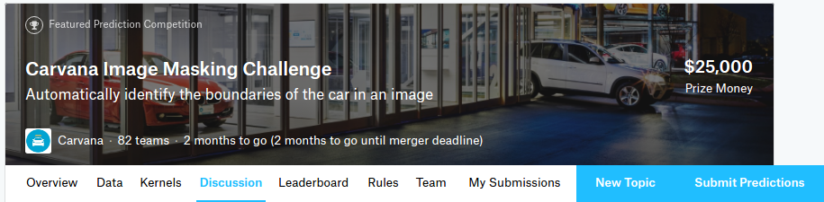
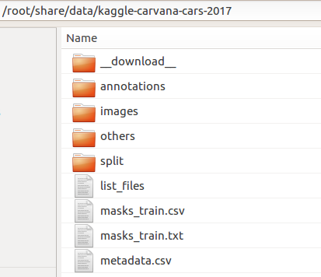
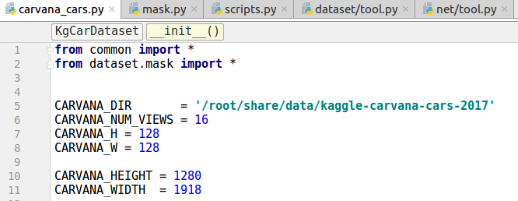
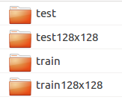
This is a pytorch starter-kit for kaggle "Carvana Image Masking Challenge"
https://www.kaggle.com/c/carvana-image-masking-challenge
1. dataset setup
data dir
image are resized to 128x128 for fast experiments

Slide 2
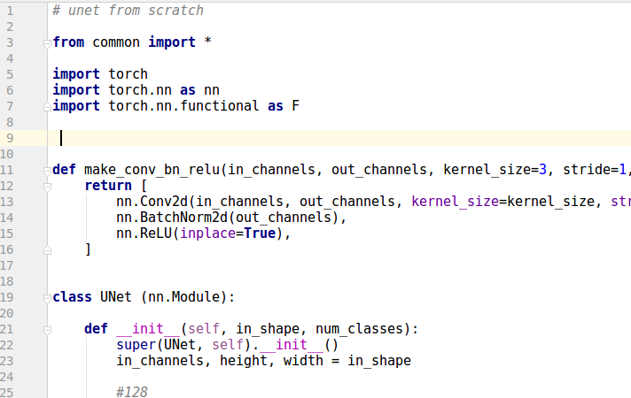
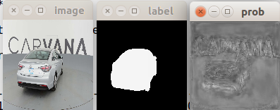
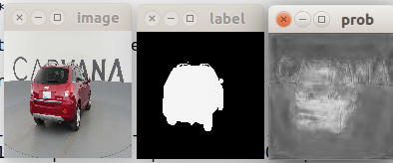
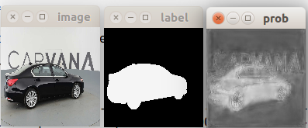
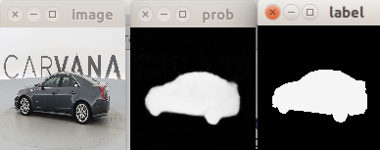
2. software implementation
2.1. network
my_ubet.py : customised unet for segmentation
2.2. training
train_seg_net.py : see run_train()
** note that this implementation is not completed yet. there is no cross validation, data augmentation, etc
example of train results
epoch=0
epoch=1
input
ground truth
predicted p

Slide 3
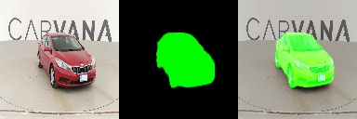
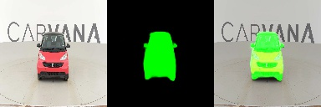
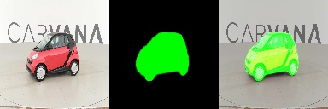
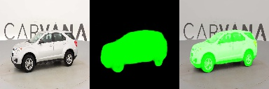
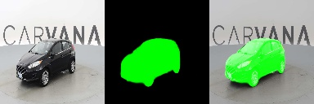
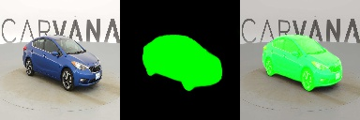
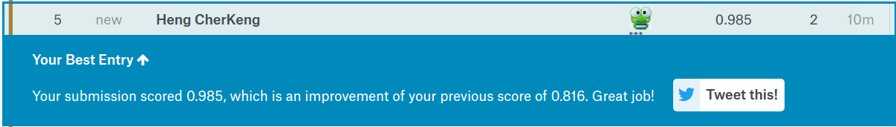
2.2. submission
train_seg_net.py : see run_submit()
example of submit results

