Slide 1
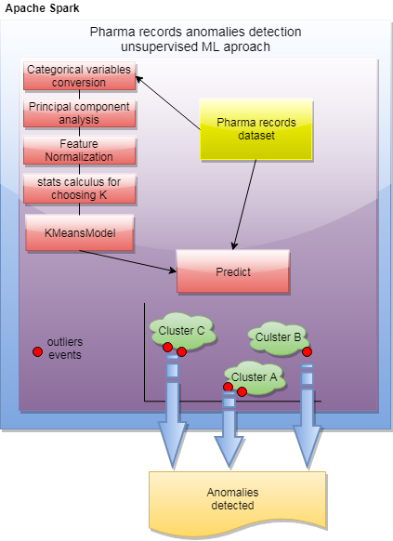
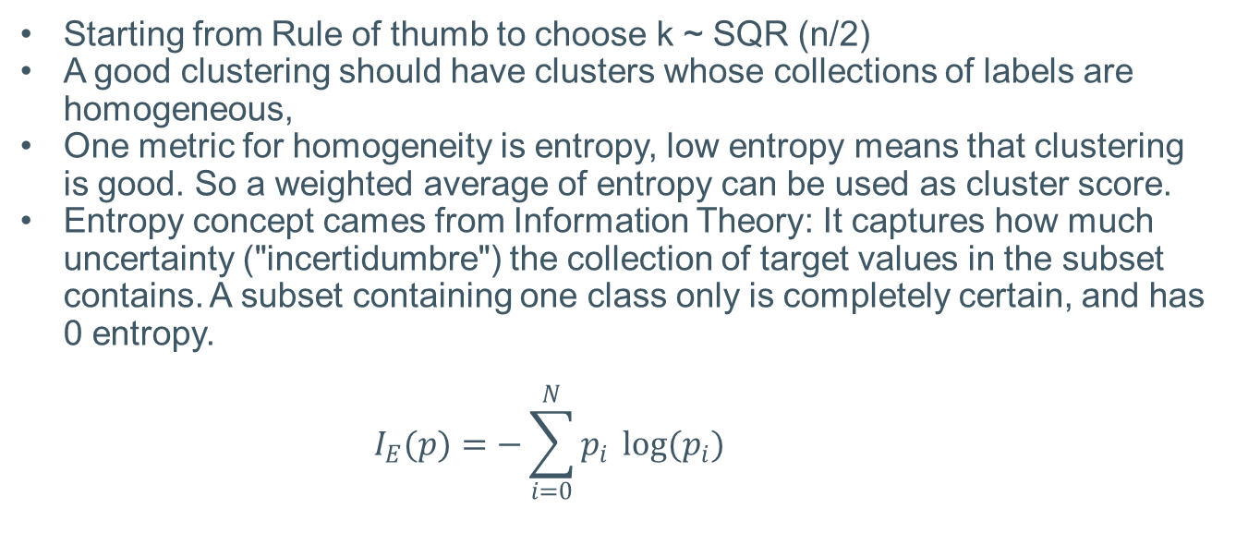
Anomalies Detection on Pharma Data
Ángel J. Rey
INTRODUCTION
RESULTS
Machine Learning pipeline proposed as a PoC will consist in a distributed not supervised clustering algorithm plus ml techniques to clean, normalize and convert data as previous steps to provide as result candidate records suspected of being anomalous for further inspection.
Also, as part of the process other ml calculations like the selection of the main parameters of the algorithm will be developed as well.
Approach will use Spark and Scala with K-means as initial algorithm
The algorithm is able to predict 6 of 10 introduced anomalies in a dataset of 100,009 records
Anomalies detected:
+------+--------+------+-------+-------------+---------+---------+-----+ | wk_id|trans_dt|fcc_cd|shop_cd|trans_typ_nbr|trans_qty|trans_amt|label| +------+--------+------+-------+-------------+---------+---------+-----+ |201701|20170103|320722| 8336| 31| 2| 5000.98| 0| |201701|20170103|214268| 5204| 11| 2| 32000.9| 0| |201701|20170104|112008| 2710| 21| 2| 8000.26| 0| |201701|20161231| 8715| 7336| 31| 2| 20000.9| 0| |201701|20170104|230765| 4543| 21| 2| 24000.64| 0| |201701|20170104|829011| 2363| 91| 2| 27410.34| 1| |201701|20170103|532337| 2948| 31| 2| 40000.0| 0| |201701|20161231|793279| 4176| 11| 2| 2198.16| 1|
OBJECTIVE
DATA DESCRIPTION
Detect Anomalies in transaction pharma récords
K-means can cluster transactions based on statistics about each of them.
The resulting clusters themselves aren’t interesting per se, but they collectively define types of transactions that are like past transactions.
Any transaction not close to a cluster could be anomalous. Clusters are interesting because they define regions of normal transactions; everything else outside is unusual and potentially anomalous.
Outside it will be defined as all the distances between a transaction and the centroid of the cluster where the transaction has been assigned, that exceed a user-defined threshold
Fact table dataset for Pharmacies with Transactions.
Already clean with no categorical values.
Plain text, csv formatted, comma separated.
Features:
wk_id: Transaction week
trans_dt: Date of Transaction
fcc_cd: Product code
shop_cd: shop / pharmacy id
trans_typ_nbr: Type of transaction like sellin or sellout
trans_qty: Transaction quantity (amount of medicine sold)
trans_amt: Total Transaction amount
METHODOLOGY
First look to the dataset:
Real dataset do not have a label.
A label column has been added for testing purposes.
All the records have been labeled as good Records (1).
Synthetic records have been introduced with anomalous values and labeled as bad Records (0) for testing purposes.
+-----+-----+
|label|count|
+-----+-----+
| 1|99999|
| 0| 10|
+-----+-----+
MODEL EVALUATION
Starting from Rule of thumb to choose k ~ SQR (n/2)
A good clustering should have clusters whose collections of labels are homogeneous,
One metric for homogeneity is entropy, low entropy means that clustering is good. So a weighted average of entropy can be used as cluster score.
Entropy concept cames from Information Theory: It captures how much uncertainty ("incertidumbre") the collection of target values in the subset contains. A subset containing one class only is completely certain, and has 0 entropy.
$$I_{E}(p)=−\sum_{i=0}^{N}{p_{i}} log(p_{i})$$
CONCLUSIONS
Pros
Easy to implement
Accurate results
Cons
Very dependant of the size of data
Needs human intervetion to finally discriminate anomalous records
https://en.wikipedia.org/wiki/K-means_clustering
https://en.wikipedia.org/wiki/Entropy_(information_theory)
https://spark.apache.org/docs/latest/ml-pipeline.html
https://spark.apache.org/docs/latest/ml-clustering.html#k-means
Poster presented at IQVIA 1st Data Science Conference, Feb 19-20, 2019 - Steigenberger Airport Hotel, Frankfurt, Germany

