Slide 1

Introduction to Scala
Ángel J. Rey

Slide 2
AGENDA
Introduction & Installation
Basic Operations – Type Inference
Data: Literals, Values, Variables & Types
Expressions & Conditionals
Functions
First-class functions

Slide 3
AGENDA
Common Collections
More Collections
Classes
Objects, Case Classes & Traits
Advanced Typing

Slide 4
Scope of the course
introduction to scala
Introduction to Scala with:
Lectures
Hands-on exercises
Virtual Machine
And much more …
Course Materials available in GitHub
https://github.com/chicochica10/spark-scala-developer
Contact me if you need help !!

Slide 5
Introduction to scala
1. Introduction and Installation

Slide 6
Scalable language
introduction to scala
Scala is a modern multi-paradigm programming language designed to express common programming patterns in a concise, elegant, and type-safe way.
Concise
Scriptable
Read-Eval-Print-Loop (REPL)
Functional (Higher Order Functions)
Extend existing classes (implicits)
Duck Typing
IDE’S Support
Fewer Tests
Good Documentation
Open Source
Performance
Runs on JVM, inter-op with Java
Dynamic Features

Slide 7
Scala good integration
introduction to scala
Can be used as drop-in replacement for Java
Mixed Scala/Java projects
Use existing Java libraries
Use existing Java tools (Ant, Maven, JUnit, etc…)
Decent IDE Support (NetBeans, IntelliJ, Eclipse)

Slide 8
Introduction to scala
2. Basic Operations – Type Inference

Slide 9
Type Inference
introduction to scala
Implicit types
val sum = 1 + 2 + 3
val nums = List(1, 2, 3)
val map = Map("abc" -> List(1,2,3))
Explicit types
val sum: Int = 1 + 2 + 3
val nums: List[Int] = List(1, 2, 3)
val map: Map[String, List[Int]] = ...

Slide 10
Exercises
introduction to scala
Exercise 1 – Basic operations in RPEL / Worksheet

Slide 11
Introduction to scala
3. Data: Literals, Values, Variables & Types

Slide 12
Literals, Values, Variables & Types
introduction to scala
A literal (or literal data) is data that appears directly in the source code, like the number 5, the character A, and the text “Hello, World.”
A value is an immutable, typed storage unit. A value can be assigned data when it is defined, but it can never be reassigned.
scala> val x: Int = 20
x: Int = 20
scala> val greeting: String = "Hello, World"
greeting: String = Hello, World
scala> val atSymbol: Char = '@'
atSymbol: Char = @

Slide 13
Literals, Values, Variables & Types
introduction to scala
A variable is a mutable, typed storage unit. A variable can be assigned when it is defined and can also be reassigned at any time.
scala> var a: Double = 2.72
a: Double = 2.72
scala> a = 355.0 / 113.0
a: Double = 3.1415929203539825
A type is the kind of data you are working with, a definition or classification of data. All data in Scala corresponds to a specific type, and all Scala types are defined as classes with methods that operate on the data. It’s optional to type it (type inference). Some basic types:
Byte | Short | Int | Long | Float | Double | Boolean | Char | String
1 byte | 2 bytes | 4 bytes 5, 0x0f | 8 bytes 5l, 5L | 4 bytes 5f, 5F | 8 bytes 5.0, 5d, 5D | true / false | ‘h’ | “hello”

Slide 14
Immutability to avoid side effects
introduction to scala
In Scala, values are preferred over variables by convention, due to the stability and predictability they bring to source code.
When you define a value you can be assured that it will retain the same value regardless of any other code that may access it.
When working with data that may be available from concurrent or multithreaded code, an immutable value will be more stable and less prone to errors than mutable data that may be modified at unexpected times.
However, in those places where variables are more suitable, such as local variables that store temporary data or accumulate values in loops, variables will certainly be used.

Slide 15
String Interpolation
introduction to scala
s prefix:
scala> val item = "apple"
item: String = apple
scala> s"How do you like them ${item}s?"
res0: String = How do you like them apples?
scala> s"Fish n chips n vinegar, ${"pepper "*3}salt"
res1: String = Fish n chips n vinegar, pepper pepper pepper salt
f prefix (printf notation):
scala> val item = "apple"
item: String = apple
scala> f"I wrote a new $item%.3s today"
res2: String = I wrote a new app today
scala> f"Enjoying this $item ${355/113.0}%.5f times today"
res3: String = Enjoying this apple 3.14159 times today

Slide 16
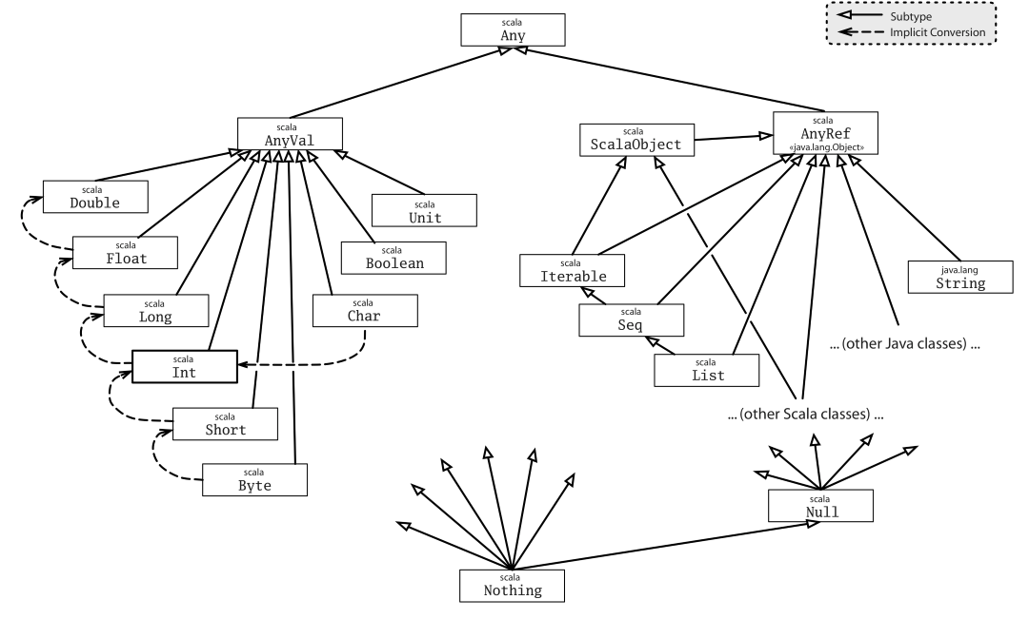
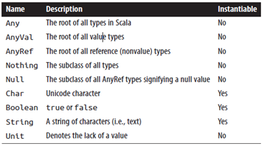
Scala class hierarchy
introduction to scala
Core non numeric types

Slide 17
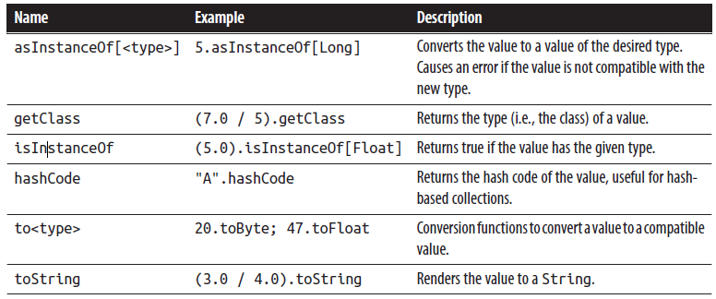
Type operations
introduction to scala
Common type operations

Slide 18
Tuples
introduction to scala
Creating:
scala> val info = (5, "Korben", true)
info: (Int, String, Boolean) = (5,Korben,true)
Accessing:
scala> val name = info._2
name: String = Korben
Using ->
scala> val red = "red" -> "0xff0000"
red: (String, String) = (red,0xff0000)
scala> val reversed = red._2 -> red._1
reversed: (String, String) = (0xff0000,red)

Slide 19
Exercises
introduction to scala
Exercise 2 – Literals, Values, Variables & Types

Slide 20
Introduction to scala
4. Expressions & Conditionals

Slide 21
Expressions and Conditionals
introduction to scala
Expression: a single unit of code that returns a value
scala> "hello“
scala> "hel" + 'l' + "o“
scala> val x = 5 * 20; val amount = x + 10 //2 expr. 1 line
scala> val amount = { val x = 5 * 20; x + 10 } // better
scala> val amount = {
| val x = 5 * 20
| x + 10
| }//the same
//nested expr.
scala> { val a = 1; { val b = a * 2; { val c = b + 4; c } } }
Statements: Expressions that doesn’t return a value (return Unit)
scala> val x = 1
// REPL repeats the definition of x but not data returned that can
// be used to create a new value

Slide 22
IF-Else Expressions
introduction to scala
Simple IF-block
scala> if ( 47 % 3 > 0 ) println("Not a multiple of 3")
Returns Any type
val result = if ( false ) "what does this return?“
if-else
val x = 10; val y = 20; val max = if (x > y) x else y //if-else
If everything fits on one line, using a single expression without an expression block in if..else expressions works well
But in case if..else expression doesn’t easily fit on a single line, consider using expression blocks to make your code more readable.

Slide 23
Match Expressions
introduction to scala
Similar to C and Java but more flexible (types, reg. exp. Numeric range, data structures )
Preferred over if-else nested blocks
scala> val status = 500
status: Int = 500
scala> val message = status match {
| case 200 => "ok"
| case 400 => {
| println("ERR- not found")
| "error"
| }
| case 500 => {
| println("ERR - internal")
| "error"
| }
| }
scala> val x = 10; val y = 20
x: Int = 10
y: Int = 20
scala> val max = x > y match {
| case true => x
| case false => y
| }
max: Int = 20

Slide 24
Match Expressions with patterns
introduction to scala
Value Binding Pattern
scala> val message = "Ok"
message: String = Ok
scala> val status = message match {
| case "Ok" => 200
| case other => {
| println(s"Couldn't parse $other")
| -1
| }
|}
Pattern Guard
scala> val response: String = null
response: String = null
scala> response match {
| case s if s != null => println(s"Rec.'$s'")
| case s =>
println("Error! Rec. null res")
| }

Slide 25
Match Expressions (cont.)
introduction to scala
Wildcard _ Operator Pattern
scala> val message = "Unauthorized"
message: String = Unauthorized
scala> val status = message match {
| case "Ok" => 200
| case _ => {
| println(s"Couldn't parse $message")
| -1
| }
|}
Matching Types
scala> val x: Int = 12180
x: Int = 12180
scala> val y: Any = x
y: Any = 12180
scala> y match {
| case x: String => s"'x'"
| case x: Double => f"$x%.2f"
| case x: Float => f"$x%.2f"
| case x: Long => s"${x}l"
| case x: Int => s"${x}i"
| }

Slide 26
Loops - For
introduction to scala
For (Simple)
scala> for (x <- 1 to 7) { println(s"Day $x:") }
For (with yield)
scala> for (x <- 1 to 7) yield { s"Day $x:" }
res10: scala.collection.immutable.IndexedSeq[String] = Vector(Day 1:,
Day 2:, Day 3:, Day 4:, Day 5:, Day 6:, Day 7:)
scala> for (day <- res0) print(day + ", ")
Day 1:, Day 2:, Day 3:, Day 4:, Day 5:, Day 6:, Day 7:,
For (filter)
scala> val threes = for (i <- 1 to 20 if i % 3 == 0) yield i
threes: scala.collection.immutable.IndexedSeq[Int] = Vector(3, 6, 9, 12, 15, 18)

Slide 27
Loops - For
introduction to scala
For (Nested)
scala> for { x <- 1 to 2
| y <- 1 to 3 }
| { print(s"($x,$y) ") }
(1,1) (1,2) (1,3) (2,1) (2,2) (2,3)
For (functional)
scala> val powersOf2 = for (i <- 0 to 8; pow = 1 << i) yield pow
powersOf2: scala.collection.immutable.IndexedSeq[Int] = Vector(1, 2, 4, 8, 16, 32, 64, 128, 256)

Slide 28
Loops – While Do/While
introduction to scala
Do not use them! (preferably with functional programming, but also not a dogma)
While
scala> var x = 10; while (x > 0) x -= 1
x: Int = 0
Do / While
scala> val x = 0
x: Int = 0
scala> do println(s"Here I am, x = $x") while (x > 0)
Here I am, x = 0

Slide 29
Exercises
introduction to scala
Exercise 3 – Expressions and conditionals

Slide 30
Introduction to scala
5. Functions

Slide 31
Functions (1 / 3)
introduction to scala
Functions are named and reusable expressions.
They may be parametrized and may return a value
Scala aims to build pure functions (functional programming)
A pure function is one that:
Has one or more input parameters
Performs calculations using only the input parameters
Returns a value
Always returns the same value for the same input
Does not use or affect any data outside the function
Is not affected by any data outside the function

Slide 32
Functions (2 / 3)
introduction to scala
Defining an Input-less Function – empty () can be used
scala> def hi = "hi"
hi: String
Defining a Function with a Return Type (not mandatory except for recursive functions)
scala> def hi: String = "hi"
hi: String
General Definition of a function
scala> def multiplier(x: Int, y: Int): Int = { x * y }
multiplier: (x: Int, y: Int)Int
scala> multiplier(6, 7)
res0: Int = 42

Slide 33
Functions (3 / 3)
introduction to scala
Procedures - Functions that don’t return a value (returns Unit) and end with a statement
scala> def log(d: Double): Unit = println(f"Got value $d%.2f")
log: (d: Double)Unit
scala> log(2.23535)
Got value 2.24
Function Invocation with Expression Blocks
scala> def formatEuro(amt: Double) = f"€$amt%.2f"
formatEuro: (amt: Double)String
scala> formatEuro { val rate = 1.32; 0.235 + 0.7123 + rate * 5.32 }
res5: String = €7.97

Slide 34
Recursive Functions
introduction to scala
A recursive function is one that may invoke itself, preferably with some type of parameter or external condition that will be checked to avoid an infinite loop of function invocation
Functional programming because they offer a way to iterate over data structures without mutable data. Each call has its own stack
Always try to use tail recursion (last statement is the recursive invocation) and mark the function with the annotation @annotation.tailrec
scala> @annotation.tailrec
| def power(x: Int, n: Int, t: Int = 1): Int = {
| if (n < 1) t
| else power(x, n-1, x*t)
| }
power: (x: Int, n: Int, t: Int)Int
scala> power(2,8)
res9: Int = 256

Slide 35
Other things about Functions (1/3)
introduction to scala
Nested Functions
scala> def max(a: Int, b: Int, c: Int) = {
| def max(x: Int, y: Int) = if (x > y) x else y
| max(a, max(b, c))
| }
max: (a: Int, b: Int, c: Int)Int
scala> max(42, 181, 19)
res10: Int = 181
Named Parameters
scala> def greet(prefix: String, name: String) = s"$prefix $name"
greet: (prefix: String, name: String)String
scala> val greeting = greet(name = "Brown", prefix = "Mr")
greeting: String = Mr Brown
Default Values
scala> def greet(prefix: String = "", name: String) = s"$prefix$name"
greet: (prefix: String, name: String)String
scala> val greeting1 = greet(name = "Paul")
greeting1: String = Paul

Slide 36
Other things about Functions (2/3)
introduction to scala
Var arg Parameters
scala> def sum(items: Int*): Int = {
| var total = 0
| for (i <- items) total += i
| total
| }
sum: (items: Int*)Int
scala> sum(10, 20, 30)
res11: Int = 60
scala> sum()
res12: Int = 0
Parameter Groups (more about this later)
scala> def max(x: Int)(y: Int) = if (x > y) x else y
max: (x: Int)(y: Int)Int
scala> val larger = max(20)(39)
larger: Int = 39
Type Parameters (like Generics)
scala> def identity[A](a: A): A = a
identity: [A](a: A)A
scala> val s: String = identity[String]("Hello")
s: String = Hello
scala> val d: Double = identity[Double](2.717)
d: Double = 2.717

Slide 37
Other things about Functions (3/3)
introduction to scala
Methods & Operators
A method is a function defined in a class and available from any instance of the class. (more about classes later)
scala> val s = "vacation.jpg"
s: String = vacation.jpg
scala> val isJPEG = s.endsWith(".jpg")
isJPEG: Boolean = true
scala> val d = 65.642
d: Double = 65.642
scala> d.+(2.721)
res16: Double = 68.363
scala> d compare 18.0
res17: Int = 1
scala> d + 2.721
res18: Double = 68.363

Slide 38
Exercises
introduction to scala
Exercise 4 – Functions

Slide 39
Introduction to scala
6. First-class functions

Slide 40
First Order Functions
introduction to scala
Can be created in literal form without ever having been assigned an identifier
Be stored in a container such as a value, variable, or data structure
Be used as a parameter to another function or used as the return value from another function.
The final goal is make declarative programming / functional programing (what to do) instead imperative programming (how to do)

Slide 41
Function Types and Values (1/2)
introduction to scala
The type of a function is a simple grouping of its input types and return value type
scala> def double(x: Int): Int = x * 2
double: (x: Int)Int
scala> double(5)
res0: Int = 10
scala> val myDouble: (Int) => Int = double
myDouble: Int => Int = <function1>
scala> myDouble(5)
res1: Int = 10
scala> val myDoubleCopy = myDouble
myDoubleCopy: Int => Int = <function1>
scala> myDoubleCopy(5)
res2: Int = 10
Assigning a Function with _ (to distinguish it from invocation)
scala> def double(x: Int): Int = x * 2
double: (x: Int)Int
scala> val myDouble = double _
myDouble: Int => Int = <function1>
scala> val amount = myDouble(20)
amount: Int = 40

Slide 42
Function Types and Values (2 / 2)
introduction to scala
Function type with no parameters
scala> def logStart() = "=" * 50 + "\nStarting NOW\n"
logStart: ()String
scala> val start: () => String = logStart
start: () => String = <function0>
scala> println( start() )
=============================================
Starting NOW
Function type with multiples parameters
scala> def max(a: Int, b: Int) = if (a > b) a else b
max: (a: Int, b: Int)Int
scala> val maximize: (Int, Int) => Int = max
maximize: (Int, Int) => Int = <function2>
scala> maximize(50, 30)
res3: Int = 50

Slide 43
Higher-Order Functions
introduction to scala
Functions that have a function type as an input parameter or return value.
scala> def safeStringOp(s: String, f: String => String) = {
| if (s != null) f(s) else s
| }
safeStringOp: (s: String, f: String => String)String
scala> def reverser(s: String) = s.reverse
reverser: (s: String)String
scala> safeStringOp(null, reverser)
res4: String = null
scala> safeStringOp("Ready", reverser)
res5: String = ydaeR

Slide 44
Functions Literals or Anonymous Functions or Lambdas expressions ( 1 / 2)
introduction to scala
A function that lacks a name
One parameter
scala> val doubler = (x: Int) => x * 2
doubler: Int => Int = <function1>
scala> val doubled = doubler(22)
doubled: Int = 44
Two parameters
scala> val maximize = (a: Int, b: Int) => if (a > b) a else b
maximize: (Int, Int) => Int = <function2>
scala> maximize(84, 96)
res6: Int = 96

Slide 45
Functions Literals (2 / 2)
introduction to scala
Can be used in higher-order functions
scala> def safeStringOp(s: String, f: String => String) = {
| if (s != null) f(s) else s
| }
safeStringOp: (s: String, f: String => String)String
scala> safeStringOp(null, (s: String) => s.reverse)
res7: String = null
scala> safeStringOp("Ready", (s: String) => s.reverse)
res8: String = ydaeR

Slide 46
Placeholder _ Syntax (1 / 2)
introduction to scala
Shortened form of functions literals
If the function type is outside the literal and the parameter is used only once
Example 1
scala> val doubler: Int => Int = _ * 2
doubler: Int => Int = <function1>
Example 2
scala> def safeStringOp(s: String, f: String => String) = {
| if (s != null) f(s) else s
| }
safeStringOp: (s: String, f: String => String)String
scala> safeStringOp(null, _.reverse)
res11: String = null
scala> safeStringOp("Ready", _.reverse)
res12: String = ydaeR

Slide 47
Placeholder _ Syntax (2 / 2)
introduction to scala
Example 3
scala> def tripleOp[A,B](a: A, b: A, c: A, f: (A, A, A) => B) = f(a,b,c)
tripleOp: [A, B](a: A, b: A, c: A, f: (A, A, A) => B)B
scala> tripleOp[Int,Int](1, 1, 1, _ + _ - _)
res15: Int = 1
scala> tripleOp[Int,Double](23, 92, 14, 1.0 * _ / _ / _)
res16: Double = 0.017857142857142856
scala> tripleOp[Int,Boolean](3, 1, 1, _ > _ + _)
res17: Boolean = false

Slide 48
Partially Applied Functions and Currying
introduction to scala
def factorOf(x: Int, y: Int) has the function type (Int, Int) => Boolean
def factorOf(x: Int)(y: Int) has the function type Int => Int => Boolean
Reuse a function invocation and retain the value of some of the parameters to avoid typing them again
scala> def factorOf(x: Int, y: Int) = y % x == 0
factorOf: (x: Int, y: Int)Boolean
scala> val f = factorOf _
f: (Int, Int) => Boolean = <function2>
scala> val x = f(7, 20)
x: Boolean = false

Slide 49
Partially Applied Functions and Currying
introduction to scala
For checking multiple of 3:
scala> val multipleOf3 = factorOf(3, _: Int)
multipleOf3: Int => Boolean = <function1>
scala> val y = multipleOf3(78)
y: Boolean = true
Better way Currying the function:
scala> def factorOf(x: Int)(y: Int) = y % x == 0
factorOf: (x: Int)(y: Int)Boolean
scala> val isEven = factorOf(2) _
isEven: Int => Boolean = <function1>
scala> val z = isEven(32)
z: Boolean = true

Slide 50
By-Name Parameters
introduction to scala
Each time a by-name parameter is used inside a function, it gets evaluated into a value.
If a value is passed to the function then there is no effect, but if a function is passed then that function is invoked for every usage.
A function passed in a by-name parameter will not be invoked if the parameter is not accessed, so a costly function call can be avoided if necessary.

Slide 51
By-Name Parameters (Example)
introduction to scala
scala> def doubles(x: => Int) = {
| println("Now doubling " + x)
| x * 2
| }
doubles: (x: => Int)Int
scala> doubles(5)
Now doubling 5
res18: Int = 10
scala> def f(i: Int) = { println(s"Hello from f($i)"); i }
f: (i: Int)Int
scala> doubles( f(8) )
Hello from f(8)
Now doubling 8
Hello from f(8)
res19: Int = 16
The x by-name parameter is accessed here just like a normal by-value parameter
Invoke the doubles method with a regular value and it will operate normally
…but when you invoke it with a function value, that function value will get
invoked inside the doubles method
Because the double method refers to the x parameter twice, the “Hello” message gets invoked twice

Slide 52
Partial Functions
introduction to scala
Function literals that apply a series of case patterns to their input, requiring that the input match at least one of the given patterns.
Invoking one of these partial functions with data that does not meet at least one case pattern results in a Scala error
scala> val statusHandler: Int => String = {
| case 200 => "Okay"
| case 400 => "Your Error"
| case 500 => "Our error"
| }
statusHandler: Int => String = <function1>
525252
scala> statusHandler(200)
res20: String = Okay
scala> statusHandler(401)
scala.MatchError: 401 (of class java.lang.Integer)
at $anonfun$1.apply(<console>:7)
at $anonfun$1.apply(<console>:7)
... 32 elided

Slide 53
Invoking Higher-Order Functions with Function Literal Blocks (1 / 2)
introduction to scala
To invoke utility functions with an expression block. For example, a higher-order function can wrap a given expression block in a single database session or transaction.
Example1:
scala> def safeStringOp(s: String)(f: String => String) = {
| if (s != null) f(s) else s
| }
safeStringOp: (s: String)(f: String => String)String
scala> val timedUUID = safeStringOp(uuid) { s =>
| val now = System.currentTimeMillis
| val timed = s.take(24) + now
| timed.toUpperCase
| }
timedUUID: String = BFE1DDDA-92F6-4C7A-8BFC-1394546915011

Slide 54
Invoking Higher-Order Functions with Function Literal Blocks (2 / 2)
introduction to scala
Example 2:
scala> def timer[A](f: => A): A = {
| def now = System.currentTimeMillis
| val start = now; val a = f; val end = now
| println(s"Executed in ${end - start} ms")
| a
| }
timer: [A](f: => A)A
scala> val veryRandomAmount = timer {
| util.Random.setSeed(System.currentTimeMillis)
| for (i <- 1 to 100000) util.Random.nextDouble
| util.Random.nextDouble
| }
The type parameter “A” helps the return type of the “f” by-name parameter become the return type of the “timer” function, reducing the impact of wrapping code with the “timer” function
This inner, nested function is here for purely aesthetic reasons, enabling us to retrieve the current millisecond amount compactly.
Finally, we have reduced the expression block syntax for higher-order functions to its simplest form: the function name and the block. You can view the code between the braces as being an expression block, or as a function literal block, or as regular code being wrapped by the “timer” function

Slide 55
Exercises
introduction to scala
Exercise 5 – First-Class Functions

Slide 56
Introduction to scala
7. Common Collections

Slide 57
Common Collections
introduction to scala
A collections framework provides data structures for collecting one or more values of a given type such as arrays, lists, maps, sets, and trees.
Scala has a high-performance, object-oriented, and type-parameterized Collections
Collections have higher-order operations like map, filter, and reduce that make it possible to manage and manipulate data with short and expressive expressions
Scala has separate mutable versus immutable collection type hierarchies (always favor immutable version in your code)
Root of all iterable collections: Iterable

Slide 58
Lists (1/2)
introduction to scala
List type: An immutable singly linked list.
scala> val numbers = List(32, 95, 24, 21, 17)
numbers: List[Int] = List(32, 95, 24, 21, 17)
scala> val colors = List("red", "green", "blue")
colors: List[String] = List(red, green, blue)
scala> println(s"I have ${colors.size} colors: $colors")
I have 3 colors: List(red, green, blue)
Head & Tail
scala> colors.head
res0: String = red
scala> colors.tail
res1: List[String] = List(green, blue)
scala> colors(1)
res2: String = green
scala> colors(2)
res3: String = blue
Call.isEmpty to check for the end of the list. All lists end with an invisible Nil

Slide 59
List (2 / 2)
introduction to scala
For loops (DON’T use)
scala> val numbers = List(32, 95, 24, 21, 17)
numbers: List[Int] = List(32, 95, 24, 21, 17)
scala> var total = 0; for (i <- numbers) { total += i }
total: Int = 189
scala> val colors = List("red", "green", "blue")
colors: List[String] = List(red, green, blue)
scala> for (c <- colors) { print(c + “ “) }
red green blue
Higher-order functions
scala> val colors = List("red", "green", "blue")
colors: List[String] = List(red, green, blue)
scala> colors.foreach( (c: String) => print(c + “ “) )
red green blue
scala> val sizes = colors.map( (c: String) => c.size )
sizes: List[Int] = List(3, 5, 4)
scala> val total = numbers.reduce( (a: Int, b: Int) => a + b )
total: Int = 189
takes a function (a procedure, to be accurate) and invokes it with every item in the list.
map() takes a function that converts a single list element to another value and/or type.
reduce() takes a function that combines two list elements into a single element

Slide 60
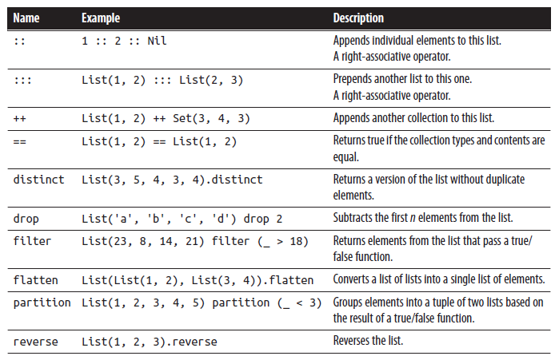
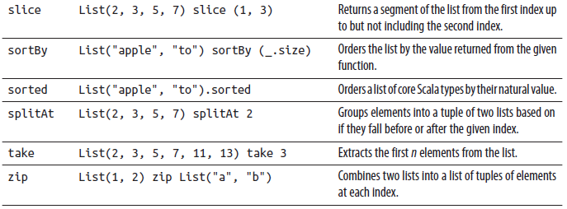
List Arithmetic – Operations on lists
introduction to scala

Slide 61
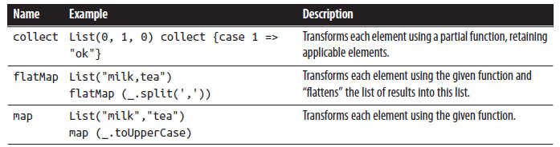
Mapping Lists
introduction to scala
List mapping operations

Slide 62
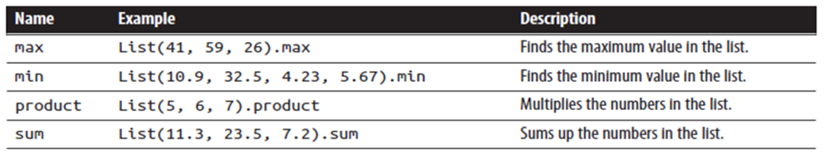
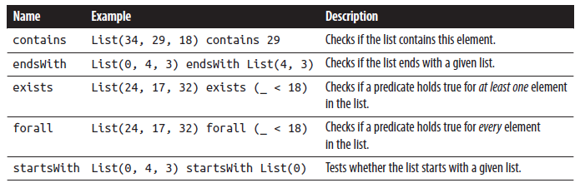
Reducing Lists (1 / 2)
introduction to scala
Math reduction operations
Boolean reduction operations

Slide 63
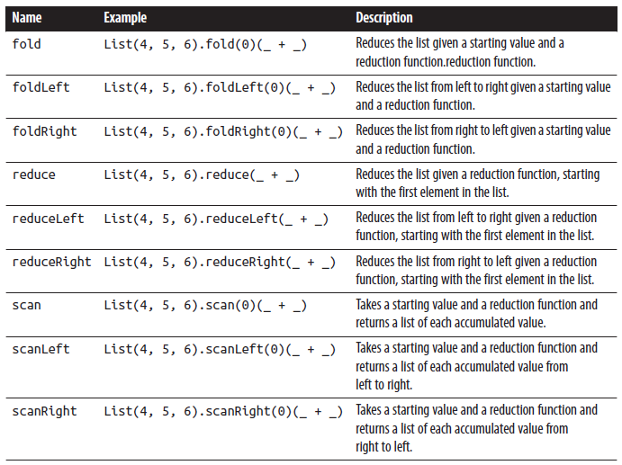
Reducing Lists (2 / 2 )
introduction to scala
Generic list reduction operations
Fold, reduce, scan are just for distributed parallel, collections
Left is preferred unless right-to-left iteration is needed

Slide 64
Set
introduction to scala
A Set is an immutable and unordered collection of unique elements. It works similarly to a List
scala> val unique = Set(10, 20, 30, 20, 20, 10)
unique: scala.collection.immutable.Set[Int] = Set(10, 20, 30)
scala> val sum = unique.reduce( (a: Int, b: Int) => a + b )
sum: Int = 60

Slide 65
Map
introduction to scala
A Map is an immutable key-value store
scala> val colorMap = Map("red"->0xFF0000,"green"->0xFF00,"blue"->0xFF)
colorMap: scala.collection.immutable.Map[String,Int] =
Map(red -> 16711680, green -> 65280, blue -> 255)
scala> val redRGB = colorMap("red")
redRGB: Int = 16711680
scala> val cyanRGB = colorMap("green") | colorMap("blue")
cyanRGB: Int = 65535
scala> val hasWhite = colorMap.contains("white")
hasWhite: Boolean = false
scala> for (pairs <- colorMap) { println(pairs) }
(red,16711680)
(green,65280)
(blue,255)

Slide 66
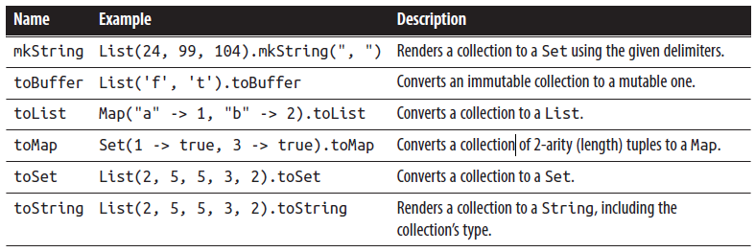
Converting collections (1 / 2)
introduction to scala
It is easy to convert between types, so you can create a collection with one type and end up with the other
Operations to convert collections

Slide 67
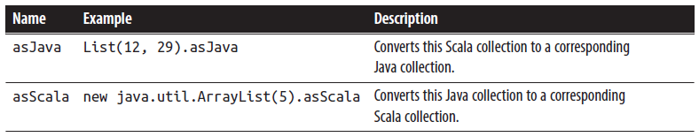
Converting collections (2 / 2)
introduction to scala
Java and Scala collection conversions:
import collection.JavaConverters._

Slide 68
Pattern Matching with Collections (1 / 2)
introduction to scala
Match single value patterns
scala> val statuses = List(500, 404)
statuses: List[Int] = List(500, 404)
scala> val msg = statuses.head match {
| case x if x < 500 => "okay"
| case _ => "whoah, an error"
| }
msg: String = whoah, an error
Match a single value inside a collection:
scala> val msg = statuses match {
| case x if x contains(500) => "error"
| case _ => "okay"
| }
msg: String = has error
Match entire collections:
scala> val msg = statuses match {
| case List(404, 500) => "not found"
| case List(500, 404) => "error"
| case List(200, 200) => "okay"
| case _ => "not sure what happened"
| }
msg: String = error & not found

Slide 69
Pattern Matching with Collections (2 / 2)
introduction to scala
Bind values to some or all elements of a collection
scala> val msg = statuses match {
| case List(500, x) => s"Error by $x"
| case List(e, x) => s"$e by $x"
| }
msg: String = Error followed by 404
Lists are decomposable in head & tail
scala> val head = List('r','g','b') match {
| case x :: xs => x
| case Nil => ' '
| }
head: Char = r
Tuples also support patter matching
scala> val code = ('h', 204, true) match {
| case (_, _, false) => 501
| case ('c', _, true) => 302
| case ('h', x, true) => x
| case (c, x, true) => {
| println(s"not expect code $c")
| x
| }
| }
code: Int = 204

Slide 70
Exercises
introduction to scala
Exercise 6 – Common Collections

Slide 71
Introduction to scala
8. More Collections

Slide 72
Mutable / Immutable (1/2)
introduction to scala
Until now immutable collections
scala> val m = Map("AAPL" -> 597, "MSFT" -> 40)
m: scala.collection.immutable.Map[String,Int] =
Map(AAPL -> 597, MSFT -> 40)
scala> val n = m - "AAPL" + ("GOOG" -> 521)
n: scala.collection.immutable.Map[String,Int] =
Map(MSFT -> 40, GOOG -> 521)
scala> println(m)
Map(AAPL -> 597, MSFT -> 40)
A new map with “AAPL” and “MSFT” keys.
Removing “APPL” and adding “GOOG” gives us a different collection…
… while the original collection in “m” remains the same

Slide 73
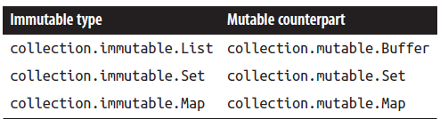
Mutable / Immutable (2/2)
introduction to scala
We can work with mutable collections when it will be safe to use:
Mutable data structure within a function
Data converted to immutable before being returned (E.g. .toList)
scala> val nums = collection.mutable.Buffer[Int]()
nums: scala.collection.mutable.Buffer[Int] = ArrayBuffer()
scala> for (i <- 1 to 10) nums += i
scala> println(nums)
Buffer(1, 2, 3, 4, 5, 6, 7, 8, 9, 10)
Mutable collection types

Slide 74
Arrays
introduction to scala
Fixed-size, mutable, indexed collection.
It’s not officially a collection, because it isn’t in the “scala.collections” package and doesn’t extend from the root Iterable type
Although it has all of the Iterable operations like map and filter)
Wrapper around Java’s array type
Can be used like a sequence used to deal with Java code
scala> val colors = Array("red", "green", "blue")
colors: Array[String] = Array(red, green, blue)
scala> colors(0) = "purple"
scala> colors
res0: Array[String] = Array(purple, green, blue)
scala> println("very purple: " + colors)
very purple: [Ljava.lang.String;@70cf32e3
scala> val files = new java.io.File(".").listFiles
files: Array[java.io.File] = Array(./Build.scala, ./Dep.scala)
scala> val scala = files map (_.getName) filter(_ endsWith "scala")
scala: Array[String] = Array(Build.scala, Dep.scala)
Use a zero-based index to replace any item in an Array
The Scala REPL knows how to print an Array …
but not println(), which can only call a type’s toString() method
The listFiles method in java.io.File, a JDK class, returns an array that we can easily map and filter

Slide 75
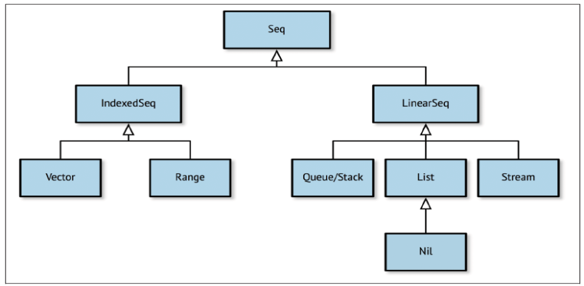
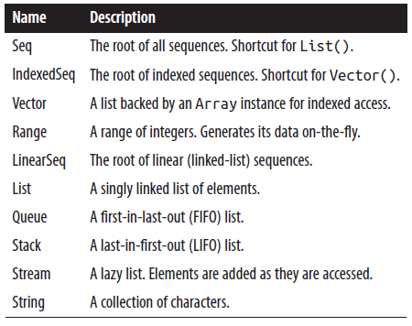
Seq & Sequences
introduction to scala
Seq the root type of all sequences
Not instantiable but shortcut for creating List
The sequence collections hierarchy:

Slide 76
Streams
introduction to scala
Popular collection in functional programming Languages
Builds itself as its elements are accessed
Lazy collection. Generated from one or more starting elements and a recursive function
They are theoretically infinite collections
Streams end with Stream.Empty

Slide 77
Streams – Example
introduction to scala
scala> def inc(i: Int): Stream[Int] = Stream.cons(i, inc(i+1))
//or using cons operator #:: (via implicit conversion)
scala> def inc(head: Int): Stream[Int] = head #:: inc(head+1)
inc: (i: Int)Stream[Int]
scala> val s = inc(1)
s: Stream[Int] = Stream(1, ?) //one element and a promise of futures vals (?)
scala> val l = s.take(5).toList //forcing to build next four elements
l: List[Int] = List(1, 2, 3, 4, 5)
scala> s
res1: Stream[Int] = Stream(1, 2, 3, 4, 5, ?)

Slide 78
Streams – Bounded Stream
introduction to scala
scala> def to(head: Char, end: Char): Stream[Char] = (head > end) match {
| case true => Stream.empty
| case false => head #:: to((head+1).toChar, end)
| }
to: (head: Char, end: Char)Stream[Char]
scala> val hexChars = to('A', 'F').take(20).toList
hexChars: List[Char] = List(A, B, C, D, E, F)

Slide 79
Monadic Collections
introduction to scala
Scale only for a single element
Support transformative operations like the ones in Iterable (that support “map” for example)
Most important:
Option Collections
Try Collections
Future Collections

Slide 80
Option Collections (1/2)
introduction to scala
Will never be larger than one.
Option represents the presence or absence of a single value
Safe replacement for null values
Safe way to build chains of operations with only valid values
Option has two subtypes:
Some: Type-parametrized collection of one element
None: Empty collection
scala> var x: String = "Indeed"
x: String = Indeed
scala> var a = Option(x)
a: Option[String] = Some(Indeed)
scala> x = null
x: String = null
scala> var b = Option(x)
b: Option[String] = None
scala>//checks if Some a is defined?
scala>println(s"a is? ${a.isDefined}")
a is? true
scala> println(s"b is not? ${b.isEmpty}") //checks if is None
b is not ? true

Slide 81
Option Collections (2/2)
introduction to scala
Prevent division by zero
scala> def divide(amt: Double, divisor: Double): Option[Double] = {
| if (divisor == 0) None
| else Option(amt / divisor)
| }
divide: (amt: Double, divisor: Double)Option[Double]
scala> val legit = divide(5, 2)
legit: Option[Double] = Some(2.5)
scala> val illegit = divide(3, 0)
illegit: Option[Double] = None

Slide 82
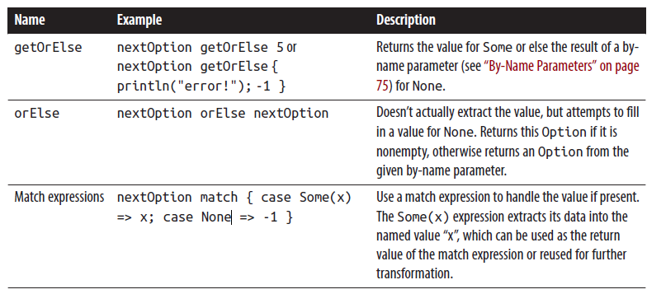
Option Collections (2/2)
introduction to scala
Extracting values from Options:
Option.get(): Avoid it If you call get on an None instance “no such element” error will be trigger
Safe Option extractions:

Slide 83
Try Collections (1/2)
introduction to scala
The util.Try collection turns error handling into collection management.
It provides a mechanism to catch errors that occur in a given function parameter, returning either the error or the result of the function if successful.
Scala supports try {} .. catch {} blocks but util.Try () is the functional way.
To throw an exception:
scala> def loopAndFail(end: Int, failAt: Int): Int = {
| for (i <- 1 to end) {
| println(s"$i) ")
| if (i == failAt) throw new Exception("Too many iter")
| }
| end
| }
scala> loopAndFail(10, 3)
1)
2)
3)
java.lang.Exception: Too many iter

Slide 84
Try Collections (2/2)
introduction to scala
Util.Try is unimplemented but has two implemented subtypes
Success type contains the return value of the attempted expression if no exception was thrown
Failure type contains the thrown Exception
scala> val t1 = util.Try( loopAndFail(2, 3) )
1)
2)
t1: scala.util.Try[Int] = Success(2)
scala> val t2 = util.Try{ loopAndFail(4, 2) }
1)
2)
t2: scala.util.Try[Int] = Failure(java.lang.Exception: Too many iter)

Slide 85
Try Collections – Handling Errors
introduction to scala
scala> def nextError = util.Try{ 1 / util.Random.nextInt(2) }
nextError: scala.util.Try[Int]
scala> val x = nextError
x: scala.util.Try[Int] = Failure(
java.lang.ArithmeticException: / by zero)
scala> val y = nextError
y: scala.util.Try[Int] = Success(1)

Slide 86
Try Collections – Other Examples
introduction to scala
scala> val input = " 123 "
input: String = " 123 "
scala> val result = util.Try(input.toInt) orElse
util.Try (input.trim.toInt)
result: scala.util.Try[Int] = Success(123)
scala> result foreach { r => println(s"Parsed '$input' to $r!") }
Parsed ' 123 ' to 123!
scala> val x = result match {
| case util.Success(x) => Some(x)
| case util.Failure(ex) => {
| println(s"Couldn't parse input '$input'")
| None
| }
| }
x: Option[Int] = Some(123)

Slide 87
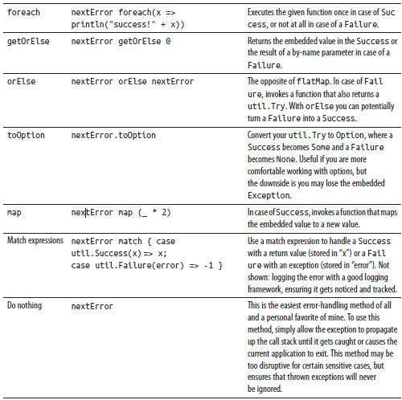
Try Collections – Table
introduction to scala

Slide 88
Future Collections (1/2)
introduction to scala
Concurrent.Future Initiates a background task
Like Option & Try safe way to chain additional operations or extract value
But may be not immediately available. The background task launched could still be working
It is necessary to specify the “context” in the current session or application for running functions concurrently. We’ll use the default “global” context, which makes use of Java’s thread library
scala> val f = concurrent.Future { Thread.sleep(5000); println("hi") }
f: scala.concurrent.Future[Unit] =
scala.concurrent.impl.Promise$DefaultPromise@4aa3d36
scala> println("waiting")
waiting
scala> hi
You can chain a function or another future to be executed following the completion of a future and eventually will return util.Try with the result or an exception
BETTER USE AKKA FRAMEWORK

Slide 89
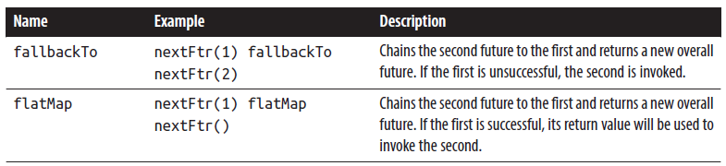
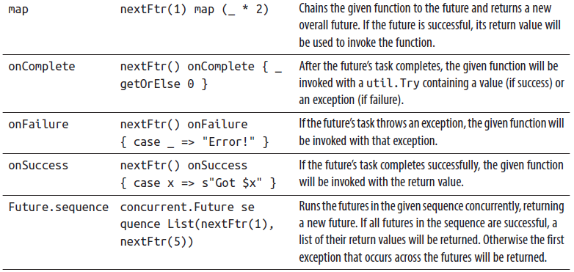
Future Collections (2/3)
introduction to scala
Operations for chaining futures and setting callback functions.
scala> import concurrent.ExecutionContext.Implicits.global
import concurrent.ExecutionContext.Implicits.global
scala> import concurrent.Future
import concurrent.Future
scala> def nextFtr(i: Int = 0) = Future {
| def rand(x: Int) = util.Random.nextInt(x)
|
| Thread.sleep(rand(5000))
| if (rand(3) > 0) (i + 1) else throw new Exception
| }
nextFtr: (i: Int)scala.concurrent.Future[Int]

Slide 90
Future Collections (3/3)
introduction to scala

Slide 91
Exercises
introduction to scala
Exercise 7 – More Collections

Slide 92
Introduction to scala
9. Classes

Slide 93
OOScala - Classes
introduction to scala
Classes are the core building block of object-oriented languages, a combination of data structures with functions (“methods”)
scala> class User(n: String) {
| val name: String = n
| def greet: String = s"Hello from $name"
| override def toString = s"User($name)"
| }
defined class User
scala> val u = new User("Zeniba")
u: User = User(Zeniba)
scala> println(u.greet)
Hello from Zeniba
Field of a class
n parameter class just for initialization fields, not can be used in methods
Method of a class
Override default JVM toString

Slide 94
OOScala - Classes
introduction to scala
scala> class User(val name: String) {
| def greet: String = s"Hello from $name"
| override def toString = s"User($name)"
| }
defined class User
scala> val users = List(new User("Shoto"), new User("Art3mis"),
new User("Aesch"))
users: List[User] = List(User(Shoto), User(Art3mis), User(Aesch))
scala> val sizes = users map (_.name.size)
sizes: List[Int] = List(8, 7, 5)
scala> val third = users find (_.name contains "3")
third: Option[User] = Some(User(Art3mis))
scala> val greet = third map (_.greet) getOrElse "hi"
greet: String = Hello from Art3mis
By adding the keywords val or var before a class param becomes a field in the class

Slide 95
Classes Inheritance & Polymorphism
introduction to scala
Inheritance: Like in Java we have extends, this & super
scala> class A {
| def hi = "Hello from A"
| override def toString = getClass.getName
| }
defined class A
scala> class B extends A
defined class B
scala> class C extends B { override def hi = "hi C -> " + super.hi }
defined class C
scala> val hiA = new A().hi
hiA: String = Hello from A
scala> val hiB = new B().hi
hiB: String = Hello from A
scala> val hiC = new C().hi
hiC: String = hi C -> Hello from A

Slide 96
Classes Inheritance & Polymorphism
introduction to scala
Polymorphism
scala> val a: A = new A
a: A = A
scala> val a: A = new B
a: A = B
scala> val b: B = new A
<console>:9: error: type mismatch;
found : A
required: B
val b: B = new A
^
scala> val b: B = new B
b: B = B
Inference of common type:
scala> val misc = List(new C, new A, new B)
misc: List[A] = List(C, A, B)
scala> val messages = misc.map(_.hi).distinct.sorted
messages: List[String] = List(Hello from A, hi C -> Hello from A)
- An instance of a subclass can be used in place of an instance of its parent class, but not the inverse

Slide 97
Class Definition (1 / 3)
introduction to scala
With val and var fields as parameters
scala> class Car(val make: String, var reserved: Boolean) {
| def reserve(r: Boolean): Unit = { reserved = r }
| }
defined class Car
scala> val t = new Car("Toyota", false)
t: Car = Car@4eb48298
scala> t.reserve(true)
scala> println(s"My ${t.make} is now reserved? ${t.reserved}")
My Toyota is now reserved? True

Slide 98
Class Definition (2/3)
introduction to scala
Subclass definition
scala> class Lotus(val color: String, reserved: Boolean) extends
Car("Lotus", reserved)
defined class Lotus
scala> val l = new Lotus("Silver", false)
l: Lotus = Lotus@52c46334
scala> println(s"Requested a ${l.color} ${l.make}")
Requested a Silver Lotus

Slide 99
Class Definition (3/3)
introduction to scala
Default Values
scala> class Car(val make: String, var reserved: Boolean = true,
| val year: Int = 2015) {
| override def toString = s"$year $make, reserved = $reserved"
| }
defined class Car
scala> val a = new Car("Acura")
a: Car = 2015 Acura, reserved = true
scala> val l = new Car("Lexus", year = 2010)
l: Car = 2010 Lexus, reserved = true
scala> val p = new Car(reserved = false, make = "Porsche")
p: Car = 2015 Porsche, reserved = false

Slide 100
Classes with Type Parameters
introduction to scala
Let’s create our own collection and use a type parameter to ensure type safety. The new collection will extend Traversable[A], the parent class of Iterable
scala> class Singular[A](element: A) extends Traversable[A] {
| def foreach[B](f: A => B) = f(element)
| }
defined class Singular
scala> val p = new Singular("Planes")
p: Singular[String] = (Planes)
scala> p foreach println
Planes
scala> val name: String = p.head
name: String = Planes
passing a type parameter to the parent class in the class definition
By defining a foreach() operation, Traversable will ensure our class is a real collection
Here is a validation of our type-parameterized class
An example usage of the foreach method we defined
Another example usage of foreach, indirectly this time, as we access Traversable.head, which invokes foreach for us. By extending Traversable we can access head and a range of other standard collection operations

Slide 101
Abstract classes
introduction to scala
An abstract class is a class designed to be extended by other classes but not instantiated itself
scala> abstract class Car {
| val year: Int
| val automatic: Boolean = true
| def color: String
| }
defined class Car
First Implementation
scala> class RedMini(val year: Int) extends Car {
| def color = "Red"
| }
defined class RedMini
scala> val m: Car = new RedMini(2005)
Best implementation
scala> class Mini(val year: Int, val color: String) extends Car
defined class Mini
scala> val redMini: Car = new Mini(2005, "Red")
redMini: Car = Mini@1f4dd016
scala> println(s"Got a ${redMini.color} Mini")
Got a Red Mini
you can implement a required method using a
Value if the method is parentheses and parameter-free

Slide 102
Anonymous Classes
introduction to scala
Javascript style:
scala> abstract class Listener { def trigger }
defined class Listener
scala> class Listening {
| var listener: Listener = null
| def register(l: Listener) { listener = l }
| def sendNotification() { listener.trigger }
| }
defined class Listening
scala> val notification = new Listening()
notification: Listening = Listening@66596c4c
scala> notification.register(new Listener {
| def trigger { println(s"Trigger at ${new java.util.Date}") }
| })
scala> notification.sendNotification
Trigger at Fri Jan 24 13:15:32 PDT 2014

Slide 103
Field and Method Types
introduction to scala
Overloaded Methods
scala> class Printer(msg: String) {
| def print(s: String): Unit = println(s"$msg: $s")
| def print(l: Seq[String]): Unit = print(l.mkString(", "))
| }
defined class Printer
scala> new Printer("Today's Report").print("Foggy" :: "Rainy" :: Nil)
Today's Report: Foggy, Rainy, Hot

Slide 104
Field and Method Types - Apply Method
introduction to scala
Apply Method can be invoked without the method name.
It’s the default method of a class (invoked with () )
scala> class Multiplier(factor: Int) {
| def apply(input: Int) = input * factor
| }
defined class Multiplier
scala> val tripleMe = new Multiplier(3)
tripleMe: Multiplier = Multiplier@339cde4b
scala> val tripled = tripleMe.apply(10)
tripled: Int = 30
scala> val tripled2 = tripleMe(10)
tripled2: Int = 30
In lists the syntax for retrieving an element by its index uses the List.apply method
scala> val l = List('a', 'b', 'c')
l: List[Char] = List(a, b, c)
scala> val character = l(1)
character: Char = b

Slide 105
Field and Method Types – Lazy Values
introduction to scala
Lazy value expression is executed when the value is invoked, but only the very first time
scala> class RandomPoint {
| val x = { println("creating x"); util.Random.nextInt }
| lazy val y = { println("now y"); util.Random.nextInt }
| }
defined class RandomPoint
scala> val p = new RandomPoint()
creating x
p: RandomPoint = RandomPoint@6c225adb
scala> println(s"Location is ${p.x}, ${p.y}")
now y
Location is 2019268581, -806862774
scala> println(s"Location is ${p.x}, ${p.y}")
Location is 2019268581, -806862774

Slide 106
Packaging (1/2)
introduction to scala
System for code organization like Java
package com.netflix.utilities
// stores classes under com/netflis/utilities directory
Accessing Packaged classes:
Full qualified name:
scala> val d = new java.util.Date
Import them (from anywhere of code)
scala> import java.util.Date
import java.util.Date
scala> val d = new Date

Slide 107
Packaging (2/2)
introduction to scala
Accessing Packaged classes:
Import the entire contents of a package with _
scala> import collection.mutable._
import collection.mutable._
scala> val b = new ArrayBuffer[String]
b: scala.collection.mutable.ArrayBuffer[String] = ArrayBuffer()
To avoid importing full package you can use groups
scala> import collection.mutable.{Queue,ArrayBuffer}
import collection.mutable.{Queue, ArrayBuffer}
scala> val q = new Queue[Int]
Import Alias (to avoid name conflicts)
scala> import collection.mutable.{Map=>MutMap}
import collection.mutable.{Map=>MutMap}
scala> val m1 = Map(1 -> 2)
m1: scala.collection.immutable.Map[Int,Int] = Map(1 -> 2)
scala> val m2 = MutMap(2 -> 3)
m2: scala.collection.mutable.Map[Int,Int] = Map(2 -> 3)

Slide 108
Privacy Controls
introduction to scala
By default, Scala does not add privacy controls. Any class you write will be instantiable and its fields and methods accessible by any other code
To add privacy controls, such as mutable state that should only be handled inside the class:
protected: limits the access of fields and methods to the same class or its subclasses
scala> class User { protected val passwd = util.Random.nextString(10) }
defined class User
scala> class ValidUser extends User { def isValid = ! passwd.isEmpty }
defined class ValidUser
scala> val isValid = new ValidUser().isValid
isValid: Boolean = true
private: limits the access of fields and methods to the same class which they are defined
scala> class User(private var password: String) {
| def update(p: String) {
| println("Modifying the password!")
| password = p
| }
| def validate(p: String) = p == password
| }
defined class User

Slide 109
Final and Sealed Classes
introduction to scala
The protected and private access controls and their modifiers can limit access to a class or its members overall or based on location. However, they lack the ability to restrict creating subclasses.
Final class members can never be overridden in subclasses. Marking a value, variable, or method with the final keyword ensures that the implementation is the one that all.
Entire classes can be marked as final as well, preventing any possible subclasses of that class
Sealed classes restrict the subclasses of a class to being located in the same file as the parent class. By sealing a class, you can write code that makes safe assumptions about its hierarchy. Classes are sealed by prefixing the class definition and class keyword with the sealed keyword.

Slide 110
Exercises
introduction to scala
Exercise 8 – Classes

Slide 111
Introduction to scala
10. Objects, Case Classes & Traits

Slide 112
Objects (1/4)
introduction to scala
A type of class with just one instance (singleton)
Until it is accessed the first time it won’t get instantiated
An object can extend another class, making its fields and methods available in a global instance. The reverse is not true
Objects can be used to provide pure functions (only depending on the input) as utilities
--object
scala>object Hello {println("Hello");def hi = "hi" }
defined object Hello
scala> println(Hello.hi)
Hello
hi
scala> println(Hello.hi)
Hi
- pure functions
scala> object HtmlUtils {
| def removeMarkup(input: String) = {
| input
| .replaceAll("""</?\w[^>]*>""","")
| .replaceAll("<.*>","")
| }
| }
scala> val html = "<html>Intro</html>“
scala> val text = HtmlUtils.removeMarkup(html)
text: String = Introduction
Notes:
.

Slide 113
Objects (2/4)
introduction to scala
An Object can not take class parameters but it can use:
apply() method: Makes it posible to invoke an object by name like List (1,2,3) wich is really an object.
List object has an apply() that takes arguments and returns a new collection from them.
This is known a factory pattern. A popular way to generate new instances of class from its companion object
A companion object is an object that shares the same name as a class and is defined together in the same file as the class
Companion objects and classes are considered a single unit in terms of access controls, so they can access each other’s private and protected fields and methods.

Slide 114
Objects (3/4)
introduction to scala
Same class without companion object
scala> class Multiplier(factor: Int) {
| def apply(input: Int) = input * factor
| }
defined class Multiplier
scala> val tripleMe = new Multiplier(3)
tripleMe: Multiplier = Multiplier@339cde4b
scala> val tripled = tripleMe.apply(10)
tripled: Int = 30
scala> val tripled2 = tripleMe(10)
tripled2: Int = 30
scala> class Multiplier(val x: Int) {
| def product(y: Int) = x * y
|}
scala> object Multiplier { def apply(x: Int) | = new Multiplier(x) }
// Exiting paste mode, now interpreting.
defined class Multiplier
defined object Multiplier
scala> val tripler = Multiplier(3)
tripler: Multiplier = Multiplier@5af28b27
scala> val result = tripler.product(13)
result: Int = 39

Slide 115
Objects (4/4)
introduction to scala
Special access controls that companion object shares with its companion class
object DBConnection {
private val db_url = "jdbc://localhost"
private val db_user = "franken"
private val db_pass = "berry"
def apply() = new DBConnection
}
class DBConnection {
private val props = Map(
"url" -> DBConnection.db_url,
"user" -> DBConnection.db_user,
"pass" -> DBConnection.db_pass
)
println(s"Created new connection for " + props("url"))
}
scala> val conn = DBConnection()
Created new connection for jdbc://localhost
conn: DBConnection = DBConnection@4d27d9d

Slide 116
Command-Line Applications with Objects
introduction to scala
Special main method in Object as the entry point for the application:
$ cat Cat.scala
object Cat {
def main(args: Array[String]) {
for (arg <- args) {
println( io.Source.fromFile(arg).mkString )
}
}
}
$ scalac Cat.scala
$ scala Cat Cat.scala

Slide 117
Case Classes (1/3)
introduction to scala
A case class is an instantiable class that includes several automatically generated methods.
It also includes an automatically generated companion object with its own automatically generated methods.
Include equals implementation based on the fields
A pretty print toString
Used for storing data (pojos)
By default, case classes convert parameters to value fields so it isn’t necessary to prefix them with the val keyword. You can still use the var keyword if you need a variable field.

Slide 118
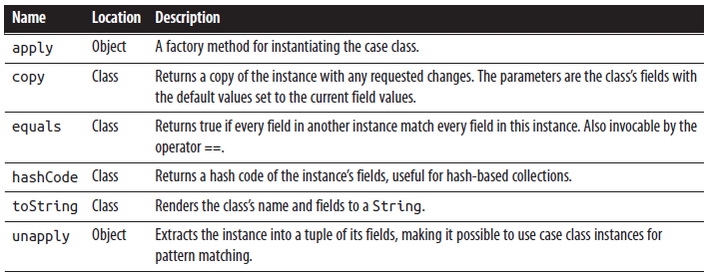
Case Classes (2/3)
introduction to scala
Automatically generated case class methods

Slide 119
Case Classes (3/3)
introduction to scala
Use case classes over classes for data storage
Use object and traits (see next) for writing functions over classes

Slide 120
Case Classes – Example
introduction to scala
scala> case class Character(name: String, isThief: Boolean)
defined class Character
scala> val h = Character("Hadrian", true)
h: Character = Character(Hadrian,true)
scala> val r = h.copy(name = "Royce")
r: Character = Character(Royce,true)
scala> h == r
res0: Boolean = false
scala> h match {
| case Character(x, true) => s"$x is a thief"
| case Character(x, false) => s"$x is not a thief"
| }
res1: String = Hadrian is a thief
Here the object’s factory method Character.apply()
The second instance shares the same value for the second field, so we only specify a new value for the first field
If both are non-null, the == operator triggers an instance’s equals
The companion object’s unapply method allows us to decompose the instance into its parts, binding the first field and using a literal value to match

Slide 121
Traits (1/2)
introduction to scala
Trait is a kind of class for multiple inheritance
Classes, case classes, and objects can extend just for one class but traits can extend multiple traits at the same time
Traits cannot be instantiated and take class parameters
Traits can take type parameters to make them very reusable
scala> trait HtmlUtils {
| def removeMarkup(input: String) = {
| input
| .replaceAll("""</?\w[^>]*>""","")
| .replaceAll("<.*>","")
| }
| }
defined trait HtmlUtils
scala> class Page(val s: String) extends HtmlUtils {
| def asPlainText = removeMarkup(s)
| }
defined class Page
scala> new Page("<html>Intro</html>").asPlainText
res2: String = Introduction

Slide 122
Traits (2/2)
introduction to scala
If you are extending a class and one or more traits, you will need to extend the class before you can add the traits using the with keyword. A parent class, if specified, must always come before any parent traits
scala> trait SafeStringUtils {
| // Returns a trimmed version of the string wrapped in an Option,
| // or None if the trimmed string is empty.
| def trimToNone(s: String): Option[String] = {
| Option(s) map(_.trim) filterNot(_.isEmpty)
| }
| }
defined trait SafeStringUtils
scala> class Page(val s: String) extends SafeStringUtils with HtmlUtils {
| def asPlainText: String = {
| trimToNone(s) map removeMarkup getOrElse "n/a"
| }
| }
defined class Page
scala> new Page("<html><body><h1>Introduction</h1></body></html>").asPlainText
res3: String = Introduction
scala> new Page(" ").asPlainText
res4: String = n/a
scala> new Page(null).asPlainText
res5: String = n/a

Slide 123
Linearization - Traits
introduction to scala
Linearization:
scala> trait Base { override def toString = "Base" }
defined trait Base
scala> class A extends Base { override def toString = "A->" + super.toString }
defined class A
scala> trait B extends Base { override def toString = "B->" + super.toString }
defined trait B
scala> trait C extends Base { override def toString = "C->" + super.toString }
defined trait C
scala> class D extends A with B with C { override def toString = "D->" +
super.toString }
defined class D
scala> new D()
res50: D = D->C->B->A->Base

Slide 124
Self Types in Traits (1 / 2)
introduction to scala
self type is a trait annotation that asserts that the trait must be mixed in with a specific type, or its subtype, when it is added to a class
A popular use of self types is to add functionality with traits to classes that require input parameters
scala> class A { def hi = "hi" }
defined class A
scala> trait B { self: A =>
| override def toString = "B: " + hi
| }
defined trait B
scala> class C extends B
<console>:9: error: illegal inheritance;
self-type C does not conform to B's selftype B with A
class C extends B
scala> class C extends A with B
defined class C
scala> new C()
res1: C = B: hi
Our trait B has a self type, adding the requirement that the trait can only ever be mixed into a subtype of the specified type, the A class
… but just to prove it, let’s try defining a class with trait B but without the requested class. No luck
This time, trait B is directly extending its requested type, A, so its self type requirement has been met
When our C class is instantiated, B.toString is invoked, which then invokes A.hi. The B trait is indeed used as a subtype of A here and can invoke one of its methods

Slide 125
Self Types in Traits (2 / 2)
introduction to scala
Benefits of self types (extend a class without specifying its input parameters):
scala> class TestSuite(suiteName: String) { def start() {} }
defined class TestSuite
scala> trait RandomSeeded { self: TestSuite =>
| def randomStart() {
| util.Random.setSeed(System.currentTimeMillis)
| self.start()
| }
| }
defined trait RandomSeeded
scala> class IdSpec extends TestSuite("ID Tests") with RandomSeeded {
| def testId() { println(util.Random.nextInt != 1) }
| override def start() { testId() }
|
| println("Starting...")
| randomStart()
| }
defined class IdSpec
Here is the base class, TestSuite, which takes an input parameter
Our trait needs to invoke TestSuite.start() but cannot extend TestSuite because it would require hardcoding the input parameter. By using a self type, the trait can expect to be a subtype of TestSuite without explicitly being declared as one
The test class IdSpec defines our self-typed trait as a subclass, allowing its randomStart() to be invocable

Slide 126
Instantiation with Traits (1 / 2)
introduction to scala
Instantiation with Traits: add the traits when the class is instantiated
The traits must use with and no extends. Are the traits which are been extended with the classs
scala> class A
defined class A
scala> trait B { self: A => }
defined trait B
scala> val a = new A with B
a: A with B = $anon$1@26a7b76d
The instance’s class is indeed anonymous, because it contains a combination of a class and trait that are not formally included in any named
class definition

Slide 127
Instantiation with Traits (2 / 2)
introduction to scala
The real value in instantiating with traits is in adding new functionality or configurations to existing classes.
This feature is commonly known as dependency injection:
scala> class User(val name: String) {
| def suffix = ""
| override def toString = s"$name$suffix"
| }
defined class User
scala> trait Attorney { self: User => override def suffix = “with attorney" }
defined trait Attorney
scala> val h = new User(“John")
h: User = John
scala> val m = new User(“Mary") with Attorney
m: User with Attorney = Mary with Attorney

Slide 128
Import Instance Members
introduction to scala
The import keyword can also be used to import members of classes and objects into the current namespace
scala> case class Receipt(id: Int, amount: Double, who: String, title: String)
defined class Receipt
scala>
val latteReceipt = Receipt(123, 4.12, "fred", "Medium Latte")
import latteReceipt._
println(s"Sold a $title for $amount to $who")
Sold a Medium Latte for 4.12 to fred
Use of members of util.Random object
scala> import util.Random._
import util.Random._
scala> val letters = alphanumeric.take(20).toList.mkString
letters: String = MwDR3EyHa1cr0JqsP9Tf
scala> val numbers = shuffle(1 to 20)
numbers: scala.collection.immutable.IndexedSeq[Int] = Vector(5, 10, 18, 1,
16, 8, 20, 14, 19, 11, 17, 3, 15, 7, 4, 9, 6, 12, 13, 2)

Slide 129
Exercises
introduction to scala
Exercise 9 - Object, Case Classes and Traits

Slide 130
Introduction to scala
11. Advanced Typing

Slide 131
Implicit parameters
introduction to scala
Invoke a function without specifying all of the parameters (not partially applied functions, not default parameters)
scala> object Doubly {
| def print(num: Double)(implicit fmt: String) = {
| println(fmt format num)
| }
| }
defined object Doubly
scala> Doubly.print(3.724)
<console>:9: error: could not find implicit value for parameter fmt: String
Doubly.print(3.724)
scala> Doubly.print(3.724)("%.1f") //using all parameters
3.7
scala> case class USD(amount: Double) {
| implicit val printFmt = "%.2f“ // define an implicit value in the caller
| def print = Doubly.print(amount)
| }
defined class USD
scala> new USD(81.924).print
81.92
Excessive use can make your code hard to read and understand

Slide 132
Implicit Classes
introduction to scala
Add new methods to a Class without modification
Example add a method “fishes” to Class Int
object IntUtils { implicit class Fishies(val x: Int) { def fishes = "Fish" * x } }
import IntUtils._ println(3.fishes)
Fishies, defined inside an object, implicitly converts integers to itself …
… so that the fishes() method will be defined for all integers.
Before using it, the implicit class must be added to the namespace
… and then the fishes() method can be invoked on any integer.

Slide 133
Types - Type alias
introduction to scala
Type alias: creates a new named type for a specific, existing type (or class).
scala> object TypeFun {
| type Whole = Int
| val x: Whole = 5
| type UserInfo = Tuple2[Int,String]
| val u: UserInfo = new UserInfo(123, "George")
| type T3[A,B,C] = Tuple3[A,B,C]
| val things = new T3(1, 'a', true)
| }
defined object TypeFun
scala> val x = TypeFun.x
x: TypeFun.Whole = 5
scala> val u = TypeFun.u
u: TypeFun.UserInfo = (123,George)
scala> val things = TypeFun.things
things: (Int, Char, Boolean) = (1,a,true)

Slide 134
Types - Abstract Types
introduction to scala
Used to create type declarations in abstract classes, which declare types that concrete (non abstract) subclasses must implement.
scala> class User(val name: String)
defined class User
scala> trait Factory { type A; def create: A }
defined trait Factory
scala> trait UserFactory extends Factory {
| type A = User
| def create = new User("")
| }
defined trait UserFactory
The same using type paramenters
scala> trait Factory[A] { def create: A }
defined trait Factory
scala> trait UserFactory extends Factory[User] { def create = new User("") }
defined trait UserFactory

Slide 135
Types- Bounded Types (1 / 2)
introduction to scala
A bounded type is restricted to being either a specific class or else its subtype or base type
An upper bound restricts a type to only that type or one of its subtypes
A lower bound restricts a type to only that type or else one of the base types it extends.

Slide 136
Types- Bounded Types (2 / 2)
introduction to scala
scala> class BaseUser(val name: String)
defined class BaseUser
scala> class Admin(name: String, val level: String) extends BaseUser(name)
defined class Admin
scala> class Customer(name: String) extends BaseUser(name)
defined class Customer
scala> class PreferredCustomer(name: String) extends Customer(name)
defined class PreferredCustomer
scala> def check[A <: BaseUser](u: A) { if (u.name.isEmpty) println("Fail!") }
check: [A <: BaseUser](u: A)Unit
scala> check(new Customer("Fred"))
scala> check(new Admin("", "strict"))
Fail!
scala> def recruit[A >: Customer](u: Customer): A = u match {
| case p: PreferredCustomer => new PreferredCustomer(u.name)
| case c: Customer => new Customer(u.name)
| }
recruit: [A >: Customer](u: Customer)A
scala> val customer = recruit(new Customer("Fred"))
customer: Customer = Customer@4746fb8c
scala> val preferred = recruit(new PreferredCustomer("George"))
preferred: Customer = PreferredCustomer@4cd8db31
Now we’ll define a function that takes a parameter with an upper bound
And a function that takes a parameter with an lower bound

Slide 137
Types - Type Variance (1 / 2)
introduction to scala
Ading upper or lower bounds will make type parameters more restrictive,
Ading type variance makes type parameters less restrictive
Type variance specifies how a type parameter may adapt to meet a base type or subtype
Type parameters are invariant by default, cannot adapt to alternate types even if they are compatible

Slide 138
Types - Type Variance
introduction to scala
Scala’s polymorphism, allows lower types to be stored in values with higher types
scala> class Car { override def toString = "Car()" }
defined class Car
scala> class Volvo extends Car { override def toString = "Volvo()" }
defined class Volvo
scala> val c: Car = new Volvo()
c: Car = Volvo()
The same polymorphic adaptation doesn’t hold for type parameters
scala> case class Item[A](a: A) { def get: A = a }
defined class Item
scala> val c: Item[Car] = new Item[Volvo](new Volvo)
<console>:12: error: type mismatch;
found : Item[Volvo]
required: Item[Car]
Note: Volvo <: Car, but class Item is invariant in type A.
You may wish to define A as +A instead. (SLS 4.5)
val c: Item[Car] = new Item[Volvo](new Volvo)

Slide 139
Types – Covariant type
introduction to scala
Covariant type parameters can automatically morph into one of their base types when necessary
scala> case class Item[+A](a: A) { def get: A = a }
defined class Item
scala> val c: Item[Car] = new Item[Volvo](new Volvo)
c: Item[Car] = Item(Volvo())
scala> val auto = c.get
auto: Car = Volvo()

Slide 140
Types – Contravariant type
introduction to scala
Covariant is not always applicable. An input parameter to a method cannot be covariant. it would be bound to a subtype but be invokable with a base type
scala> class Check[+A] { def check(a: A) = {} }
<console>:7: error: covariant type A occurs in contravariant position in
type A of value a
class Check[+A] { def check(a: A) = {} }
Contravariance is where a type parameter may morph into a subtype
They can be used for input parameters to methods but not as their return types. Return types are covariant, because their result may be a subtype that is polymorphically converted to a base type
scala> class Check[-A] { def check(a: A) = {} }
defined class Check

Slide 141
Types – covariant / contravariant
introduction to scala
Example
scala> class Car; class Volvo extends Car; class VolvoWagon extends Volvo
defined class Car
defined class Volvo
defined class VolvoWagon
scala> class Item[+A](a: A) { def get: A = a }
defined class Item
scala> class Check[-A] { def check(a: A) = {} }
defined class Check
scala> def item(v: Item[Volvo]) { val c: Car = v.get }
item: (v: Item[Volvo])Unit
scala> def check(v: Check[Volvo]) { v.check(new VolvoWagon()) }
check: (v: Check[Volvo])Unit

Slide 142
LinkedIn
https://es.linkedin.com/in/chicochica10

