Slide 1
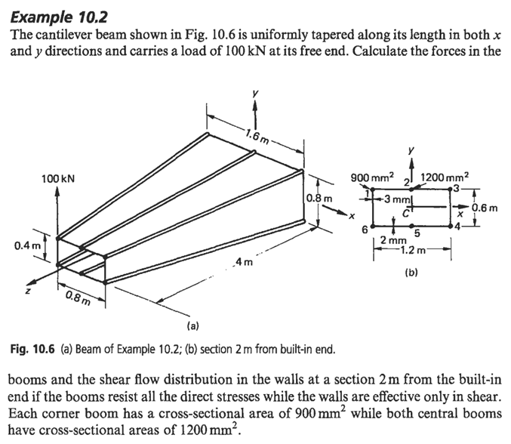

Slide 2
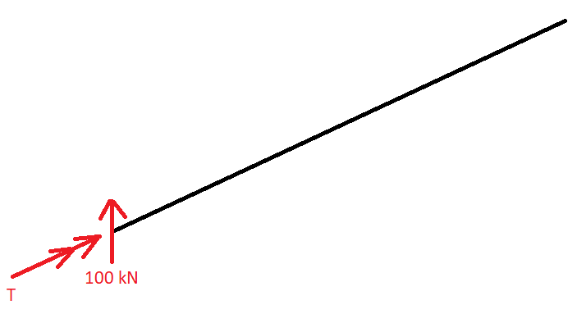
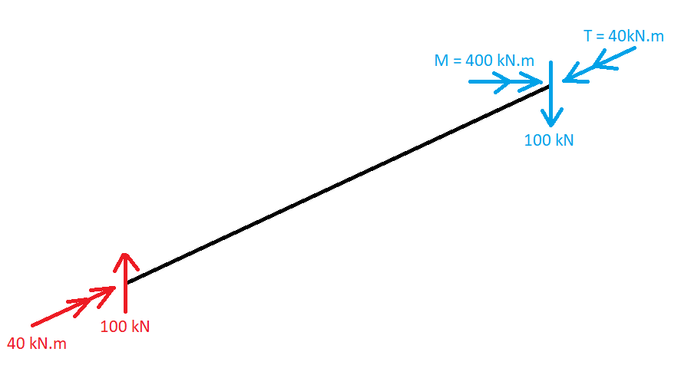
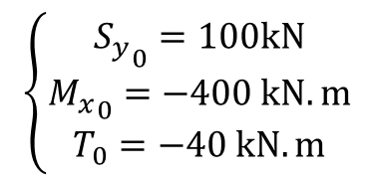

Passo 1: Diagrama de Corpo Livre
$$T=100kN×0.4m=40kN.m$$
$$\left\{\begin{aligned}{S_{y}}_{0}=100kN \\ {M_{x}}_{0}=−400 kN.m \\ T_{0}=−40 kN.m\end{aligned}\right.$$

Slide 3
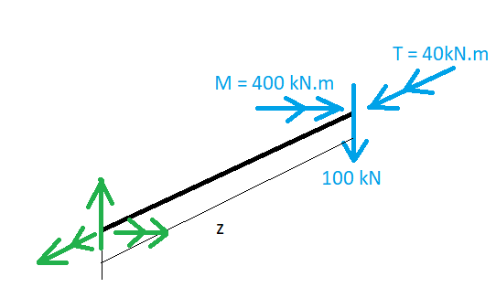
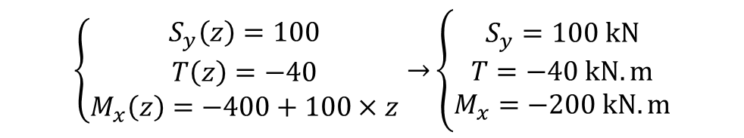
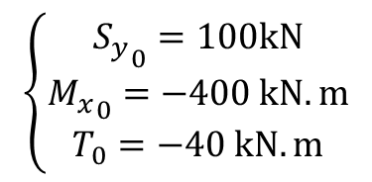
Passo 2: Análise da Seção
$$\left\{\begin{aligned}S_{y}\left(z\right)=100 \\ T\left(z\right)=−40 \\ M_{x}\left(z\right)=−400+100×z\end{aligned}→\right.\left\{\begin{aligned}S_{y}=100 kN \\ T=−40 kN.m \\ M_{x}=−200 kN.m\end{aligned}\right.$$
$$\left\{\begin{aligned}{S_{y}}_{0}=100kN \\ {M_{x}}_{0}=−400 kN.m \\ T_{0}=−40 kN.m\end{aligned}\right.$$

Slide 4
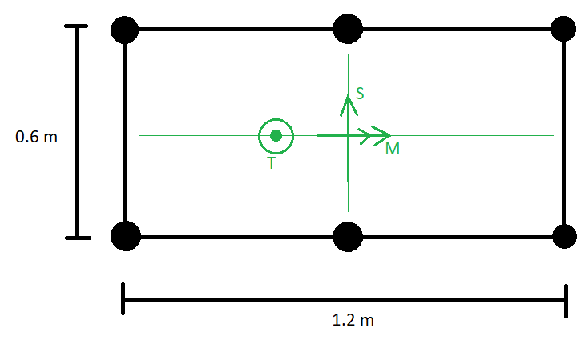
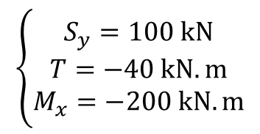
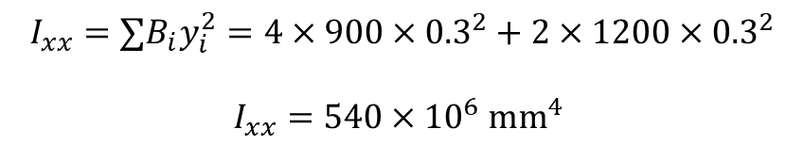
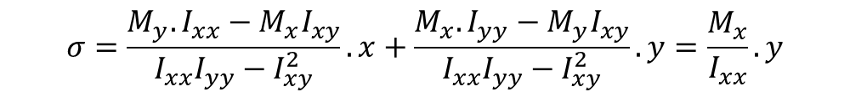
Passo 3: Análise das Cargas (Seção z = 2m)
Passo 3.1: Cálculo das tensões axiais
$$σ=\frac{M_{y}.I_{xx}−M_{x}I_{xy}}{I_{xx}I_{yy}−I_{xy}^{2}}.x+\frac{M_{x}.I_{yy}−M_{y}I_{xy}}{I_{xx}I_{yy}−I_{xy}^{2}}.y=\frac{M_{x}}{I_{xx}}.y$$
a. Cálculo das Propriedades Geométricas
$$\left\{\begin{aligned}S_{y}=100 kN \\ T=−40 kN.m \\ M_{x}=−200 kN.m\end{aligned}\right.$$
$$I_{xx}=∑B_{i}y_{i}^{2}=4×900×{0.3}^{2}+2×1200×{0.3}^{2}$$
$$I_{xx}=540×{10}^{6} mm^{4}$$

Slide 5
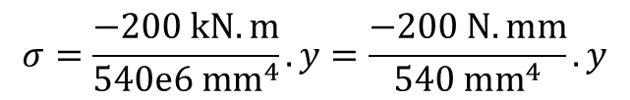
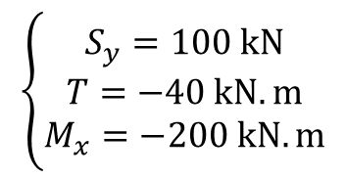
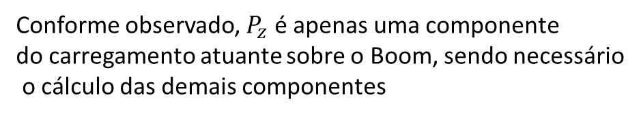
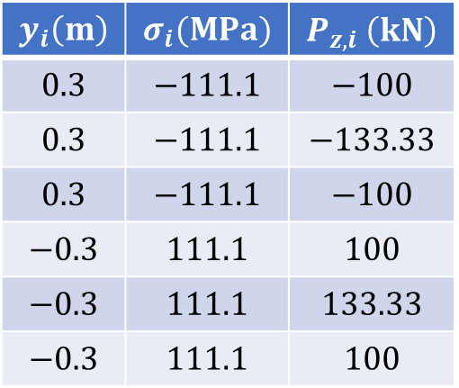
b. Cálculo das Tensões nos Booms
$$y_{i}\left(m\right)$$ | $$σ_{i}(MPa)$$ | $$P_{z,i} \left(kN\right)$$
$$0.3$$ | $$−111.1$$ | $$−100$$
$$0.3$$ | $$−111.1$$ | $$−133.33$$
$$0.3$$ | $$−111.1$$ | $$−100$$
$$−0.3$$ | $$111.1$$ | $$100$$
$$−0.3$$ | $$111.1$$ | $$133.33$$
$$−0.3$$ | $$111.1$$ | $$100$$
$$σ=\frac{−200 kN.m}{540e6 mm^{4}}.y=\frac{−200 N.mm}{540 mm^{4}}.y$$
Conforme observado, $P_{z}$ é apenas uma componente
do carregamento atuante sobre o Boom, sendo necessário
o cálculo das demais componentes
$$\left\{\begin{aligned}S_{y}=100 kN \\ T=−40 kN.m \\ M_{x}=−200 kN.m\end{aligned}\right.$$

Slide 6
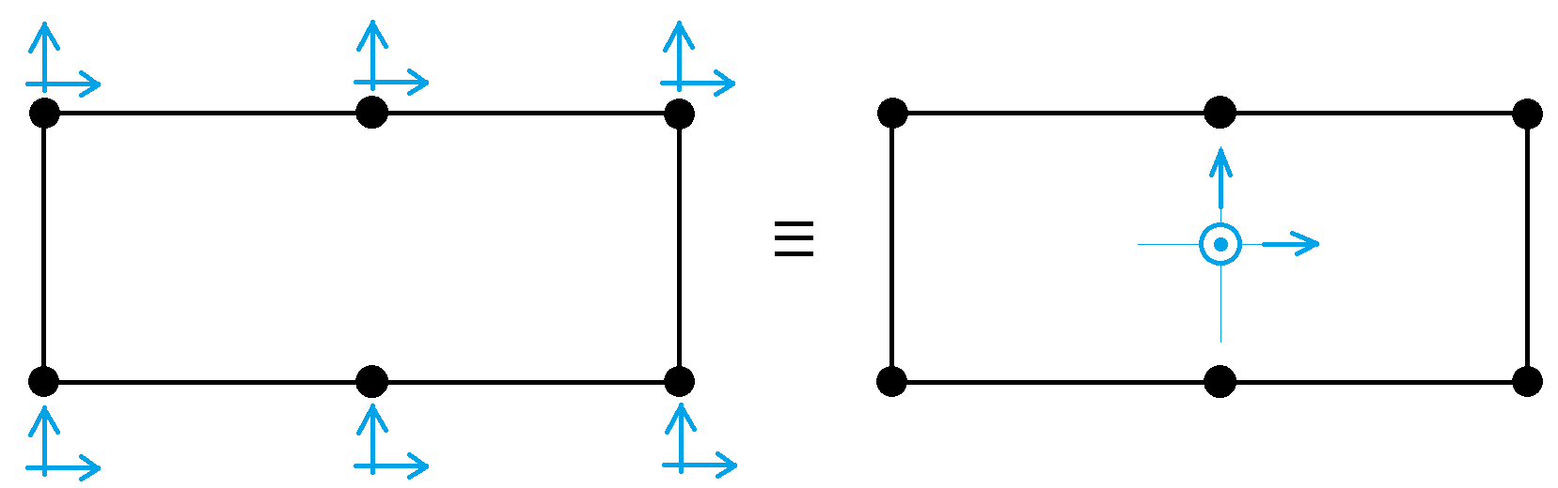
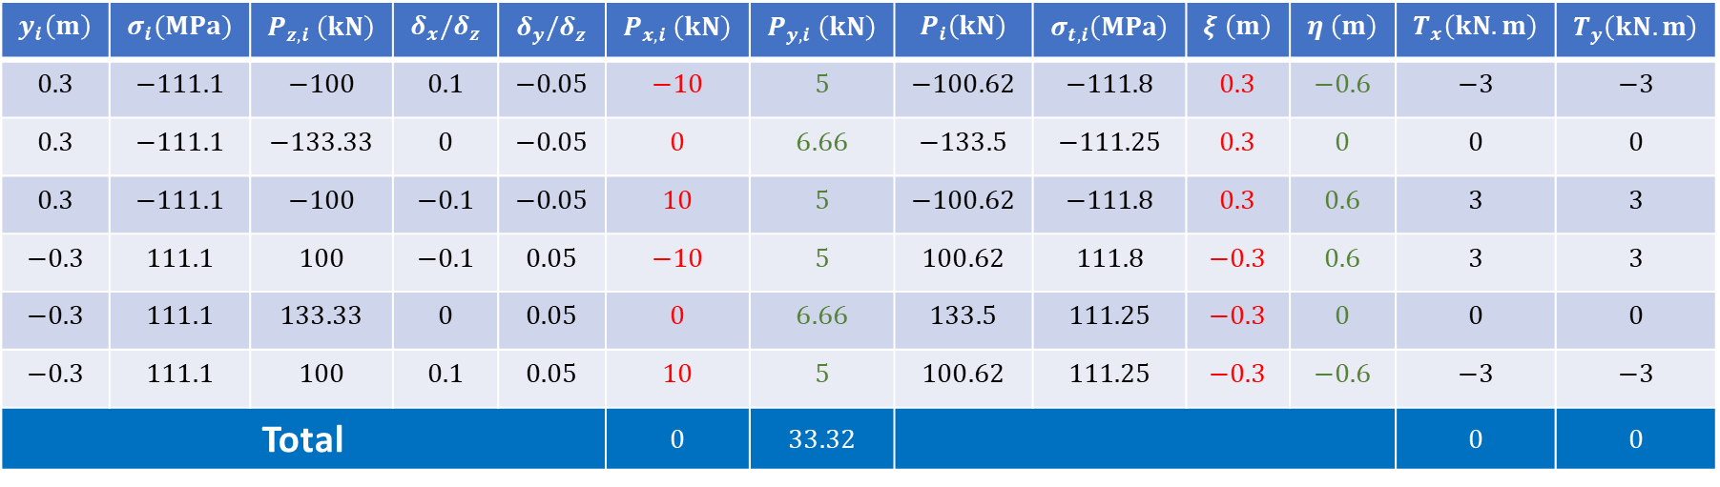
b. Cálculo das Tensões nos Booms
$$y_{i}\left(m\right)$$ | $$σ_{i}(MPa)$$ | $$P_{z,i} \left(kN\right)$$ | $$δ_{x}/δ_{z}$$ | $$δ_{y}/δ_{z}$$ | $$P_{x,i} \left(kN\right)$$ | $$P_{y,i} \left(kN\right)$$ | $$P_{i}\left(kN\right)$$ | $$σ_{t,i}\left(MPa\right)$$ | $$ξ \left(m\right)$$ | $$η \left(m\right)$$ | $$T_{x}\left(kN.m\right)$$ | $$T_{y}\left(kN.m\right)$$
$$0.3$$ | $$−111.1$$ | $$−100$$ | $$0.1$$ | $$−0.05$$ | $$−10$$ | $$5$$ | $$−100.62$$ | $$−111.8$$ | $$0.3$$ | $$−0.6$$ | $$−3$$ | $$−3$$
$$0.3$$ | $$−111.1$$ | $$−133.33$$ | $$0$$ | $$−0.05$$ | $$0$$ | $$6.66$$ | $$−133.5$$ | $$−111.25$$ | $$0.3$$ | $$0$$ | $$0$$ | $$0$$
$$0.3$$ | $$−111.1$$ | $$−100$$ | $$−0.1$$ | $$−0.05$$ | $$10$$ | $$5$$ | $$−100.62$$ | $$−111.8$$ | $$0.3$$ | $$0.6$$ | $$3$$ | $$3$$
$$−0.3$$ | $$111.1$$ | $$100$$ | $$−0.1$$ | $$0.05$$ | $$−10$$ | $$5$$ | $$100.62$$ | $$111.8$$ | $$−0.3$$ | $$0.6$$ | $$3$$ | $$3$$
$$−0.3$$ | $$111.1$$ | $$133.33$$ | $$0$$ | $$0.05$$ | $$0$$ | $$6.66$$ | $$133.5$$ | $$111.25$$ | $$−0.3$$ | $$0$$ | $$0$$ | $$0$$
$$−0.3$$ | $$111.1$$ | $$100$$ | $$0.1$$ | $$0.05$$ | $$10$$ | $$5$$ | $$100.62$$ | $$111.25$$ | $$−0.3$$ | $$−0.6$$ | $$−3$$ | $$−3$$
Total |  |  |  |  | $$0$$ | $$33.32$$ |  |  |  |  | $$0$$ | $$0$$

Slide 7
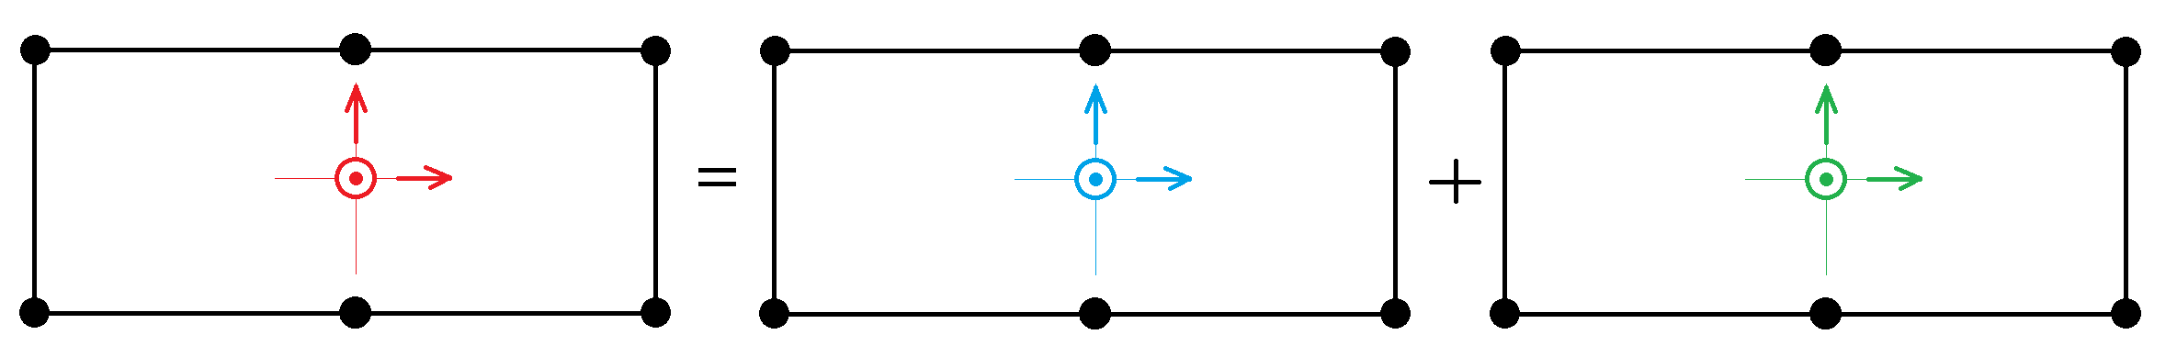
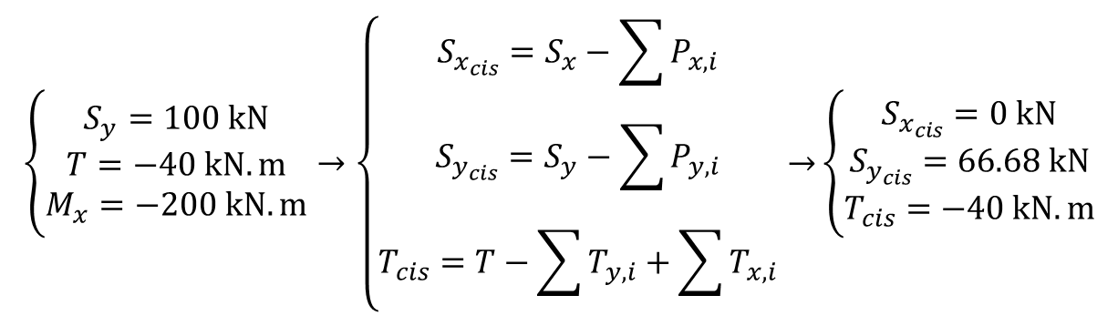
Passo 3.2: Cálculo dos Fluxos de Cisalhamento
a. Recalculo das cargas de cisalhamento atuantes apenas nas cascas
$$\left\{\begin{aligned}S_{y}=100 kN \\ T=−40 kN.m \\ M_{x}=−200 kN.m\end{aligned}\right.→\left\{\begin{aligned}S_{x_{cis}}=S_{x}−\sum{P_{x,i}} \\ S_{y_{cis}}=S_{y}−\sum{P_{y,i}} \\ T_{cis}=T−\sum{T_{y,i}}+\sum{T_{x,i}}\end{aligned}→\right.\left\{\begin{aligned}S_{x_{cis}}=0 kN \\ S_{y_{cis}}=66.68 kN \\ T_{cis}=−40 kN.m\end{aligned}\right.$$

Slide 8
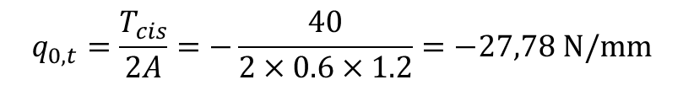
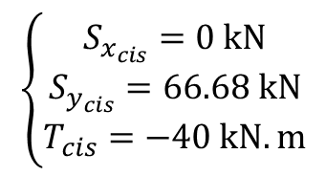
Passo 3.2: Cálculo dos Fluxos de Cisalhamento
a. Recalculo das cargas de cisalhamento atuantes apenas nas cascas
$$\left\{\begin{aligned}S_{x_{cis}}=0 kN \\ S_{y_{cis}}=66.68 kN \\ T_{cis}=−40 kN.m\end{aligned}\right.$$
b. Fluxo devido a torção em uma seção fechada
$$q_{0,t}=\frac{T_{cis}}{2A}=−\frac{40}{2×0.6×1.2}=−27,78 N/mm$$
c. Fluxo devido ao cisalhamento
$$q_{s}=−\frac{S_{x_{cis}}.I_{xx}−S_{y_{cis}}I_{xy}}{I_{xx}I_{yy}−I_{xy}^{2}}.\left(\int_{0}^{s}{t_{d}xds}+\sum_{r=1}^{n}{B_{r}x_{r}}\right)−\frac{S_{y_{cis}}.I_{yy}−S_{x_{cis}}I_{xy}}{I_{xx}I_{yy}−I_{xy}^{2}}.\left(\int_{0}^{s}{t_{d}yds}+\sum_{r=1}^{n}{B_{r}y_{r}}\right)+q_{s,0}$$

Slide 9
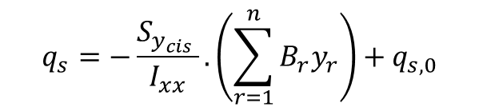
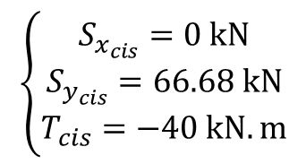
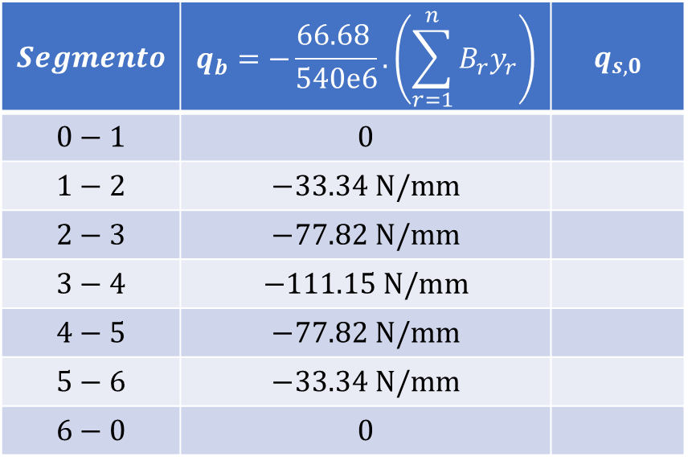
c. Fluxo devido ao cisalhamento
$$q_{s}=−\frac{S_{y_{cis}} }{I_{xx}}.\left(\sum_{r=1}^{n}{B_{r}y_{r}}\right)+q_{s,0}$$
$$Segmento$$ | $$q_{b}=−\frac{66.68 }{540e6}.\left(\sum_{r=1}^{n}{B_{r}y_{r}}\right)$$ | $$q_{s,0}$$
$$0−1$$ | $$0$$
$$1−2$$ | $$−33.34 N/mm$$
$$2−3$$ | $$−77.82 N/mm$$
$$3−4$$ | $$−111.15 N/mm$$
$$4−5$$ | $$−77.82 N/mm$$
$$5−6$$ | $$−33.34 N/mm$$
$$6−0$$ | $$0$$
$$\left\{\begin{aligned}S_{x_{cis}}=0 kN \\ S_{y_{cis}}=66.68 kN \\ T_{cis}=−40 kN.m\end{aligned}\right.$$

Slide 10
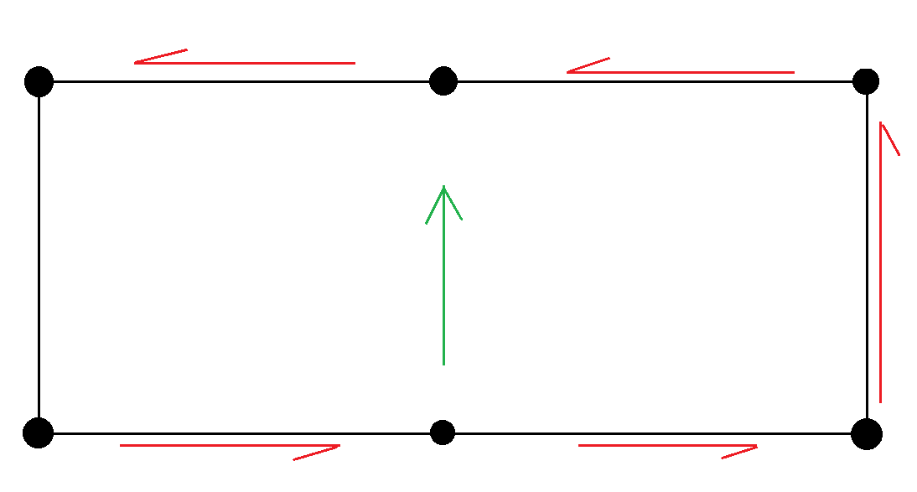
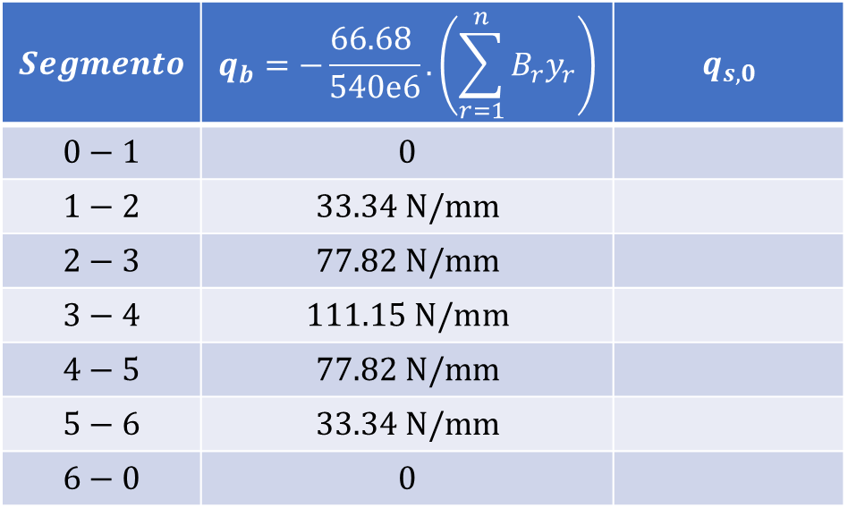
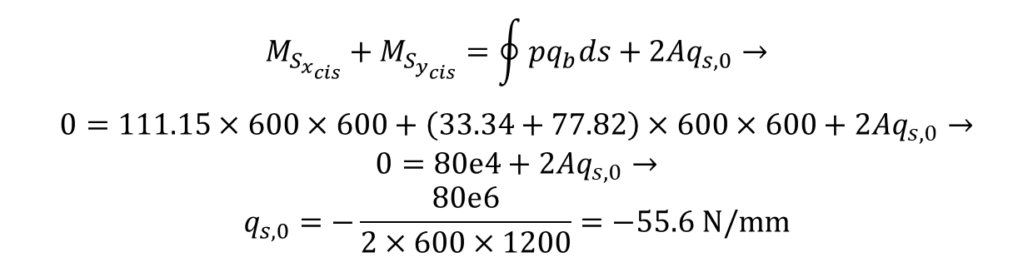

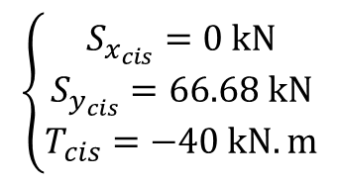
c. Fluxo devido ao cisalhamento
$$Segmento$$ | $$q_{b}=−\frac{66.68 }{540e6}.\left(\sum_{r=1}^{n}{B_{r}y_{r}}\right)$$ | $$q_{s,0}$$
$$0−1$$ | $$0$$
$$1−2$$ | $$33.34 N/mm$$
$$2−3$$ | $$77.82 N/mm$$
$$3−4$$ | $$111.15 N/mm$$
$$4−5$$ | $$77.82 N/mm$$
$$5−6$$ | $$33.34 N/mm$$
$$6−0$$ | $$0$$
$$q_{s}=−\frac{S_{y_{cis}} }{I_{xx}}.\left(\sum_{r=1}^{n}{B_{r}y_{r}}\right)+q_{s,0}$$
$$\left\{\begin{aligned}S_{x_{cis}}=0 kN \\ S_{y_{cis}}=66.68 kN \\ T_{cis}=−40 kN.m\end{aligned}\right.$$
Cálculo do $q_{s,0}$ (Boom 5)
$$M_{S_{x_{cis}}}+M_{S_{y_{cis}}}=\oint{pq_{b}ds}+2Aq_{s,0}→$$
$$0=111.15×600×600+\left(33.34+77.82\right)×600×600+2Aq_{s,0}→$$
$$0=80e4+2Aq_{s,0}→$$
$$q_{s,0}=−\frac{80e6}{2×600×1200}=−55.6 N/mm$$

Slide 11
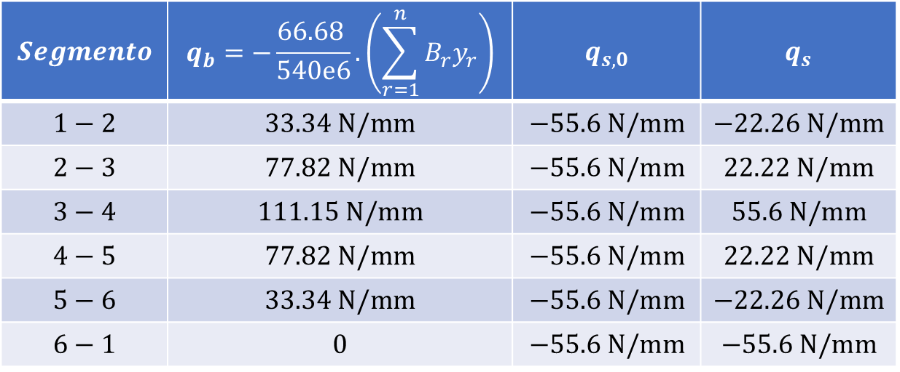
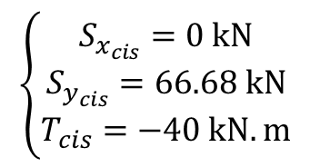
c. Fluxo devido ao cisalhamento
$$q_{s}=−\frac{S_{y_{cis}} }{I_{xx}}.\left(\sum_{r=1}^{n}{B_{r}y_{r}}\right)+q_{s,0}$$
$$Segmento$$ | $$q_{b}=−\frac{66.68 }{540e6}.\left(\sum_{r=1}^{n}{B_{r}y_{r}}\right)$$ | $$q_{s,0}$$ | $$q_{s}$$
$$1−2$$ | $$33.34 N/mm$$ | $$−55.6 N/mm$$ | $$−22.26 N/mm$$
$$2−3$$ | $$77.82 N/mm$$ | $$−55.6 N/mm$$ | $$22.22 N/mm$$
$$3−4$$ | $$111.15 N/mm$$ | $$−55.6 N/mm$$ | $$55.6 N/mm$$
$$4−5$$ | $$77.82 N/mm$$ | $$−55.6 N/mm$$ | $$22.22 N/mm$$
$$5−6$$ | $$33.34 N/mm$$ | $$−55.6 N/mm$$ | $$−22.26 N/mm$$
$$6−1$$ | $$0$$ | $$−55.6 N/mm$$ | $$−55.6 N/mm$$
$$\left\{\begin{aligned}S_{x_{cis}}=0 kN \\ S_{y_{cis}}=66.68 kN \\ T_{cis}=−40 kN.m\end{aligned}\right.$$

Slide 12
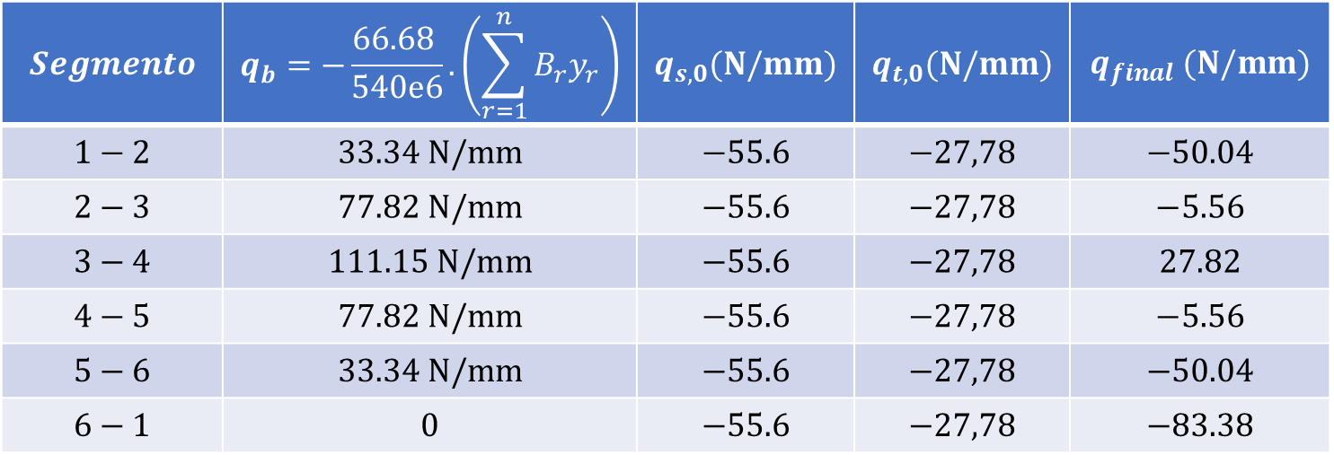
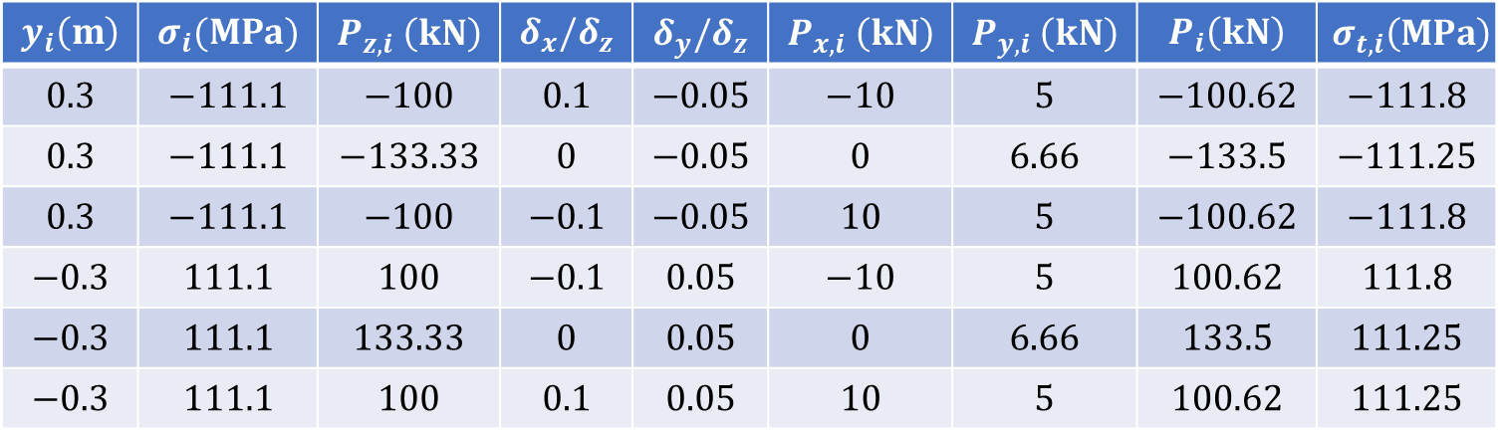
Passo 4: Resumo de Resultados
$$y_{i}\left(m\right)$$ | $$σ_{i}(MPa)$$ | $$P_{z,i} \left(kN\right)$$ | $$δ_{x}/δ_{z}$$ | $$δ_{y}/δ_{z}$$ | $$P_{x,i} \left(kN\right)$$ | $$P_{y,i} \left(kN\right)$$ | $$P_{i}\left(kN\right)$$ | $$σ_{t,i}\left(MPa\right)$$
$$0.3$$ | $$−111.1$$ | $$−100$$ | $$0.1$$ | $$−0.05$$ | $$−10$$ | $$5$$ | $$−100.62$$ | $$−111.8$$
$$0.3$$ | $$−111.1$$ | $$−133.33$$ | $$0$$ | $$−0.05$$ | $$0$$ | $$6.66$$ | $$−133.5$$ | $$−111.25$$
$$0.3$$ | $$−111.1$$ | $$−100$$ | $$−0.1$$ | $$−0.05$$ | $$10$$ | $$5$$ | $$−100.62$$ | $$−111.8$$
$$−0.3$$ | $$111.1$$ | $$100$$ | $$−0.1$$ | $$0.05$$ | $$−10$$ | $$5$$ | $$100.62$$ | $$111.8$$
$$−0.3$$ | $$111.1$$ | $$133.33$$ | $$0$$ | $$0.05$$ | $$0$$ | $$6.66$$ | $$133.5$$ | $$111.25$$
$$−0.3$$ | $$111.1$$ | $$100$$ | $$0.1$$ | $$0.05$$ | $$10$$ | $$5$$ | $$100.62$$ | $$111.25$$
$$Segmento$$ | $$q_{b}=−\frac{66.68 }{540e6}.\left(\sum_{r=1}^{n}{B_{r}y_{r}}\right)$$ | $$q_{s,0}(N/mm)$$ | $$q_{t,0}(N/mm)$$ | $$q_{final} (N/mm)$$
$$1−2$$ | $$33.34 N/mm$$ | $$−55.6$$ | $$−27,78$$ | $$−50.04$$
$$2−3$$ | $$77.82 N/mm$$ | $$−55.6$$ | $$−27,78$$ | $$−5.56$$
$$3−4$$ | $$111.15 N/mm$$ | $$−55.6$$ | $$−27,78$$ | $$27.82$$
$$4−5$$ | $$77.82 N/mm$$ | $$−55.6$$ | $$−27,78$$ | $$−5.56$$
$$5−6$$ | $$33.34 N/mm$$ | $$−55.6$$ | $$−27,78$$ | $$−50.04$$
$$6−1$$ | $$0$$ | $$−55.6$$ | $$−27,78$$ | $$−83.38$$

