Slide 1
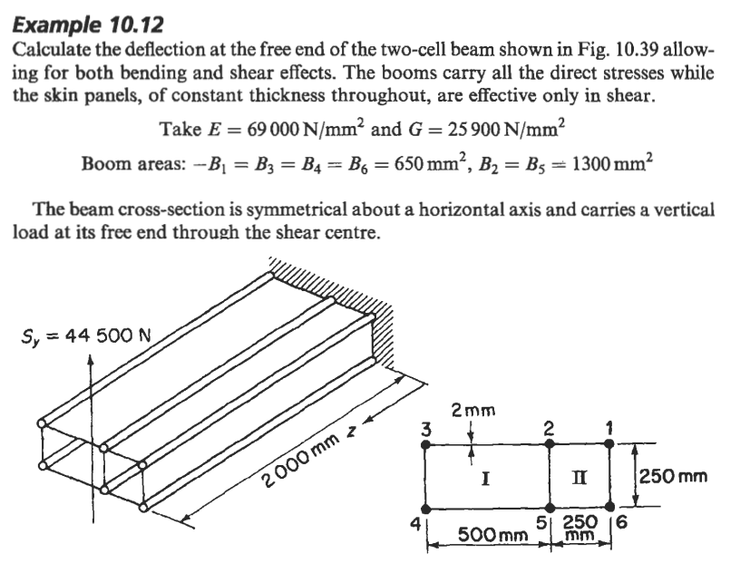

Slide 2
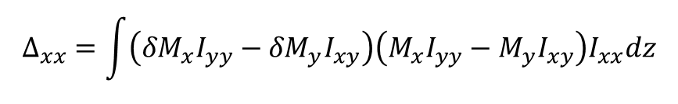

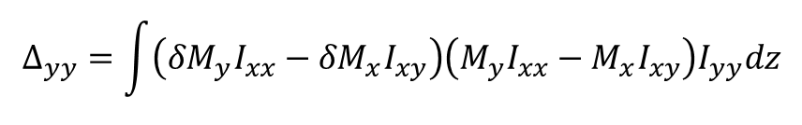
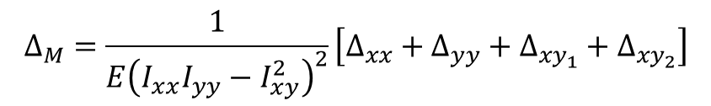
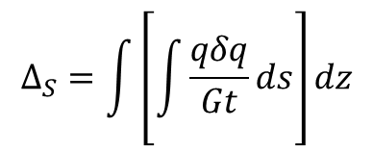
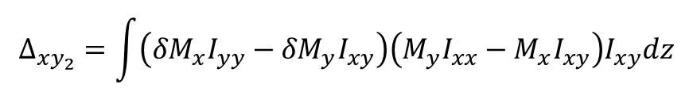
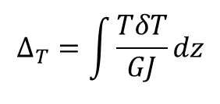
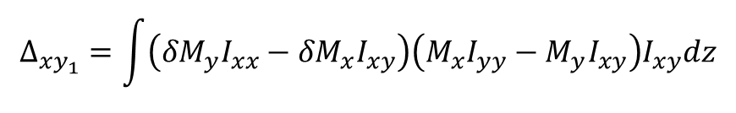
Equação de deslocamento (Princípio das Forças Virtuais)
$$Δ=Δ_{T}+Δ_{M}+Δ_{S}$$
$$Δ_{S}=\int{\left[\int{\frac{qδq}{Gt}ds}\right]dz}$$
$$Δ_{T}=\int{\frac{TδT}{GJ}dz}$$
$$Δ_{M}=\frac{1}{E{\left(I_{xx}I_{yy}−I_{xy}^{2}\right)}^{2}}\left[Δ_{xx}+Δ_{yy}+Δ_{xy_{1}}+Δ_{xy_{2}}\right]$$
$$Δ_{xx}=\int{\left({δM}_{x}I_{yy}−{δM}_{y}I_{xy}\right)\left(M_{x}I_{yy}−M_{y}I_{xy}\right)I_{xx}dz}$$
$$Δ_{yy}=\int{\left({δM}_{y}I_{xx}−{δM}_{x}I_{xy}\right)\left(M_{y}I_{xx}−M_{x}I_{xy}\right)I_{yy}dz}$$
$$Δ_{xy_{1}}=\int{\left({δM}_{y}I_{xx}−{δM}_{x}I_{xy}\right)\left(M_{x}I_{yy}−M_{y}I_{xy}\right)I_{xy}dz}$$
$$Δ_{xy_{2}}=\int{\left({δM}_{x}I_{yy}−{δM}_{y}I_{xy}\right)\left(M_{y}I_{xx}−M_{x}I_{xy}\right)I_{xy}dz}$$

Slide 3

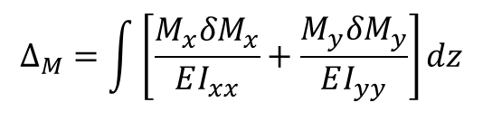
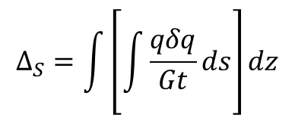
Equação de deslocamento (Princípio das Forças Virtuais)
$$Δ=Δ_{M}+Δ_{S}$$
$$Δ_{S}=\int{\left[\int{\frac{qδq}{Gt}ds}\right]dz}$$
$$Δ_{M}=\int{\left[\frac{M_{x}{δM}_{x}}{EI_{xx}}+\frac{M_{y}{δM}_{y}}{EI_{yy}}\right]dz}$$

Slide 4
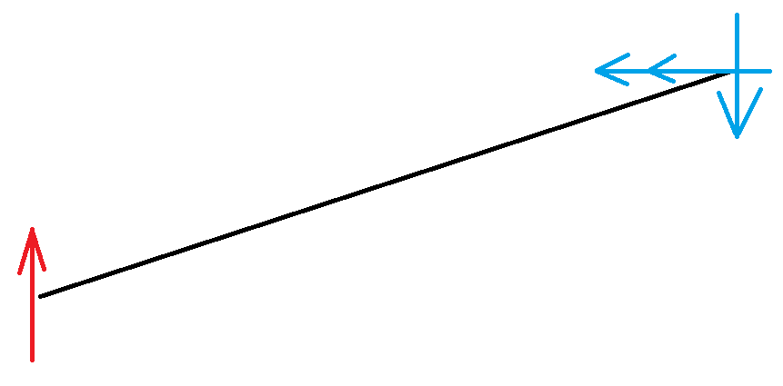
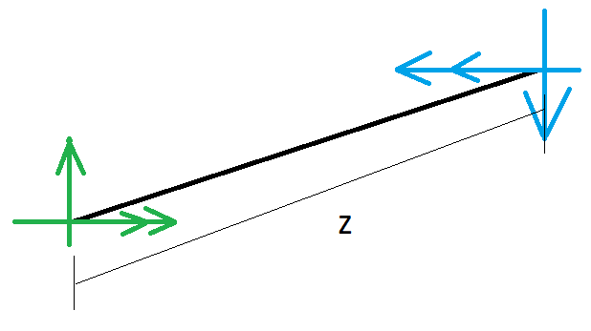
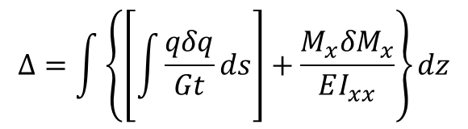
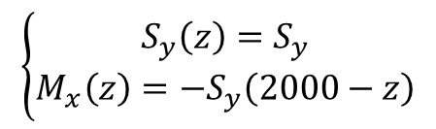
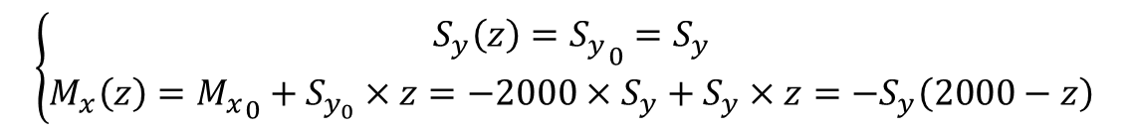

Passo 1: Diagrama de corpo livre
$$\left\{\begin{aligned}{S_{y}}_{0}=S_{y} \\ M_{x_{0}}=−2000×S_{y}\end{aligned}\right.$$
Passo 2: Análise da seção
$$\left\{\begin{aligned}S_{y}\left(z\right)={S_{y}}_{0}=S_{y} \\ M_{x}\left(z\right)={M_{x}}_{0}+S_{y_{0}}×z=−2000×S_{y}+S_{y}×z=−S_{y}\left(2000−z\right)\end{aligned}\right.$$
$$\left\{\begin{aligned}S_{y}\left(z\right)=S_{y} \\ M_{x}\left(z\right)=−S_{y}\left(2000−z\right)\end{aligned}\right.$$
$$Δ=\int{\left\{\left[\int{\frac{qδq}{Gt}ds}\right]+\frac{M_{x}{δM}_{x}}{EI_{xx}}\right\}dz}$$

Slide 5
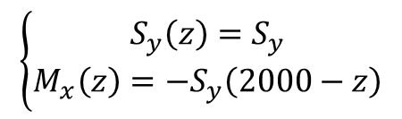
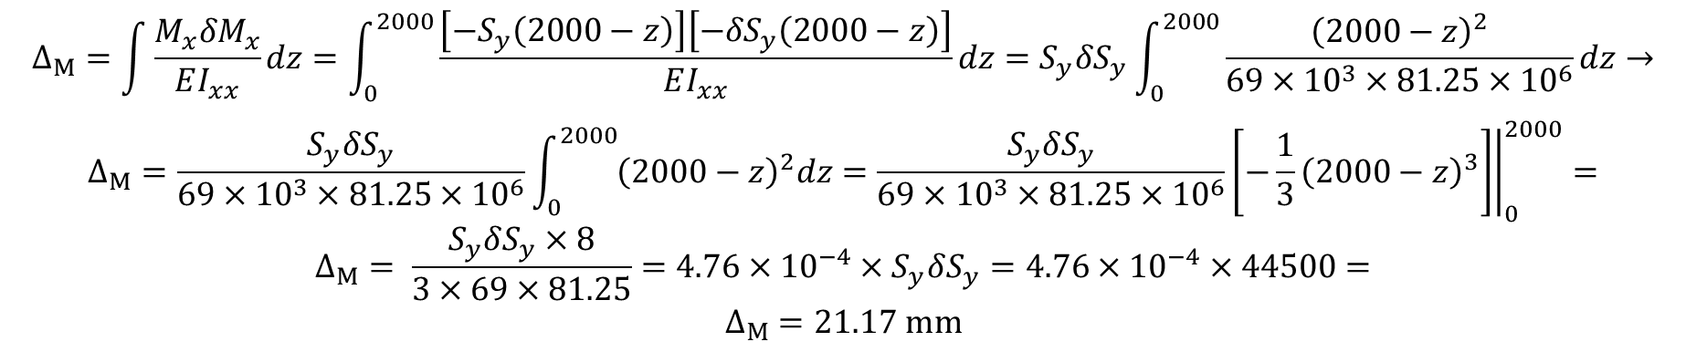
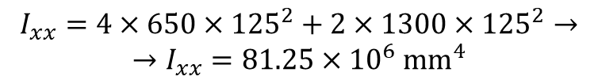
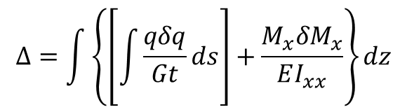
Passo 3: Análise do Carregamento
$$\left\{\begin{aligned}S_{y}\left(z\right)=S_{y} \\ M_{x}\left(z\right)=−S_{y}\left(2000−z\right)\end{aligned}\right.$$
$$Δ=\int{\left\{\left[\int{\frac{qδq}{Gt}ds}\right]+\frac{M_{x}{δM}_{x}}{EI_{xx}}\right\}dz}$$
Passo 3.1: Contribuição do Momento
a) Propriedades geométricas
$$I_{xx}=4×650×{125}^{2}+2×1300×{125}^{2}→$$
$$→I_{xx}=81.25×{10}^{6} mm^{4}$$
$$Δ_{M}=\int{\frac{M_{x}{δM}_{x}}{EI_{xx}}dz}=\int_{0}^{2000}{\frac{\left[−S_{y}\left(2000−z\right)\right]\left[−{δS}_{y}\left(2000−z\right)\right]}{EI_{xx}}dz}=S_{y}δS_{y}\int_{0}^{2000}{\frac{{\left(2000−z\right)}^{2}}{69×{10}^{3}×81.25×{10}^{6}}dz}→$$
$$Δ_{M}=\frac{S_{y}δS_{y}}{69×{10}^{3}×81.25×{10}^{6}}\int_{0}^{2000}{{\left(2000−z\right)}^{2}dz}=\frac{S_{y}δS_{y}}{69×{10}^{3}×81.25×{10}^{6}}{\left.\left[−\frac{1}{3}{\left(2000−z\right)}^{3}\right]\right|}_{0}^{2000}=$$
$$Δ_{M}= \frac{S_{y}δS_{y}×8}{3×69×81.25}=4.76×{10}^{−4}×S_{y}δS_{y}=4.76×{10}^{−4}×44500=$$
$$Δ_{M}=21.17 mm$$

Slide 6
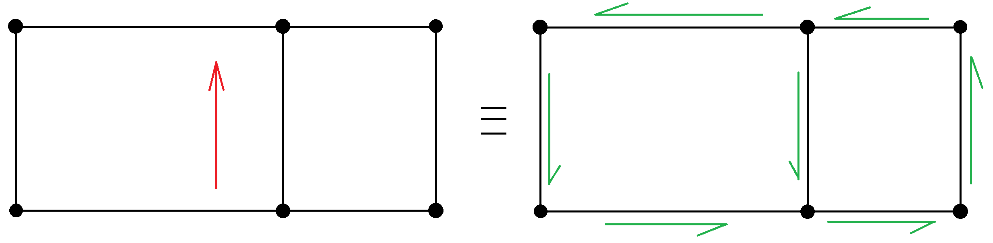
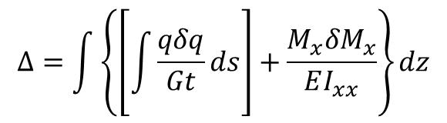
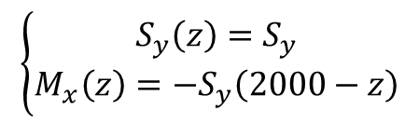
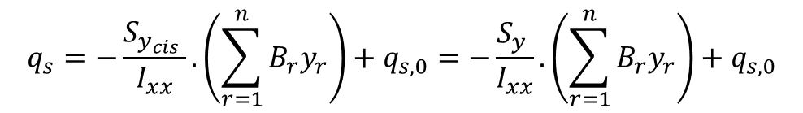
Passo 3: Análise do Carregamento
$$\left\{\begin{aligned}S_{y}\left(z\right)=S_{y} \\ M_{x}\left(z\right)=−S_{y}\left(2000−z\right)\end{aligned}\right.$$
$$Δ=\int{\left\{\left[\int{\frac{qδq}{Gt}ds}\right]+\frac{M_{x}{δM}_{x}}{EI_{xx}}\right\}dz}$$
Passo 3.2: Contribuição do Cisalhamento
Dado que os booms não se encontram inclinados,
nota-se que toda a carga cisalhante será suportada
apenas pela casca
a) Cálculo do Fluxo
$$q_{s}=−\frac{S_{x_{cis}}.I_{xx}−S_{y_{cis}}I_{xy}}{I_{xx}I_{yy}−I_{xy}^{2}}.\left(\int_{0}^{s}{t_{d}xds}+\sum_{r=1}^{n}{B_{r}x_{r}}\right)−\frac{S_{y_{cis}}.I_{yy}−S_{x_{cis}}I_{xy}}{I_{xx}I_{yy}−I_{xy}^{2}}.\left(\int_{0}^{s}{t_{d}yds}+\sum_{r=1}^{n}{B_{r}y_{r}}\right)+q_{s,0}$$
$$q_{s}=−\frac{S_{y_{cis}} }{I_{xx}}.\left(\sum_{r=1}^{n}{B_{r}y_{r}}\right)+q_{s,0}=−\frac{S_{y} }{I_{xx}}.\left(\sum_{r=1}^{n}{B_{r}y_{r}}\right)+q_{s,0}$$

Slide 7
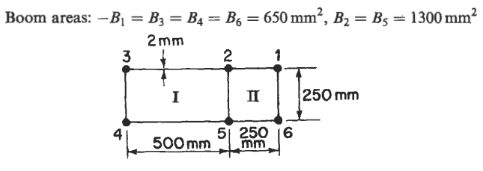
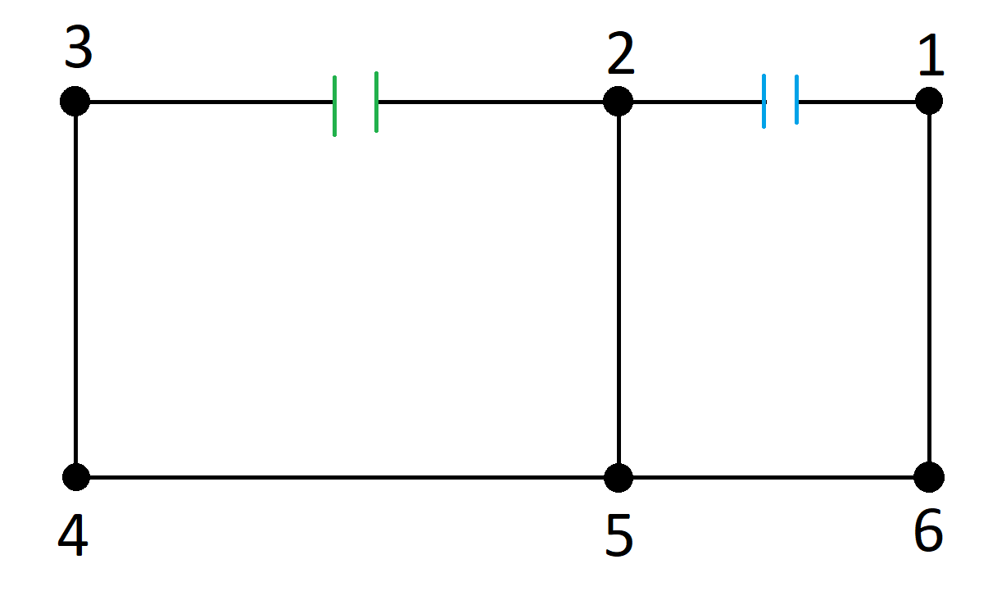
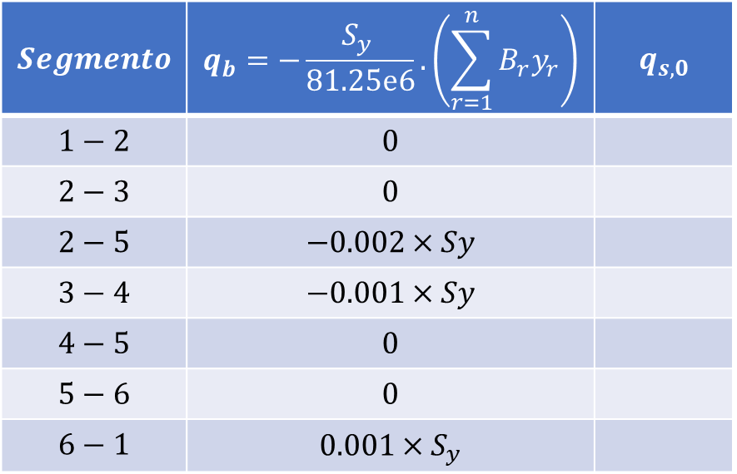
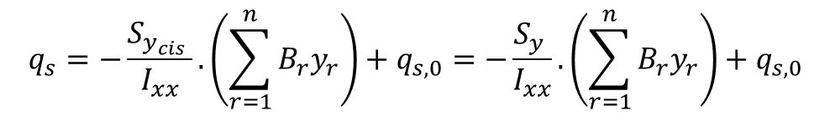
Passo 3: Análise do Carregamento
$$\left\{\begin{aligned}S_{y}\left(z\right)=S_{y} \\ M_{x}\left(z\right)=−S_{y}\left(2000−z\right)\end{aligned}\right.$$
$$Δ=\int{\left\{\left[\int{\frac{qδq}{Gt}ds}\right]+\frac{M_{x}{δM}_{x}}{EI_{xx}}\right\}dz}$$
Passo 3.2: Contribuição do Cisalhamento
a) Cálculo do Fluxo
$$q_{s}=−\frac{S_{y_{cis}} }{I_{xx}}.\left(\sum_{r=1}^{n}{B_{r}y_{r}}\right)+q_{s,0}=−\frac{S_{y} }{I_{xx}}.\left(\sum_{r=1}^{n}{B_{r}y_{r}}\right)+q_{s,0}$$
$$Segmento$$ | $$q_{b}=−\frac{S_{y} }{81.25e6}.\left(\sum_{r=1}^{n}{B_{r}y_{r}}\right)$$ | $$q_{s,0}$$
$$1−2$$ | $$0$$
$$2−3$$ | $$0$$
$$2−5$$ | $$−0.002×Sy$$
$$3−4$$ | $$−0.001×Sy$$
$$4−5$$ | $$0$$
$$5−6$$ | $$0$$
$$6−1$$ | $$0.001×S_{y}$$

Slide 8
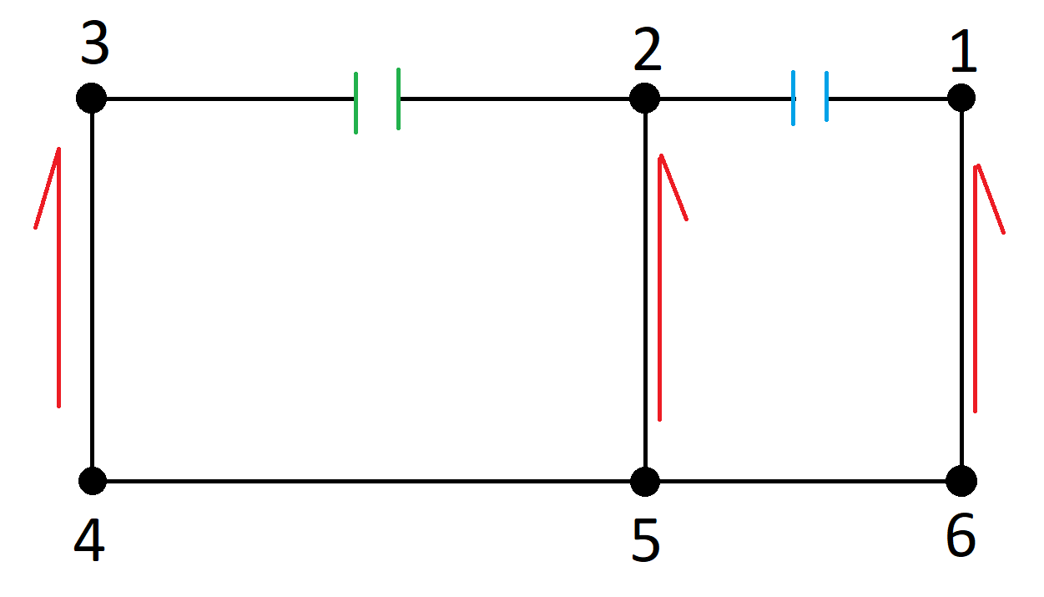
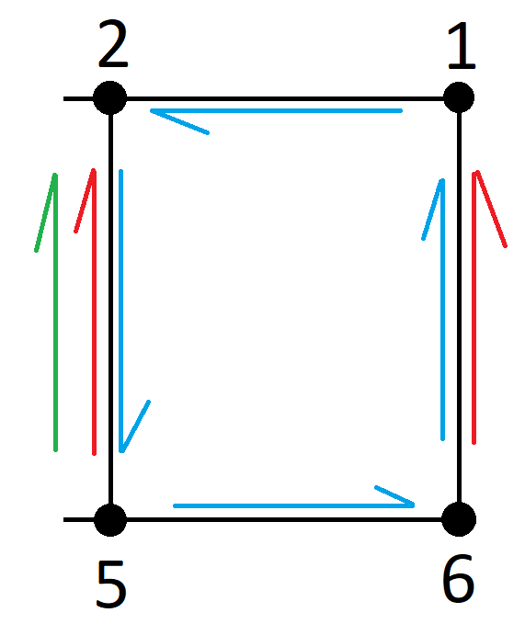
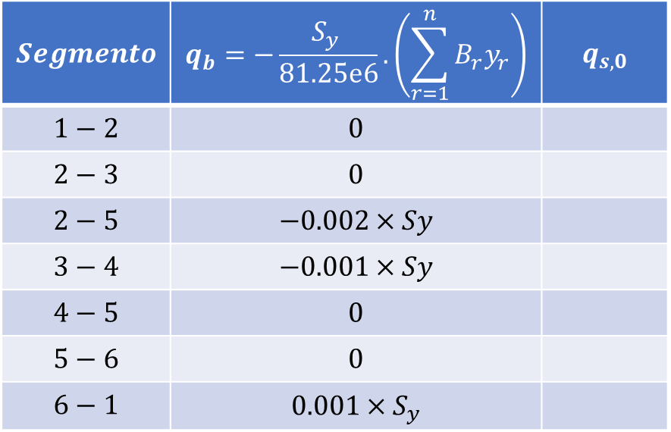
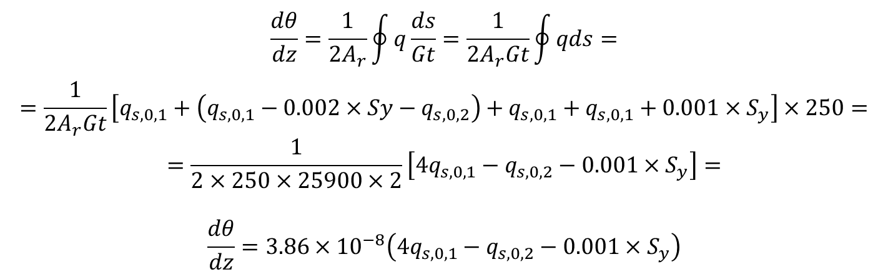

Passo 3.2: Contribuição do Cisalhamento
$$Segmento$$ | $$q_{b}=−\frac{S_{y} }{81.25e6}.\left(\sum_{r=1}^{n}{B_{r}y_{r}}\right)$$ | $$q_{s,0}$$
$$1−2$$ | $$0$$
$$2−3$$ | $$0$$
$$2−5$$ | $$−0.002×Sy$$
$$3−4$$ | $$−0.001×Sy$$
$$4−5$$ | $$0$$
$$5−6$$ | $$0$$
$$6−1$$ | $$0.001×S_{y}$$
a) Cálculo do Fluxo
Cálculo dos $q_{s,0,i}$
Análise da Célula I
$$\frac{dθ}{dz}=\frac{1}{2A_{r}}\oint{q\frac{ds}{Gt}}=\frac{1}{2A_{r}Gt}\oint{qds}=$$
$$=\frac{1}{2A_{r}Gt}\left[q_{s,0,1}+\left(q_{s,0,1}−0.002×Sy−q_{s,0,2}\right)+q_{s,0,1}+q_{s,0,1}+0.001×S_{y}\right]×250=$$
$$=\frac{1}{2×250×25900×2}\left[4q_{s,0,1}−q_{s,0,2}−0.001×S_{y}\right]=$$
$$\frac{dθ}{dz}=3.86×{10}^{−8}\left(4q_{s,0,1}−q_{s,0,2}−0.001×S_{y}\right)$$

Slide 9
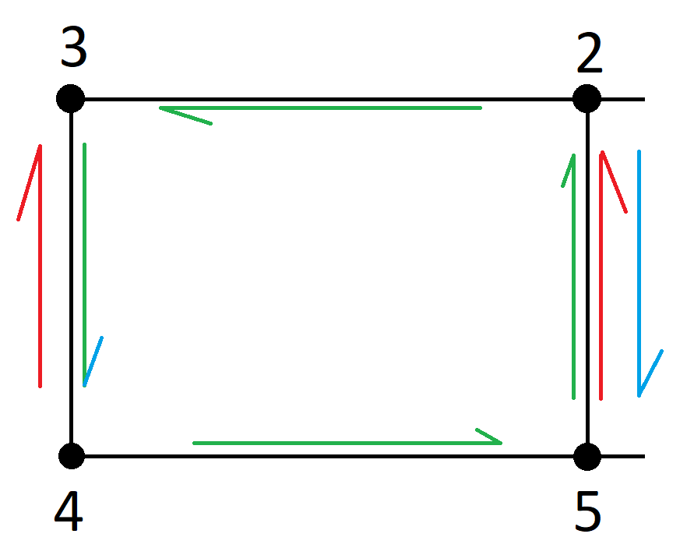
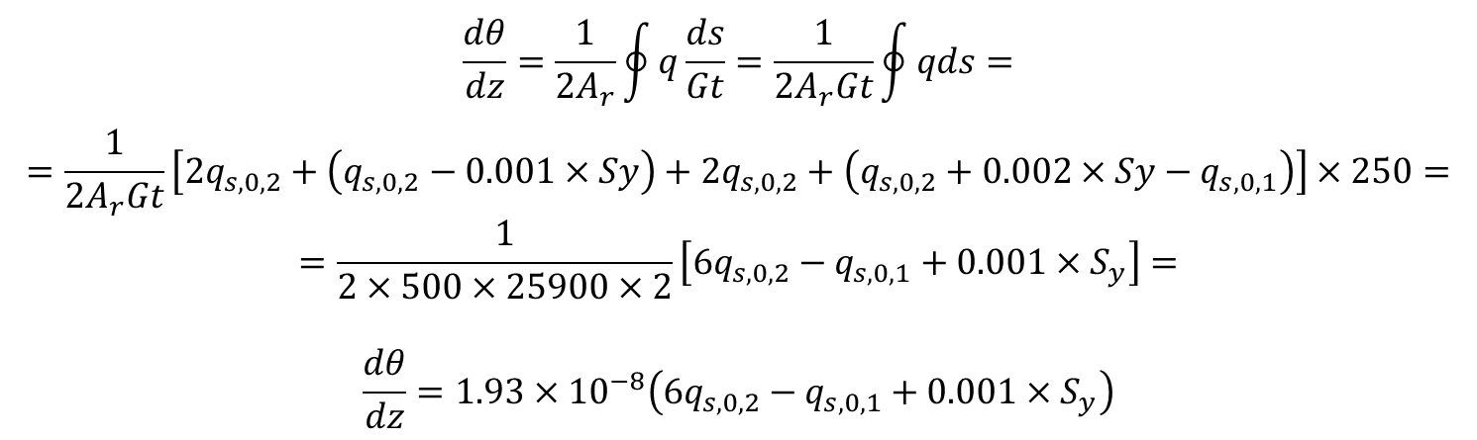
Passo 3.2: Contribuição do Cisalhamento
$$Segmento$$ | $$q_{b}=−\frac{S_{y} }{81.25e6}.\left(\sum_{r=1}^{n}{B_{r}y_{r}}\right)$$ | $$q_{s,0}$$
$$1−2$$ | $$0$$
$$2−3$$ | $$0$$
$$2−5$$ | $$−0.002×Sy$$
$$3−4$$ | $$−0.001×Sy$$
$$4−5$$ | $$0$$
$$5−6$$ | $$0$$
$$6−1$$ | $$0.001×S_{y}$$
a) Cálculo do Fluxo
Cálculo dos $q_{s,0,i}$
Análise da Célula II
$$\frac{dθ}{dz}=\frac{1}{2A_{r}}\oint{q\frac{ds}{Gt}}=\frac{1}{2A_{r}Gt}\oint{qds}=$$
$$=\frac{1}{2A_{r}Gt}\left[2q_{s,0,2}+\left(q_{s,0,2}−0.001×Sy\right)+2q_{s,0,2}+\left(q_{s,0,2}+0.002×Sy−q_{s,0,1}\right)\right]×250=$$
$$=\frac{1}{2×500×25900×2}\left[6q_{s,0,2}−q_{s,0,1}+0.001×S_{y}\right]=$$
$$\frac{dθ}{dz}=1.93×{10}^{−8}\left(6q_{s,0,2}−q_{s,0,1}+0.001×S_{y}\right)$$

Slide 10
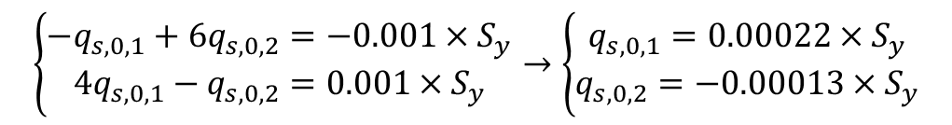
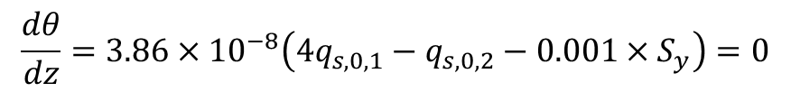
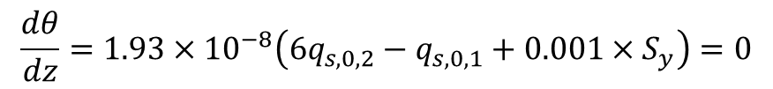
Passo 3.2: Contribuição do Cisalhamento
$$Segmento$$ | $$q_{b}=−\frac{S_{y} }{81.25e6}.\left(\sum_{r=1}^{n}{B_{r}y_{r}}\right)$$ | $$q_{s,0}$$
$$1−2$$ | $$0$$
$$2−3$$ | $$0$$
$$2−5$$ | $$−0.002×Sy$$
$$3−4$$ | $$−0.001×Sy$$
$$4−5$$ | $$0$$
$$5−6$$ | $$0$$
$$6−1$$ | $$0.001×S_{y}$$
a) Cálculo do Fluxo
Cálculo dos $q_{s,0,i}$
$$\frac{dθ}{dz}=1.93×{10}^{−8}\left(6q_{s,0,2}−q_{s,0,1}+0.001×S_{y}\right)=0$$
$$\frac{dθ}{dz}=3.86×{10}^{−8}\left(4q_{s,0,1}−q_{s,0,2}−0.001×S_{y}\right)=0$$
$$\left\{\begin{aligned}−q_{s,0,1}+6q_{s,0,2}=−0.001×S_{y} \\ 4q_{s,0,1}−q_{s,0,2}=0.001×S_{y}\end{aligned}\right.→\left\{\begin{aligned}q_{s,0,1}=0.00022×S_{y} \\ q_{s,0,2}=−0.00013×S_{y}\end{aligned}\right.$$

Slide 11
Passo 3.2: Contribuição do Cisalhamento
$$Segmento$$ | $$q_{b}=−\frac{S_{y} }{81.25e6}.\left(\sum_{r=1}^{n}{B_{r}y_{r}}\right)$$ | $$q_{s,0}$$
$$1−2$$ | $$0$$
$$2−3$$ | $$0$$
$$2−5$$ | $$−0.002×Sy$$
$$3−4$$ | $$−0.001×Sy$$
$$4−5$$ | $$0$$
$$5−6$$ | $$0$$
$$6−1$$ | $$0.001×S_{y}$$
a) Cálculo do Fluxo
Cálculo dos $q_{s,0,i}$
$$\frac{dθ}{dz}=1.93×{10}^{−8}\left(6q_{s,0,2}−q_{s,0,1}+0.001×S_{y}\right)=0$$
$$\frac{dθ}{dz}=3.86×{10}^{−8}\left(4q_{s,0,1}−q_{s,0,2}−0.001×S_{y}\right)=0$$
$$\left\{\begin{aligned}−q_{s,0,1}+6q_{s,0,2}=−0.001×S_{y} \\ 4q_{s,0,1}−q_{s,0,2}=0.001×S_{y}\end{aligned}\right.→\left\{\begin{aligned}q_{s,0,1}=0.00022×S_{y} \\ q_{s,0,2}=−0.00013×S_{y}\end{aligned}\right.$$

Slide 12
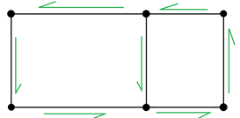
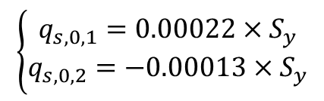
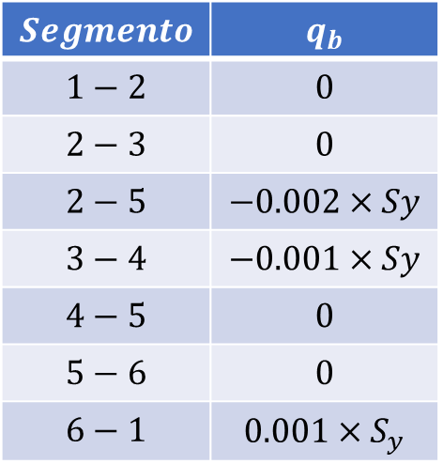
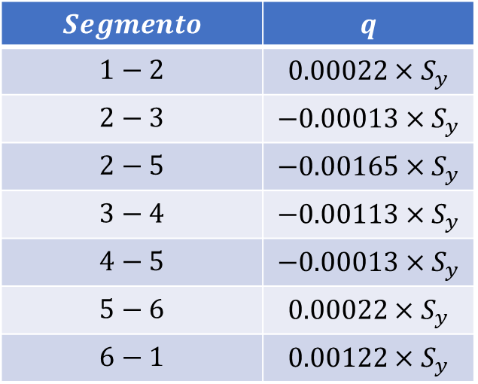
Passo 3.2: Contribuição do Cisalhamento
$$Segmento$$ | $$q_{b}$$
$$1−2$$ | $$0$$
$$2−3$$ | $$0$$
$$2−5$$ | $$−0.002×Sy$$
$$3−4$$ | $$−0.001×Sy$$
$$4−5$$ | $$0$$
$$5−6$$ | $$0$$
$$6−1$$ | $$0.001×S_{y}$$
b) Cálculo do Fluxo Total
$$\left\{\begin{aligned}q_{s,0,1}=0.00022×S_{y} \\ q_{s,0,2}=−0.00013×S_{y}\end{aligned}\right.$$
$$Segmento$$ | $$q$$
$$1−2$$ | $$0.00022×S_{y}$$
$$2−3$$ | $$−0.00013×S_{y}$$
$$2−5$$ | $$−0.00165×S_{y}$$
$$3−4$$ | $$−0.00113×S_{y}$$
$$4−5$$ | $$−0.00013×S_{y}$$
$$5−6$$ | $$0.00022×S_{y}$$
$$6−1$$ | $$0.00122×S_{y}$$

Slide 13
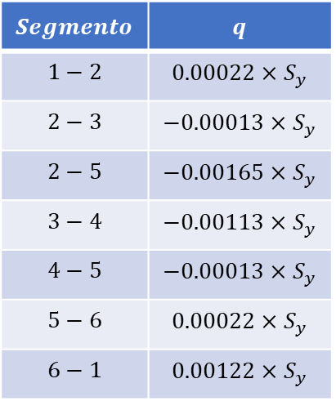
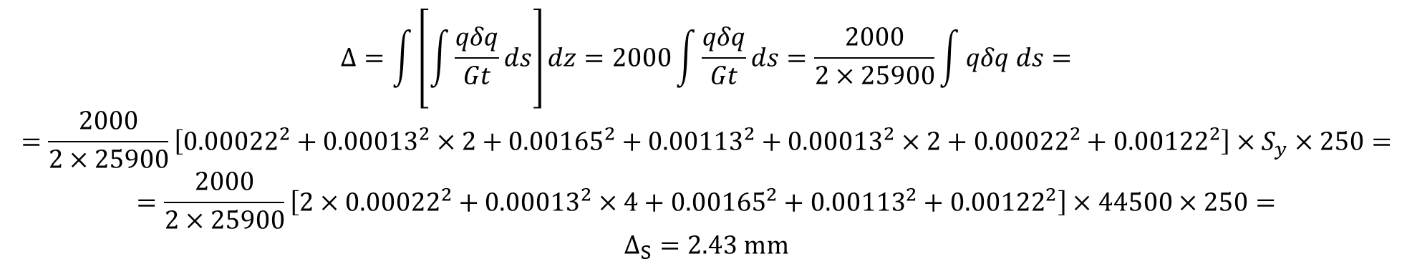
Passo 3.2: Contribuição do Cisalhamento
$$Segmento$$ | $$q$$
$$1−2$$ | $$0.00022×S_{y}$$
$$2−3$$ | $$−0.00013×S_{y}$$
$$2−5$$ | $$−0.00165×S_{y}$$
$$3−4$$ | $$−0.00113×S_{y}$$
$$4−5$$ | $$−0.00013×S_{y}$$
$$5−6$$ | $$0.00022×S_{y}$$
$$6−1$$ | $$0.00122×S_{y}$$
c) Cálculo do Deslocamento
$$Δ=\int{\left[\int{\frac{qδq}{Gt}ds}\right]dz}=2000\int{\frac{qδq}{Gt}ds}=\frac{2000}{2×25900}\int{qδq ds}=$$
$$=\frac{2000}{2×25900}\left[{0.00022}^{2}+{0.00013}^{2}×2+{0.00165}^{2}+{0.00113}^{2}+{0.00013}^{2}×2+{0.00022}^{2}+{0.00122}^{2}\right]×S_{y}×250=$$
$$=\frac{2000}{2×25900}\left[2×{0.00022}^{2}+{0.00013}^{2}×4+{0.00165}^{2}+{0.00113}^{2}+{0.00122}^{2}\right]×44500×250=$$
$$Δ_{S}=2.43 mm$$

Slide 14

Passo 4: Resultado Final
$$Δ=21.17+2.43=23.6 mm$$

Slide 15
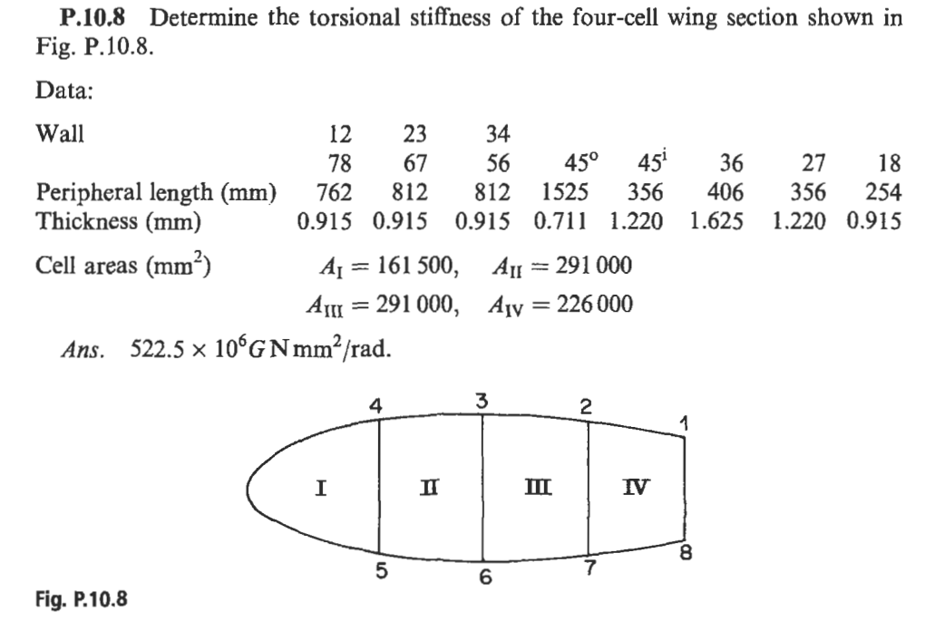

Slide 16
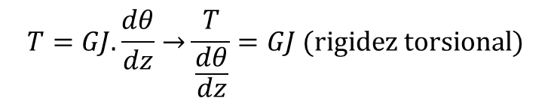
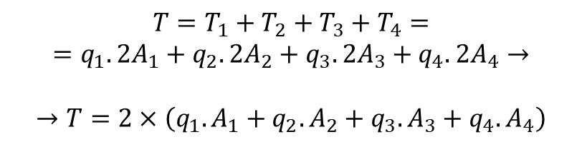
$$T=GJ.\frac{dθ}{dz}→\frac{T}{\frac{dθ}{dz}}=GJ (rigidez torsional)$$
Passo 1: Análise da Carga
$$T=T_{1}+T_{2}+T_{3}+T_{4}=$$
$$=q_{1}.2A_{1}+q_{2}.2A_{2}+q_{3}.2A_{3}+q_{4}.2A_{4}→$$
$$→T=2×\left(q_{1}.A_{1}+q_{2}.A_{2}+q_{3}.A_{3}+q_{4}.A_{4}\right)$$

Slide 17
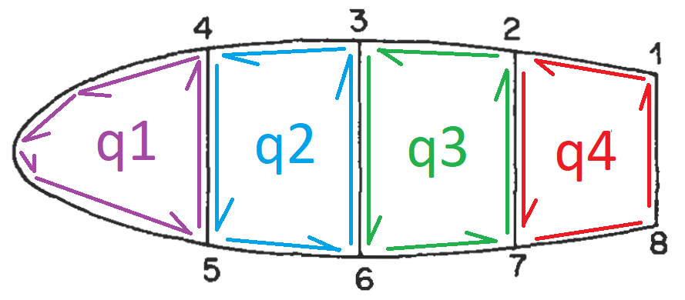

Passo 2: Análise de compatibilidade de deslocamento
Célula I
$$\frac{dθ}{dz}=\frac{1}{2A_{r}}\oint{q\frac{ds}{Gt}}=\frac{1}{2A_{r}G}\oint{\frac{q}{t}ds}=\frac{1}{2A_{1}G}\left[q_{1}×\frac{1525}{0.711}+\left(q_{1}−q_{2}\right)×\frac{356}{1.22}\right]=$$
$$=\frac{1}{2×161500×G}\left[q_{1}×\left(\frac{1525}{0.711}+\frac{356}{1.22}\right)−q_{2}×\frac{356}{1.22}\right]=$$
$$\frac{dθ}{dz}=\left[{75.4 q}_{1}−9.03 q_{2}\right]×\frac{{10}^{−4}}{G}$$

Slide 18
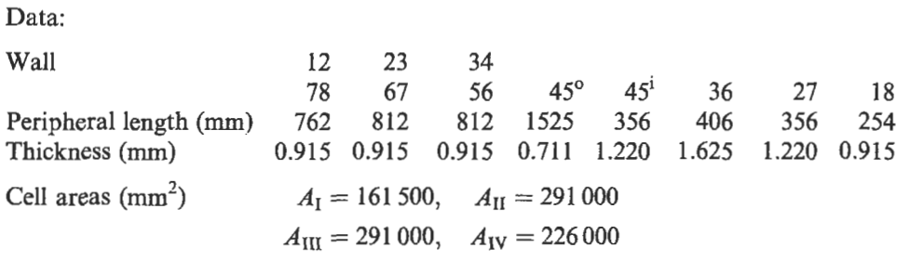
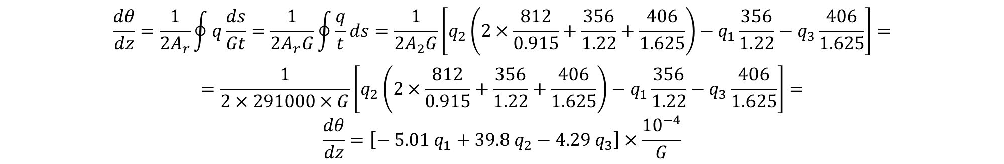
Passo 2: Análise de compatibilidade de deslocamento
Célula II
$$\frac{dθ}{dz}=\frac{1}{2A_{r}}\oint{q\frac{ds}{Gt}}=\frac{1}{2A_{r}G}\oint{\frac{q}{t}ds}=\frac{1}{2A_{2}G}\left[q_{2}\left(2×\frac{812}{0.915}+\frac{356}{1.22}+\frac{406}{1.625}\right)−q_{1}\frac{356}{1.22}−q_{3}\frac{406}{1.625}\right]=$$
$$=\frac{1}{2×291000×G}\left[q_{2}\left(2×\frac{812}{0.915}+\frac{356}{1.22}+\frac{406}{1.625}\right)−q_{1}\frac{356}{1.22}−q_{3}\frac{406}{1.625}\right]=$$
$$\frac{dθ}{dz}=\left[{− 5.01 q}_{1}+{39.8 q}_{2}−4.29 q_{3}\right]×\frac{{10}^{−4}}{G}$$

Slide 19
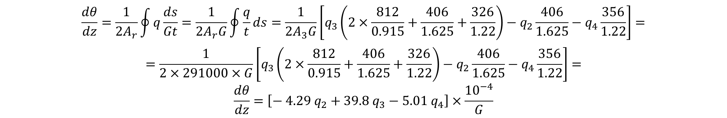
Passo 2: Análise de compatibilidade de deslocamento
Célula III
$$\frac{dθ}{dz}=\frac{1}{2A_{r}}\oint{q\frac{ds}{Gt}}=\frac{1}{2A_{r}G}\oint{\frac{q}{t}ds}=\frac{1}{2A_{3}G}\left[q_{3}\left(2×\frac{812}{0.915}+\frac{406}{1.625}+\frac{326}{1.22}\right)−q_{2}\frac{406}{1.625}−q_{4}\frac{356}{1.22}\right]=$$
$$=\frac{1}{2×291000×G}\left[q_{3}\left(2×\frac{812}{0.915}+\frac{406}{1.625}+\frac{326}{1.22}\right)−q_{2}\frac{406}{1.625}−q_{4}\frac{356}{1.22}\right]=$$
$$\frac{dθ}{dz}=\left[{− 4.29 q}_{2}+{39.8 q}_{3}−5.01 q_{4}\right]×\frac{{10}^{−4}}{G}$$

Slide 20

Passo 2: Análise de compatibilidade de deslocamento
Célula IV
$$\frac{dθ}{dz}=\frac{1}{2A_{r}}\oint{q\frac{ds}{Gt}}=\frac{1}{2A_{r}G}\oint{\frac{q}{t}ds}=\frac{1}{2A_{4}G}\left[q_{4}\left(2×\frac{762}{0.915}+\frac{254}{0.915}+\frac{326}{1.22}\right)−q_{3}\frac{356}{1.22}\right]=$$
$$=\frac{1}{2×226000×G}\left[q_{4}\left(2×\frac{762}{0.915}+\frac{254}{0.915}+\frac{326}{1.22}\right)−q_{3}\frac{356}{1.22}\right]=$$
$$\frac{dθ}{dz}=\left[−6.45 q_{3}+49.4 q_{4}\right]×\frac{{10}^{−4}}{G}$$

Slide 21

Passo 3: Sistema de Equações
$$\left\{\begin{aligned}T=2×\left(q_{1}.A_{1}+q_{2}.A_{2}+q_{3}.A_{3}+q_{4}.A_{4}\right) \\ \frac{dθ}{dz}=\left[{75.4 q}_{1}−9.03 q_{2}\right]×\frac{{10}^{−4}}{G} \\ \frac{dθ}{dz}=\left[{− 5.01 q}_{1}+{39.8 q}_{2}−4.29 q_{3}\right]×\frac{{10}^{−4}}{G} \\ \frac{dθ}{dz}=\left[{− 4.29 q}_{2}+{39.8 q}_{3}−5.01 q_{4}\right]×\frac{{10}^{−4}}{G} \\ \frac{dθ}{dz}=\left[−6.45 q_{3}+49.4 q_{4}\right]×\frac{{10}^{−4}}{G}\end{aligned}\right.→\left\{\begin{aligned}{75.4 q}_{1}−9.03 q_{2}={− 5.01 q}_{1}+{39.8 q}_{2}−4.29 q_{3} \\ {75.4 q}_{1}−9.03 q_{2}={− 4.29 q}_{2}+{39.8 q}_{3}−5.01 q_{4} \\ {75.4 q}_{1}−9.03 q_{2}=−6.45 q_{3}+49.4 q_{4}\end{aligned}\right.$$

Slide 22

Passo 3: Sistema de Equações
$$\left\{\begin{aligned}{75.4 q}_{1}−9.03 q_{2}={− 5.01 q}_{1}+{39.8 q}_{2}−4.29 q_{3} \\ {75.4 q}_{1}−9.03 q_{2}={− 4.29 q}_{2}+{39.8 q}_{3}−5.01 q_{4} \\ {75.4 q}_{1}−9.03 q_{2}=−6.45 q_{3}+49.4 q_{4}\end{aligned}\right.→\left\{\begin{aligned}{80.41 q}_{1}−48.83 q_{2}+4.29 q_{3}=0 \\ {75.4 q}_{1}−4.74 q_{2} −{39.8 q}_{3}=−5.01 q_{4} \\ {75.4 q}_{1}−9.03 q_{2}+6.45 q_{3}=49.4 q_{4}\end{aligned}\right.→$$
$$→\left\{\begin{aligned}{80.41 q}_{1}−48.83 q_{2}+4.29 q_{3}=0 \\ {75.4 q}_{1}−4.74 q_{2} −{39.8 q}_{3}=−5.01 q_{4} \\ {75.4 q}_{1}−9.03 q_{2}+6.45 q_{3}=49.4 q_{4}\end{aligned}\right.→\left\{\begin{aligned}q_{1}=0.695 q_{4} \\ q_{2}=1.260 q_{4} \\ q_{3}=1.290q_{4}\end{aligned}\right.$$
$$\left\{\begin{aligned}T=2×\left(q_{1}.A_{1}+q_{2}.A_{2}+q_{3}.A_{3}+q_{4}.A_{4}\right) \\ \frac{dθ}{dz}=\left[−6.45 q_{3}+49.4 q_{4}\right]×\frac{{10}^{−4}}{G}\end{aligned}\right.→\left\{\begin{aligned}T=2×\left[0.695×161500+\left(1.26+1.29\right)×291000+226000\right]q_{4} \\ \frac{dθ}{dz}=\frac{{41.07×10}^{−4}}{G}q_{4}\end{aligned}\right.$$

Slide 23

Passo 3: Sistema de Equações
$$\left\{\begin{aligned}T=2×\left(q_{1}.A_{1}+q_{2}.A_{2}+q_{3}.A_{3}+q_{4}.A_{4}\right) \\ \frac{dθ}{dz}=\left[−6.45 q_{3}+49.4 q_{4}\right]×\frac{{10}^{−4}}{G}\end{aligned}\right.→\left\{\begin{aligned}T=2×\left[0.695×161500+\left(1.26+1.29\right)×291000+226000\right]q_{4} \\ \frac{dθ}{dz}=\frac{{41.07×10}^{−4}}{G}q_{4}\end{aligned}\right.$$
$$\left\{\begin{aligned}T=2160585q_{4} \\ \frac{dθ}{dz}=\frac{{41.07×10}^{−4}}{G}q_{4}\end{aligned}\right.→\frac{T}{\frac{dθ}{dz}}=\frac{2160585}{{41.07×10}^{−4}}G=526.08×{10}^{6} G N\frac{mm^{2}}{rad}→$$
$$→GJ=526.08×{10}^{6} G N\frac{mm^{2}}{rad}$$

