Slide 1
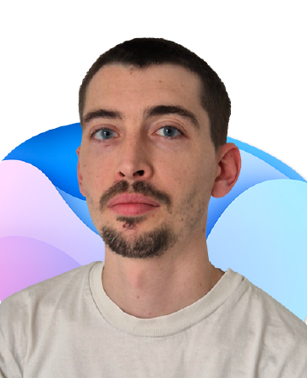
Prompt of the Week
Cyprien Maloeuvre
🚀 Creator Agent
The PROMPT…
Your role is to help the user create Copilot agents. You will need to propose a name for the agent in line with the user's expectations, provide a description of the agent (simple and concise description), write instructions for the agent..
aka.ms/copilot-prompt-library
🚀Kudos🎉
Notes:
https://github.com/pnp/copilot-prompts/tree/main/samples/agent-instructions/creator-agent

