Slide 1
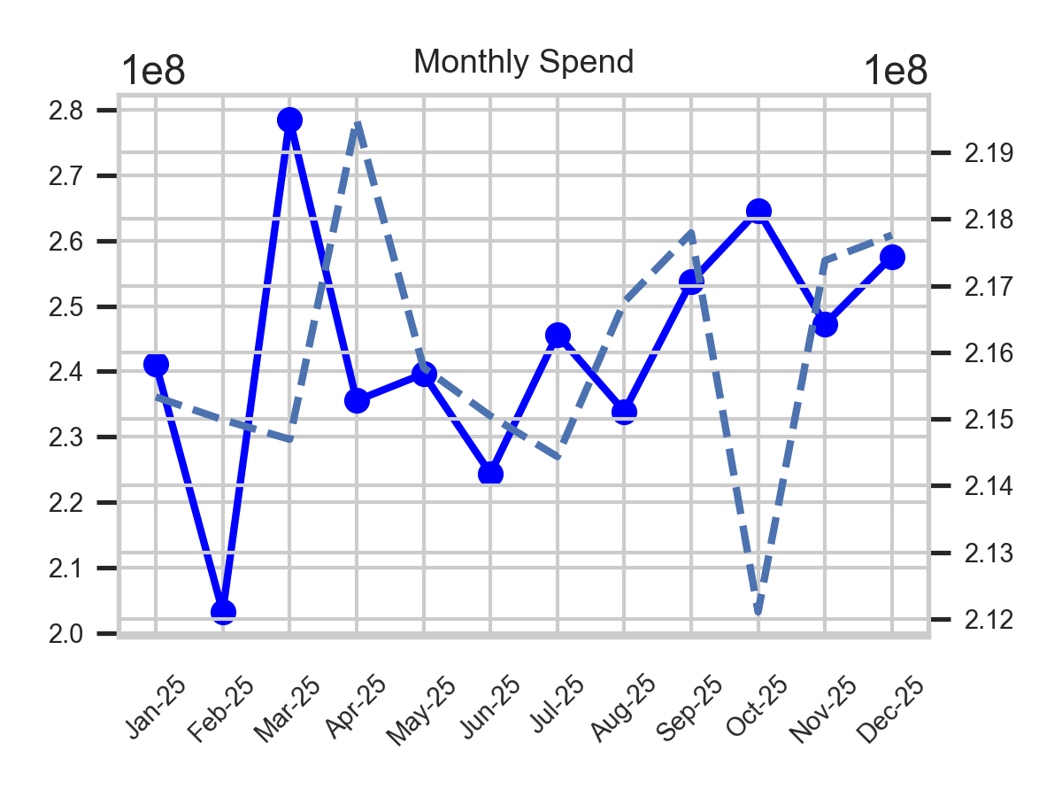
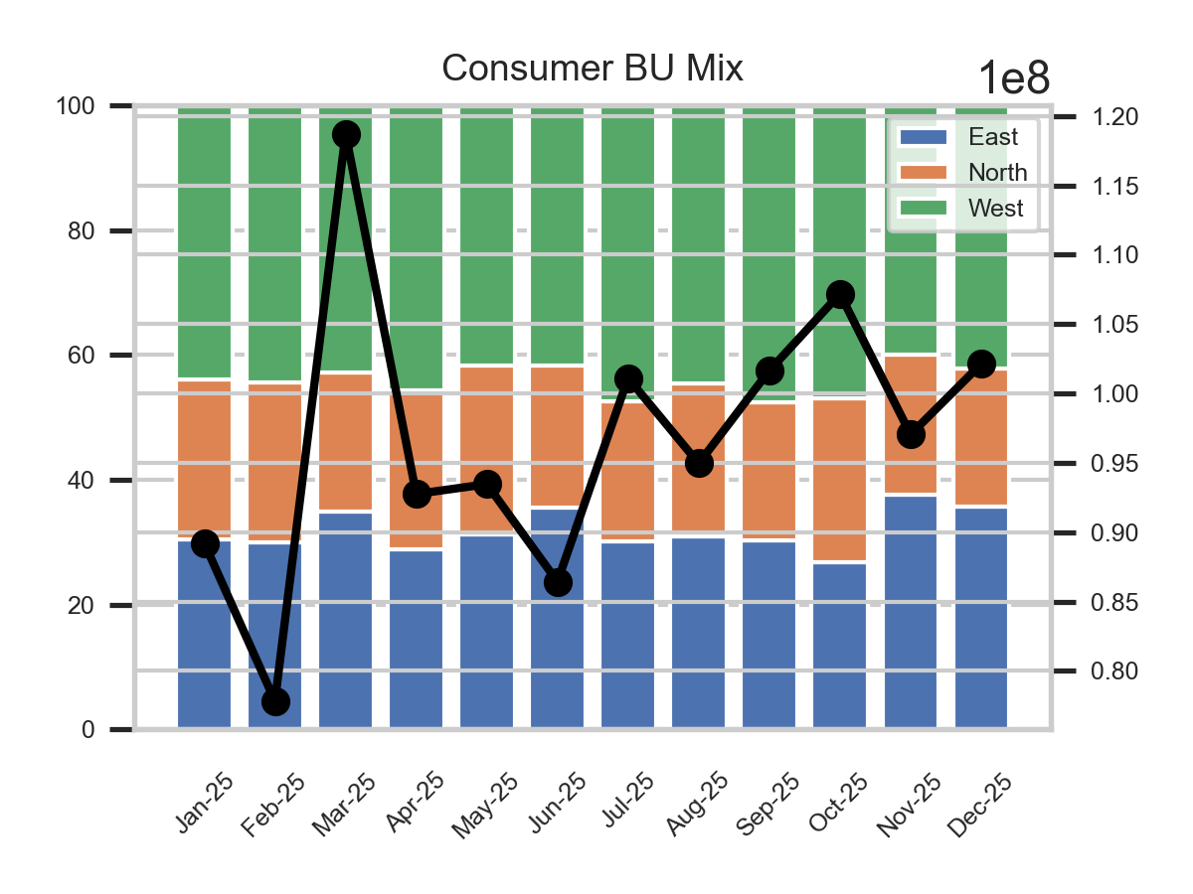
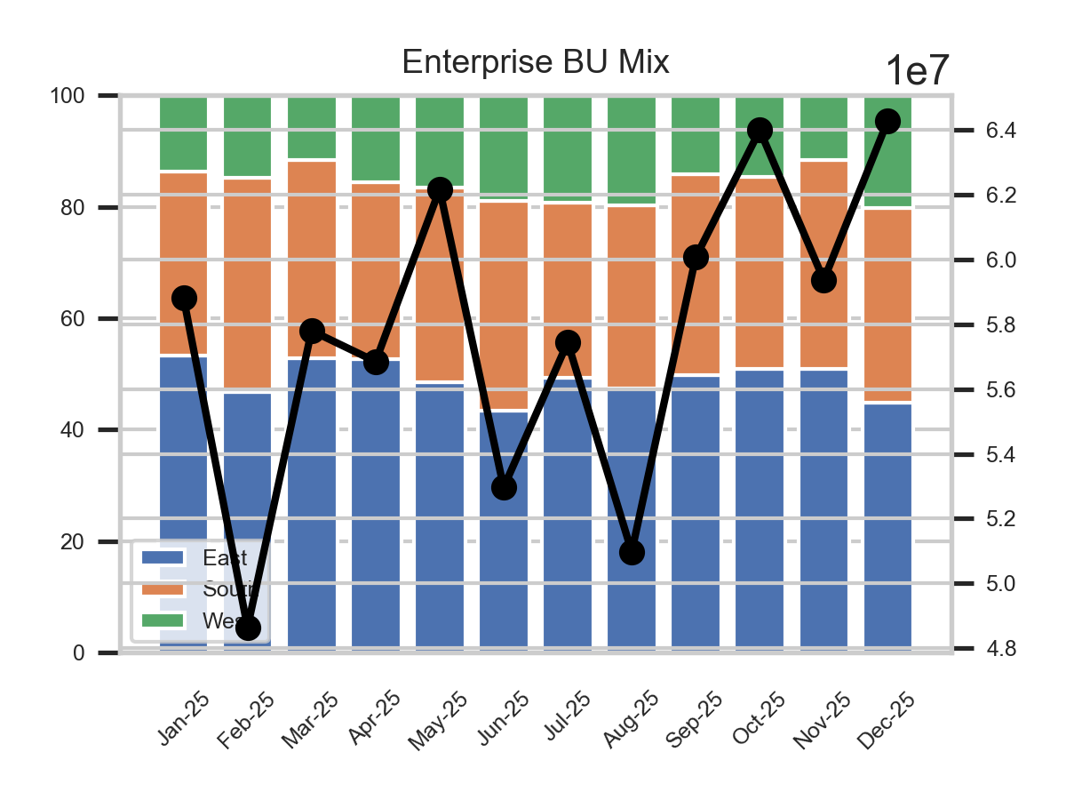
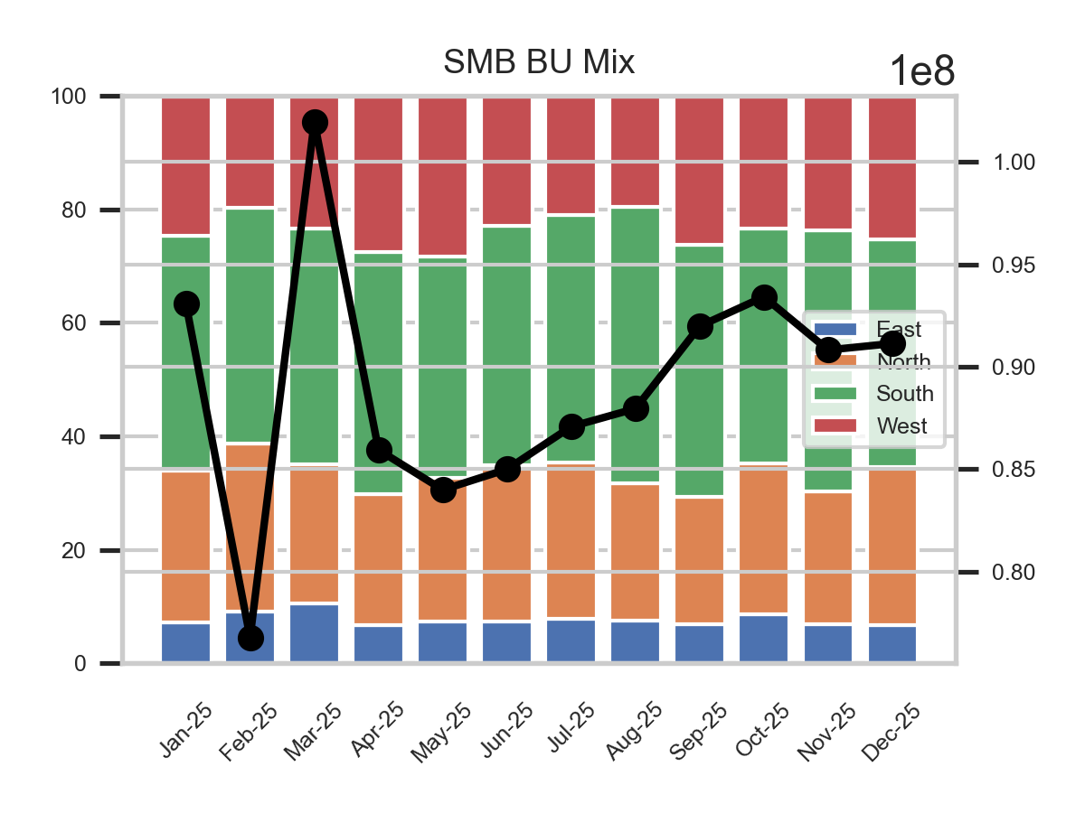
• Spend increased by 4.17% in December 2025, driven mainly by the Consumer and Enterprise units with Consumer spend rising to $102M and Enterprise to $64.3M. Consumer region mix shifted with East region share at 35.6%, indicating higher activity there compared to prior month.
• SMB spend remained flat at $91.1M but showed a regional shift with North region increasing to 27.85% and South declining to 40.16%, suggesting potential focus areas for cost control. Recommend investigating specific drivers behind Consumer and Enterprise spend growth, particularly East and West regions.

Slide 2
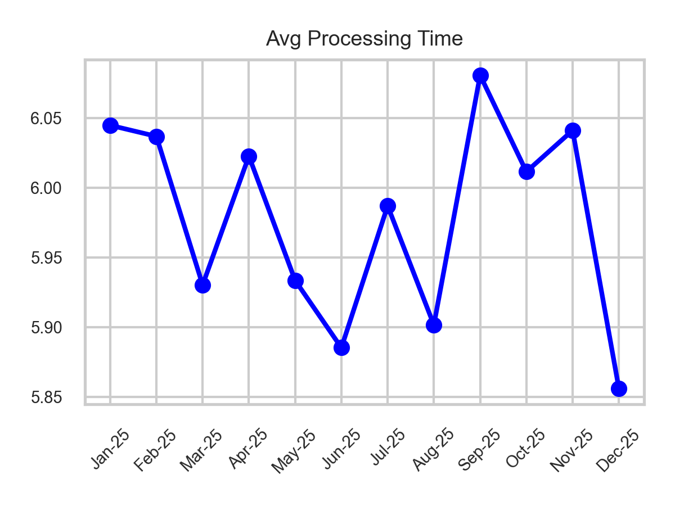
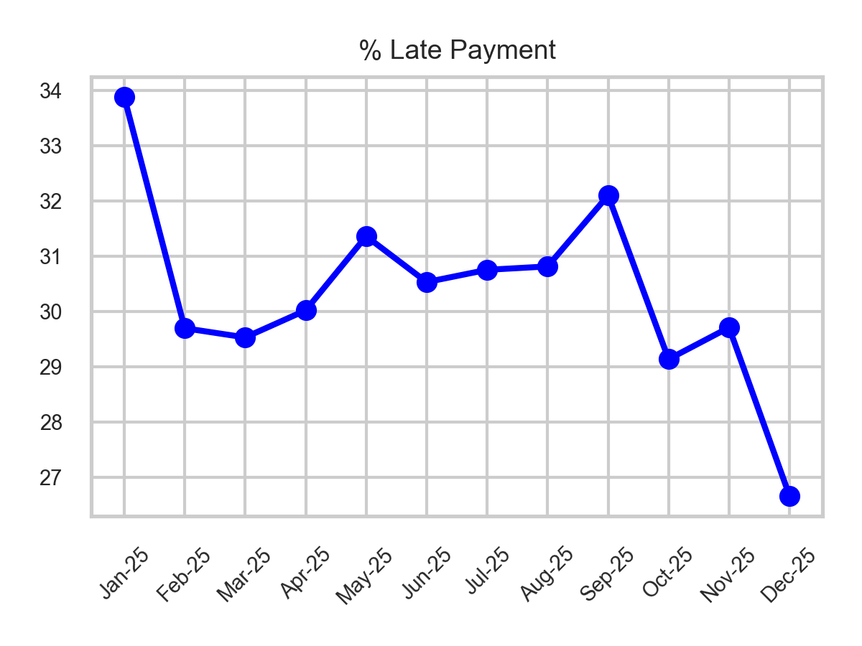
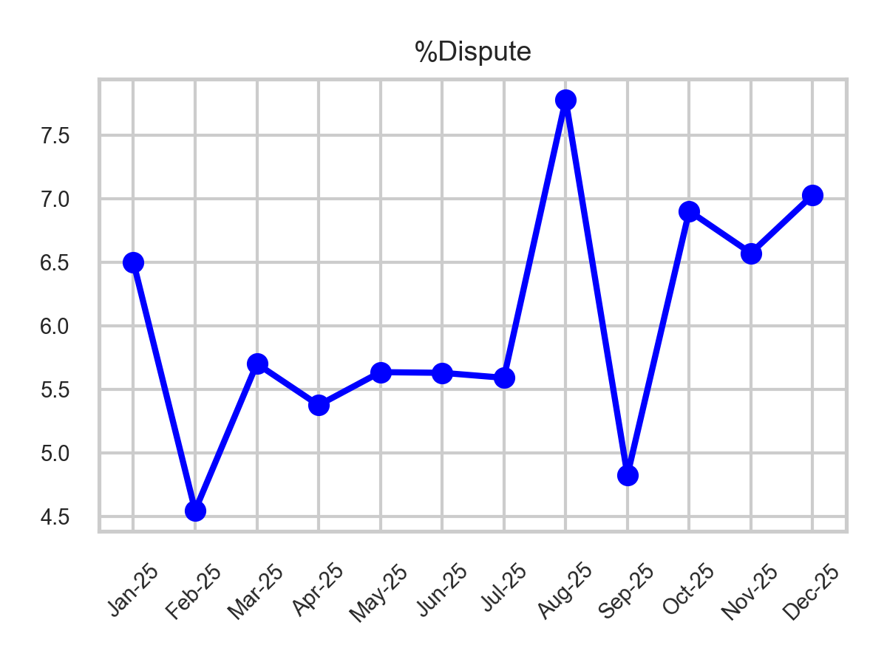
• Processing time improved by 3.07%, indicating enhanced operational efficiency; late payment percentage dropped significantly to 26.66%, the lowest in the year, which can reduce financial carrying costs.
• Dispute rate worsened slightly to 7.03%, signaling potential issues with invoice accuracy or vendor disagreements. Recommend focusing on dispute root causes to sustain efficiency gains and further reduce late payments.

Slide 3
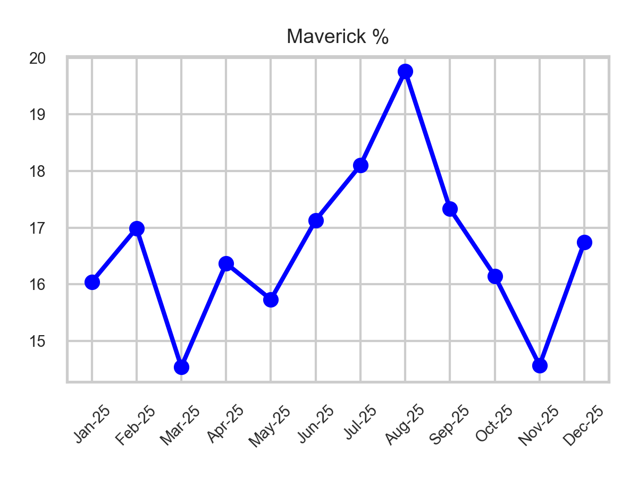
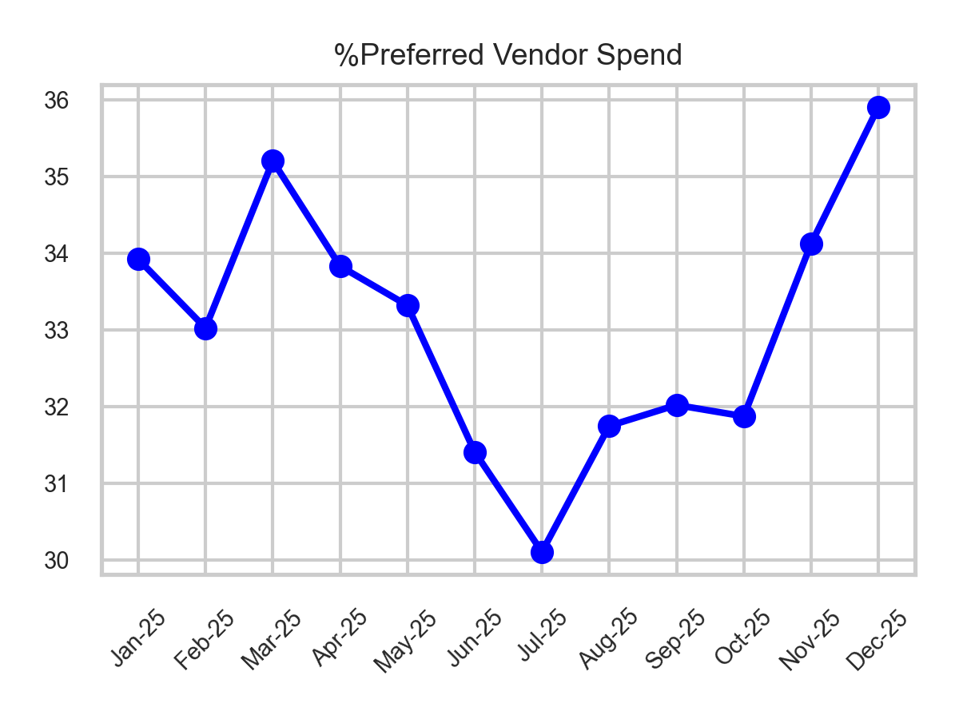
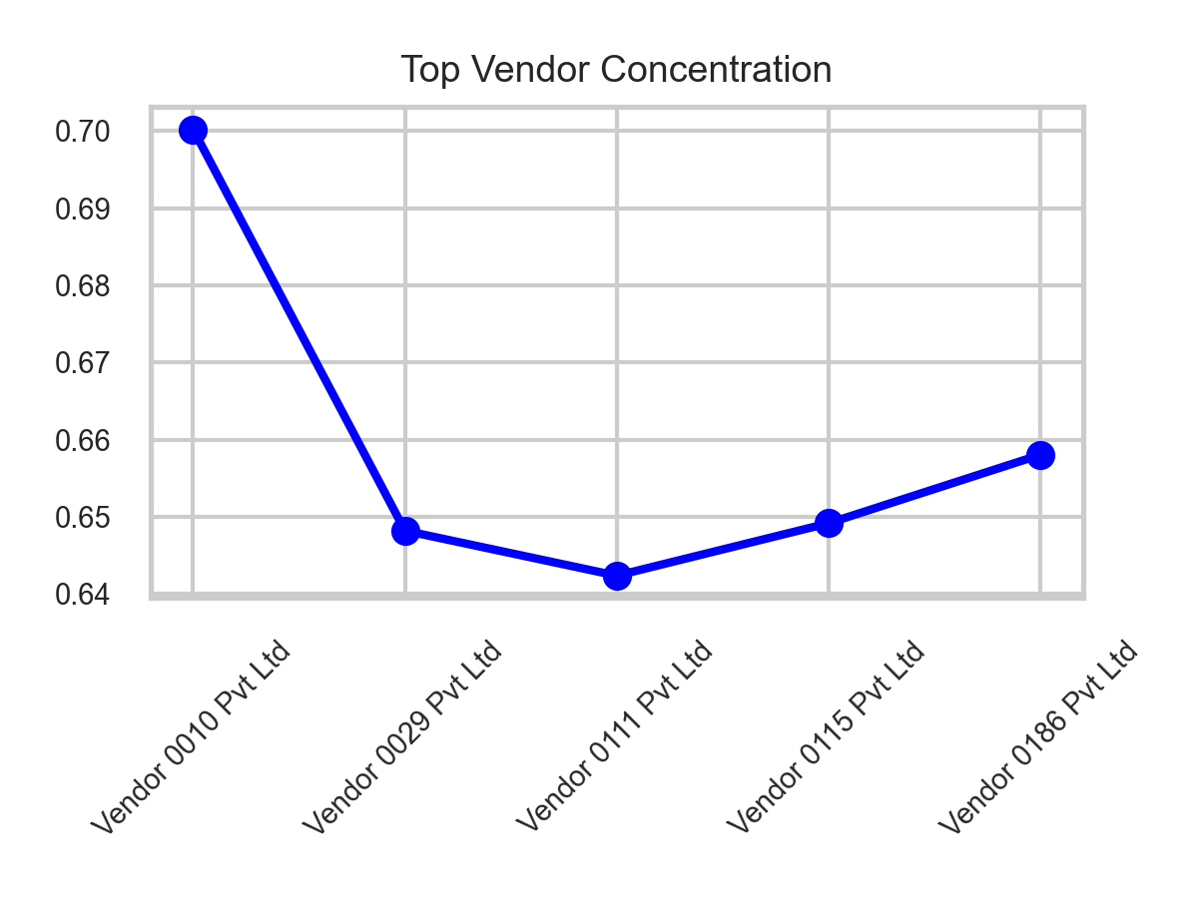
• Maverick spend rose sharply by 14.94%, pointing to increased off-contract or unmanaged supplier usage; vendor risk remained stable around 27.66%, showing no immediate heightened risk level.
• High vendor concentration remains with top 5 vendors each having over 64% concentration, indicating potential single supplier dependencies. Recommend reviewing maverick spend categories and mitigating vendor concentration risks by diversifying suppliers.

Slide 4
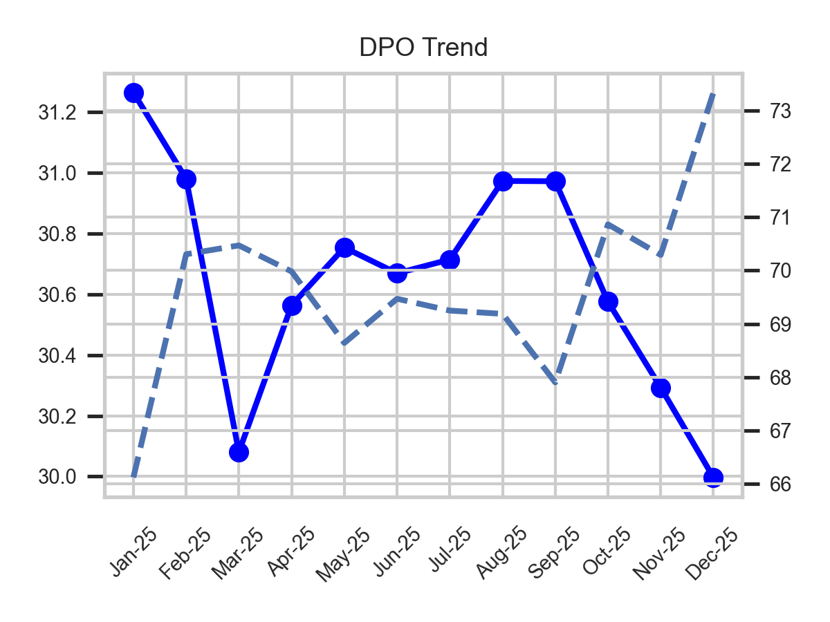

Slide 5
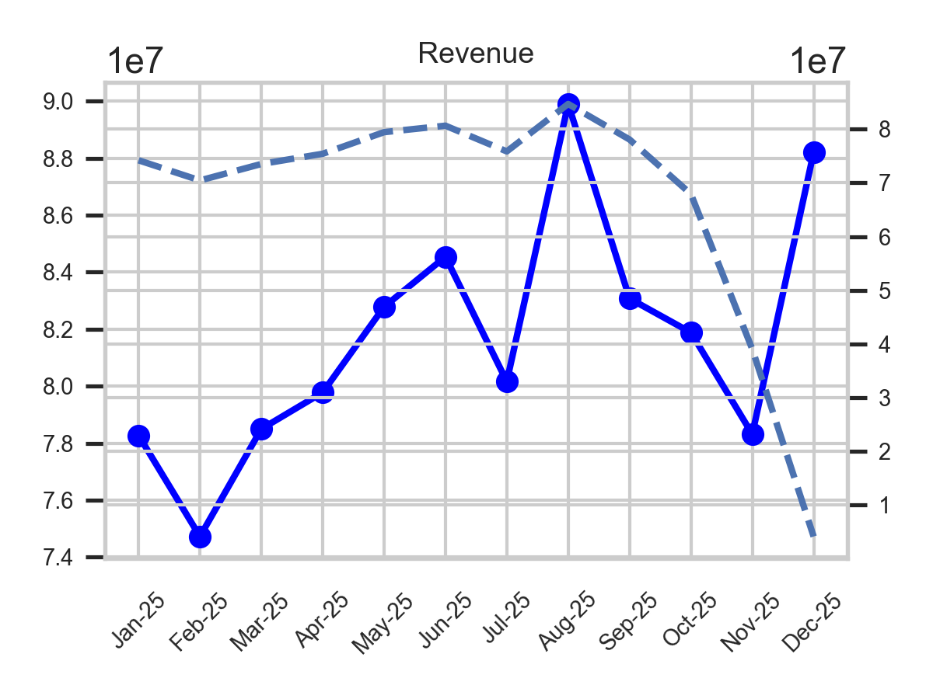

Slide 6
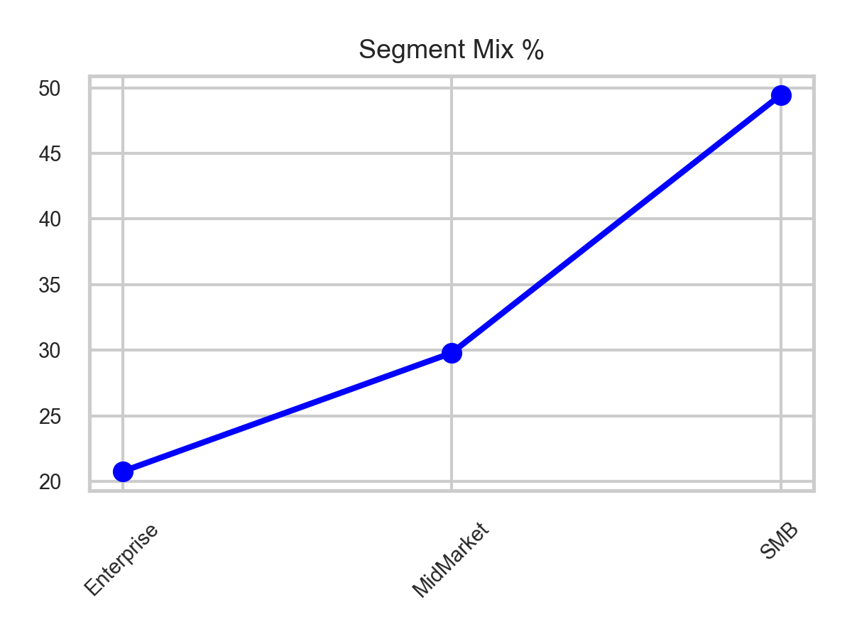

Slide 7
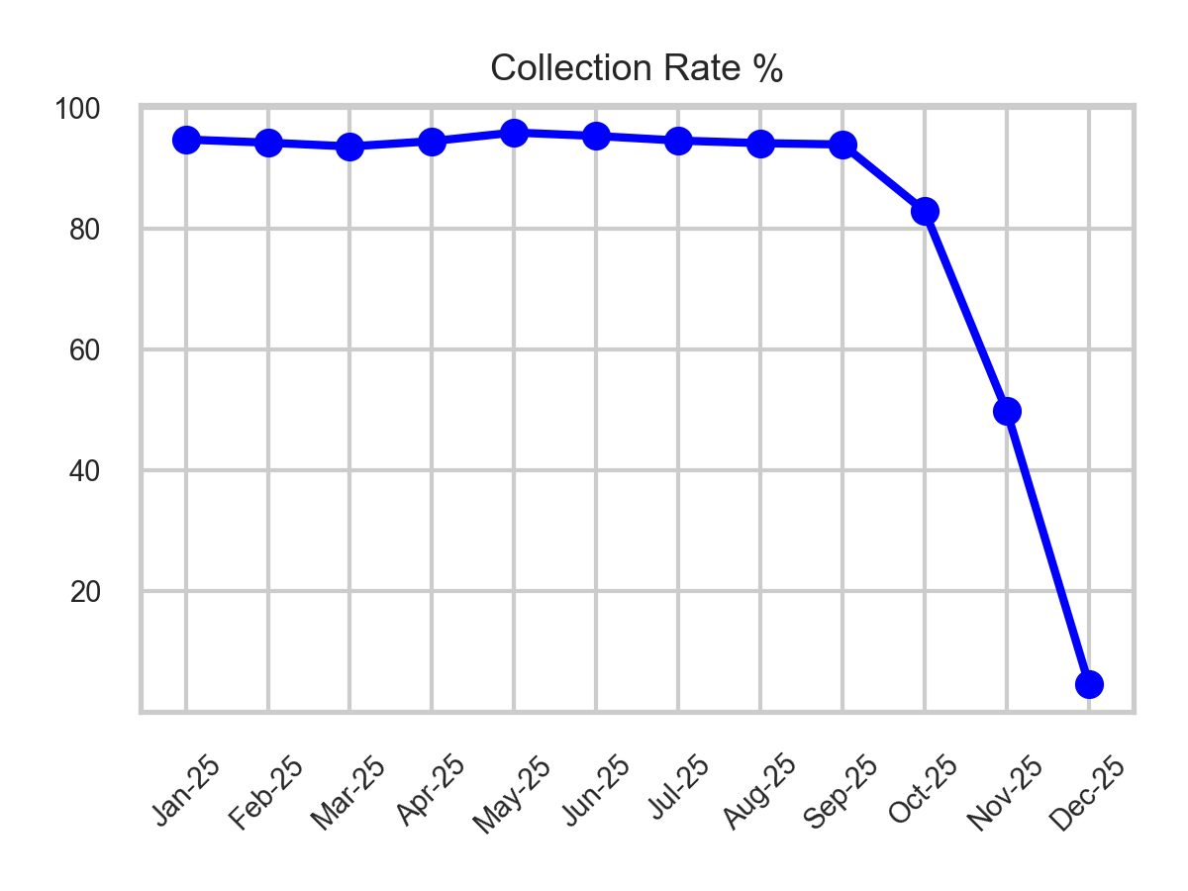

Slide 8
• December 2025 reflects a mixed AP and AR performance with spend growth and operational efficiencies in AP tempered by rising maverick spend and vendor concentration risks. Conversely, AR shows strong revenue gains overshadowed by a critical collapse in collections necessitating urgent remediation.
• Recommended focus areas include detailed analysis of Consumer and Enterprise spend drivers, aggressive containment of maverick and vendor concentration risk in AP, and immediate enhancement of AR collection practices to prevent cash flow disruptions while leveraging improved payment timeliness.

