Slide 1
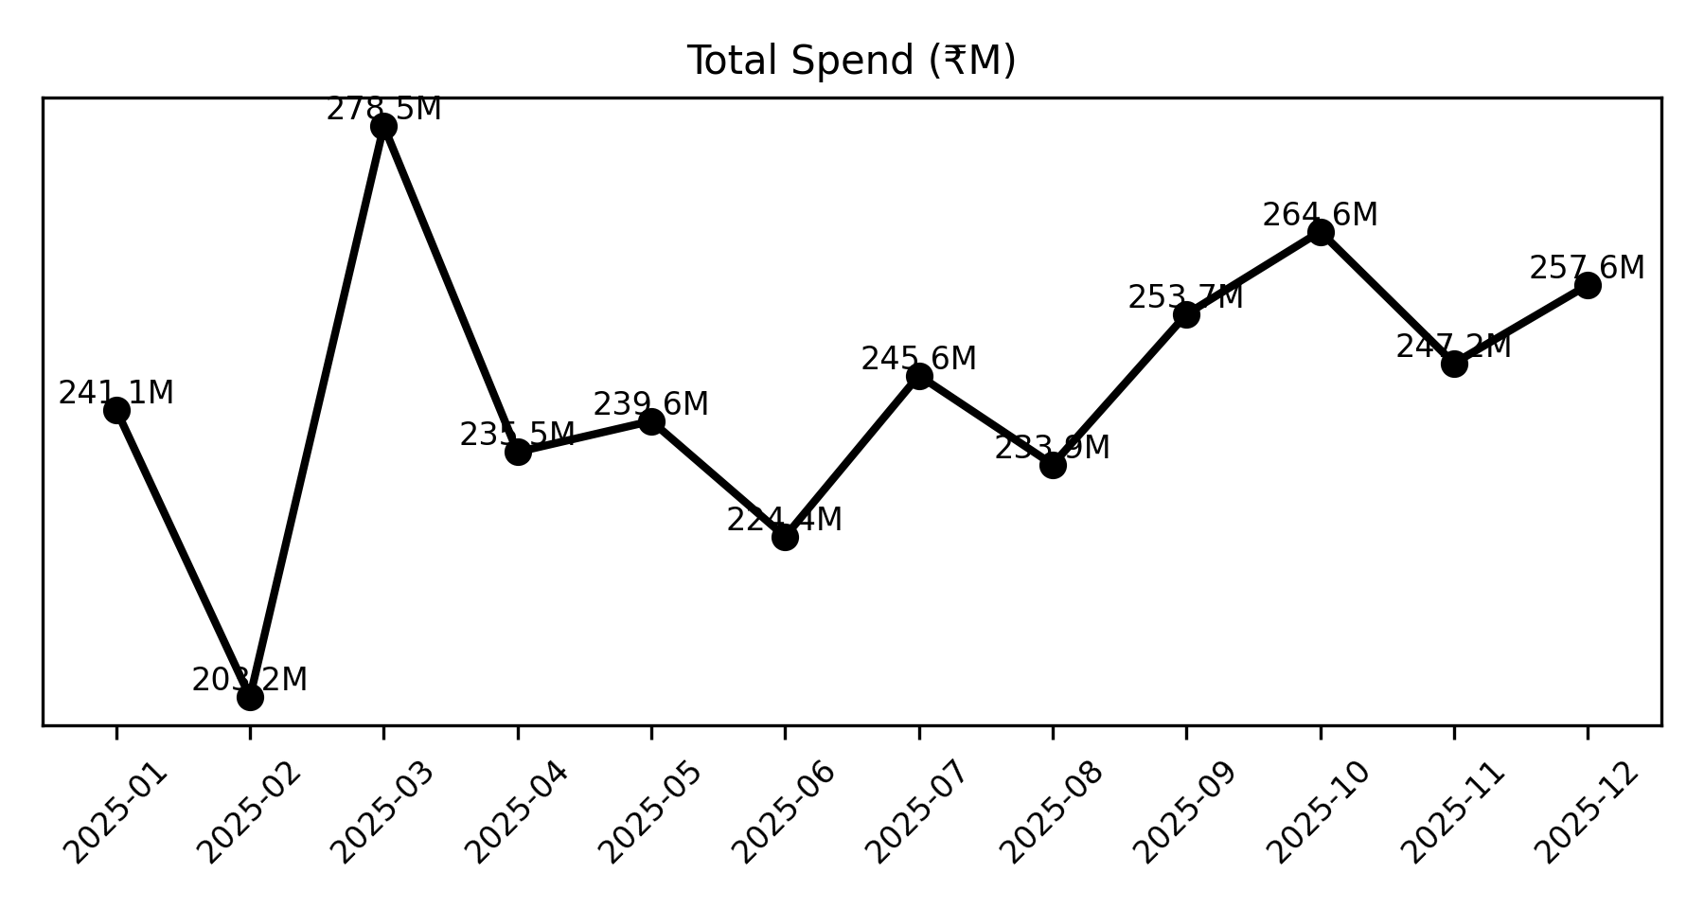
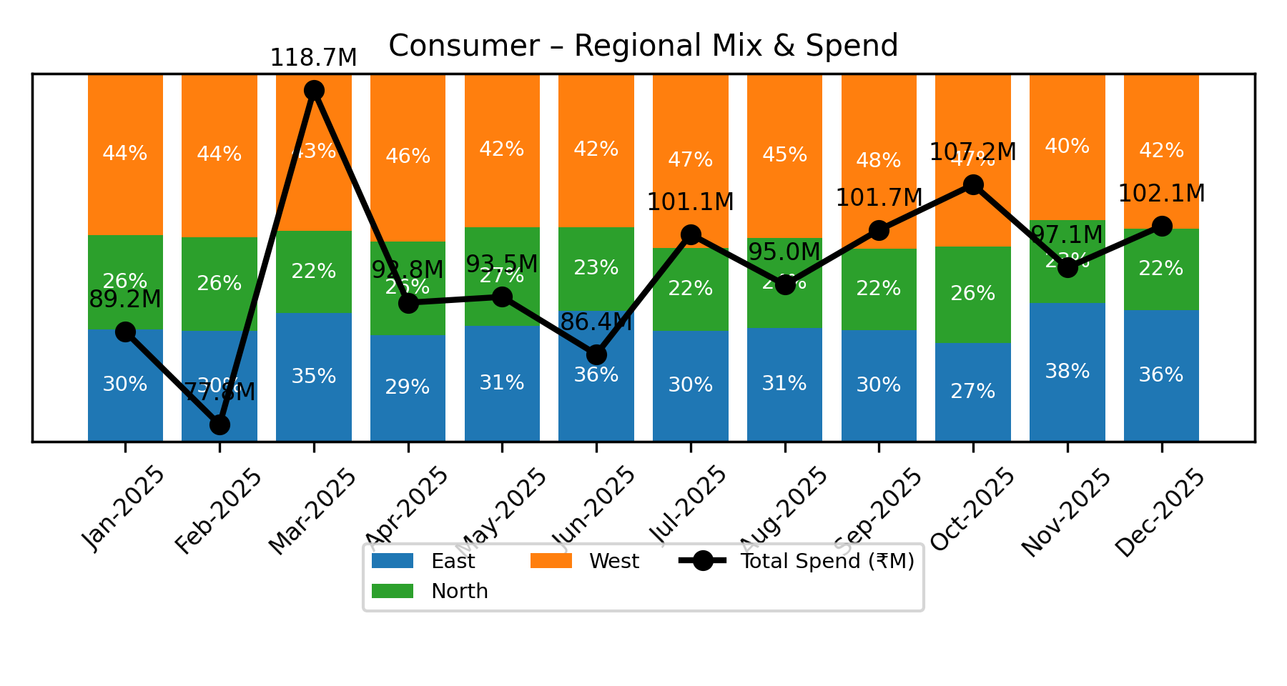
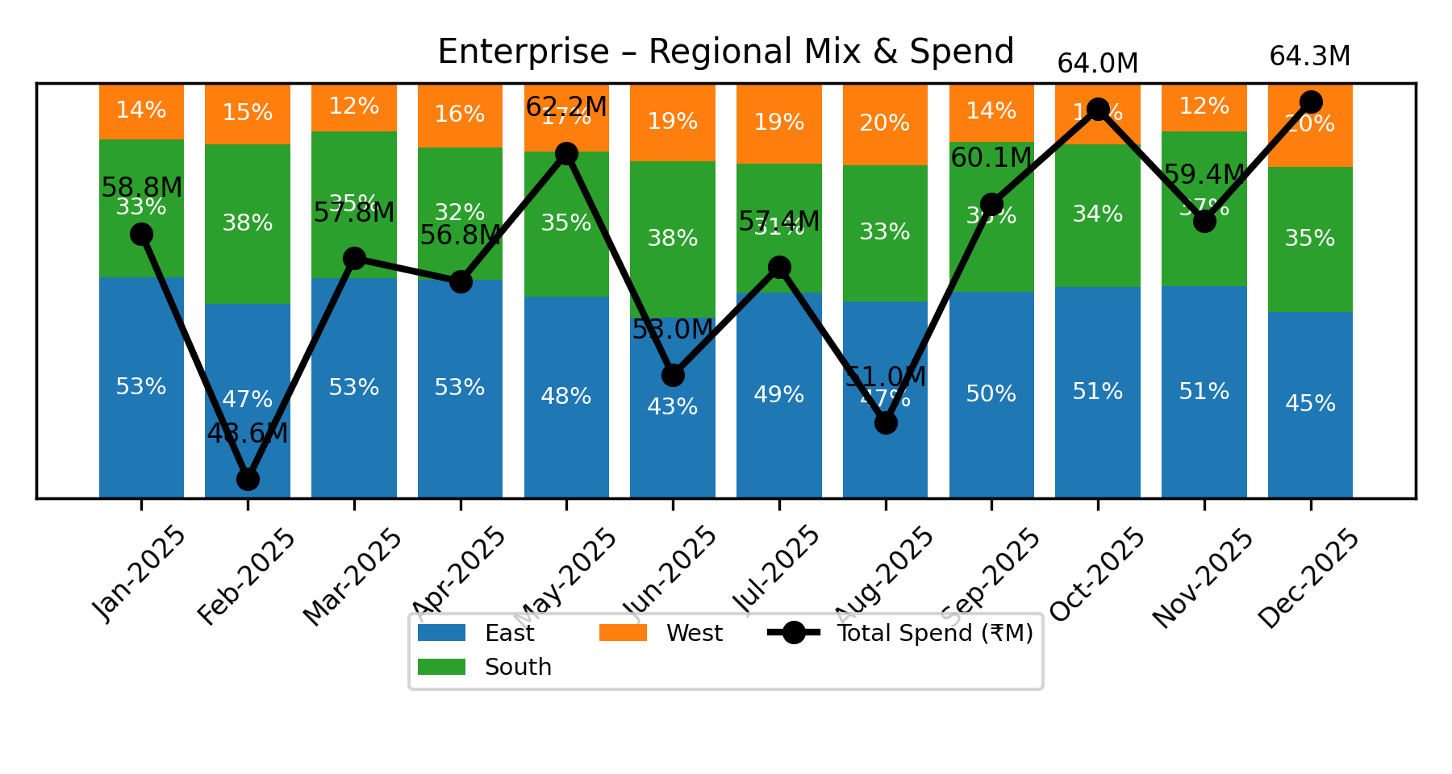
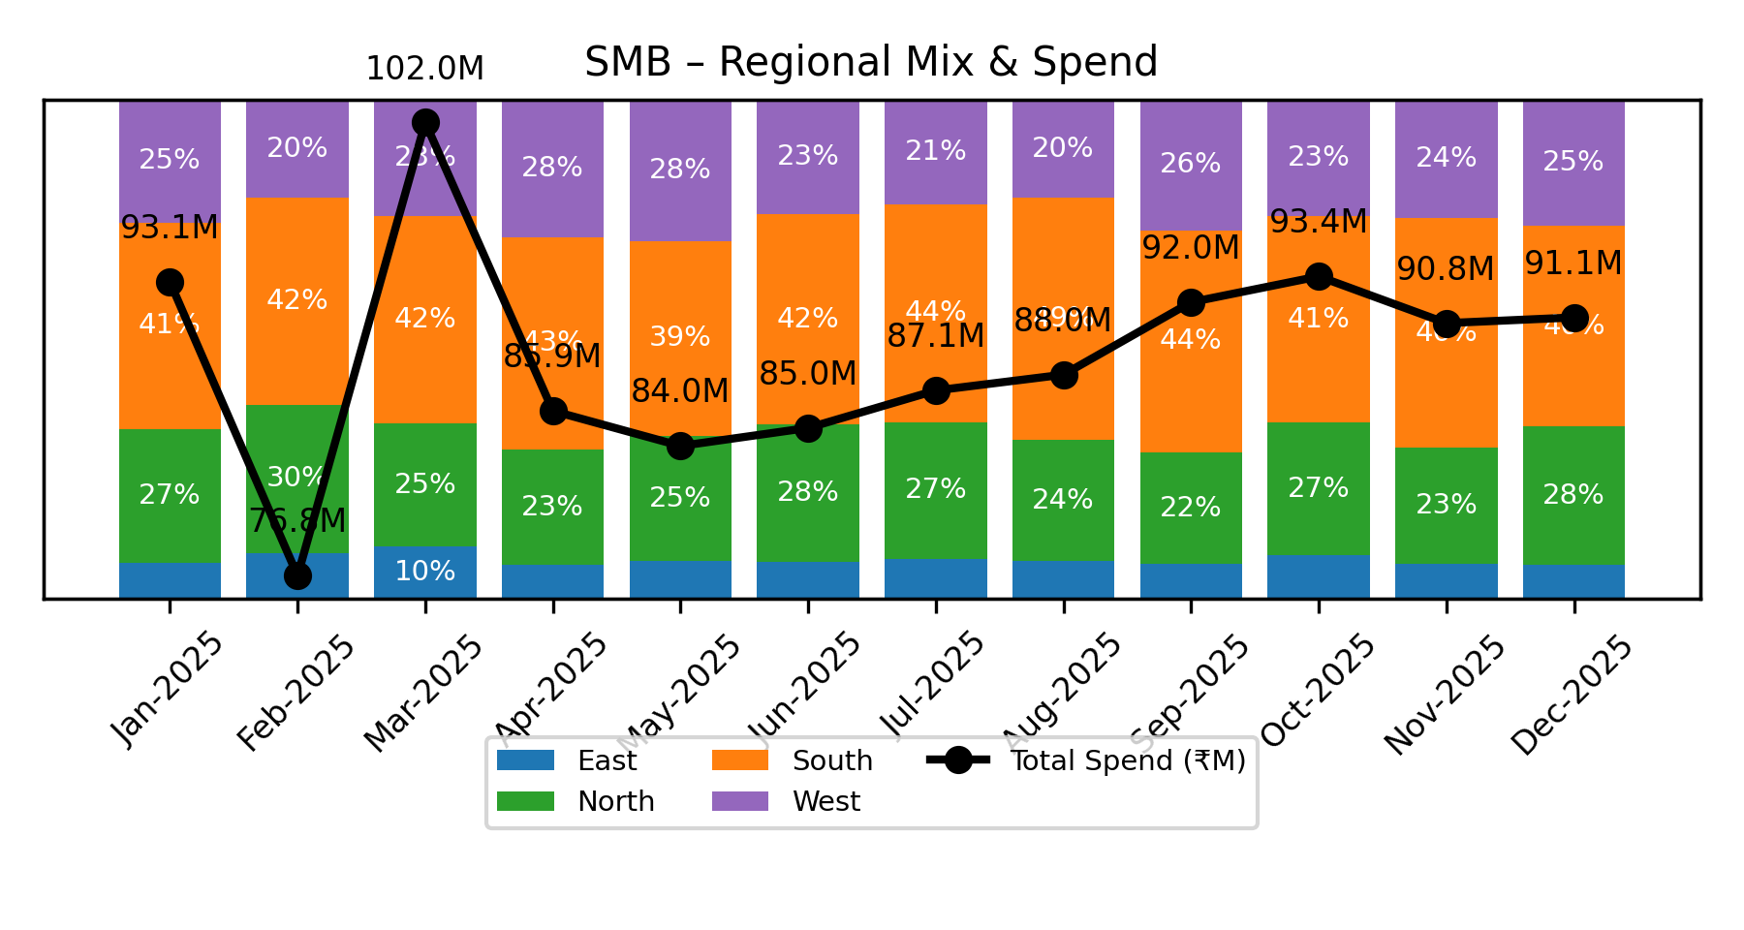
Business Unit Spend & Regional Mix Analysis
• Total spend increased by 4.17% in December 2025, driven mainly by the Enterprise BU with an 8.29% rise. The West region within Enterprise led this growth with an 8.65% increase; leadership should moni
• Consumer BU contributed a significant portion to the total spend rise with a 5.24% increase, primarily fueled by the West region's 2.37% growth despite declines in East and North regions. Leadership s

