Slide 1
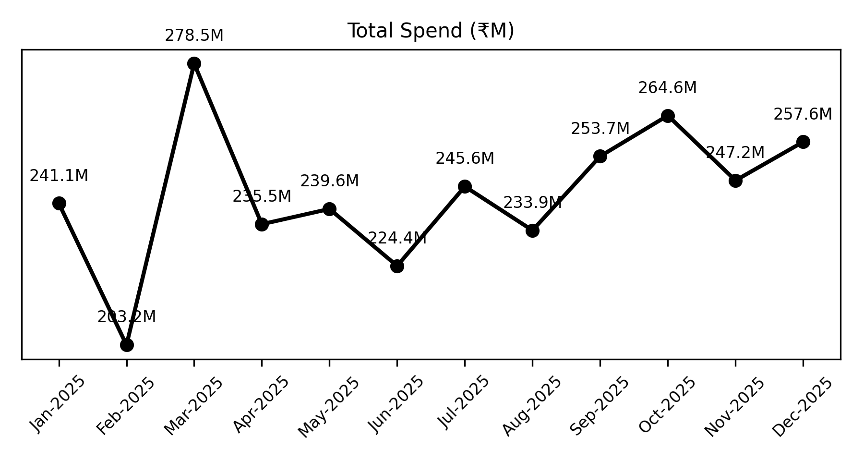
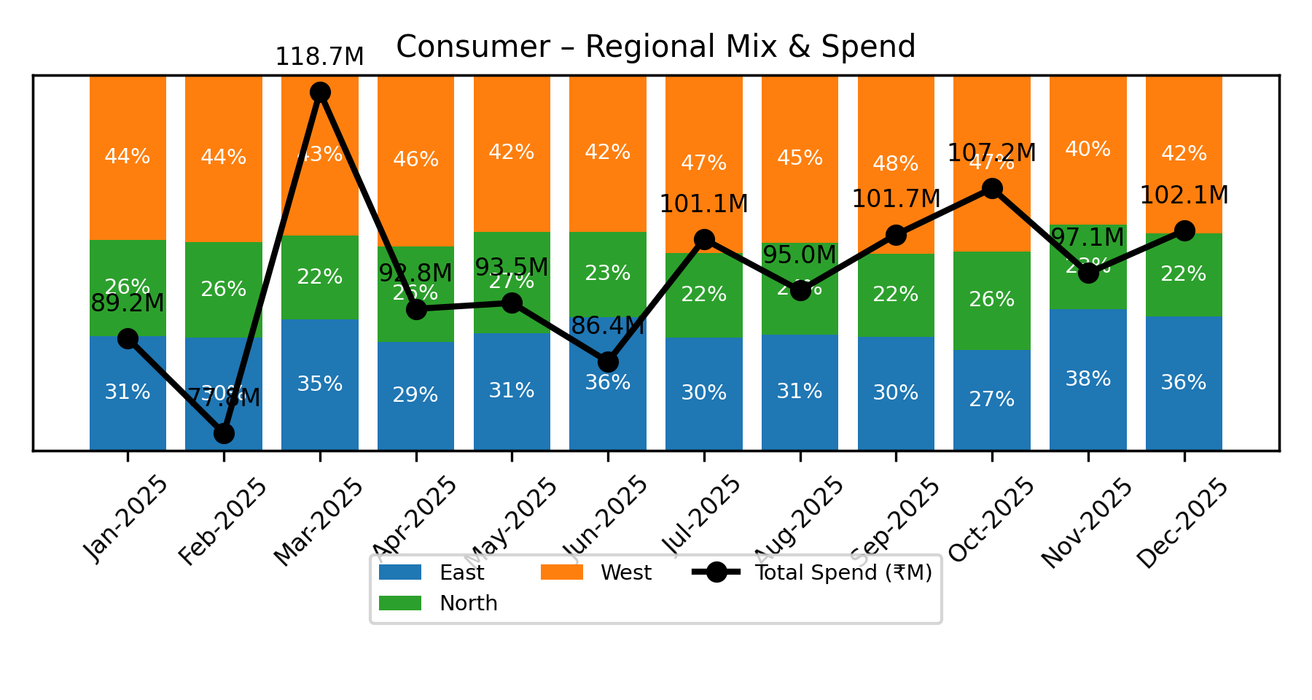
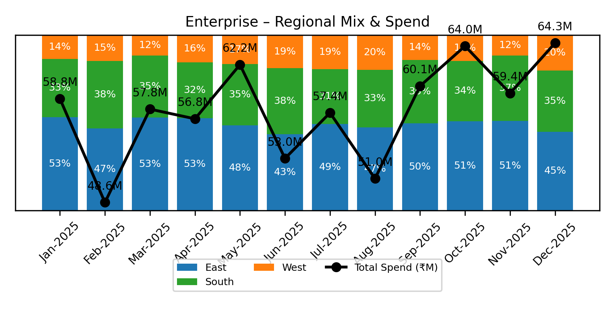
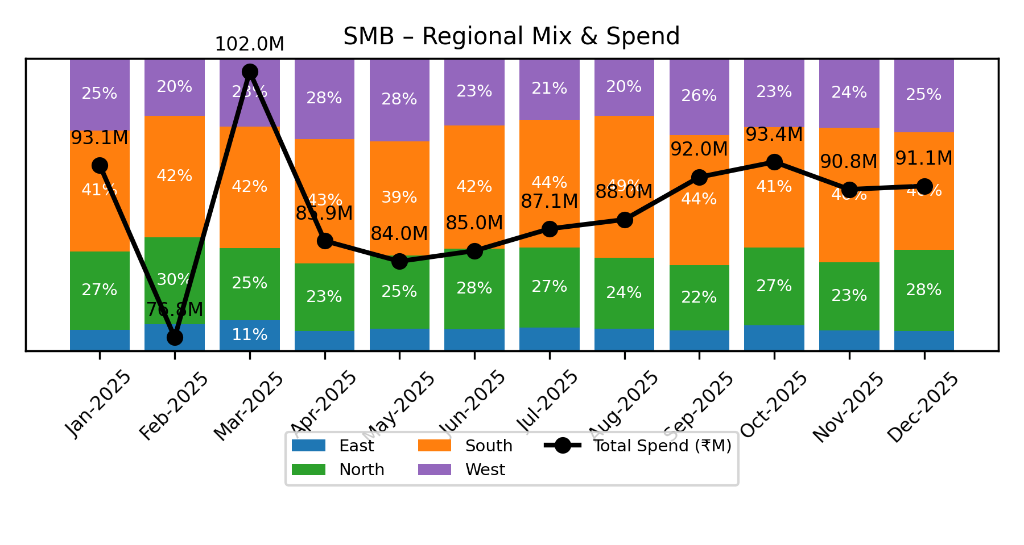
Spend & Regional Mix
• Total AP spend in December 2025 was $257.55M, showing seasonal fluctuations with peaks in March and October.
• Consumer BU leads with $102.13M spend; East region dominates Enterprise BU spend (44.81%) while West leads Consumer BU (42.24%).

Slide 2
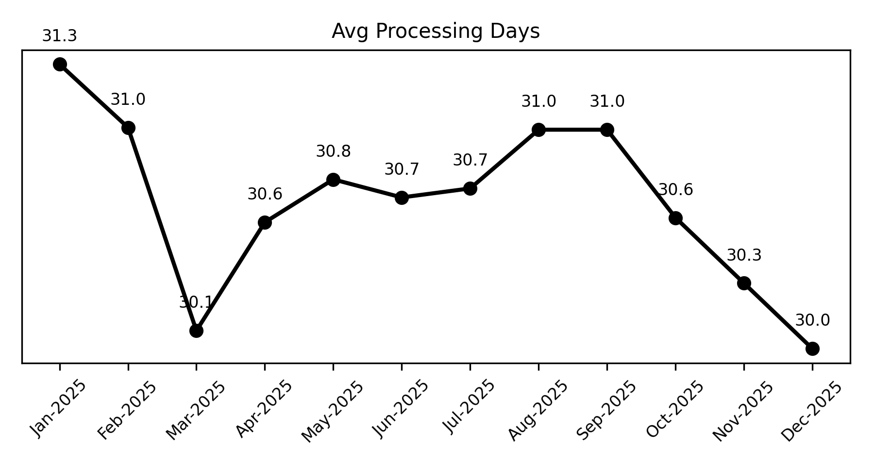
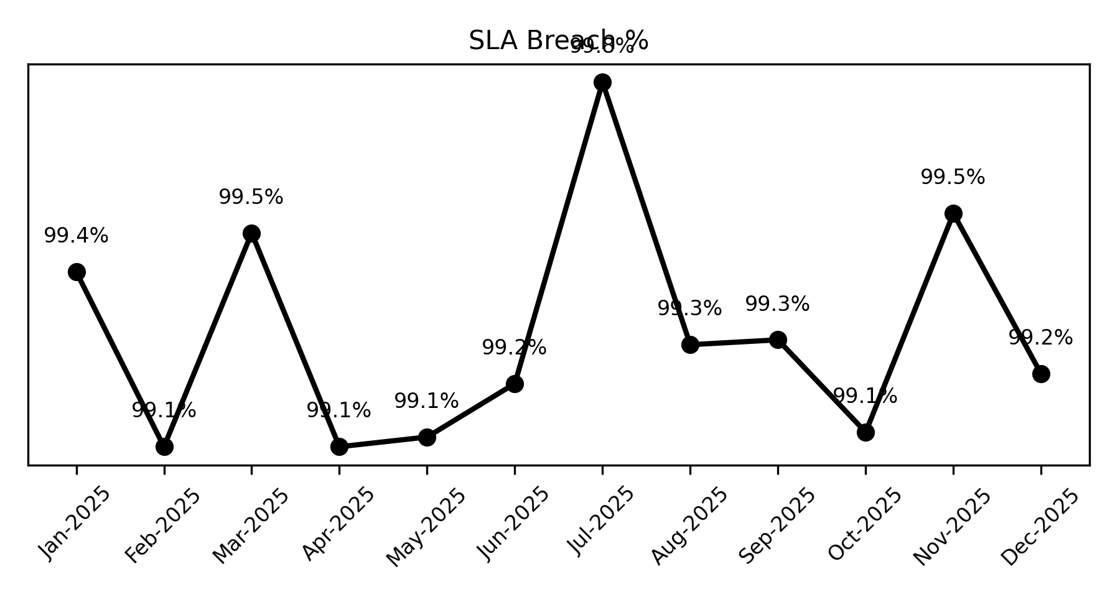
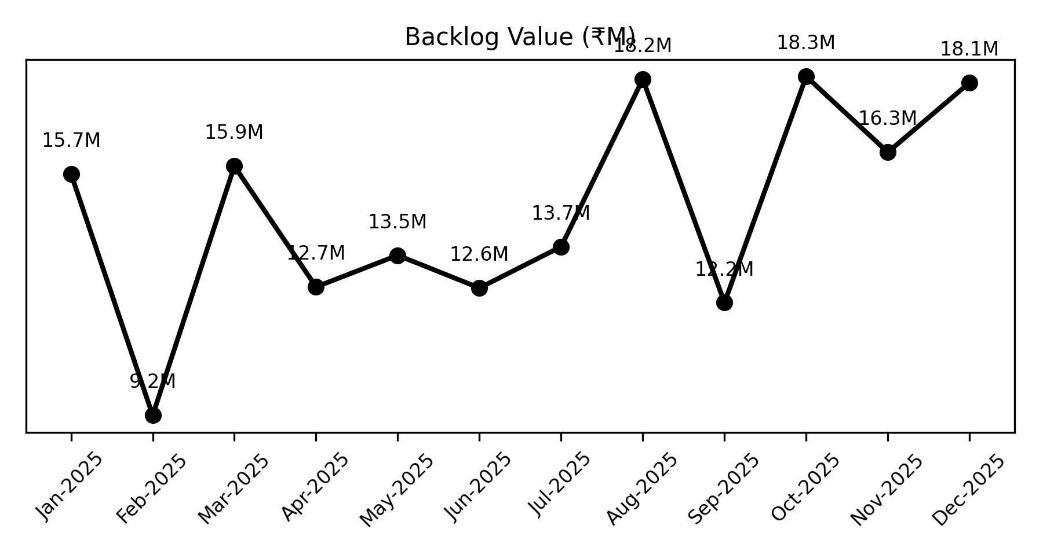
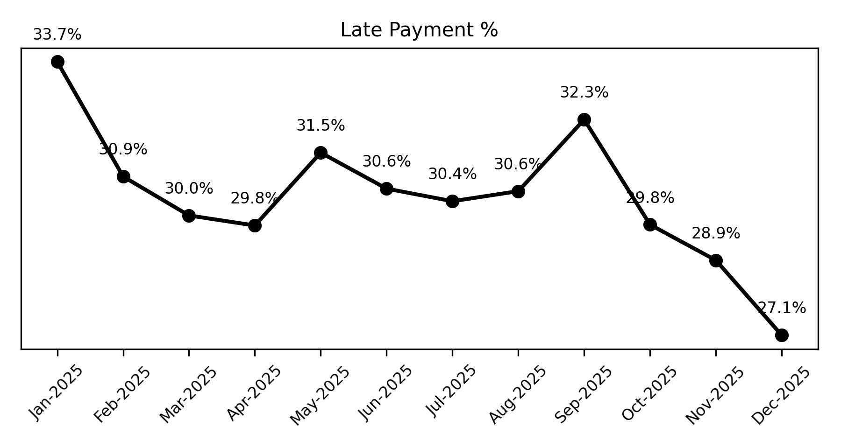
Operational Efficiency
• Processing days trended down to 30.0 days in December 2025, maintaining SLA breach above 99% consistently.
• Backlog value increased to $18.10M in December; late payments improved to 27.15%, the lowest of the year.

Slide 3
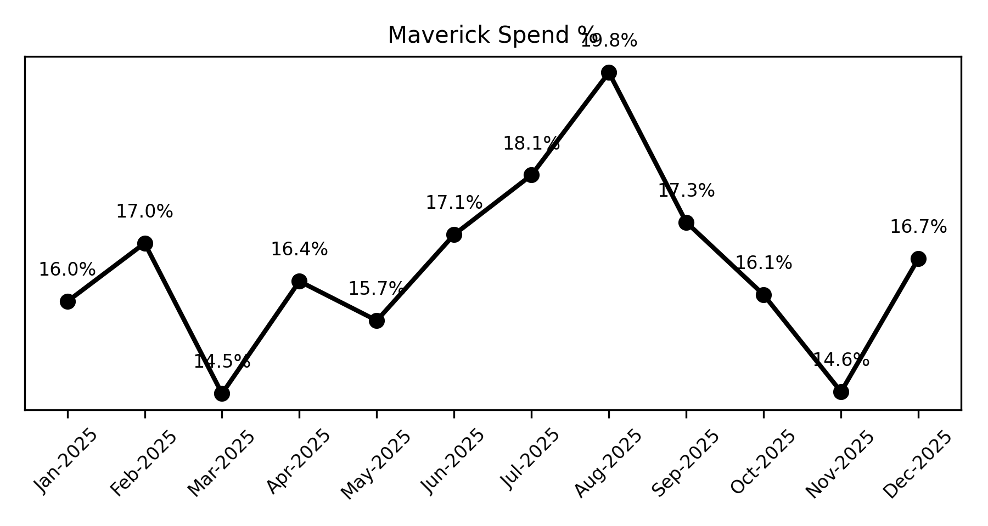
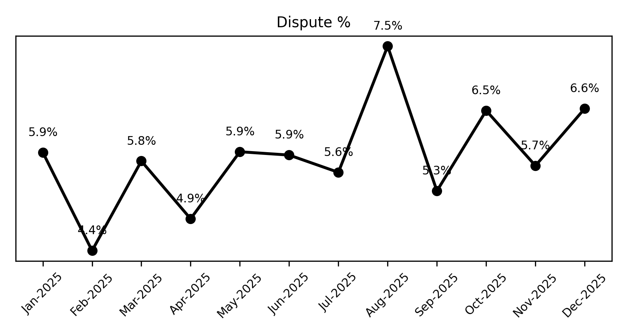
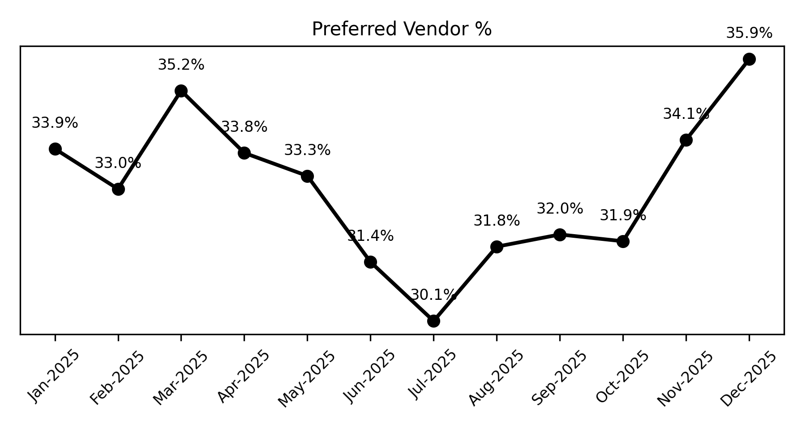
Compliance & Control
• Maverick spend rose to 16.74% in December 2025, indicating control gaps; dispute rate increased to 6.57%.
• Preferred vendor utilization improved to 35.91%, highest in the year, supporting cost and compliance optimization.

Slide 4
Risk & Working Capital
• Rising backlog and sustained high SLA breach suggest potential operational risks impacting working capital.
• Late payment reduction in December may ease financial exposure but vigilance on maverick spend is required.

