Slide 1
Executive KPI Report

Slide 2
KPI Summary
{'latest_month': '2024-12-31 00:00:00', 'total_revenue': 8777334.253914285, 'mom_growth_percent': 2.84, 'top_driver_region': 'South', 'worst_region': 'North', 'anomaly_detected': False}

Slide 3
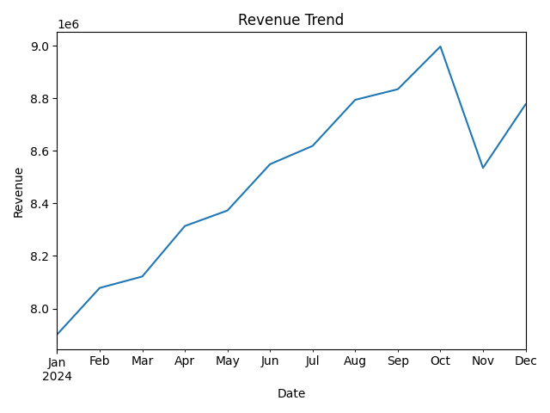
Revenue Trend

Slide 4
Executive Insights
**Executive Summary: December 2024 KPI Insights**
As we close the year with our December 2024 performance metrics, we observe notable changes that paint a compelling picture of our operational landscape and future growth trajectory.
**What Changed?**
Our total revenue for December 2024 reached approximately **$8,777,334**, marking a **month-over-month growth of 2.84%**. This growth indicates not only a sustained revenue stream but also a slight uptick that aligns positively with our quarterly benchmarking goals.
**Where?**
The most significant growth was observed in our **South region**, which emerged as the top driver of revenue, contributing markedly to our month-over-month performance. In contrast, our **North region** has underperformed, qualifying it as the worst region for revenue growth during this period. This regional disparity signals critical insights into market dynamics and our positioning.
**Why?**
Several factors have contributed to these variances in performance. The South region likely benefits from a combination of effective local marketing strategies, increased sales team engagement, and favorable market conditions that have resonated well with our target demographics. Conversely, the North region's challenges may stem from competitive pressures, a mismatch in product offerings, or perhaps saturation in the market — areas that warrant our attention.
Interestingly, there were no anomalies flagged in our data for this reporting period, indicating that the changes we observe are consistent with market behaviors rather than extraordinary fluctuations.
**Recommended Next Steps**
To capitalize on the strengths identified in the South and mitigate the weaknesses in the North, we recommend:
1. **Strategic Reinforcement in the South**: Amplify successful local campaigns and consider reallocating resources to further enhance market penetration in this region.
2. **Targeted Interventions in the North**: Conduct a thorough market analysis to understand the root causes of the North region's underperformance. Develop targeted initiatives, possibly including product innovation or refreshed marketing strategies, aimed at revitalizing interest and sales in this area.
3. **Performance Monitoring**: Establish a robust monthly review process for regional performance metrics to ensure that we remain agile and responsive to changes as they occur. This will also help us identify any emerging trends early on.
In conclusion, December 2024 has presented us with valuable insights that will inform our strategic roadmap moving forward. By leveraging our strengths in the South and addressing challenges in the North, we can enhance our overall performance and drive sustained growth in the coming quarters.

