Slide 1
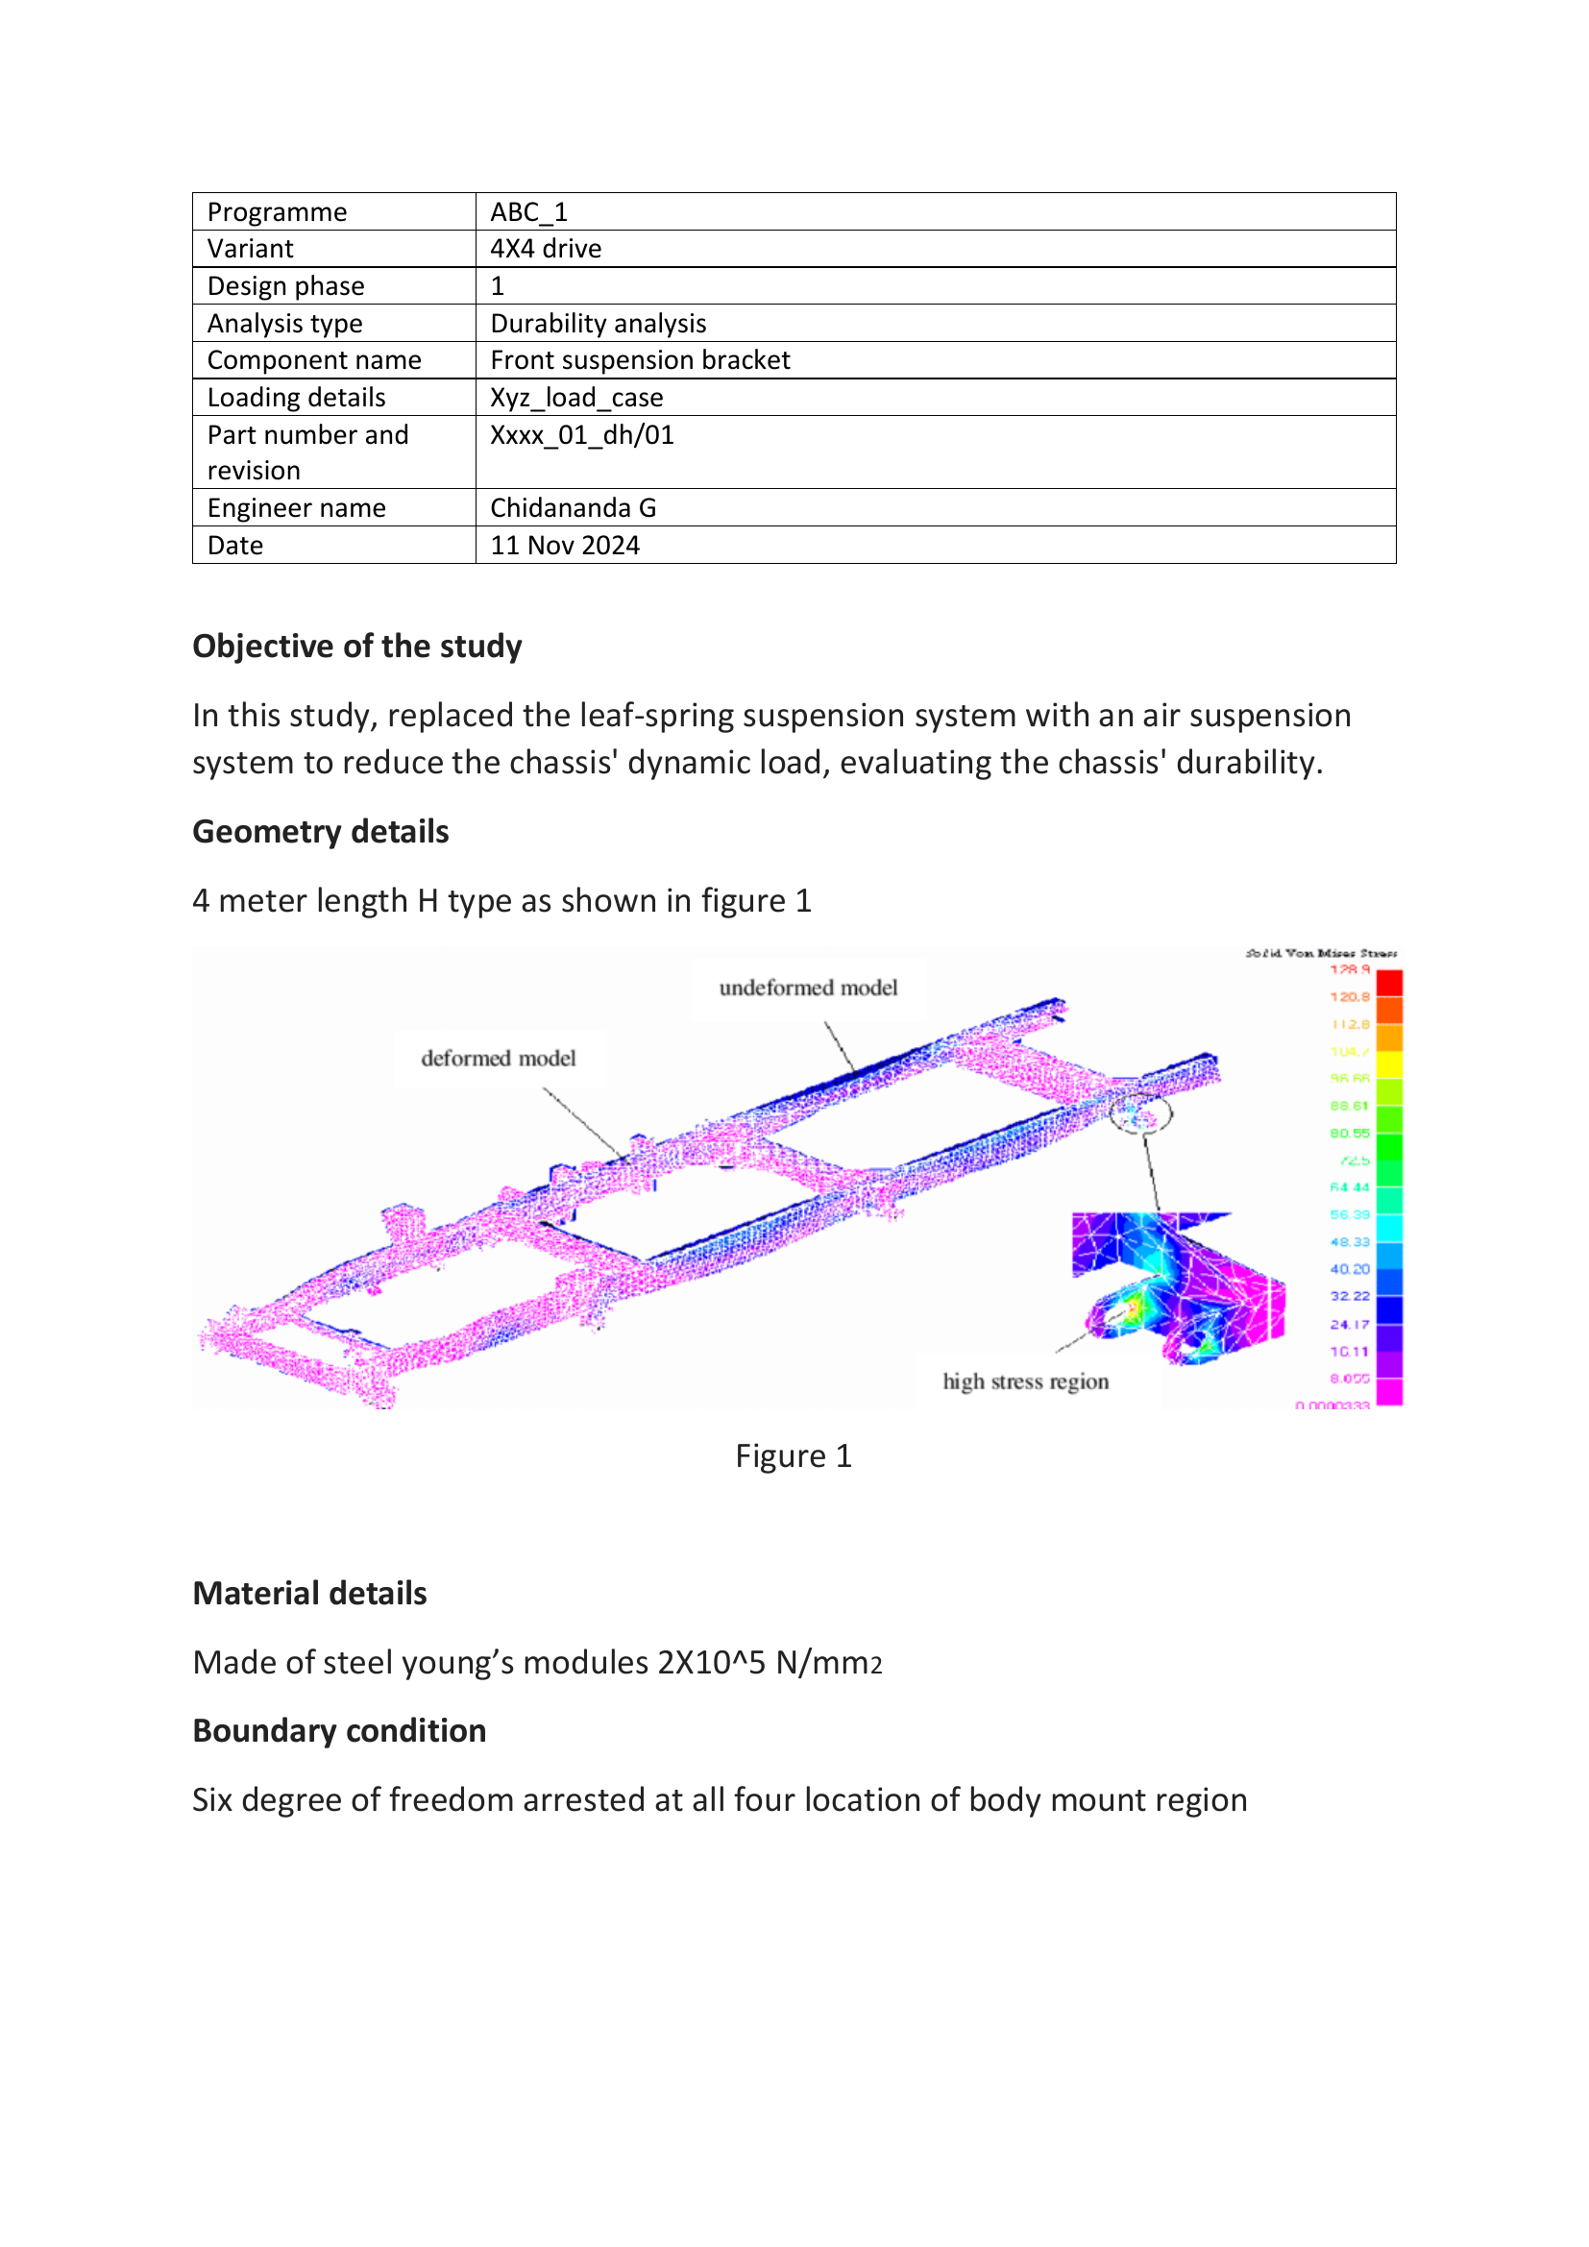
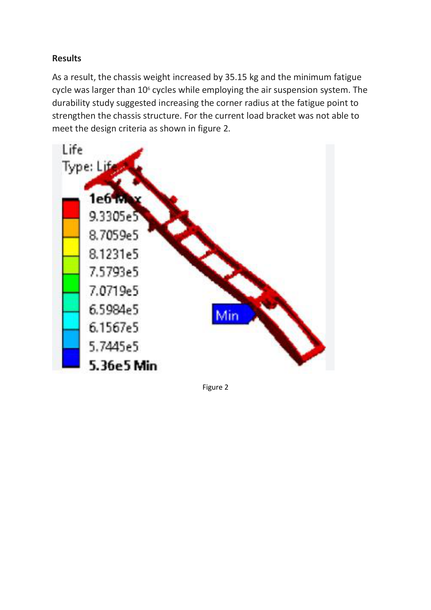
Summary for CAE_SUSPENSION_BRACKET_REPORT.pdf
- The study replaced the leaf -spring suspension system with an air suspension system to reduce the chassis' dynamic load
- The study suggested increasing the corner radius at the fatigue point to strengthen the chassis structure
- As a result, the chassis weight increased by 35.15 kg and the minimum fatigue cycle was larger than 1 06 cycles.

