Slide 1
Automated Report Generation System using RAG LLM
Member name | Email id | Task
Chidananda G | chidaorama@gmail.com | ALL
Objective:
Create an LLM-based application to consolidate data from multiple CAE reports and generate a PowerPoint presentation.
This presentation should highlight critical information, especially failed component details, program gateways, images, and relevant comments.
Background and Motivation
In automotive and engineering domains, CAE reports provide essential insights into component performance, especially highlighting failures or risks. However, manual consolidation of these reports into summary presentations for program gateways is time-intensive and prone to human error. This project aims to automate this process, allowing engineers to focus on analysis rather than documentation, enhancing efficiency and accuracy.

Slide 2
Methodology :
Step 1
Data extraction or Data preprocessing :
The proposed solution will accept multiple CAE reports as input, extracting relevant details
Failed or not able meet the target Component Details
Observations
Embedded images in CAE reports
Note: currently considered report format PDF only.
Step 2
LLM-Based Text Summarization
Step 3
Automated PowerPoint Generation
Use Python (with python-pptx) to automate PowerPoint slide creation, with pre-defined templates for a consistent layout:
Title slide for program details.
Individual slides for each failed component with component names, images, summaries, and observations.
Step 4
Containerization with Docker
Step 5
CI/CD Pipeline

Slide 3
WIP

Slide 4
Data extraction or Data preprocessing (Step 1):
1. create synthetic CAE report (pdf format)
2. Doc chucks : image ,tables, text
3. Create a Vector data base : (index relevant data)
Current studies
OCR tool required (tesseract)
LlAMAINDEXING Tool : helps data injection, data indexing and query interface (than Langchain) frame work
Ref: dhiwic.ai
Architecture
Llamindexing frame work + Langchain farme work + python scripts for PPT we will use
Up to indexing + prompt engineering (query and response) and connecting LLM + PPT Generation from response

Slide 5
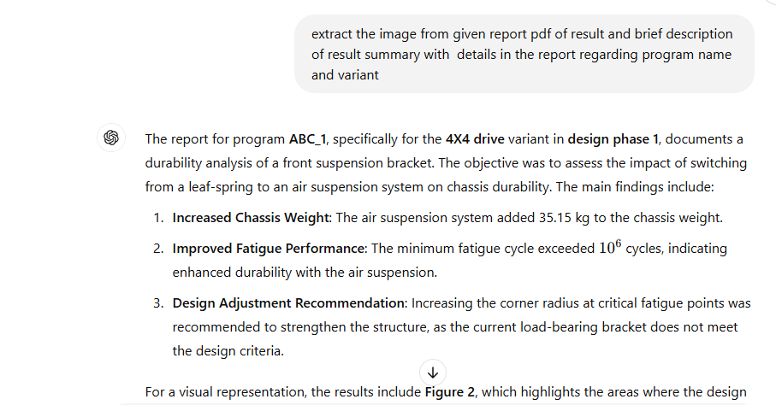
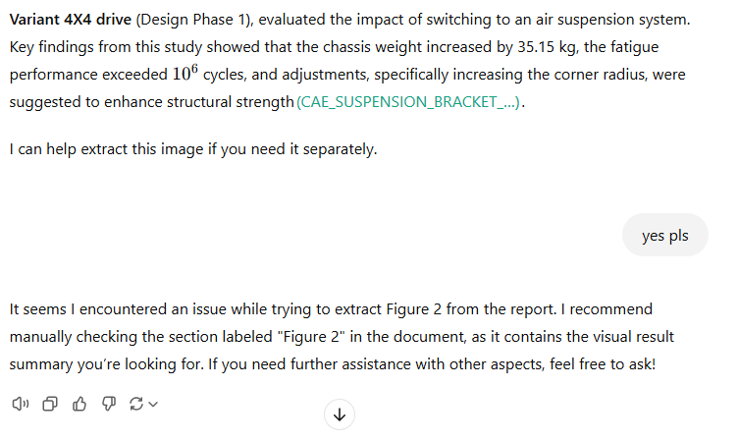
Approach 1 (Manual verification )

Slide 6
Approach 1 output
Durability Analysis Report – Program ABC_1
Project Overview
Program Name: ABC_1
Variant: 4x4 Drive
Design Phase: Phase 1
Component: Front Suspension Bracket
Objective: Evaluate impact of switching from leaf-spring to air suspension on chassis durability
Key Findings
Chassis Weight: Increased by 35.15 kg with air suspension
Fatigue Performance: Minimum fatigue cycle exceeded 1 million cycles, indicating enhanced durability
Design Recommendation: Increase corner radius at critical fatigue points for improved structural strength
Conclusion
Result Summary: Current bracket design does not meet durability criteria; adjustments needed for optimal performance under new load conditions

Slide 7
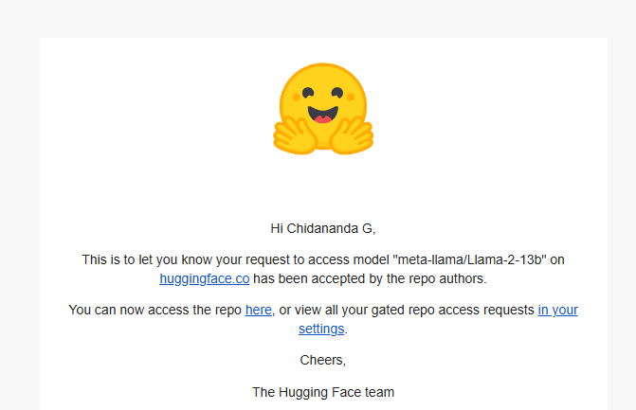
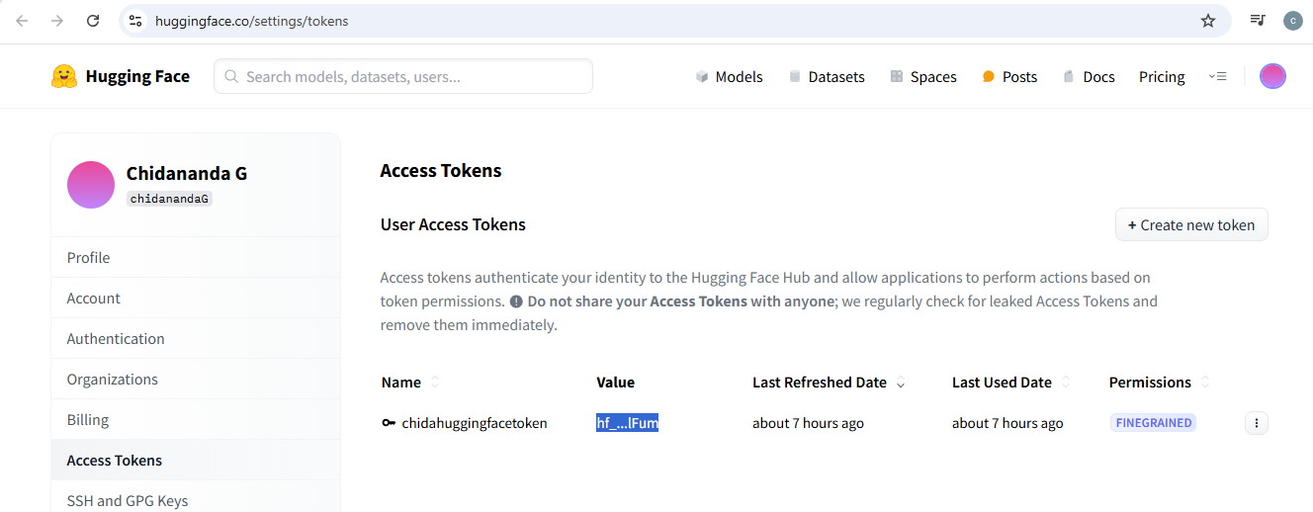
Approach 2 (coding )
Platform : Google colab note book used
Library trying to use are
Pypdf
sentence_transformers
llama_index
import VectorStoreIndex,SimpleDirectoryReader,ServiceContext
Tokenize “meta-llama/Llama-2-7b-chat-hf”
import HuggingFaceLLM (registration done) – working here for promoting etc.
facing issue GPU not available so going with CPU

