Slide 1

Capstone Project
Group 9

Slide 2
Automatic Flood Detection
Bhupesh Dutta Sharma
Chidananda G
Rabi Narayan Sahoo
Keertimalini A
Kinjarapu Sriram
Parth Arora
Ranjitha Murthy

Slide 3
Overview
Title : Automatic Flood Detection
Description : Predict the probability of a region flooding based on various factors.
ML Model : Logistic Regression
Data set : Flood predication Dataset from Kaggle.
Metrics : Confusion Metrics and ROC Curve.
CI-CD Pipeline : GitHub, GitHub Action

Slide 4
Data Preparation
Data Cleaning
Remove Duplicate Data
Filter outliers
Splitting the data set to training and testing set.

Slide 5
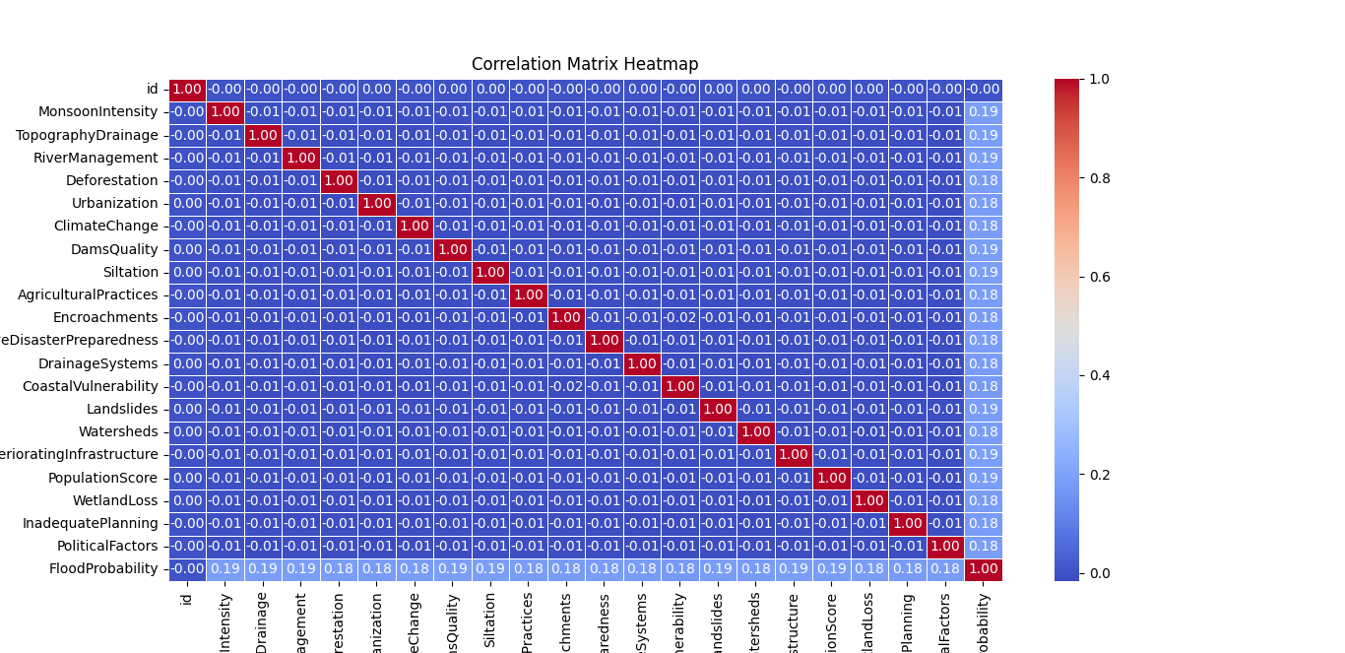
Correlation Matrix Analysis of Flooding Predictive Features
Objective: To analyze the relationship between various factors affecting flood risk.
Key Features Analyzed: Monsoon Intensity, Topography Drainage, River Management, Deforestation, Urbanization, Climate Change, Dams Quality, Siltation, Agricultural Practices, Encroachments, Ineffective Disaster Preparedness, Drainage Systems, Coastal Vulnerability, Landslides, Watersheds, Deteriorating Infrastructure, Population Density, Wetland Loss, Inadequate Planning, Political Factors.
Findings
The correlation between all the features and flooding probability is approximately 0.19.
A 0.19 correlation suggests weak to moderate association between the features and the flooding probability.
The correlation matrix results indicate complexity in flood prediction.

Slide 6
Developing the model

Slide 7
Hyperparameter tuning.

Slide 8
Model performance

Slide 9
CI-CD Pipeline
Code use GitHub (Git and GitHub learning resources - GitHub Docs)
Data use DVC (Data Version Control · DVC)
ML Artifacts use (W&B Artifacts: Lightweight Dataset and Model Versioning)
To integrate All these 3 together we can use GitHub Action (GitHub Actions · GitHub)
We can use ClearML too(Accelerate Your Generative AI, LLMOps, and MLOps with ClearML | ClearML).

