Slide 1
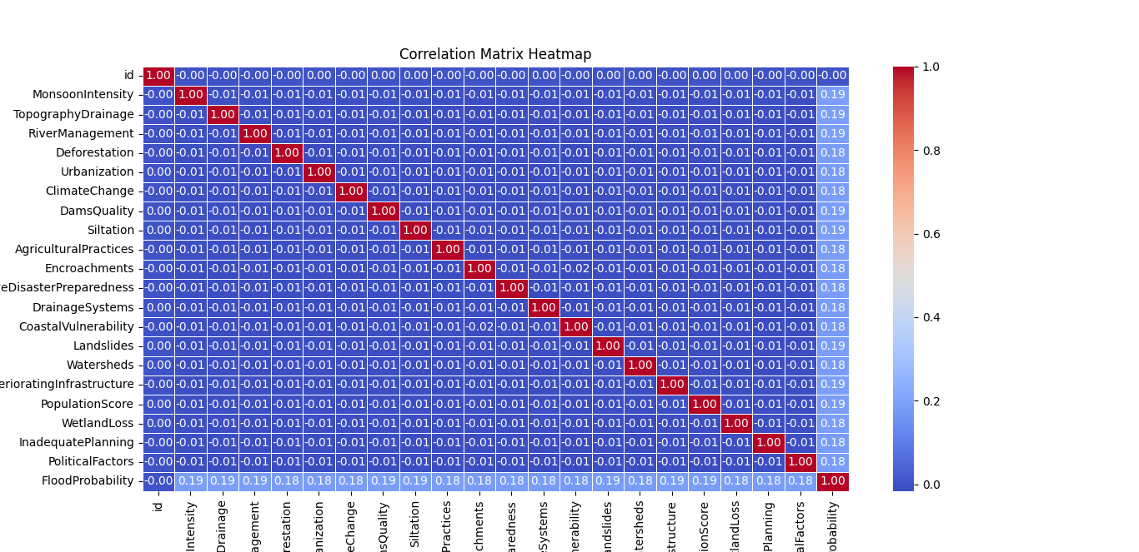
Correlation Matrix Analysis of Flooding Predictive Features
Objective: To analyze the relationship between various factors affecting flood risk.
Key Features Analyzed: Monsoon Intensity, Topography Drainage, River Management, Deforestation, Urbanization, Climate Change, Dams Quality, Siltation, Agricultural Practices, Encroachments, Ineffective Disaster Preparedness, Drainage Systems, Coastal Vulnerability, Landslides, Watersheds, Deteriorating Infrastructure, Population Density, Wetland Loss, Inadequate Planning, Political Factors.
Findings
The correlation between all the features and flooding probability is approximately 0.19.
A 0.19 correlation suggests weak to moderate association between the features and the flooding probability.
The correlation matrix results indicate complexity in flood prediction.

