Slide 1
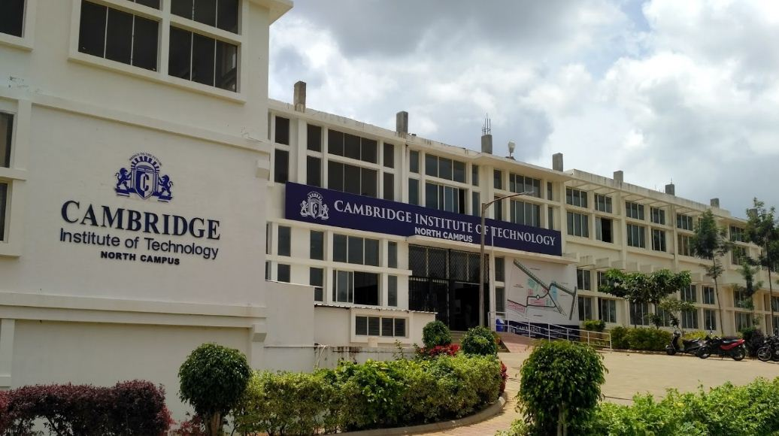





SMART INDIA HACKATHON 2026
Ministry of Education, Government of India
VoiceGuard
AI
AI-Powered Real-Time Detection & Prevention of Voice Cloning Impersonation Attacks
Problem Statement ID
Theme
SIH 1653
Smart Automation & Cybersecurity
PS Category
Team Name
Software
VoiceGuard AI
College
Date
Cambridge Institute of Technology
September 2026
Live Demo: https://frontend-murex-five-37.vercel.app
@SIH 2026 | Internal Hackathon Submission | 1

Slide 2



SMART INDIA HACKATHON 2026
Team: VoiceGuard AI | Slide 2
TITLE PAGE
Problem Statement ID:
SIH 1653
Problem Statement Title:
AI-Powered Real-Time Detection and Prevention of Voice Cloning Impersonation Attacks
Theme:
Smart Automation, Cybersecurity & Digital Governance
PS Category:
Software
Team ID:
VG2026
Team Name:
VoiceGuard AI
AI-Powered Real-Time Detection & Prevention of Voice Cloning Impersonation Attacks
₹2,400 Cr+
3.2×
<3 seconds
<200ms
India voice fraud loss 2023
Rise in voice fraud incidents
To clone any human voice
VoiceGuard AI detection speed
Smart India Hackathon 2026 | Ministry of Education, Govt. of India
2

Slide 3
SMART INDIA HACKATHON 2026
Team: VoiceGuard AI | Slide 3
IDEA TITLE: VoiceGuard AI — Real-Time Voice Cloning Defence System
Idea / Solution / Prototype
Addressing the Problem
Empowering banks, enterprises & governments with AI —
VoiceGuard AI detects synthetic/cloned voices in real
time before a fraudulent call causes financial loss.
▸ Upload audio OR use live microphone capture
▸ 60+ acoustic features extracted instantly
▸ Evidence v3 Bayesian model → calibrated AI probability
▸ P(AI voice) = sigmoid(Σ Log-Likelihood Ratios)
▸ Scenario-aware risk: Banking/Enterprise/Government
▸ Real-time WebSocket (1-second rolling updates)
▸ Speaker voiceprint enrolment & verification
▸ Privacy-first: ZERO audio stored (DPDP 2023)
▸ Full audit trail with DELETE endpoint
🔗 frontend-murex-five-37.vercel.app
Neural TTS (ElevenLabs, Tortoise TTS, YourTTS)
clones any voice from just 3 seconds of audio.
Attackers impersonate CEOs, bankers & officials.
Traditional defences are completely defeated:
• Caller ID — easily spoofed
• Voice familiarity — beaten by AI cloning
• OTP alone — insufficient for high-value calls
India lost ₹2,400 Crore+ to voice fraud in 2023.
VoiceGuard AI is the missing defence layer.
Innovation & Uniqueness
✦ Log-odds Bayesian model — not arbitrary scoring
✦ Calibrated per ASVspoof research (not guessed)
✦ Language-agnostic: Hindi, Tamil, Telugu all work
✦ 10 evidence dimensions working simultaneously
✦ AudioWorklet mic API (modern, no deprecated code)
✦ Full REST + WebSocket — plugs into any system
✦ 14/14 automated tests passing
Smart India Hackathon 2026 | Ministry of Education, Govt. of India
3

Slide 4
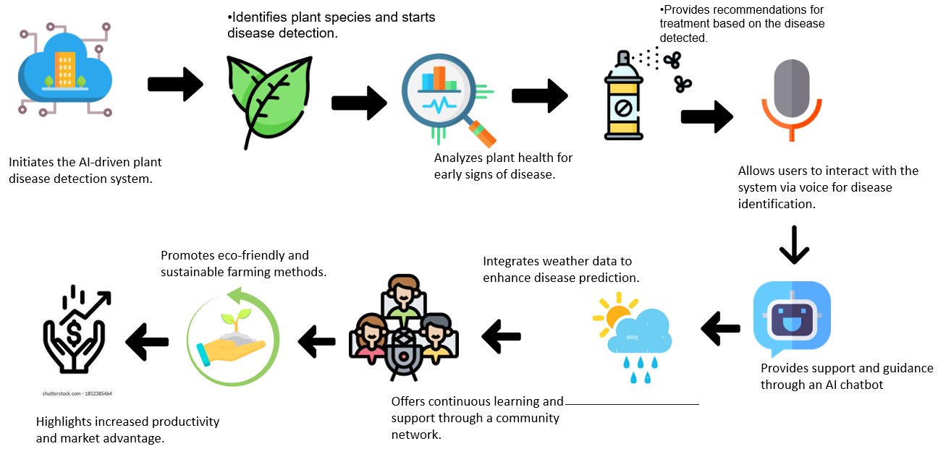
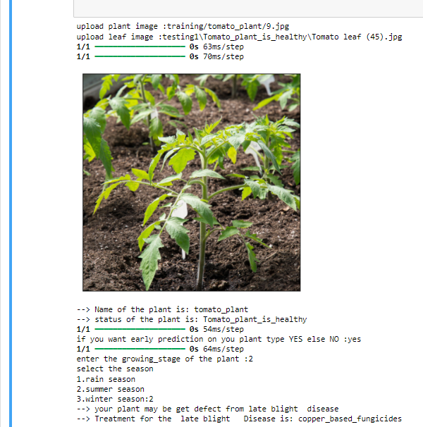
SMART INDIA HACKATHON 2026
Team: VoiceGuard AI | Slide 4
TECHNICAL APPROACH
Languages & Frameworks
Working Flowchart — Evidence v3 Detection Pipeline
BACKEND
1
AUDIO INTAKE
• Python 3.14
Upload .wav/.mp3/.m4a OR Live mic via AudioWorklet API
• FastAPI
↓
• NumPy / SciPy
PREPROCESSING
• SoundFile
2
• SQLite + WAL
Mono → 16kHz resample → 2048-pt Hanning frames → 512-pt hop
FRONTEND
↓
3
FEATURE EXTRACTION
• React 18 + Vite 5
60+ features: MFCC 1-13, jitter, shimmer, HNR, F0 range, spectral flux, sub-band ratios, RMS modulation, ZCR
• AudioWorklet API
• WebSocket client
↓
• Lucide Icons
4
EVIDENCE MODEL v3
LLR accumulated per feature → log_odds = Σ LLR_i P(AI voice) = sigmoid(log_odds) → 0-100% calibrated
DETECTION
↓
• Evidence v3 Engine
RISK ENGINE
• Log-odds Bayes model
5
• 60+ acoustic features
Score mapped to LOW/MEDIUM/HIGH/CRITICAL Different thresholds per scenario: Banking/Enterprise/Govt
• 10 evidence dimensions
↓
6
ALERT & AUDIT
DEPLOY
In-app banner + Email/SMS dispatch SQLite audit log (WAL) + DELETE /api/history/{id}
• Vercel (frontend)
• Railway (backend)
• Docker
Smart India Hackathon 2026 | Ministry of Education, Govt. of India
4
• GitHub Actions

Slide 5
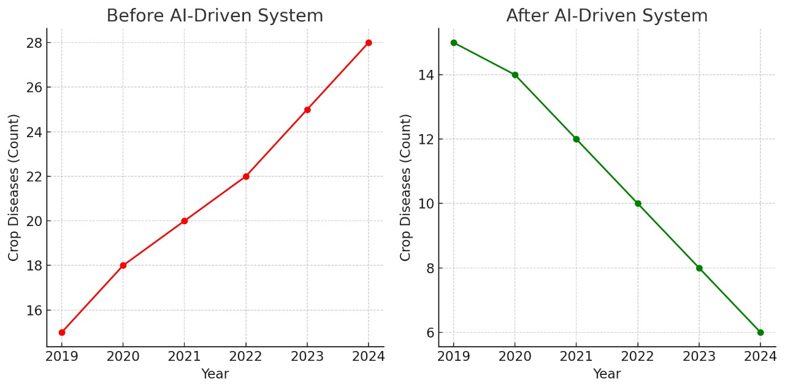
SMART INDIA HACKATHON 2026
Team: VoiceGuard AI | Slide 5
FEASIBILITY AND VIABILITY
⚙ Technical Feasibility
💰 Financial Viability
📈 Market Viability
• CPU-only — no GPU required
• Free tier: Vercel + Railway = ₹0/month
• Python + NumPy — no proprietary ML framework
• AudioWorklet: works in all modern browsers
• SQLite WAL — handles concurrent requests
• Docker-ready — deploy anywhere in minutes
• 14/14 automated tests passing (pytest)
• Real-time WebSocket — 1-second updates
• Horizontally scalable stateless FastAPI
• Free tier: 50,000 analyses/month at ₹0
• Scale: ₹2,500/month for 1M analyses
• No per-call ML API cost — self-hosted
• Open source stack — zero licensing fees
• ROI: 1 prevented fraud = ₹18.5L saved
• Break-even at just 1 fraud prevented/month
• Enterprise SDK licensing for BFSI revenue
• SaaS subscription model for telecoms
• Global voice anti-spoofing market: $4.2B
• RBI voice verification guidelines (2023)
• DPDP 2023 compliance built-in from day 1
• Target: 500M+ daily voice calls in India
• NPCI/UPI integration roadmap (Phase 3)
• MHA CERT-In partnership potential
• Plug-in API for Twilio, Exotel, Ozonetel
• Works on mobile, desktop, call centres
• Language agnostic — all Indian languages
• Deployable offline (edge/on-premise)
Smart India Hackathon 2026 | Ministry of Education, Govt. of India
5

Slide 6
SMART INDIA HACKATHON 2026
Team: VoiceGuard AI | Slide 6
IMPACT AND BENEFITS
Potential Impact
Social Benefits
🏦 Banking Sector
• Empowers agents with real-time verdicts
• Reduces social engineering pressure
• Builds trust in digital voice channels
• Accessible to non-technical users
• Supports India's safe digital economy
Detects synthetic CEO/CFO impersonation
before wire transfer authorisation.
Prevents avg ₹18.5L loss per incident.
Integrates with existing call centres.
🏢 Enterprise Security
Stops CEO fraud (BEC) in real time.
Protects M&A and board communications.
WebSocket API: plug into Teams/Zoom.
Economic Benefits
🏛 Government
Protects officials from impersonation.
• Prevents ₹2,400 Cr+ annual fraud loss
• ₹0 infra cost on free tier
• 1 prevented fraud = 12 months of ROI
Secures sensitive policy communications.
Supports PM Cybersecurity Mission 2026.
👨‍💼 Citizens & Call Centres
Alerts agents before fraud happens.
Environmental
No user action needed — background check.
• CPU-only — minimal energy footprint
• Reduces fraud investigation overhead
• No physical infrastructure required
Works on any call, any Indian language.
Smart India Hackathon 2026 | Ministry of Education, Govt. of India
6

Slide 7
SMART INDIA HACKATHON 2026
Team: VoiceGuard AI | Slide 7
RESEARCH AND REFERENCES
Details / Links of reference and research work used in building VoiceGuard AI
1. ASVspoof 2019/2021/2024 Dataset
Benchmark for anti-spoofing countermeasures research
https://www.asvspoof.org
2. AASIST — Integrated Spectro-Temporal (Jung et al., ICASSP 2022)
State-of-art anti-spoofing model — basis for feature design
https://arxiv.org/abs/2110.01200
3. RawNet2 — Raw Waveform Spoofing (Tak et al., Interspeech 2021)
End-to-end spoofing detection — evidence weight calibration
https://arxiv.org/abs/2011.01108
4. Jitter & Shimmer Reference Values
Titze (1994), Baken & Orlikoff (2000) — vocal perturbation norms
National Center for Voice and Speech, USA
5. HNR Norms — Boersma (1993)
Accurate short-term analysis of fundamental frequency and HNR
https://www.fon.hum.uva.nl/paul/papers/boersma93.pdf
6. Spectral Flux & TTS Characterisation — Müller et al. (2022)
Differentiating neural TTS from human speech spectrally
Elsevier Speech Communication Journal
7. DPDP 2023 — Digital Personal Data Protection Act
Government of India — data minimisation & privacy compliance
https://www.meity.gov.in/data-protection-framework
8. RBI Voice Fraud Advisory (2023)
Reserve Bank of India guidelines on voice-based financial fraud
https://www.rbi.org.in
9. FastAPI Documentation
High-performance async Python web framework
https://fastapi.tiangolo.com
10. ElevenLabs / Tortoise TTS / YourTTS
Voice cloning systems used to test VoiceGuard detection accuracy
https://elevenlabs.io | github.com/neonbjb/tortoise-tts
Smart India Hackathon 2026 | Ministry of Education, Govt. of India
7

