Slide 1
Introduction to Cell Biology
Lecture 3 · Membranes and Transport
細胞生物學導論 · 第三講

Slide 2
Today's outline
• Structure of the plasma membrane
  – Phospholipid bilayer and fluid mosaic model
• Passive transport
  – Diffusion, osmosis, facilitated diffusion
• Active transport and pumps
• Review questions
2

Slide 3
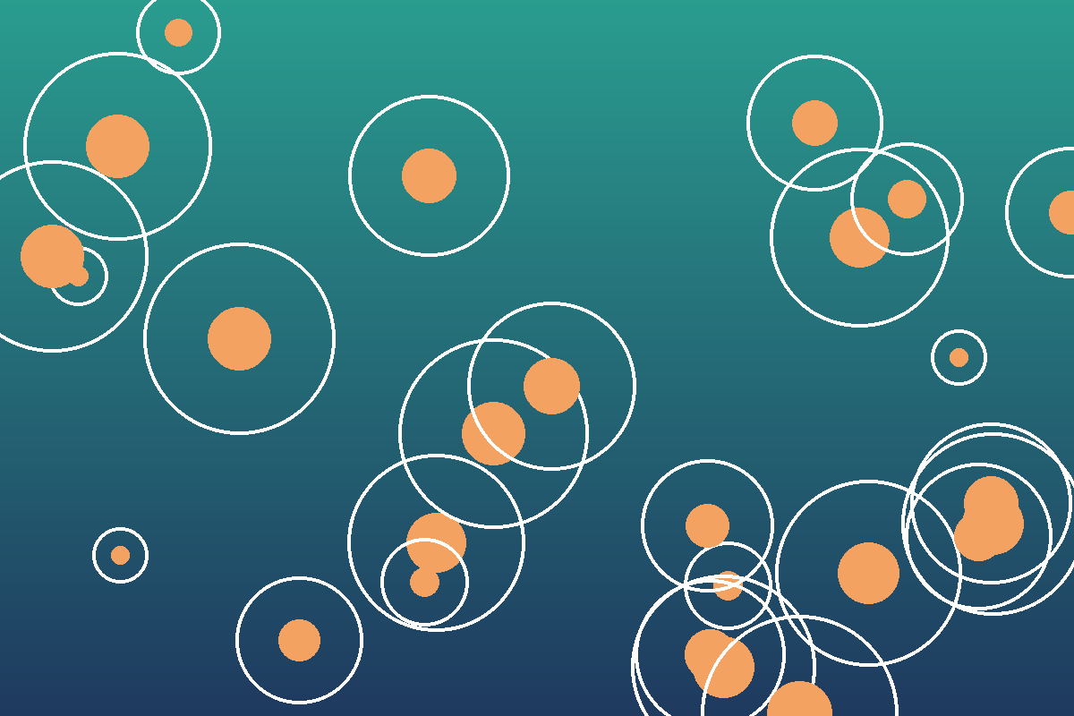
Cells under the microscope
• Membranes separate inside from outside
• Selective: lets some molecules through
  – Small, non-polar molecules pass easily
  – Ions need channels or pumps
3

Slide 4
Three ways across the membrane
Diffusion
High → low
no energy
Facilitated
Through channel
proteins
Active
Low → high
uses ATP
4

Slide 5
Diffusion rate vs. temperature
Lab results, section A–C
5

Slide 6
Transport proteins at a glance
Protein | Type | Moves | Energy
Aquaporin | Channel | Water | None
GLUT1 | Carrier | Glucose | None
Na⁺/K⁺ pump | Pump | Na⁺ out, K⁺ in | ATP
Ca²⁺ pump | Pump | Ca²⁺ | ATP
6

Slide 7
重點整理 Key points
• 細胞膜由磷脂雙層構成，具有選擇性通透
• 被動運輸：順著濃度梯度，不消耗能量
• 主動運輸：逆著濃度梯度，需要 ATP
  – 例：鈉鉀幫浦維持神經細胞的膜電位
7

Slide 8
Review questions
• Why can't ions cross the bilayer on their own?
• What happens to a red blood cell in pure water?
• Name one pump and what it moves.
• Next week: cell signalling
8

