Slide 1
OpenTrace RAG Pipeline Architecture
Version 2.0 · Data pipelines → vector store & BigQuery → query-time LangGraph
Generated 2026-08-15 · ml/rag

Slide 2
Agenda
• Data pipelines — how unstructured and structured sources land in stores
• Vector store — six Qdrant corpora, ingest ERD, hybrid-ready indexes
• BigQuery — staging_dev as the RAG SQL surface (not silver/gold at query time)
• Query-time RAG — control plane → vector + BQ legs → merge → generate → ACF
• Takeaways for product and engineering audiences

Slide 3
Design principles
• Co-equal retrieval: six Qdrant text corpora (unstructured) and BigQuery staging_dev (structured).
• Orchestrate via LangGraph in ml/rag/chatbot/graph.py — vector parallel_retrieve then BQ reason/retrieve, both legs merge.
• Control plane: query enricher (memory) → decompose → Africa panel/ranking → agri measure ontology → task_mode.
• Ontology aids the BQ SQL reasoner (scoped tables/filters); does not replace the LLM; fallback only after retries.
• Retrieval uses the latest user message (enriched if elliptical); chat memory affects generation and enricher.

Slide 4
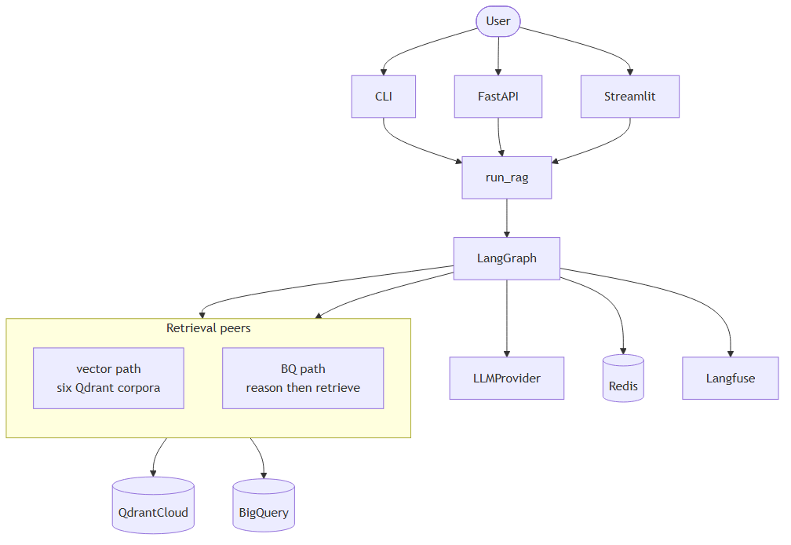
System context
Actors, LangGraph, and external services — Qdrant and BigQuery as peer retrieval backends.

Slide 5
Data pipelines
Offline paths that fill Qdrant and BigQuery before any user query

Slide 6
Two retrieval stores (co-equal)
Unstructured → Qdrant
Structured → BigQuery
• News, academic papers, policies, public reports, formation, OTA
• Drive / JSONL → preprocess → chunk → embed
• Dense E5 + optional BM25 sparse (hybrid RRF at query time)
• Payload indexes: geo, time, doc_kind
• Warehouse layers feed staging tables used by RAG
• Live SQL targets staging_dev only (never silver/gold)
• YAML catalog + measure ontology scope the reasoner
• Validated SELECT + LIMIT; templates / patterns / NL2SQL

Slide 7
Vector ingest path
• Google Drive sync (ingestion/gdrive) or local files → text_processors/preprocess.
• JSONL under ml-eng/data/local/preprocessed_data/ (news, research, ota).
• Chunk IDs: UUID5 from chunking_config.CHUNK_ID_NAMESPACE.
• Loaders upsert to Qdrant; ingest_manifest.json tracks content_hash for incremental skip.
• Collection specs: scripts/qdrant_collection_specs.py (vectors, payload indexes).
See ingest ERD on next slide

Slide 8
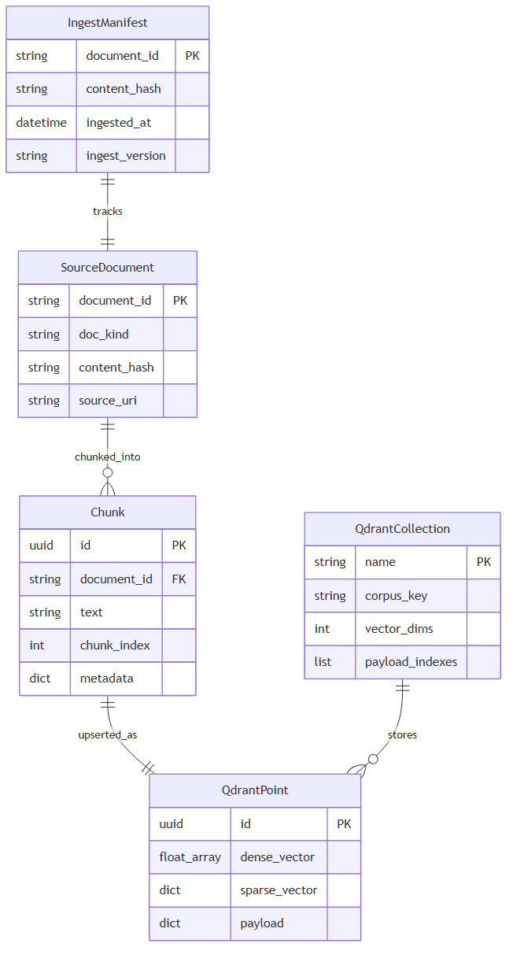
Ingest and vector store ERD
Offline document → chunk → Qdrant pipeline.

Slide 9
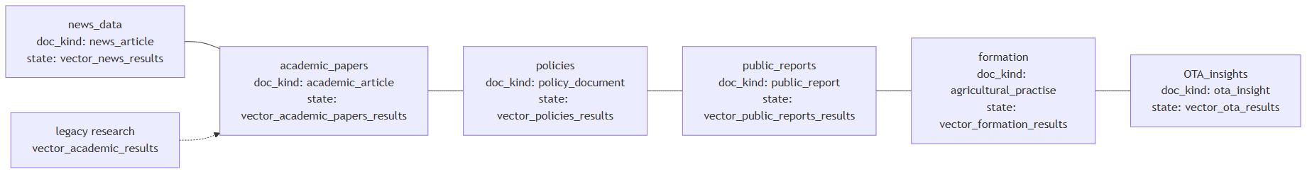
Six Qdrant corpora
Collections, doc_kind, and RAGGraphState vector_* fields.

Slide 10
Six Qdrant corpora (defaults)
• news → news_data — Timely journalism
• academic_papers → academic_papers — Peer-reviewed research
• policies → policies — Policy documents
• public_reports → public_reports — Institutional reports
• formation → formation — Training / farmer practice
• ota → OTA_insights — Analyst insights (triple vectors)

Slide 11
BigQuery data path for RAG
• Upstream bronze / silver / gold pipelines remain the warehouse source of truth
• RAG query surface is BQ_DATASET_SILVER (default staging_dev) — staging tables only
• Table contracts live under bq_tables_yaml_files/ (columns, joins, sample filters)
• Measure ontology maps food security, yield, prices, GDP, etc. to candidate tables
• Vector chunks may describe other layers; live SQL never queries them directly

Slide 12
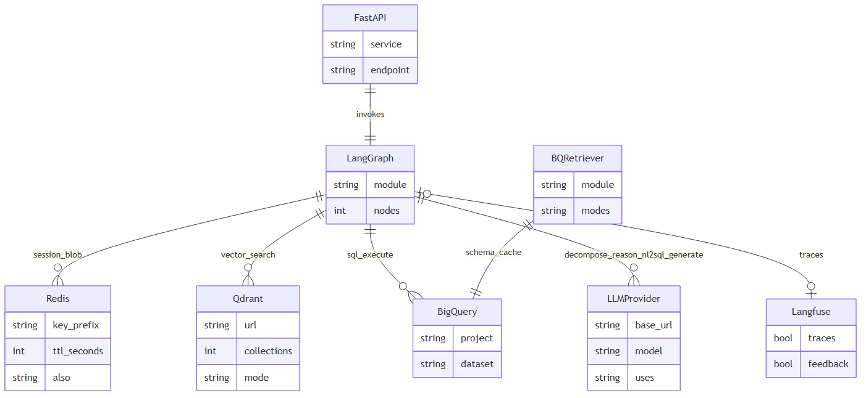
Infrastructure (services)
External services invoked by LangGraph.

Slide 13
Query-time RAG
LangGraph: control plane → vector leg → BQ leg → merge → generate

Slide 14
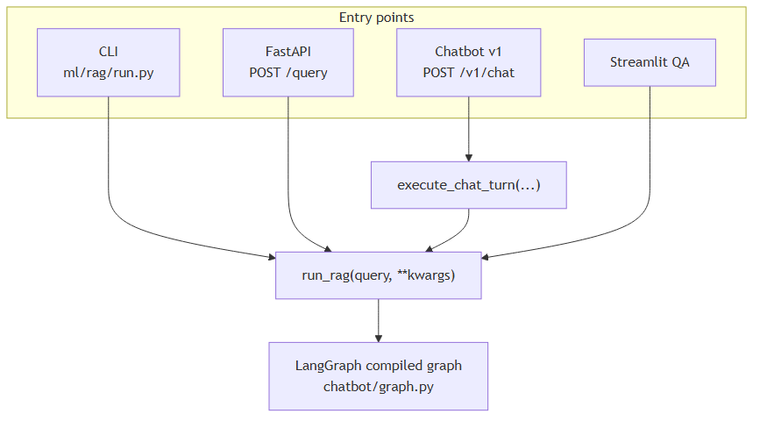
Entry points
CLI, FastAPI, Chatbot v1, and Streamlit routes into run_rag / LangGraph.

Slide 15
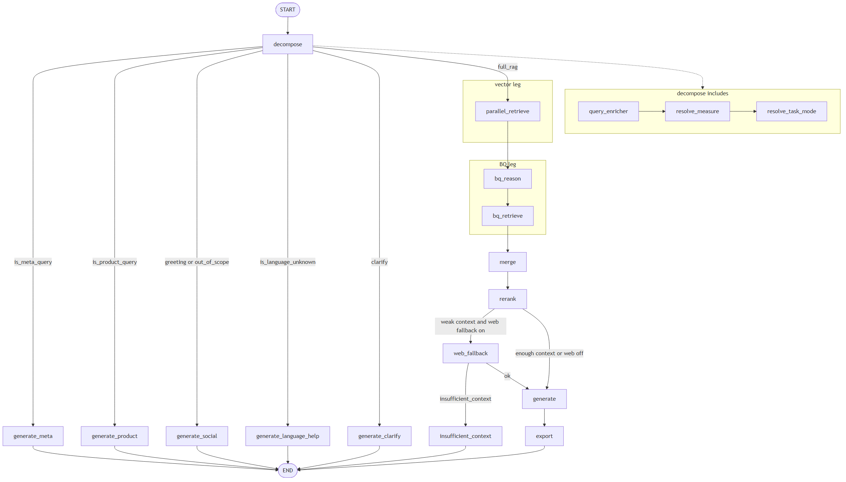
Full LangGraph (E2E)
Start-to-finish graph with vector and BQ retrieval legs into merge.

Slide 16
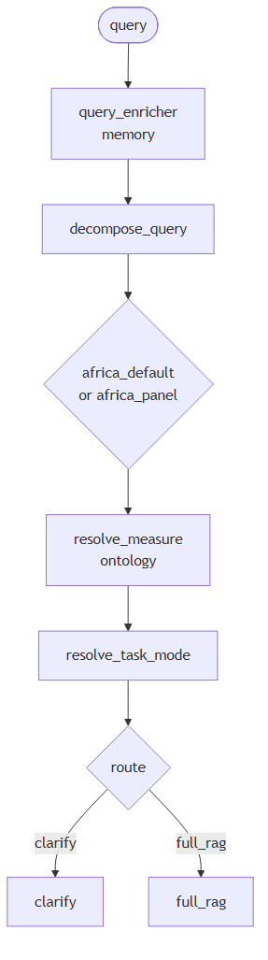
Control plane
Enricher → decompose → Africa scope → measure ontology → task_mode → route.

Slide 17
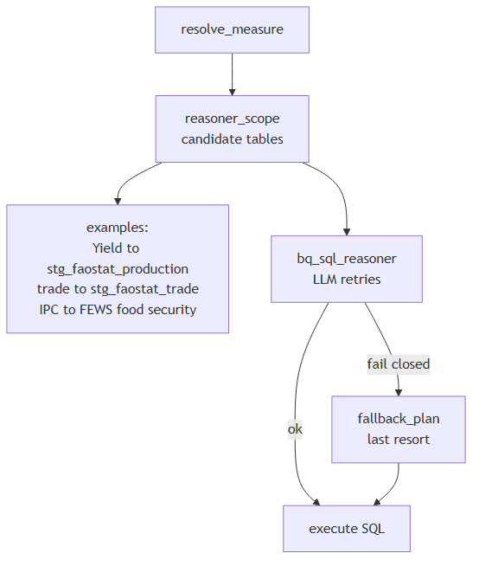
Measure ontology (BQ aid)
resolve_measure → reasoner_scope → LLM reasoner retries → ontology fallback last resort.

Slide 18
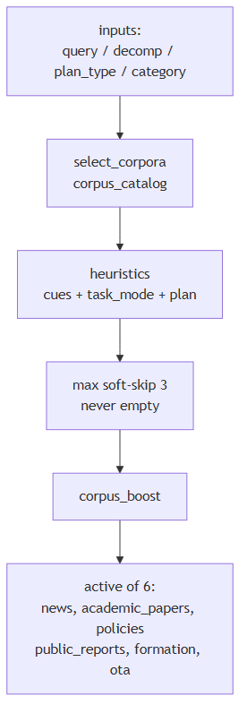
Corpus router
select_corpora gates which of six Qdrant collections to query (max soft-skip 3).

Slide 19
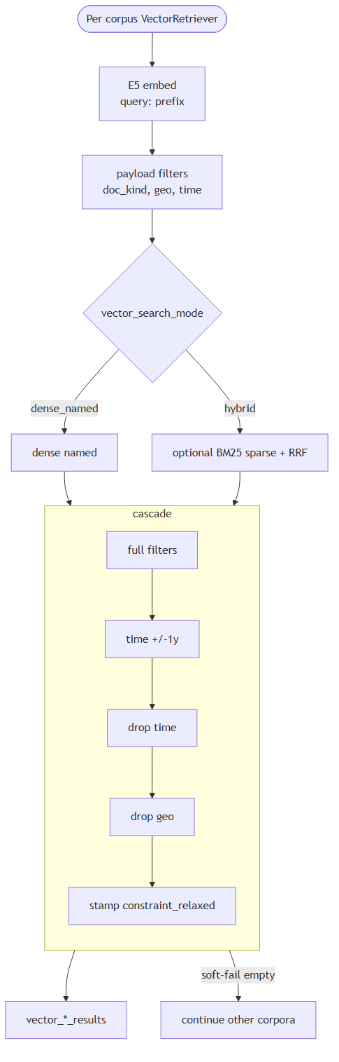
Vector retrieve (per-corpus cascade)
E5 embed → filters → hybrid RRF → filter cascade → vector_*_results.

Slide 20
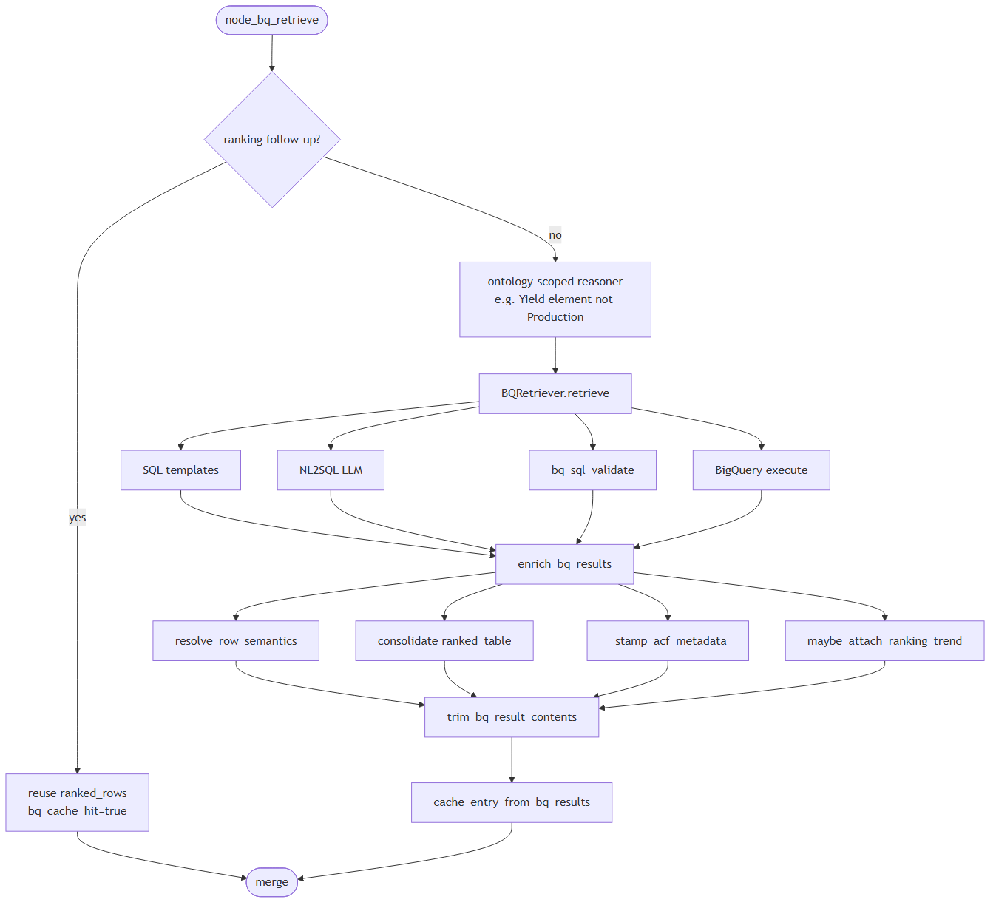
BigQuery retrieve
Ontology-scoped reason → templates/NL2SQL → execute → enrich/cache.

Slide 21
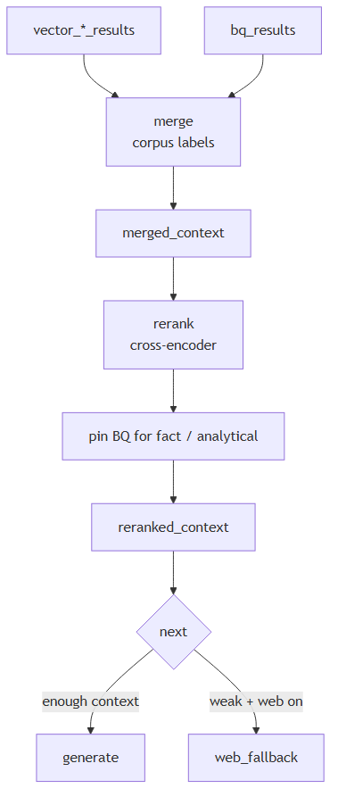
Merge and rerank
Fuse vector chunks + BQ rows; pin BQ for fact/analytical; cross-encoder rerank.

Slide 22
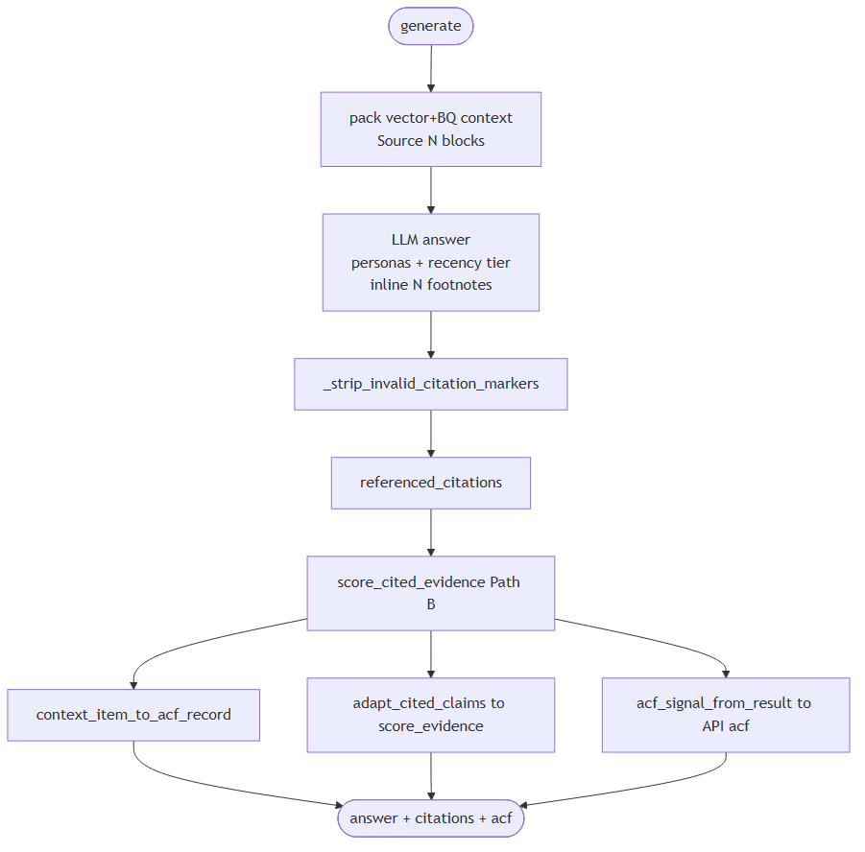
Generation and ACF
Pack vector+BQ context → persona/recency → LLM → citations → ACF Path B.

Slide 23
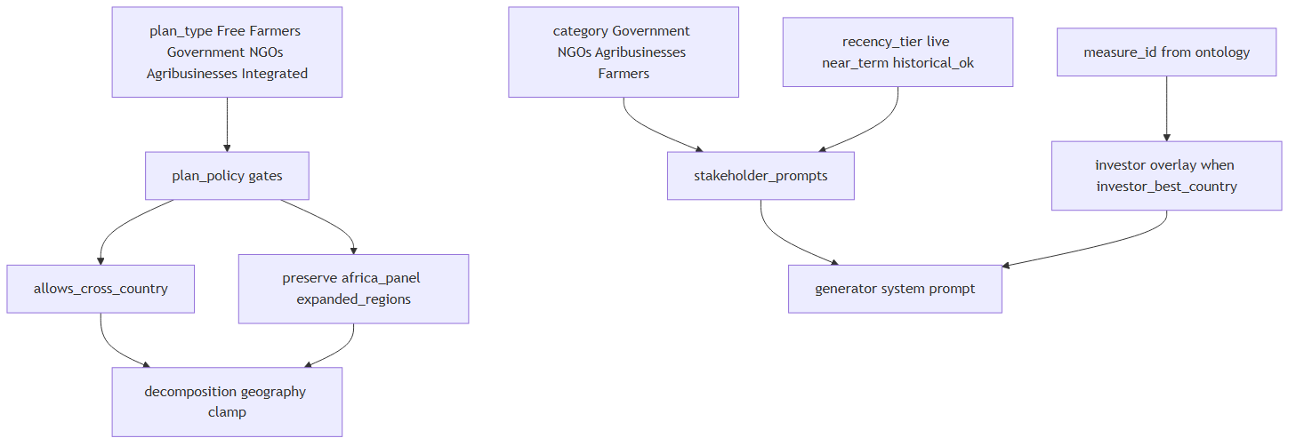
Plan tiers and personas
plan_type gates, category personas, investor overlay, recency tiers.

Slide 24
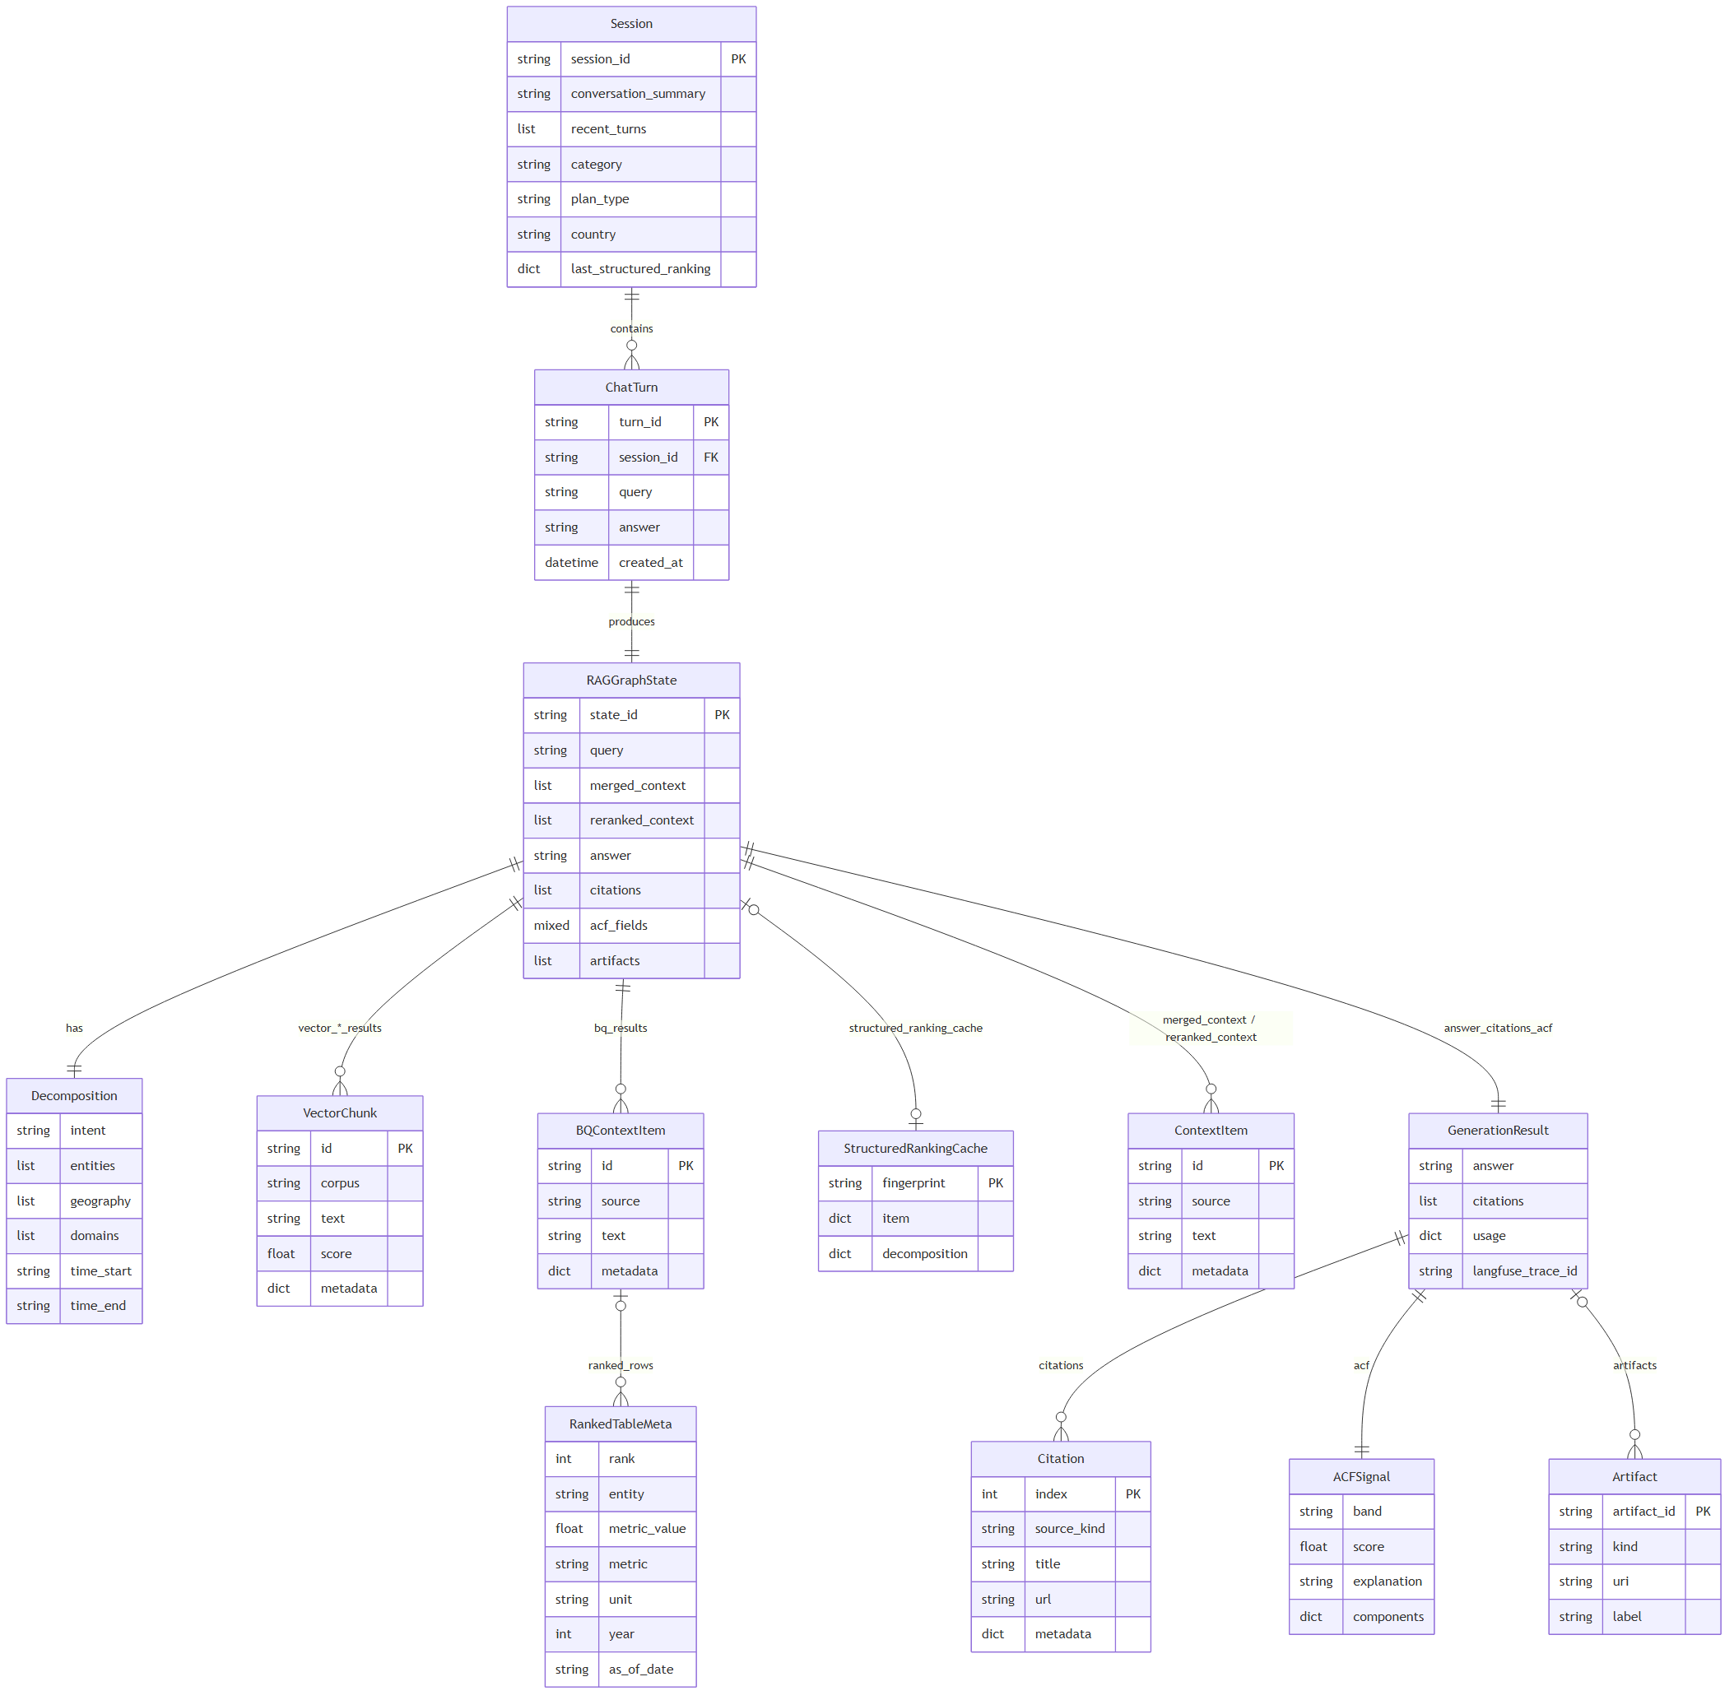
Runtime domain ERD
Query-time session, state, and generation entities.

Slide 25
Takeaways
• Vector and BigQuery are peer retrieval legs that fuse at merge — not SQL-only RAG
• Offline ingest fills six Qdrant corpora; query-time SQL stays on staging_dev
• Control plane (enrich → decompose → ontology → task_mode) routes clarify vs full_rag
• ACF Path B scores cited OpenTrace evidence only (0–100); empty cites → no evidence
• LLM steps fail soft — heuristics / ontology fallbacks keep the graph from crashing

Slide 26
Regenerate this deck
• From ml-eng/: python scripts/generate_rag_architecture_pptx.py
• Skip Mermaid re-render: python scripts/generate_rag_architecture_pptx.py --skip-render
• Also available: generate_rag_architecture_pdf.py · generate_rag_architecture_docx.py
• Output: ml/rag/docs/OpenTrace-RAG-Pipeline-Architecture.pptx
• Content version: 2.0

