Slide 1
DATABASE Principle Final Project: Coffee Shop Database
Presented BY: Chidimma Ibeh

Slide 2
The Database: Coffee shop
Database objectives:
Collects and stores customer’s personal information
Tracks customers’ purchases
Tracks best-selling items
Calculates sale prices, discounts, and taxes
Tracks inventory

Slide 3

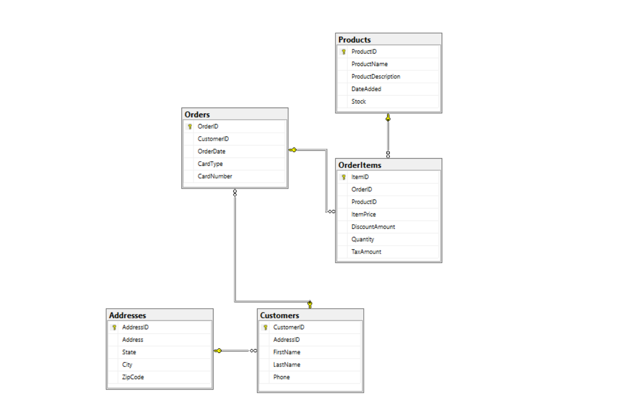

Slide 4
Coffee Shop Scripts
1. Database
2. Tables
3. Views
4. Queries
5. Function

Slide 5
List OF tables
1. Address
2. Customers
3. OrderItems
4. Orders
5. Products

Slide 6
Coffee shop VIEWS
1. AddressList: this view might be useful for an analyst and marketing team
2. CustomerList: this information would be useful to the support and marketing staff
3 OrderItemList: this view would be useful to the business owner.
5. ProductList: this information would be useful to the warehouse staff
4. OrderList: this view would be useful for an accounting team

