Slide 1

Data Science and AI Careers in Government and Academia Timipado Imomotebegha
This presentation uses SliDo. Get set up by searching ‘SliDo’ and, when prompted, enter the code #[3106253]
Notes:
Host:
Welcome, this talk has been put together by The Alan Turing Institute, the UK’s national institute for data science and AI. The project is supported by the Institute’s Defence and Security Partners and, as such (and in addition to general government/academia careers), will also cover specific roles and routes into defence and security careers.
My name is ______ and I am [insert information about the presenter here]
Name and pronouns
Organisation affiliation
Job title
(Summary of career trajectory)
Before we kick off, I’d like to go through some general housekeeping – just so that you know what to expect and how you can interact with us and with the content.
We will use SLiDo for certain interactive elements, which can be accessed via phones, tablets or laptops – just input the # code once you’ve visited their website. There is the option to vote in polls or ask questions anonymously, which is our default setting – if you'd like, you will be able to change this to show your name once you access SliDo via the code.​
We welcome questions and will endeavour to provide an answer to as many as possible – please don’t leave your questions unasked! In the interest of time and presentation flow, we ask that you submit your questions via the Q&A feature on SliDo so that we can address them at the end in our allocated Q&A time. You will have opportunity then to raise your hand if you’d like. If you’ve not used SliDo before, all questions in the Q&A section will be visible to all and there is a ‘thumbs up’ feature for liking other questions that have been asked that also interest you. We will prioritise questions with the most ‘thumbs up’, where possible, and, in the even that we’re unable to answer all questions, we will save the questions and address these after the session in the follow-up mailing list emails.
​
Notes:
As students enter the room, encourage them to get set up with SliDo (using the hashtag displayed).
For info only – do not read out loud SliDo account details: Username: events@turing.ac.uk Password: Enigma12
SliDo needs polls activating before each session.
During Q&A, or throughout the session, it might be useful to have one facilitator monitoring the Q&A to filter questions.

Slide 2

What's in it for you?
Gain an overview of data science and AI
Learn about Critical National Infrastructure (CNI) and the increasing importance of CNI responses
Consider the importance of diversity in data science and AI
Learn about some of the different data science / AI roles available in Defence and Security (D&S) and the public sector
Identify a route to useful resources to support a career in this area
See an example of a researcher/professional(s) in the spotlight and ask questions
Jan 2026 The Alan Turing Institute
Notes:
Host:
Welcome.
Let’s go over our objectives for today. By the end of the session, you will have (read from the screen)
1. Gained an overview of data science and AI: what it is and what it is not
2. Learnt what Critical National Infrastructure (CNI) is and why our responses to situations in this field are so important
3. Considered the importance of diversity in data science
4. Learnt about some of the different data science roles available in Defence and Security (D&S) and the public sector more widely
5. Identified a route to useful resources to support a career in this area
6. Seen an example of a researcher(s) in the spotlight and asked questions
Because diversity, and diversity of thought is integral to better processes, systems and better data science, we are also going to have a section focussing on diversity during this presentation, where we will be encouraging you to think about diversity and why it is so important, how it has already impacted and continues to impact elements of our everyday lives.
We are also going to think about the impact of not including people from multiple groups in data science and AI-centric roles and how this might affect different groups and society.
Notes:
Each objective is animated to come out one-by-one.

Slide 3



Do not edit How to change the design
What do you know about data science ?
The Slido app must be installed on every computer you’re presenting from

Slide 4

What is Data Science?
Jan 2026 The Alan Turing Institute
Notes:
Host:
First ask the audience what they know about data science to gauge the level to pitch the presentation. If they're very knowledgeable then can be quicker through the first half of the slides) e.g.:
What is data science?
What do you already know about data science ?
How many people feel like they know what data science is? Can do hands for a lot, not much, a reasonable amount etc.
Then show short video:
We are going to show you a short section of a video introducing The Alan Turing Institute, the UK’s national institute for data science and AI, and which addresses what Data Science is.
Show to 1:23 ie end of what DS is, stop when talking about Turing Institute
Link to the next few slides:
Let's look at what a typical pipeline might be for problem solving with data
Notes:
Alternative link here if embedded video doesn’t work: https://www.youtube.com/watch?v=BCbwj5O6g9w

Slide 5
Life cycle of data for problem solving
Identify the research question
Plan and design the model
Collect the relevant data
Clean and pre-process the data
Run analysis
Write up the results
Store the data
Consider future uses of the data
Jan 2026 The Alan Turing Institute
Notes:
Host:
(Added by Rachael)
It is a common misconception that data science is entirely about running algorithms or staring at complex charts. Only a small amount of data science is actually about analysing the data, although that is an important step. Here we consider all the steps involved in a typical data analysis task: from the moment an idea is formed and how the data is prepared, to our experiments and conclusions and finally what happens after the project is finished.
This life cycle will generally involve a large team, rather than an individual carrying all these aspects themselves. So a person might become a specialist in one area, but these projects will still require diverse teams
(Note: if short on time, highlight the stages that are lesser known, move quickly through/skip the ones it's likely they already have knowledge on them from the gauging question earlier)
1. Identify the research question:
Everything starts here. We’ve got to be sure to ask the right question and understanding the business problem or scientific hypothesis before even touching the data.
2. Plan and design the model:
Ahead of any coding, we have to plan. What's our method going to be? Perhaps it's a regression problem or a classification problem. Have we considered our ethical constraints? This is our thinking phase.
3. Collect the relevant data:
This could be setting up sensors, scraping web data, designing a survey or querying existing databases. The goal is to gather the relevant raw information.
4. Clean and pre-process the data:
We might be handling missing values, fixing formatting errors or normalising the values so that the data is fairly comparable and easily useable. This often takes a long time and can be boring but is necessary work before the interesting part!
5. Run analysis:
Here we run algorithms, test our hypotheses, and find useful patterns. As long as we do a good enough job preparing the data in the previous step, this part should run smoothly.
6. Write up the results:
Data is useless if it doesn't persuade or inform so this step is about storytelling. We must translate our data analysis into actionable insight for stakeholders who might not have a technical background.
7. Store the data:
Once the project is complete, we need to do something with the data. It should be archived for reproducibility purposes and it's important to store it securely, especially if it contains confidential information (i.e., medical records).
8. Consider future uses of the data:
Can this dataset be used again to help answer other research questions? We close the lifecycle loop by sparking ideas for the next investigation.
Ask the audience to think about the steps in the cycle (optional whether this is reported, or just for personal reflection, depends on time and if they are keen on participating)
What data science or AI techniques could be used here (and whereabouts would they be used in the lifecycle)?
Notes: The steps of the lifecycle will animate one-by-one

Slide 6
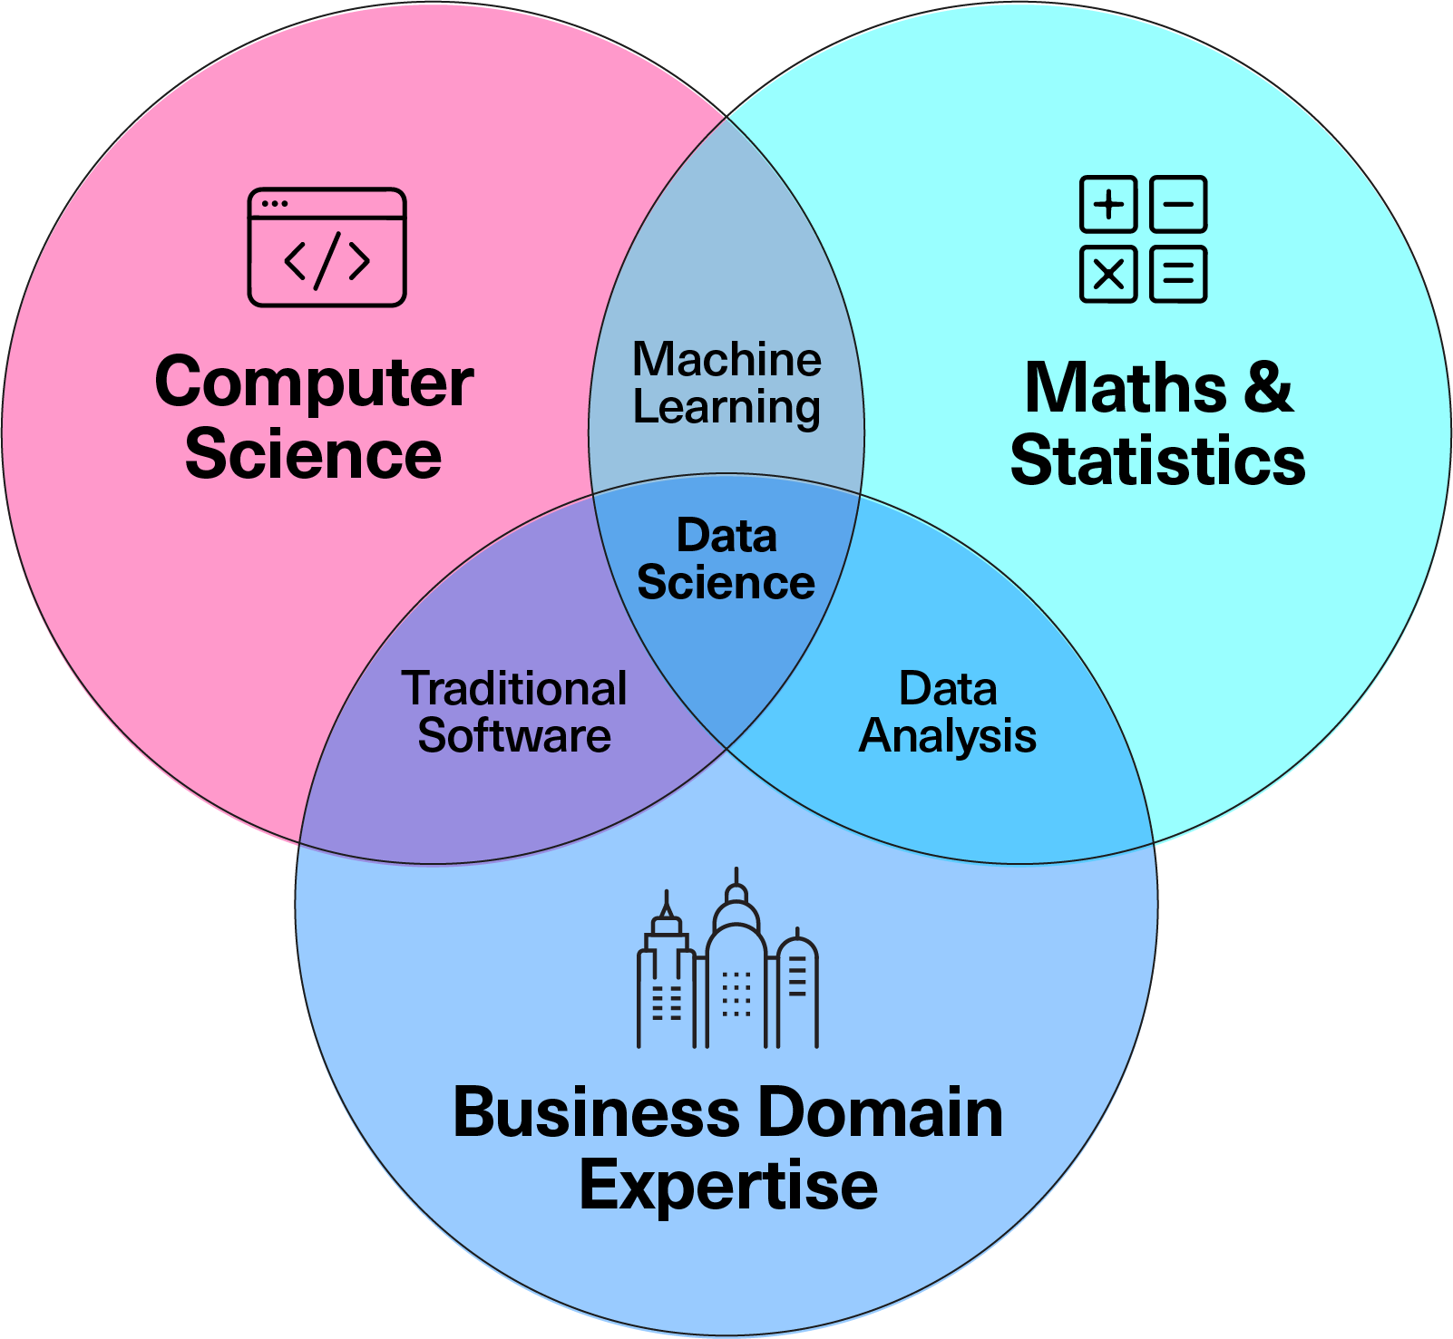
Aspects of Data Science
Can AI methods help to model this?
Is traditional statistics more appropriate?
What sort of data do I have?
What kind of methods should I use to analyse it?
How do I need to transform the data?
Do we have missing data to think about?
What is the best programming language to use?
What libraries or packages might be helpful?
Have we done something like this before?
What additional software do I need to create?
What are sensible assumptions to make?
What are the biases in this sort of data?
Jan 2026 The Alan Turing Institute
Notes:
Host:
(Added by Rachael)
Data science involves a range of skills. As a data scientist you will need to be comfortable working in these different areas, and their intersections.
The three main areas in which you will need some expertise, in order to make decisions about the analysis of data are:
1. Computer Science/IT (What is the best programming language to use?)
We have to make decisions here: are we using Python and its libraries or R for its statistical packages? Do we have the infrastructure to handle the volume of data we have? We might need access to a supercomputer or know about parallel processing.
2. Statistical Mathematics (What sort of data do I have? What kind of methods should I use to analyse it?)
This is the theoretical foundation where we ask things like: what is the distribution of our data? Is each result actually significant or just a fluke? And it guides us on which methods are mathematically valid for the specific dataset we have when we are planning our approach.
3. Business/Domain Knowledge (for example: What are sensible assumptions to make? What are the biases in this sort of data?)
This is sometimes an overlooked element - you can be a great coder and a great statistician, but if you don't understand the context (the business, the field of science, the market), you may well solve the "wrong" problem.
These areas also overlap with each other:
1. Machine learning. Can AI methods help to model this? Is traditional statistics more appropriate?
When we combine heavy computing power with advanced mathematics, we get Machine Learning, which falls under the AI umbrella... but just because we can use a complex AI model, should we? Sometimes a simple statistical regression is faster, cheaper and easier to explain - this intersection is therefore about balancing complexity with utility.
2. Data Analysis. How do I need to transform the data? Do we have missing data to think about?
When we apply statistical rigor to business problems, we get Data Analysis. Real-world business data is messy so we have to decide how to manage that: if there are missing values, do we delete those rows or estimate the missing numbers? These decisions require both maths skills (for imputation) and business skills (is it safe to assume this value?).
3. Software development. Have we done something like this before? What additional software do I need to create?
Finally, when Computer Science meets a Business need, we get Software Development. This is about operationalising our work. We don't want to reinvent the wheel - can we make use of something pre-existing (even just as a starting point)? And can we package our analysis into a repeatable piece of software for future use or even a dashboard that the business can use every day without calling a data science expert?
As a junior data scientist, you would not be expected to be equally good in all these areas, but you will need to be good at picking up skills on the job and learning from the experts you work with, which means (so-called) soft skills are also really important and we'll talk more about those later.
The variety of questions asked on this slide reflect the variety of skills that are required for the success of any project. This is highlighting the need for diverse teams and good collaboration for the best results and most efficient processes.
Before moving on to the next section, if there's time, can ask if these questions and ideas resonate with them and take a couple of their thoughts e.g. answering the question on programming languages, any biases they have seen, the similarities and differences between data science, stats, ML etc.

Slide 7
Do not edit How to change the design
what comes to mind when you think of the term "Critical National Infrastructure (CNI)" ?
The Slido app must be installed on every computer you’re presenting from

Slide 8

What is Critical National Infrastructure?
Energy (electricity, gas, oil)
Civil nuclear (power stations)
Chemical and nuclear sites
Water supply
Transport (roads, rail, airports, ports)
Communications (internet, phones, mobile networks)
Space (satellites for GPS, communications)
Health (hospitals, NHS systems)
Food supply chains
Financial services (banks, stock exchange)
Government functions
Emergency services
Defence
Jan 2026 The Alan Turing Institute
Notes:
Host:
Now that we've set the stage with what data science is and how your skills might be applied, we'll look at one of the vital government applications of these skills:
Critical National Infrastructure (CNI)
What Is It?
Critical National Infrastructure is how we describe the essential systems and assets that a modern country absolutely needs to function. Think of it as the "vital organs" of a nation - if any of these stops working, society faces serious consequences very quickly.
In the UK, there are 13 sectors classified as CNI
Can they guess them? - take 20 seconds to take any responses if possible
Note them down, then see how many match. No need to read all the answers, can just reveal them and highlight the more unlikely ones
Energy (electricity, gas, oil)
Civil nuclear (power stations)
Chemical and nuclear sites
Water supply
Transport (roads, rail, airports, ports)
Communications (internet, phones, mobile networks)
Space (satellites for GPS, communications)
Health (hospitals, NHS systems)
Food supply chains
Financial services (banks, stock exchange)
Government functions
Emergency services
Defence
Why Should You Care? (45 seconds)
You depend on CNI every second without realising it:
Ask (or highlight) what would life be like if you wake up tomorrow and:
There is No electricity? → No heating, no lights, no charging your phone, food in freezers spoiling
No water? → Taps run dry, toilets don't flush, hospitals can't operate
No internet/mobile? → Can't contact anyone, no online banking, no GPS, businesses halt
No transport? → Food doesn't reach supermarkets, you can't get to school/work
No financial systems? → Can't withdraw cash, cards don't work, economy freezes
These areas are so embedded into the fabric of our day-to-day and cover so many entities that it relies on the public services and govt management to coordinate and monitor for abnormalities.
The interconnected nature of our world might improve efficiency generally, but means there will be serious failure points that have to be kept secure.
A problem might occur, but it might affect multiple companies directly, which then has knock-on effects to others and because we're so used to these systems functioning as they should, any issues can rapidly create widespread damage.
Examples on the next slide

Slide 9
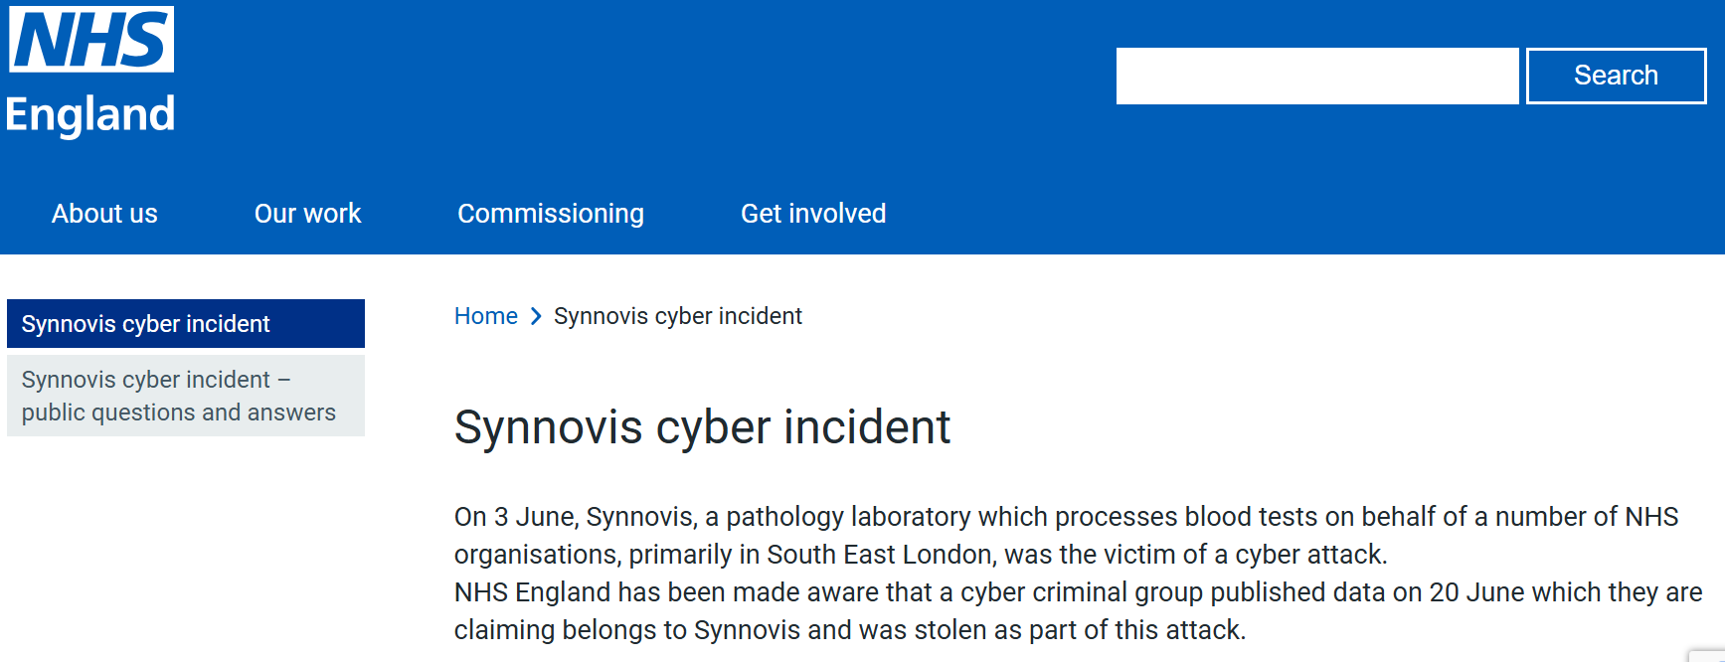

CNI - Data Science and AI in everyday life…
Jan 2026 The Alan Turing Institute
Notes:
Host:
You may recognise some of these recent incidents having a large effect on your own day-to-day life
(summarise if there's not enough time to go through them and focus on the Turing's mission at the end)
1. NHS Synnovis Ransomware Attack (June 2024)
On June 3, 2024, Synnovis, a pathology laboratory processing blood tests for NHS organizations in south-east London, suffered a ransomware attack( NHS England.)
Impact:
Widespread interruptions to pathology services with delays to over 11,000 outpatient and elective appointments
In just the first week, over 800 planned operations and 700 outpatient appointments had to be rearranged at two NHS trusts NHS England
Blood testing operated at only 10% of normal capacity HIPAA Journal
NHS had to urgently call for O Negative and O Positive blood donations because they couldn't do blood-matching tests HIPAA Journal
The attack cost Synnovis £32.7 million and recovery took over 16 months PublicTechnology
Conclusion:
Highlights the vulnerability of critical healthcare infrastructure to cyberattacks and the cascading effects such breaches can have on patient care.
2. Cyber attacks on UK retailers and brands (April - September 2025)
Between April and September 2025, major UK retailers and brands suffered a series of devastating cyber attacks.
Impact:
Over 10 days in April and early May, Marks and Spencer, the Co-operative Group, and Harrods were hit by attacks affecting ecommerce and payment processing, with H&M also experiencing an IT outage in June that took down in-store payment systems.
Jaguar Land Rover faced a major cyber incident in September causing supply chain disruptions,
Heathrow travellers experienced delays from an attack on a supplier later that month.
Conclusion:
This is a wide-range of domains and consequences impacting the day to day life and the wider economy.
The financial toll is severe—research shows companies can lose up to £73 million per minute in the first 10 minutes when payment systems go offline.
Turing mission:
CNI threat response is something the Turing is very involved in
A core ambition of the Turing's CNI mission is to shift the balance of power towards defenders.
Instead of reactive fixes, the shift is to build systems that anticipate and absorb attacks.
Threats to UK infrastructure are growing in scale and complexity, which means responses have to as well.
The Turing is collaborating with its partners in the hopes of providing a new baseline for national cyber resilience.
This is to help ensure the systems we all depend on remain safe, stable, and secure.
The aim is to design intelligent and flexible tools that can be deployed in the most fragile and sensitive environments.
The Turing is bringing together a diverse range of stakeholders: researchers, govt bodies, infrastructure operators, and industry partners to try and create a shared space for experimentation and rapid learning.
------------------
– much like a biological immune system detects, isolates and neutralises infections.
The UK’s critical infrastructure is at risk from cyber-attacks. Our AI tools will provide a new line of defence | The Alan Turing Institute

Slide 10
Do not edit How to change the design
what comes to mind when you think of the word ‘diversity’?
The Slido app must be installed on every computer you’re presenting from

Slide 11


Until 2016, the code that formed most of our (now old-fashioned) emojis generated gender-biased images. For example, the code for a ‘runner’ would depict a white, male runner and, similarly, the code for a ‘police officer’ depicted a white, male policeman. In 2016, Unicode developed code to ensure male and female representation, which has since evolved to capture a much more diverse representation of society.
Did you know?
How could diversity (and better representation) in data science and AI roles impact how we see ourselves and others?
Jan 2026 The Alan Turing Institute
Notes:
Host:
Read the slide (if there is time)
Until 2016, the code that formed most of our (now old-fashioned) emojis generated gender-biased images. For example, the code for a ‘runner’ would depict a white, male runner and, similarly, the code for a ‘police officer’ depicted a white, male policeman. In 2016, Unicode developed code to exist for male and female options, which has since evolved to capture a much more diverse representation of society. This quote was taken from a book called Invisible Women by Caroline Criado Perez.
Take answers via Slido if this embedding works, hands and noting answers is another option
Notes: Caroline Criado Perez’s book, Invisible Women: https://www.shortform.com/summary/invisible-women-summary-caroline-criado-perez?utm_source=bing&utm_medium=cpc&utm_campaign=Book%20-%20Invisible%20Women%20-%20Broad%20-%

Slide 12
Diversity in the sciences
Socio-economic background has a strong effect on an individual’s likelihood of entering the scientific workforce. One study, conducted by The Royal Society, found that the higher an individual’s socioeconomic background (measured in terms of parental social class or parental education), the more likely they were to work in science.
- The Royal Society
Jan 2026 The Alan Turing Institute
Notes:
Host:
Diversity in the science(s) is an area for improvement across the sector.
We have sourced some quotes for this presentation to really highlight both the need for greater diversity and what diversity currently looks like within the sector. This first quote is from the Royal Society and relates to the relationship between socio-economic background and studying science. We will give you a minute to just read it. The statistics and quotes we show in this presentation will change year-by-year, but it is important to note that having this awareness and bringing about change (i.e. diversifying our workforces) will have positive impacts on multiple individuals and groups.
Our aim with this presentation is to encourage those from currently underrepresented groups, such as lower socioeconomic background and diverse ethnic groups, into careers in data science and AI. We believe that everyone, regardless of gender, socioeconomic background, race, disability, illness etc. has something to bring to every table and it is important that multiple voices are heard across this sector to ensure that multiple groups are catered to.
Read the slide out loud (if there's time)
Socio-economic background has a strong effect on an individual’s likelihood of entering the scientific workforce. One study, conducted by The Royal Society, found that the higher an individual’s socioeconomic background (measured in terms of parental social class or parental education), the more likely they were to work in science. - The Royal Society

Slide 13
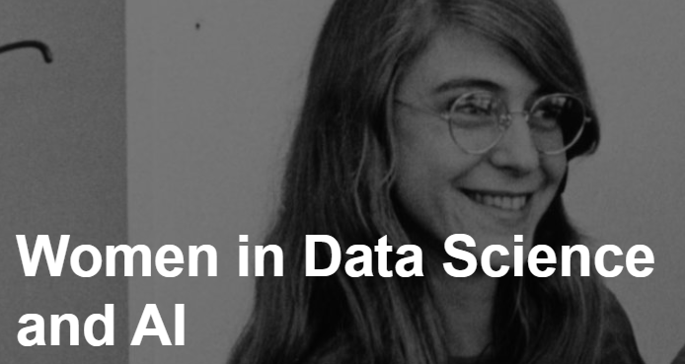
Did you know?
Women make up half the UK population, but only 22% of AI and data professionals and 18% of users across the largest online global data science platforms
What potential impact(s) would there be to society if we had diverse and representative workforces in data science and AI roles?
Jan 2026 The Alan Turing Institute
Notes:
Host:
Socio-economic background is not the only underrepresented group. Women are heavily underrepresented. According to research from The Alan Turing Institute, only 20% of AI and data professionals and 18% of users across the largest online global data science platforms are women, despite the fact that women make up half of the UK population.
Those from a black ethnic background are also underrepresented. In 2019, the Guardian reported that only 2.5% of Google’s workforce identifies as black, whilst Facebook and Microsoft state they have a 4% black workforce. You can access Google’s workforce diversity data online – we found that, as of 2024, the percentage of the tech workforce that identifies as black has increased to 4.2%, though this is still low. Do bear in mind that this includes Google’s entire tech workforce, and is not specific to data science and AI roles.
Little data exists on trans workers or other gender minorities in the AI field.
Ask students to read the slide
Ask them the question on the slide about the consequences of having a similar workforce // the impact of having a diverse workforce on society. Take notes of their ideas.
Notes:
https://royalsociety.org/topics-policy/diversity-in-science/uk-scientific-workforce-report/
https://www.theguardian.com/technology/2019/apr/16/artificial-intelligence-lack-diversity-new-york-university-study
https://www.turing.ac.uk/research/research-projects/women-data-science-and-ai-new
Google 2021 Diversity Annual Report (googleusercontent.com)
Notes:
Caroline Criado Perez’s book, Invisible Women: https://www.shortform.com/summary/invisible-women-summary-caroline-criado-perez?utm_source=bing&utm_medium=cpc&utm_campaign=Book%20-%20Invisible%20Women%20-%20Broad%20-%20Intl&utm_term=invisible%20women&utm_content=84869082580160&msclkid=975162abde701f3105ee06ccab309bd9

Slide 14
Do not edit How to change the design
What potential impact(s) would there be to society if we had diverse and representative workforces in data science and AI roles?
The Slido app must be installed on every computer you’re presenting from

Slide 15
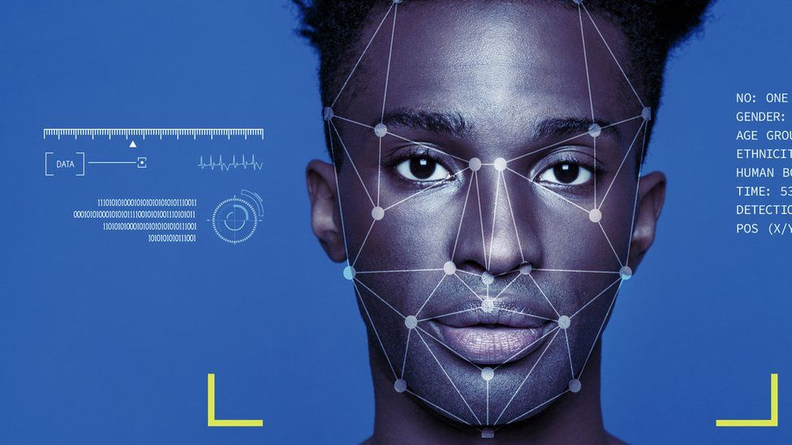
Did you know?
Facial recognition algorithms boast high classification accuracy (over 90%), but these outcomes are not universal. A growing body of research exposes divergent error rates across demographic groups, with subjects who are female, black, and between 18-30 years old consistently being most likely to be misidentified.
How do non-diverse workforces impact companies’ products?
Jan 2026 The Alan Turing Institute
Notes:
Host:
Another did you know
To add to the information presented here (taken from an article published by Harvard), in the landmark 2018 “Gender Shades” project, an intersectional approach was applied to appraise three gender classification algorithms, including those developed by IBM and Microsoft. Subjects were grouped into four categories: darker-skinned females, darker-skinned males, lighter-skinned females, and lighter-skinned males. All three algorithms performed the worst on darker-skinned females, with error rates up to 34% higher than for lighter-skinned males (Figure 1). Independent assessment by the National Institute of Standards and Technology (NIST) has confirmed these studies, finding that face recognition technologies across 189 algorithms are least accurate on women of colour.
Ask students to read the slide and think about the consequences of having a similar workforce // the impact of having a diverse workforce will impact the products a company produces. Take notes of their ideas.
1-2 mins for hands and experiences of when they've seen this occur and what they thought about it i.e. a moment for them to share experiences
Remind students that they can have access to all of the links and reading via the mailing list.
Notes: This information is taken from on article on Harvard University website: https://sitn.hms.harvard.edu/flash/2020/racial-discrimination-in-face-recognition-technology/

Slide 16
Do not edit How to change the design
How do non-diverse workforces impact companies’ products?
The Slido app must be installed on every computer you’re presenting from

Slide 17
Careers in Data Science
Myth-busting careers in Data Science
You don’t have to work at a big-name tech firm.
You can use your skills to solve important real-world problems.
You can move between academia, government and industry.
Applicants from a wide variety of backgrounds are welcome.
You don’t have to do a PhD or masters for many roles.
Jan 2026 The Alan Turing Institute
Notes:
Host:
Lets move on the careers-focussed portion of the talk
There are several myths about working in this sector, here are a few things that may or may not surprise you
You don’t have to work at a big name tech firm
It might sound obvious but data science roles exist in many different types of organisations. Today we are going to deep dive into a few of these but it’s really worth thinking about your passions and motivations and looking at an organisation that will let you harness these. If having an impact is important to you, then finding a company that reflects this is essential. The great thing about data science skills is they can be applied to anything!
You can use your skills to solve important real-world problems
Choosing to work in a public sector or government organisation will allow you to work on real world problems and make a real difference through your skills. If you are someone who is motivated to use your skills to make a difference this can be a really rewarding part of work in this area.
You can move between academia, government and industry
Many people prefer flexible careers and choose to work for a variety of different types of employers. Choosing a career in one sector increasingly doesn’t bar you from exploring other options later. There are also often opportunities to collaborate or take on secondments where you work for a different organisation within your role.
Applicants from a wide variety of backgrounds are welcome
While we may have an idea of a data scientist there really is no set type of person. A huge variety of backgrounds and skills are needed in data science particularly for roles in government.
You don’t have to do a PhD for many roles
It’s true that to progress in academia and research a PhD is usually needed but for many government roles you won’t necessarily need a PhD or even a masters! There are graduate options for many government data science roles and many research institutes will offer positions from masters onwards (or internships from earlier to try things out).
We're going to showcase some potential data science and AI-related careers. These lists/examples are not exhaustive, but merely a taster of potential careers available
Can share some personal reflections on our path to how we got to where we are now
----------------------------
As well as general myths about AI and data science, there are several myths about working in this sector as well! A few things that may or may not surprise you

Slide 18


Useful skills
Subject-specific skills
Computer Science
Statistics and probability
Coding (e.g. Python, R)
AI methods
Report writing / visualisations
Version control
Domain knowledge
Transferable skills
Working at pace to tight deadlines
Critical thinking
Strategic communication
Problem-solving
Project management
Numerical and analytical skills
Teamwork and collaboration
Jan 2026 The Alan Turing Institute
Notes:
Host:
As we’ve said there is no ‘perfect’ data scientist, and employers are looking for a range of team members to collaborate and complement each other. Some of the skills you will see valued in these professions include … [the listed skills are set to animate one-by-one].
Some roles may require transferable skills, but will support you to develop subject-specific skills on the job or via apprenticeships and internships etc.
It is worth noting that this list is not exhaustive, and you don’t have to have equal abilities in all these skills.
Some questions useful to reflect on later are: (not sharing in the session, but option to come and chat to host after the talk)
What transferable skills do you think you have already?
How did you get these skills? Any specific examples/things you're proud of?
How can you continue to improve these skills?
Notes: Each skill is animated to come out one-by-one.
If time is tight, you can cut the questions from the host script – instead, pose them as hypothetical questions e.g. We’d like you to go away and think about what skills you already have, how you got them and how you can continue to improve them.
The subject-specific skills relate to STEM and non-STEM skills.

Slide 19

Roles
Data Scientist
Programme director
Cyber Warfare Engineer
UX Developer
Compliance officer
Cyber Architect
Data Engineer
Cyber Security Engineer
Research Scientist /
Research Data Scientist
Programme/Project manager
Human Factors Engineer
Roles within a Cyber Operations Centre
Research Engineer
Software Engineer
Behavioural Scientist
Intelligence Analyst
Machine Learning Engineer
Training officer
Jan 2026 The Alan Turing Institute
Notes:
Host:
When applying for roles in data science and AI, you may come across some of these roles and titles. While this list is not exhaustive, it gives a taster of what you might come across.
Allow each role to transition in one-by-one and read aloud if there's time (last one to appear is Programme/Project manager on the right hand side)
Some roles, such as data scientists, data engineers, research scientists, research engineers, different officers and project manager roles are likely to be advertised across multiple organisations looking for data science and AI-specific applicants. Other roles, such as cyber architects or cyber security engineers are more likely to be found in defence and security organisations.
If there's time, ask students if any of these roles and titles are familiar and if they know what the role entails (elicit answers)
To find out more about working in the data science and AI sector, you can access a free bank of short films on podcasts on the Turing website. We have interviewed people from various roles and across the sector about their day to day, what skills they use, what they wish they’d known before entering the field, what misconceptions there are about working in the sector and what their roles entail, as well as a whole lot more.
Just type into google: The Alan Turing Institute’s Spotlight Series on data science and AI.
Notes: Time-depending, it might be worth talking through a selection of the roles displayed, a summary of which can be found below.
If a student asks a question clarifying the difference between certain roles, don’t be afraid to come back to them at the end (in the interest of time) and use the notes below to support an answer. Equally, students can take note of different roles and do their own research – really, this is to showcase how many different role titles are out there. Some companies will use different title names even if the JD is the same, too.
Cyber architect: The job of cybersecurity architect is a senior-level position responsible for planning, designing, testing, implementing and maintaining an organisation's computer and network security infrastructure.
Cyber Security Engineer: Cybersecurity engineers — also known as information security engineers, data security engineers or similar titles — are responsible for putting in place the security and protection features that guard against cyberattacks and other digital threats.
Cyber Operations Centre: The function of the security operations center (SOC) is to monitor, prevent, detect, investigate, and respond to cyber threats around the clock.
Software Engineer: A software engineer is a person who applies the engineering design process to design, develop, maintain, test, and evaluate computer software.
Machine Learning Engineer: Machine learning engineers design and create the AI algorithms capable of learning and making predictions that define machine learning (ML). An ML engineer typically works as part of a larger data science team and will communicate with data scientists, administrators, data analysts, data engineers and data architects. Intelligence Analyst: Intelligence Analyst responsibilities include preparing intelligence reports, handling sensitive information and providing recommendations to various law enforcement departments as needed. Ultimately, you will work with a small team to use data and different reports to prevent criminal activity throughout the year.
Behavioural Scientist: Behavioral scientists study when and why individuals engage in specific behaviors by experimentally examining the impact of factors such as conscious thoughts, motivation, social influences, contextual effects, and habits.
Human Factors Engineer: Human factors engineering (HFE) is a discipline concerned with the design of tools, machines, and systems that take into account human capabilities, limitations, and characteristics. The goals are to design for safe, comfortable, and effective human use.
Research Scientist: Research scientists are responsible for designing, undertaking and analysing information from controlled laboratory-based investigations, experiments and trials.
Data Engineer: A data engineer is an IT worker whose primary job is to prepare data for analytical or operational uses. These software engineers are typically responsible for building data pipelines to bring together information from different source systems.
Cyber Warfare Engineer: Cyber Warfare Engineers (CWE) apply principles and techniques of computer science and computer engineering to research, design, develop, test and evaluate software and firmware for computer network attack, exploitation and defence in cyberspace operations.
Data Scientist: A data scientist uses data to understand and explain the phenomena around them, and help organizations make better decisions.
UX Developer: A UX Developer is a person who has the skills to learn the journey that a user takes when they are on the front end of a website and then design the best possible journey that a front-end user can take. In the context of defence and security, this will also include ensuring that journey is ‘safe’ by implementing structures such as end-to-end encryption.

Slide 20
Working as a Data Scientist
Typical tasks include:
Scoping problems (identify the question to answer and the best way to approach it)
Data wrangling (e.g. cleaning datasets and creating databases)
Writing code to analyse data (actually run the analysis)
Reviewing other people’s code (or code written by AI tools)
Reporting the results (maybe presentations or written reports)
You can find more examples in The Alan Turing Institute’s ‘Spotlight Series on data science and AI’
Jan 2026 The Alan Turing Institute
Notes:
Host:
As a data scientist you will be expected to carry out a range of tasks. Some of those that are common to most roles are:
Scoping problems (identify the question to answer and the best way to approach it)
Data wrangling (e.g. cleaning datasets and creating databases)
Writing code to analyse data (actually run the analysis)
Reviewing other people’s code (or code written by AI tools)
Reporting the results (maybe presentations or written reports
Move this to slide beofre and cut this slide
To find out more about working in the data science and AI sector, you can access a free bank of short films on podcasts on the Turing website. We have interviewed people from various roles and across the sector about their day to day, what skills they use, what they wish they’d known before entering the field, what misconceptions there are about working in the sector and what their roles entail, as well as a whole lot more.
Just type into google: The Alan Turing Institute’s Spotlight Series on data science and AI.
Notes:
Tasks animate one-by-one

Slide 21









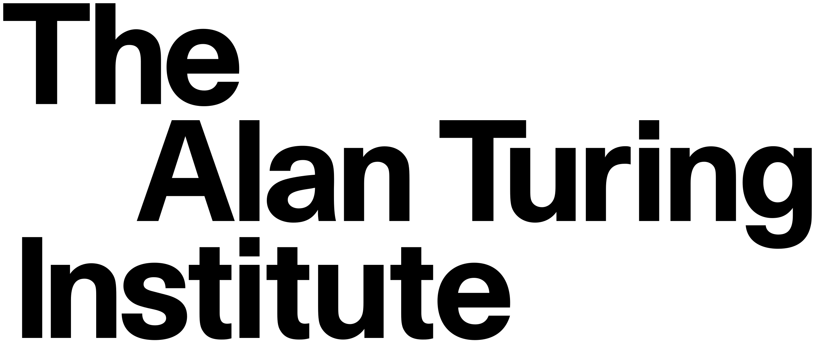



Employers
Defence and Security
Government Digital Service
UK Government
24 Ministerial Departments
20 Non ministerial departments
418 Agencies and other public bodies
Research institutes
Also:
Industry
NGOs
Jan 2026 The Alan Turing Institute
Notes:
Host:
If you choose a career in data science, you have a great choice of employers. Today we are highlighting roles in defence and security, government (and public sector) and research institutes. The next few slides will take us through examples of relevant employers, work benefits and routes into careers within these areas.
Defence and Security
Some of the organisations you could work for in the Defence and Security sector include:
- The Ministry of Defence, which is a ministerial department that works for a secure and prosperous UK.
- The Security Service, often known as Mi5, keeps the UK safe by reducing and removing threats.
- The Secret Intelligence Service, known as Mi6, works overseas to keep the UK safe.
- GCHQ, the UK’s intelligence, cyber and security agency. All three agencies work closely together.
- DSTL an executive agency of the Ministry of Defence (MOD) providing world class expertise and delivering cutting-edge science and technology for the benefit of the nation and allies.
UK govt
If Defence and Security isn’t a field available to you or of interest, there are hundreds of other options in the UK government. Civil service roles in data science are likely to fall under the Digital, Data and Technology profession. There are 24 ministerial departments in additional to non-ministerial departments and agencies. Some areas where you will find data science roles include:
- The Office for National Statistics: the UK’s largest independent producer of official statistics. This is a recognised national statistical institute.
- UK Health Security Agency: responsible for protecting every member of every community from the impact of infectious diseases, chemical, biological, radiological and nuclear incidents and other health threats.
- National Crime Agency: protecting the public from serious and organised crime.
These are just a handful of the options for government data science jobs!
Research Institutes
Furthermore, you will find other opportunities to work on real world projects and collaborate with government through roles in data at research institutes.
You’ve already heard a bit about the Alan Turing Institute, but numerous institutes exist for different purposes.
UK Research and Innovation is a non-departmental government body providing funding to researchers, businesses and other organisations for research purposes.
HDR UK is the national institute for health data research.
Wellcome is a charitable foundation supporting science to solve health challenges.
Many roles exist in other areas, such as Industry, or NGOs, but we are not going to focus on those in this talk

Slide 22
Defence and Security careers
Employers:
Job satisfaction, security, work life balance and flexible working
Inspiring colleagues
Exclusive projects to keep the UK safe
Dedicated to building diversity
Interesting and challenging research problems
Job security in a critical sector
Jan 2026 The Alan Turing Institute
Notes:
Host:
We’ll start with defence and security careers: benefits, roles and routes in. There are a number or data science or related roles within ‘UK intelligence agencies’.
Employers appear first then start clicking to reveal the benefits
You will have many benefits such as (read from the screen)
Exclusive projects not accessible in commercial sectors, to contribute to keeping the UK safe.
Opportunities to work on interesting and challenging research problems.
Great job satisfaction, work life balance and flexible working
Inspiring and motivated colleagues within an organisation dedicated to building on its diversity
Job security in a protected critical sector
Notes:
Please highlight the benefits.

Slide 23
What Defence and Security employees say about their role…*
“The thing I enjoy most about my role is the fact that I get to work on some cool projects that help to safeguard the UK. Also, the fact that I get to work with a wide variety of people, all of whom are always willing to help and talk about what they do.”
- Lisa, GCHQ
“One of the main challenges of the role is the fact that Cyber Security is constantly developing day by day, so my knowledge and thinking is constantly being challenged alongside it. It is quite a good challenge as it means that I am never bored and learning it is very interesting, especially when you can apply the learning to a real work problem!”
- Verity, GCHQ
*nb. names have been changed to maintain anonymity
Jan 2026 The Alan Turing Institute
Notes:
Host:
Here are some quotes from people who actually worked at GCHQ
Allow students some time to read through the quotes (quotes appear one at a time)
Read key parts of the quotes out loud, but not the full quote – just summarise
“The thing I enjoy most about my role is the fact that I get to work on some cool projects that help to safeguard the UK. Also, the fact that I get to work with a wide variety of people, all of whom are always willing to help and talk about what they do.”
- Lisa, GCHQ
One of the main challenges of the role is the fact that Cyber Security is constantly developing day by day, so my knowledge and thinking is constantly being challenged alongside it. It is quite a good challenge as it means that I am never bored and learning it is very interesting, especially when you can apply the learning to a real work problem!”
- Verity, GCHQ

Slide 24
Routes into Data Science at MI5, MI6 and GCHQ
Graduate Programmes
Intelligence and Data Analyst Development Programme
Technology Graduate Development Programme
Internships and placements
Tech internship
Graduate roles
Intelligence data analyst
Internship programmes
Summer Programmes
Cyber operations
Important to know
Some roles are only open to British Citizens with a residency requirement (between 5-10 years).
You will have to undergo security vetting, which can mean a long application process.
Intelligence agencies operate a strict, no drugs policy.
Jan 2026 The Alan Turing Institute
Notes:
Host: Remind the students that links for some of the graduate programmes, internships and placements and websites with direct roles can be accessed by signing up to our mailing list.
Routes into Defence and Security Data Science
There is the Early Careers Network which is a joint collaboration from MI5, MI6 and GCHQ. There are opportunities for everyone, from school leavers to graduates and some opportunities are paid. You will need to look through the opportunities available to see which are available to undergraduates.
You will get links to the Early Careers Network opportunities when you sign up to receive further details, either via the Institute’s mailing list or directly on D&S websites.
Some example opportunities with intelligence agencies are (read from screen)
Graduate Programmes and entry Schemes
Intelligence and Data Analyst Development Programme
Technology Graduate Development Programme
Internships and placements
Tech internship
Summer Programmes
Internship programmes
Graduate roles (specific roles)
Intelligence data analyst
Cyber operations
Important to know
Some roles are only open to British Citizens with a residency requirement (between 5-10 years).
You will have to undergo security vetting which can mean a long application process.
Intelligence agencies operate a strict drugs policy.
Visa sponsorship is available for some roles.
Any restrictions should be specified on the job description
Notes:
It is worth being clear that only a small proportion of very specific roles within defence and security require you to be a British Citizen or to have a residency requirement. There are many more jobs within D&S where this is not a requirement. Again, students will need to look out for job requirements when doing their research.
Short version: look up restrictions specific to the roles

Slide 25

Graduates | MI5 - The Security Service
Videos | MI5 - The Security Service
Jan 2026 The Alan Turing Institute
Notes:
Host:
MI5 have several graduate videos and testimonials on their website that you can watch or read.
Can search for these yourself as further info
(There might not be time to show this)
Listed here is Lily, who was a student that undertook the Technology Graduate Development Programme at MI5. We’re going to watch this video today, to see what the undergraduate programmes are like.
Notes:
Watch the video on Lily: https://www.mi5.gov.uk/careers/graduates – the link will not take you directly to Lily’s video (as it’s embedded into a webpage) so you will need to have this link ready to watch before delivery.

Slide 26
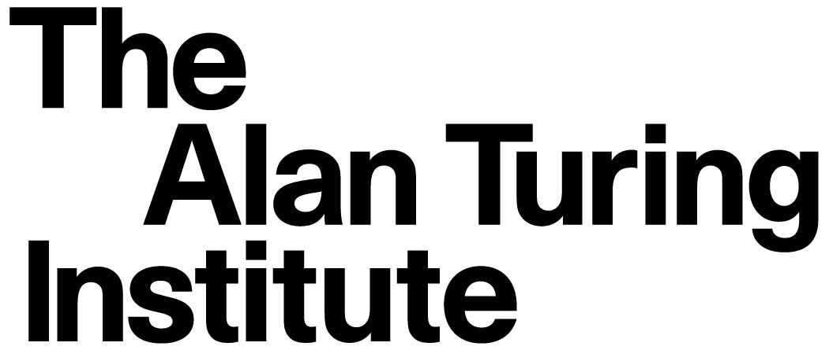

Research careers
Employer: The Alan Turing Institute
Critically important research areas, including Defence and Security
Collaborate with Defence and Security organisations
Independent Research Institute
Competitive salaries and benefits
Strong inclusion support such as flexible working
Collaborate across nations
Jan 2026 The Alan Turing Institute
Notes:
Host:
Lets now look at research institutes, public sector and govt roles.
Why work in a research role in an organisation such as The Alan Turing Institute?
The Alan Turing Institute is the national centre for Data science and AI.
We have a large Defence and Security research programme including theoretical and technical research, applied projects and policy work.
You will collaborate with Defence and Security organisations while working for an independent Research Institute.
We offer Competitive salaries and benefits, such as flexible working.
There are opportunities to work in equivalent organisation in other countries.
Yes, sometimes you get to go to the other side of the world to present research or work on shared outputs!

Slide 27



Public sector careers
Employers: NHS and the Civil Service
Advance healthcare and improve lives
Improve decision making for public good
Interesting and challenging research problems
Diversity, inclusion and staff wellbeing
Inspiring and motivated colleagues
Exciting and inspiring areas of healthcare
Jan 2026 The Alan Turing Institute
Notes:
Host:
Public sector career options
Why Work for organisations such as the NHS, the civil service or the UK Health Security Agency?
The NHS offers rewarding opportunities to develop Data Science and AI methods that advance healthcare and improve people’s lives.
You’ll help develop exciting and inspiring areas of healthcare currently being researched, such as personalised medicine or predictive models for early disease detection. Much of this work will directly contribute to building a smarter, more efficient and patient-centric healthcare system. In cyber and data security, the NHS works to protect care organisations from cyber attacks, as well as monitoring for new threats 24 hours a day.
The Civil Service supports the government to implement its policies effectively. From benefits and pensions to employment services, prisons to driving licences, their work impacts every aspect of UK life.
The UK Health Security Agency is a government department at the forefront of safeguarding the health of the nation, dedicated to protecting and improving public health and wellbeing across a vast array of diverse professional areas.
All of these departments are dedicated to diversity, inclusion and supporting staff wellbeing. You’ll also work alongside inspiring and motivated colleagues within a great wider community.

Slide 28
Routes into academia and public sector Data Science
Graduate Programmes
The Civil Service fast stream, UK Government
NHS Graduate Management Training Scheme (Health Informatics)
Internships and placements
Summer Placements
Internship programmes ‘Health Data Science Black Internship Programme’
Direct roles
Civil Service Jobs portal
Central NHS England or NHS Trusts (visit each Trust website separately)
The Alan Turing Institute
Academic roles
Research assistants (Masters)
Research Associates (PhD)
Civil Service Care Leavers Internship Scheme
Civil service fast stream internships
Jan 2026 The Alan Turing Institute
Notes:
Host:
Routes into these roles
Remind the students that links for some of the graduate programmes, internships and placements and websites with direct roles can be shared via the mailing list.
There are several routes into these roles. Check out each website directly, search job roles and always consider what transferable skills you have.
If you are unsure your experience and qualifications are quite the right fit, consider getting in touch with the recruitment manager and chatting through!
Here are a few examples of routes to support your journey in (read from the screen):
Graduate Programmes
The Civil Service fast stream – each scheme offers real responsibility across various rewarding roles in government departments, providing structured learning, on-the-job coaching and mentoring, and a clear career path in a government profession. Many also offer the chance to study for a professional qualification. Two new schemes have been introduced recently: Risk Management and Cyber Security. Entering the civil service through this scheme would place you across multiple government departments.
NHS Graduate Management Training Scheme – this covers multiple areas of the NHS (e.g. finance and HR), but most relevant would be their Health Informatics or Health Analysis streams.
Internships and placements
Summer Placements
Internship programmes e.g. ‘Health Data Science Black Internship Programme’
Civil Service fast stream internships
Civil Service care leavers internship scheme – a scheme designed specifically for care leavers
Academic roles
Research Assistant roles usually require a masters.
Research Associate roles usually require a PhD.
Research internship programmes for undergrads
Direct roles
Applying directly for roles on the Civil Service Jobs portal
Applying directly to either Central NHS England, or via NHS Trusts e.g. Barts Health NHS Trust, AI Centre for Value Based Healthcare or Guy’s and St Thomas’ NHS Foundation Trust. You might also find Cyber-specific roles via the NHS website or NHS Trusts, including Cyber trainee roles.
Important to know
Not all public sector jobs require a technical background. There are, for example, medical doctors in hospitals working within AI fellowships.
Some (but not all) roles may require security clearance and British citizenship.
Notes: For your knowledge, it may be worth knowing how the NHS is currently structured. The NHS is not one organisation – it is actually several, independent businesses working under the NHS ‘brand’ or umbrella. NHS England is currently the most central business under the NHS and will advertise some more ‘central’ roles, otherwise students will have to look at their local area and the Trusts therein for local jobs. Some Trusts include multiple hospitals or GP surgeries.

Slide 29


Job applications
Write a good CV / cover letter
Create a LinkedIn profile
Look at latest developments in the domain or in AI models
Have some examples of your code / analysis skills on GitHub or as a portfolio
Research what the interview will be like (e.g. will you need to do a coding exercise) and consider whether you can prep example answers in advance
More information at https://nationalcareers.service.gov.uk/job-profiles/data-scientist
Jan 2026 The Alan Turing Institute
Notes:
Host:
There are a number of things to consider when applying for jobs, some you can do before finding a role you want to apply to. But it is still important that you tailor you application for each role you apply to based on the job description.
Much of the advice can be found on the national careers website but some general pointers are:
Write a good CV / cover letter
Create a LinkedIn profile
Look at latest developments in the domain or in AI models
Have some examples of your code / analysis skills on GitHub or as a portfolio
Research what the interview will be like (e.g. will you need to do a coding exercise) and consider whether you can prep example answers in advance
Lots of advice available

Slide 30
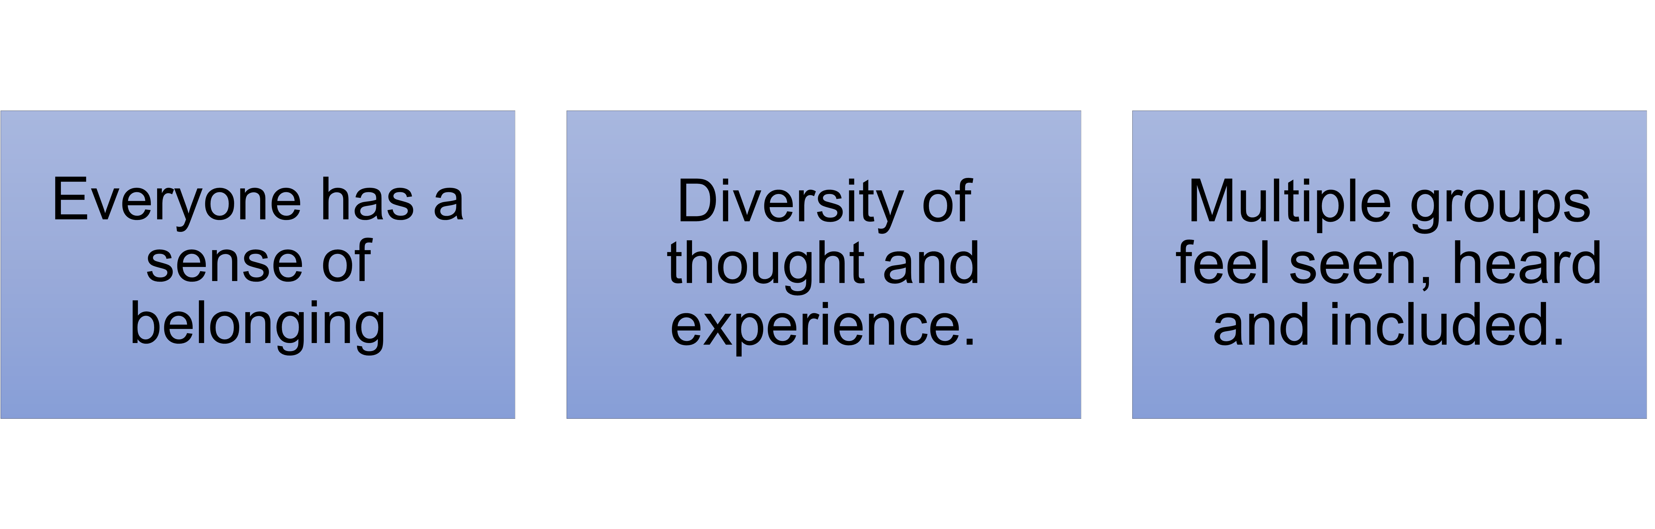
Why is it important to have diversity across data science and AI roles?
Jan 2026 The Alan Turing Institute
Notes:
Host:
Tying up this section:
Earlier in this presentation, we have looked at some statistics surrounding diversity, and we have considered how a lack of diversity might impact both day-to-day life and systems and processes.
We've now also covered some of the many roles that you can have in data science and AI.
So, to reiterate, why do we think it’s important to have diversity across data science and AI roles?
Individuals feel encouraged to apply for certain jobs as they see themselves represented in a variety of roles and sectors.
Individuals can bring their own experiences and diversity of thought to a role to ensure data science and AI is as unbiased and ethical as possible. This will have a wider impact on the health, safety and wellbeing of all groups that exist within society.
Diversity across data science and AI ensures multiple groups are seen, heard and included.

Slide 31

Researcher Spotlight
Dr Azadeh Mohammadi [Salford University]
Jan 2026
Notes:
Host:
Introduce the researcher in the spotlight: 10 mins session
Tell students their name
Tell students where they’re from
Tell students, in brief, what they’re going to cover:
An overview of their trajectory into their current role
An overview of challenges and successes in that trajectory
Reasons for their career choice and any impact
Top tips
The talk will end with a short Q&A session, using SliDo

Slide 32
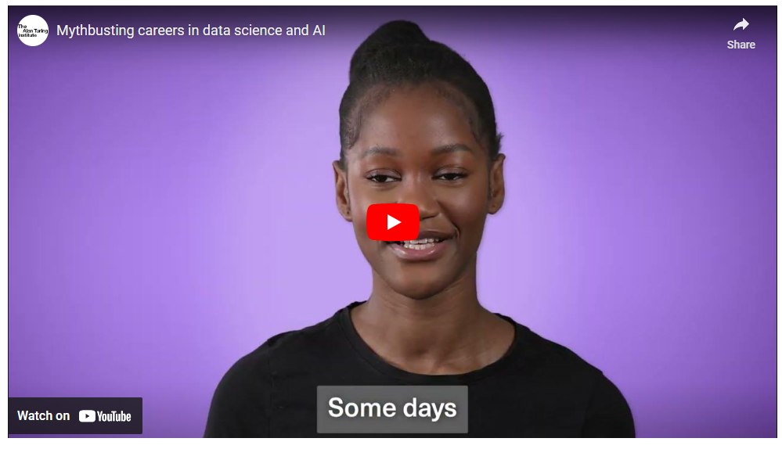
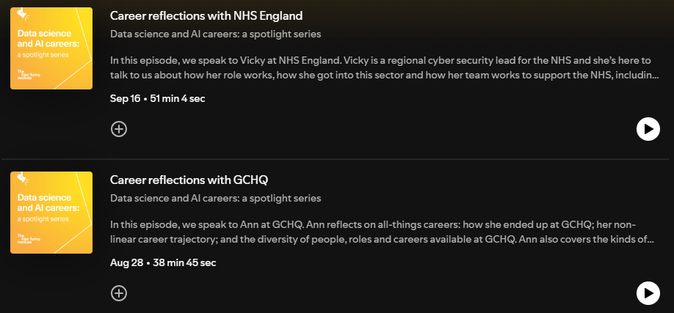
Working as a Data Scientist The Alan Turing Institute’s ‘Spotlight Series on data science and AI’
Notes:
Host:
To find out more about working in the data science and AI sector, you can access a free bank of short films on podcasts on our website. We’ve interviewed people from various roles and across the sector about their day to day, what skills they use, what they wish they’d known before entering the field, what misconceptions there are about working in the sector and what their roles entail, as well as a whole lot more.
Just type into google: The Alan Turing Institute’s Spotlight Series on data science and AI.
Notes:

Slide 33

Thank you To find out more…
Scan our QR code to sign up to the mailing list. As a member of the mailing list, you will receive a bank of useful links and resources to get you started.
If you’re unable to scan the QR code, please access the evaluation form and mailing list here:
https://bit.ly/2026UniCareers
Email us at outreach@turing.ac.uk with questions, comments or to say hi!
Jan 2026
Notes:
Host:​ ALLOW 5 mins at end of session to complete this form
If we have piqued your interest, then do sign up to our mailing list and we will send you more information, all relevant links, brochures and information on careers in these areas.​
​
This is a work in progress, and we will be adding information as opportunities come along.​
​
We have finished the talk with a few minutes to spare – this is to get your feedback. We would really appreciate you answering a few questions about the talk so we can ensure it is useful for future audiences. The feedback form also includes some questions around diversity – they are optional, but we would be hugely appreciative if you would take the time to answer them so that we can ensure our audiences are as diverse as possible.​
​

Slide 34

Do not edit How to change the design
Audience Q&A
The Slido app must be installed on every computer you’re presenting from

