Slide 1
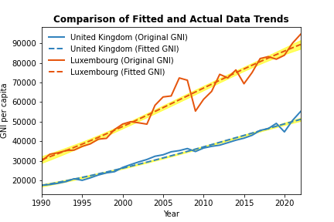
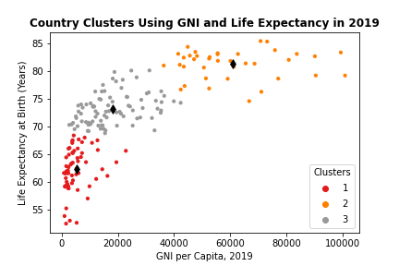
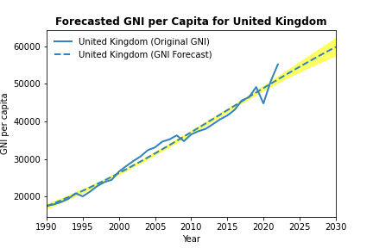
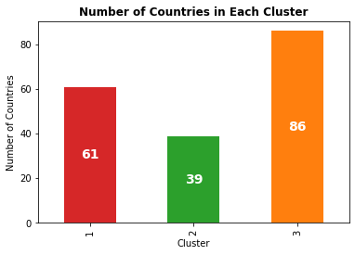
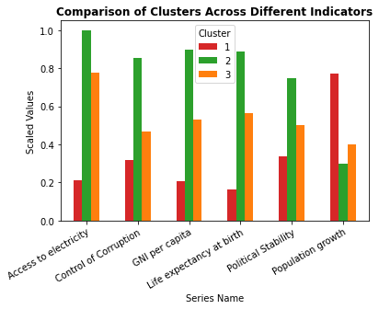
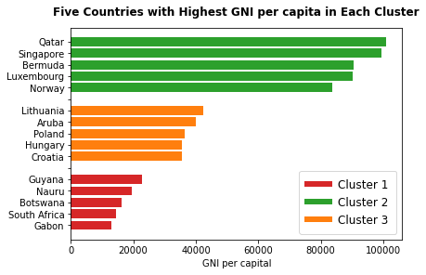
Exploring Global Development with KMeans Clustering
Abstract
Fitting and Prediction
The objective of this project is to identify distinct groups of countries that exhibit similar economic characteristics and compare the economic performance across 186 countries using the K-Means clustering.
The K-Means clustering algorithm, an unsupervised machine learning technique, was applied to categorize countries into clusters based on their economic performance. While Economic performance can be measured by various factors, this study focused on the Gross National Income (GNI) per capita as a primary indicator along with other relevant economic factors like Access to Electricity, Political stability and Absence of Violence/Terrorism, Control of corruption, Life expectancy at birth, and Population growth.
The generated clusters were visualised to examine their characteristics and how they differ from each other. We found that the countries were grouped into High-income, Middle-income and Low-income countries.
Also, the trend of GNI per capita for two randomly selected countries from the high-income countries was examined to observe the trajectory of data in the same cluster. The plot showed that the selected countries had similar GNI per capita trend all through the observed period.
A logistic function was fitted to the United Kingdom (One of the selected high-income countries) GNI per capita, and the fitted model was used to predict the GNI per capita for 8 years. The prediction showed that the GNI of the united kingdom is expected to maintain an upward trend and be approximately 60,000 by 2030.
We will further analyse the produced clusters by randomly selecting two countries from cluster 1, the cluster containing the high developed countries, and see if those countries have similarlar trend. We will also fit a logistic function to the GNI per capita of the selected countries and see how well the model will explain the data.
The selected countries are Luxembourg and the United Kingdom, even though Luxemnourg had a higher GNI per capita than United Kingdom throughout the observed period, we can see that they have similar trend. With the GNI per capital rising and fall at almost the same period.
Both countries GNI per capita has been roughly increasing over the years
Introduction
In a globalized world, understanding the diverse trajectories of economic development across countries is paramount for policymakers, economists, and researchers alike.
This poster presents a comprehensive examination of economic development across countries, employing K-Means clustering as a powerful tool for pattern recognition and grouping.
The K-Means clustering algorithm is a widely used unsupervised machine learning technique that partitions data into distinct clusters based on similarity. This unsupervised machine learning approach allows for the identification of patterns and relationships within the data without pre-defined labels. By applying this approach to economic indicators, we aim to uncover homogeneous groups of countries with similar economic development characteristics. Our analysis focuses on key metrics such as Gross National Income (GNI) and additional relevant factors, providing a nuanced perspective on the multifaceted nature of economic development.
As we delve into the intricacies of the clustering results, we seek to identify countries that exhibit shared economic patterns, allowing for more targeted and effective policy recommendations. The insights derived from this analysis can pave the way for a deeper understanding of the global economic landscape, enabling stakeholders to make informed decisions and fostering international collaboration for sustainable development.
K-Means Clustering Analysis Across Countries
The graphs below shows the countries clusters obtained from the Kmeans analysis
Using the fitted model, the GNI per capita for the United Kingdom was forecasted from 2023 to 2030.
The graph below shows the Forecasted values.
It shows an upward trend and we can see that the GNI per capita for the United Kingdom is expected
to rise to almost 60,000 by 2030.
The clusters were formed from the analysis. One cluster seems to have low GNI per capita and low Life Expectancy, the second cluster is for countries with low to middle level GNI per capita but relatively higher life expectancy. While the third cluster groups countries with high GNI per capita and high life expectancy.
The third cluster had the highest number of countries grouped into it, while the second cluster contain the least number of countries. In the graphs below we’ll examine the characteristics of this clusters and how they differ from each other.
To ensure comparability among the indicators, their values has been scaled so we can’t directly interprete or measure the indicators values but we can get a sense of the relative size as higher bars indicate higher values.
From the graph, Cluster 1 has higher access to electricity, control of corruption, GNI per capita, Life expectancy at birth, and political stability than the other clusters. It also has the lowest population growth. This points to the fact that the cluster likely contains highly developed countries.
While cluster 3 is likely a group of least developed countries.
Conclusion
The objective of this project is to identify distinct groups of countries that exhibit similar economic characteristics and trajectories and compare the economic performance across 168 countries using the K-Means clustering.
The K-Means clustering algorithm, an unsupervised machine learning technique, is applied to categorize countries into clusters based on their economic performance. While Economic performance can be measured by various factors, this study focuses on the Gross National Income (GNI) per capital as a primary indicator along with other relevant economic factors like Access to Electricity, Political stability and Absence of Violence/Terrorism, Control of corruption, Life expectancy at birth, and Population growth.
The poster will showcase visually compelling representations of the clustered data, allowing for a nuanced exploration of the similarities and differences among various groups of countries and a clear interpretation of the identified clusters.
This graph shows a sample of countries from each clusters to see if our assumption above is correct.
It also shows the actual GNI per capital for the examined year for the selected countries.
We can conclude that:
Cluster 1 contains highly developed countries
Cluster 2 contains medium developed countries
Clluster 3 contains lower developed countries
Reference
The objective of this project is to identify distinct groups of countries that exhibit similar economic characteristics and trajectories and compare the economic performance across 168 countries using the K-Means clustering.
The K-Means clustering algorithm, an unsupervised machine learning technique, is applied to categorize countries into clusters based on their economic performance. While Economic performance can be measured by various factors, this study focuses on the Gross National Income (GNI) per capital as a primary indicator along with other relevant economic factors like Access to Electricity, Political stability and Absence of Violence/Terrorism, Control of corruption, Life expectancy at birth, and Population growth.
The poster will showcase visually compelling representations of the clustered data, allowing for a nuanced exploration of the similarities and differences among various groups of countries and a clear interpretation of the identified clusters.

