Slide 1
ABC COMMUNICATIONS LTD
Understanding Customer Churn Pattern and retention opportunities
Chidinma Onyemachi
11/8/2026
Customer Behaviour & Business Performance Analysis
Analystlab Africa

Slide 2
Business Context
THE BUSINESS PROBLEM
What is Churn?
Churn is when a customer ends their relationship with the company therefore cancelling their services and moving to a competitor or leaving the category entirely
Why it matters
Retaining an existing customer is far cheaper than acquiring a new one. Even small reductions in churn can meaningfully protect recurring revenue.
What this analysis investigates
Which customer segments and behaviors are most associated with churn, so the business can target retention efforts where they matter most.

Slide 3
Approach
Dataset & Methodology
Dataset
Cleaning
Analysis
Dashboard
Insights
Dataset
Correlation analysis
One row per customer, combining account, service, and billing attributes.
Measured relationships between tenure, senior-citizen status, and service adoption.
Pivot Table
Derived ServiceCount
Summarized churn and tenure across contract type, payment method, and gender segments.
Added a column summing the number of add-on services each customer subscribes to.

Slide 4
Customer Base
Customer Overview
7,043
1869
26.54%
$139,131
Total Customers
Total Churn
Churn Rate
Revenue at Risk

Slide 5
Primary Driver
Churn Count by Contract Type
INSIGHT
Month-to-month customers show substantially higher churn than customers on longer-term contracts.

Slide 6
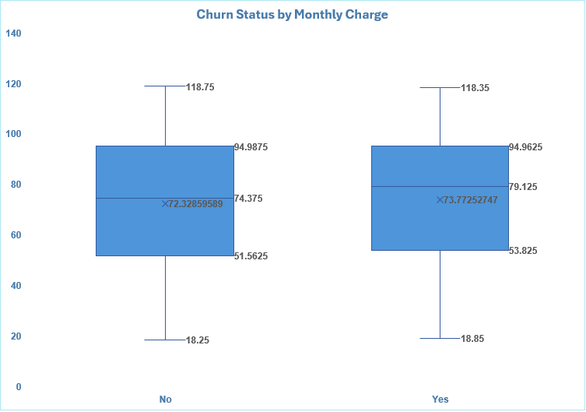
Churn Distribution
Churn Status by Monthly Charge
INSIGHT
Customers who churned have a slightly higher median monthly charge than retained customers. However, the substantial overlap between the two distributions suggests that monthly charges alone are not a strong predictor of churn

Slide 7
Primary Driver
Churn Count by Contract Type
Tenure
Senior Citizen
Service Count
STRONGEST RELATIONSHIP
Tenure ↔ ServiceCount
Tenure
1
-0.02
0.23
0.23
Tenure and service count have the strongest relationship (r = 0.23), indicating that customers with longer tenure tend to have slightly more subscribed services. However, the relationship is weak
Senior Citizen
-0.02
1
-0.02
ServiceCount
0.23
-0.02
1

Slide 8
Insights
1
Month-to-month customers have meaningfully higher churn than customers on one- or two-year contracts.
Longer-tenured customers tend to have greater service adoption, reflected in the moderate tenure–ServiceCount correlation.
2
3
Fiber optic customers have the highest churn rate, despite the service being a higher-value offering.
4
Compared with the relationship between tenure and service adoption, the correlation involving Senior Citizen is relatively weak.
Monthly charges should be considered alongside factors such as contract type and tenure rather than treated as an isolated cause of churn.
5

Slide 9
Risk and Opportunity
Risk
Opportunity
High churn among short-term customers Concentrated churn among month-to-month customers is an ongoing revenue-retention risk.
Convert high-risk customers to longer contracts Month-to-month customers are a clear target for contract-conversion campaigns.
Early customer disengagement Customers who leave early never develop a deeper relationship with the company's services.
Strengthen early-tenure engagement Structured onboarding can build engagement before customers become churn candidates.
Increase meaningful service engagement Test relevant service bundles, guided by the tenure–Service Count relationship.
Reactive, untargeted retention Without segmentation, retention effort and budget can be spent inefficiently across the wrong customers.

Slide 10
Recommendations
1
2
3
Create targeted retention campaigns for month-to-month customers and encourage migration to one-year or two-year contracts.
Why: Month-to-month customers have the highest churn rate by a wide margin.
Provide incentives for customers to remain longer, such as loyalty benefits, contract upgrades, bundled services, or preferential offers.
Focus especially on: month-to-month and higher-risk customers.
Review fiber customers' service quality, pricing, installation experience, complaints, and support interactions.
Why: Fiber-optic customers have the highest churn rate among internet-service categories.
4
5
Because the box plot shows differences in monthly-charge distributions between churn groups, management should investigate whether particular charge levels or service combinations are associated with higher churn.
Measure: Churn rate by monthly-charge bands and relevant customer segments.
Create a structured engagement process for newer customers, including onboarding communication, service education and early satisfaction checks.
Measure: Churn rate among customers within defined early-tenure periods.

Slide 11
Conclusion
The analysis identified customer segments and behavioral patterns associated with churn, supported by an interactive dashboard that lets management explore these patterns across customer segments.
Create targeted retention campaigns for month-to-month customers and encourage migration to one-year or two-year contracts.
Why: Month-to-month customers have the highest churn rate by a wide margin.
Thank you

