Slide 1

ANALYSIS OF CAR PRICES AND MARKET TRENDS
Çiğdem Akdemir

Slide 2
Description About Dataset
It contains information about car sales, including details about the car's make, model, year, condition, and selling price among other attributes.
Describe the variables used in dataset
# year: The year the car was manufactured
# make: The manufacturer of the car
# model: The model of the car
# trim: The trim level of the car
# body: The body type of the car
# transmission: The type of transmission in the car
# vin: The Vehicle Identification Number
# state: The state where the car was sold
# condition: The condition of the car
# odometer: The mileage on the car
# color: The exterior color of the car
# interior: The interior color of the car
# seller: The seller of the car
# mmr: The Manheim Market Report value
# sellingprice: The price at which the car was sold
# saledate: The date the car was sold
https://www.kaggle.com/code/mattiazitelli99/simple-eda-on-car-sales-dataset/input

Slide 3
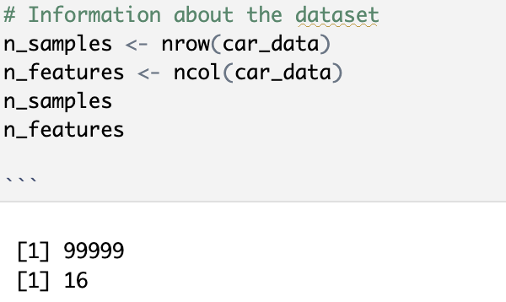
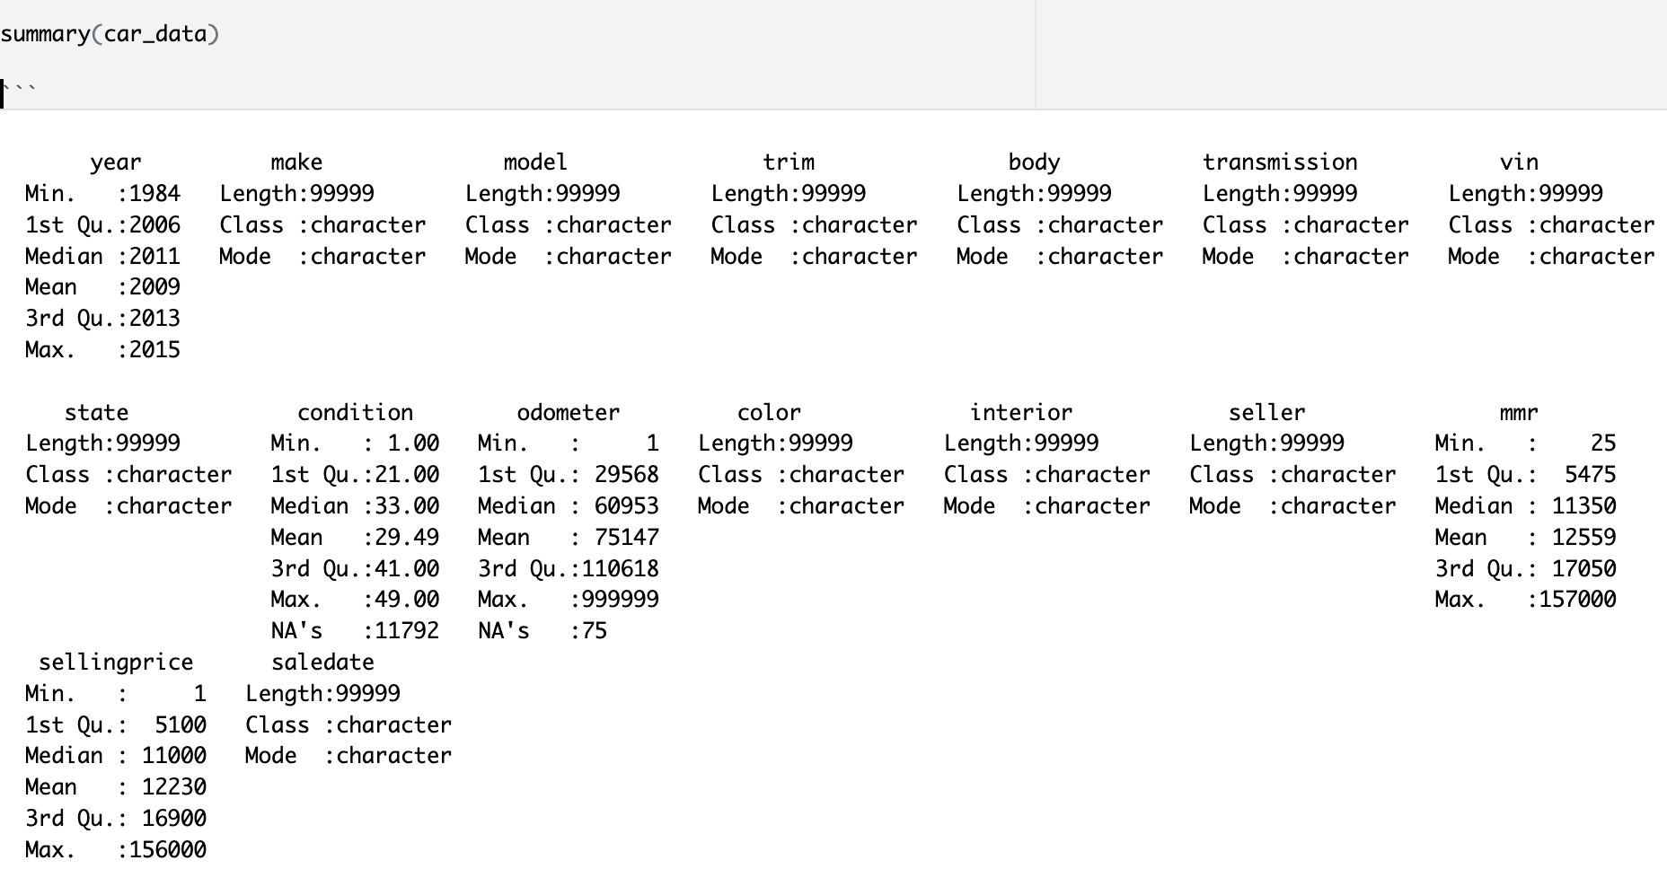
1- Dataset Introduction
Understanding Data

Slide 4
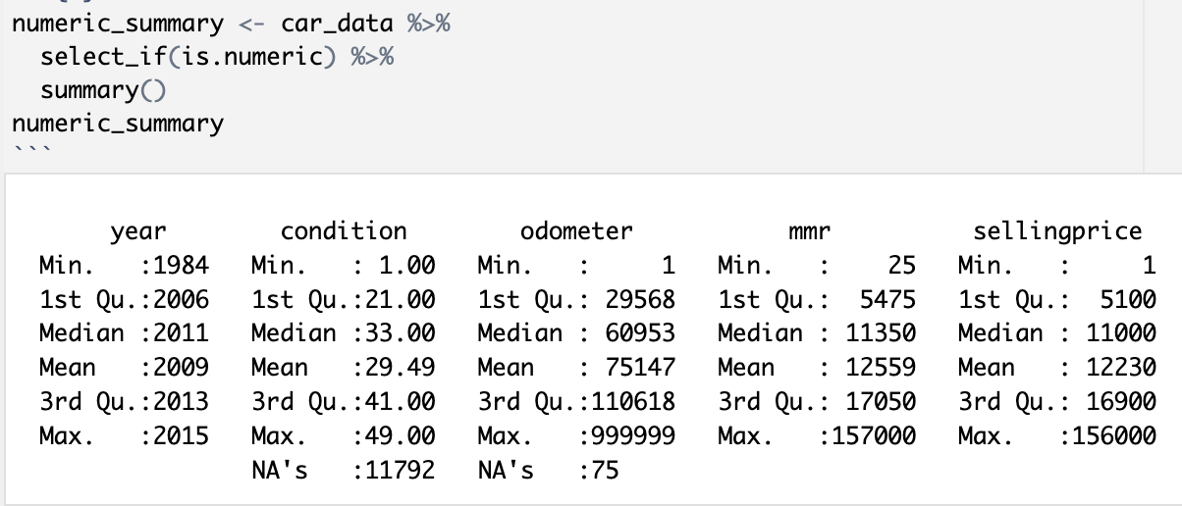
2- Summary of Data Features
Numeric Variables

Slide 5
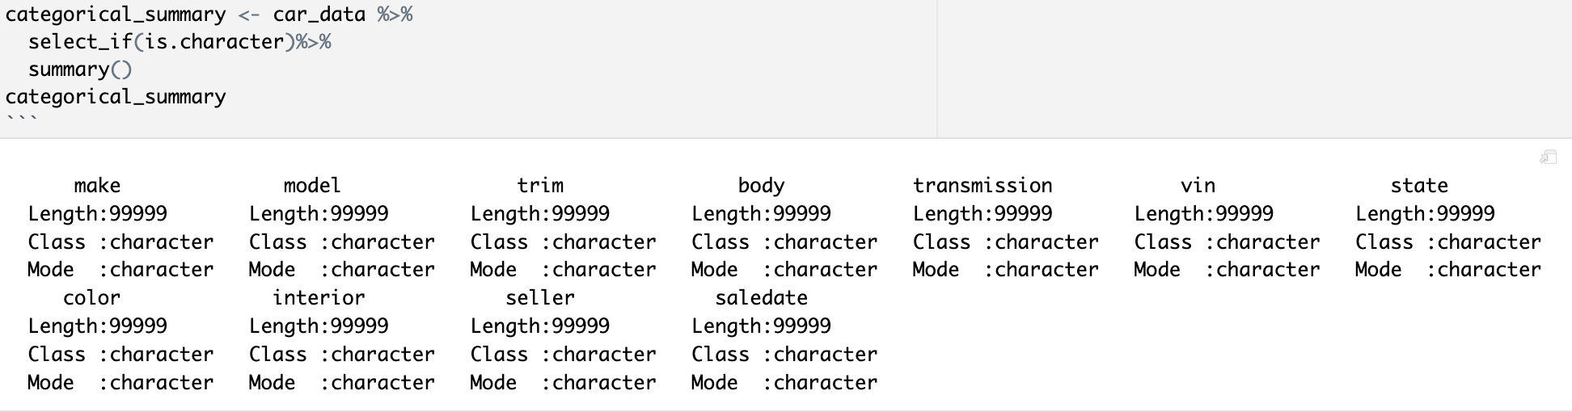
Categorical Variables

Slide 6
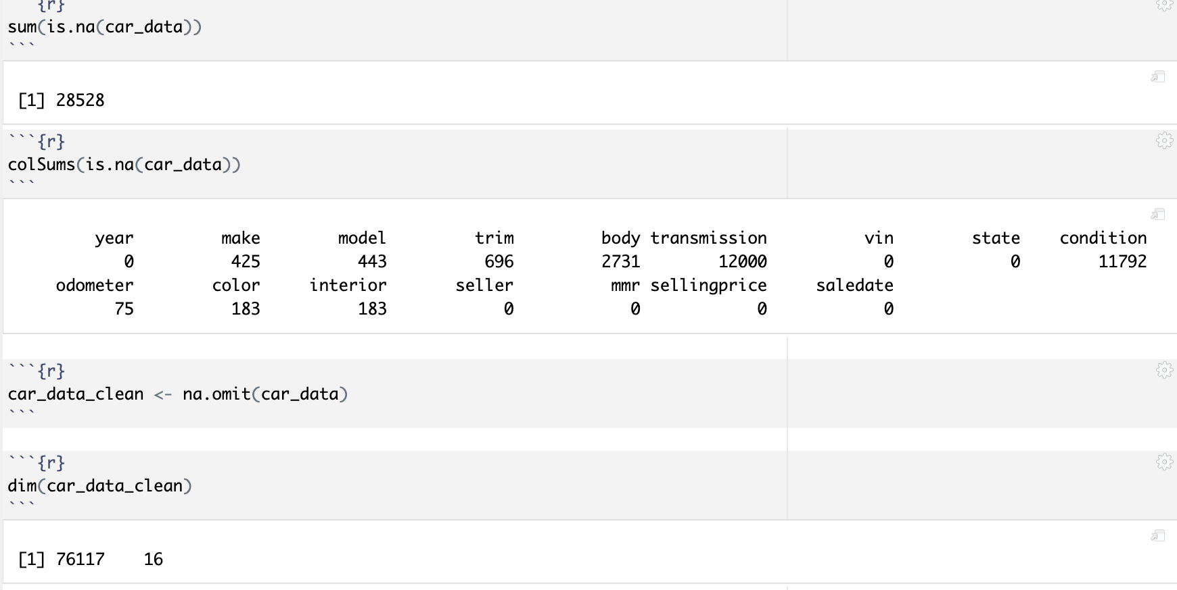
3. Missing Data Analysis
28,528 NA

Slide 7
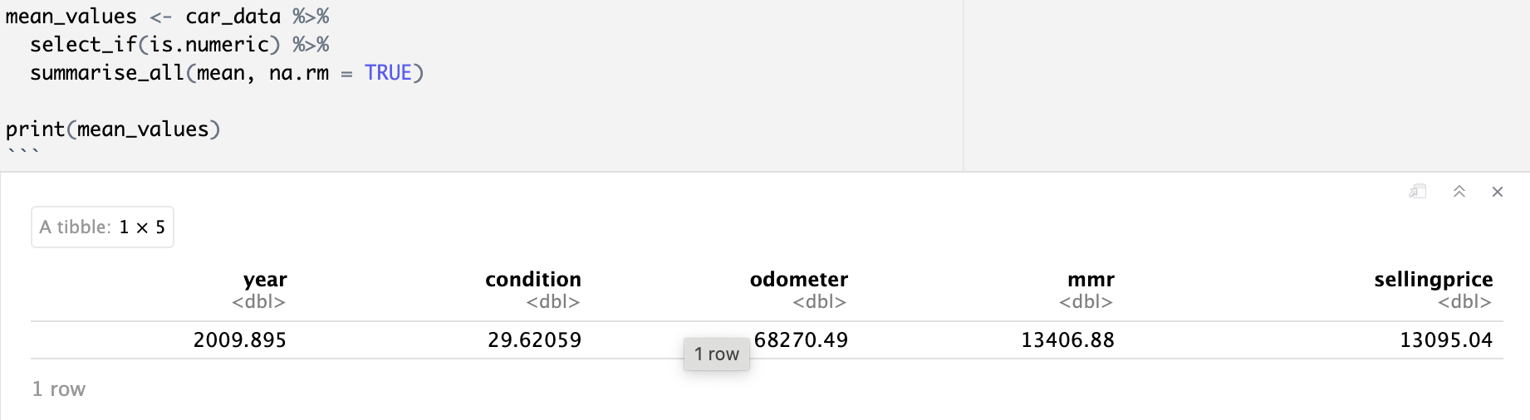
Mean values for numeric variables

Slide 8
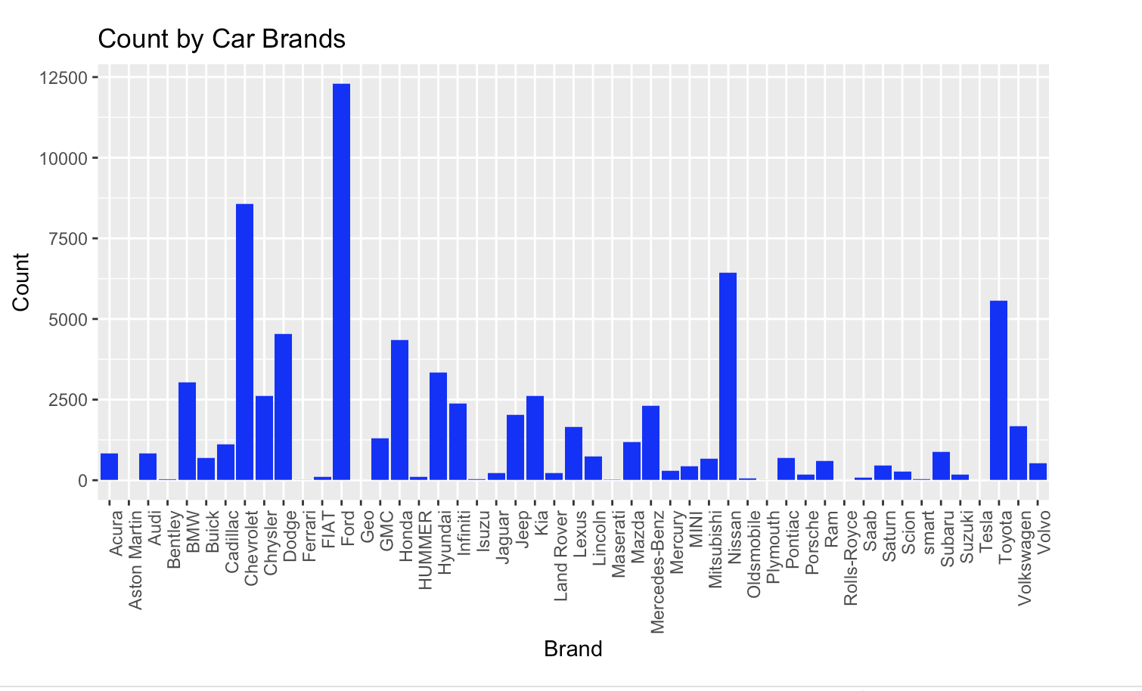
4-Data Visualization
Library: dplyr
Library: ggplot

Slide 9
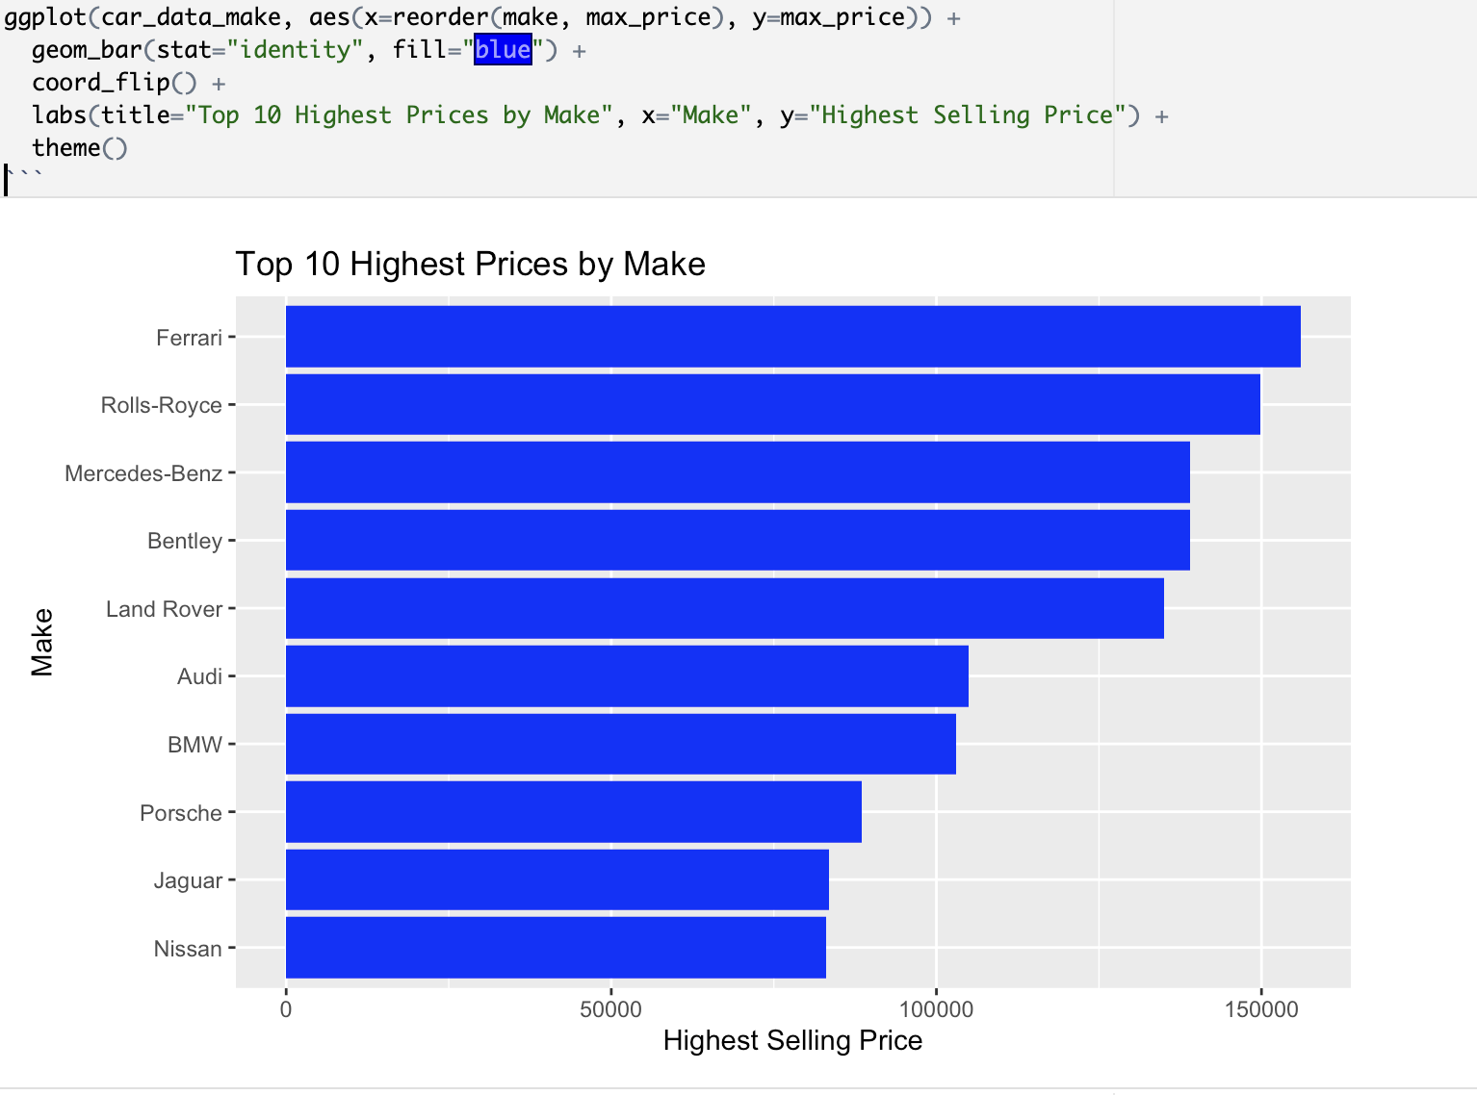

Slide 10
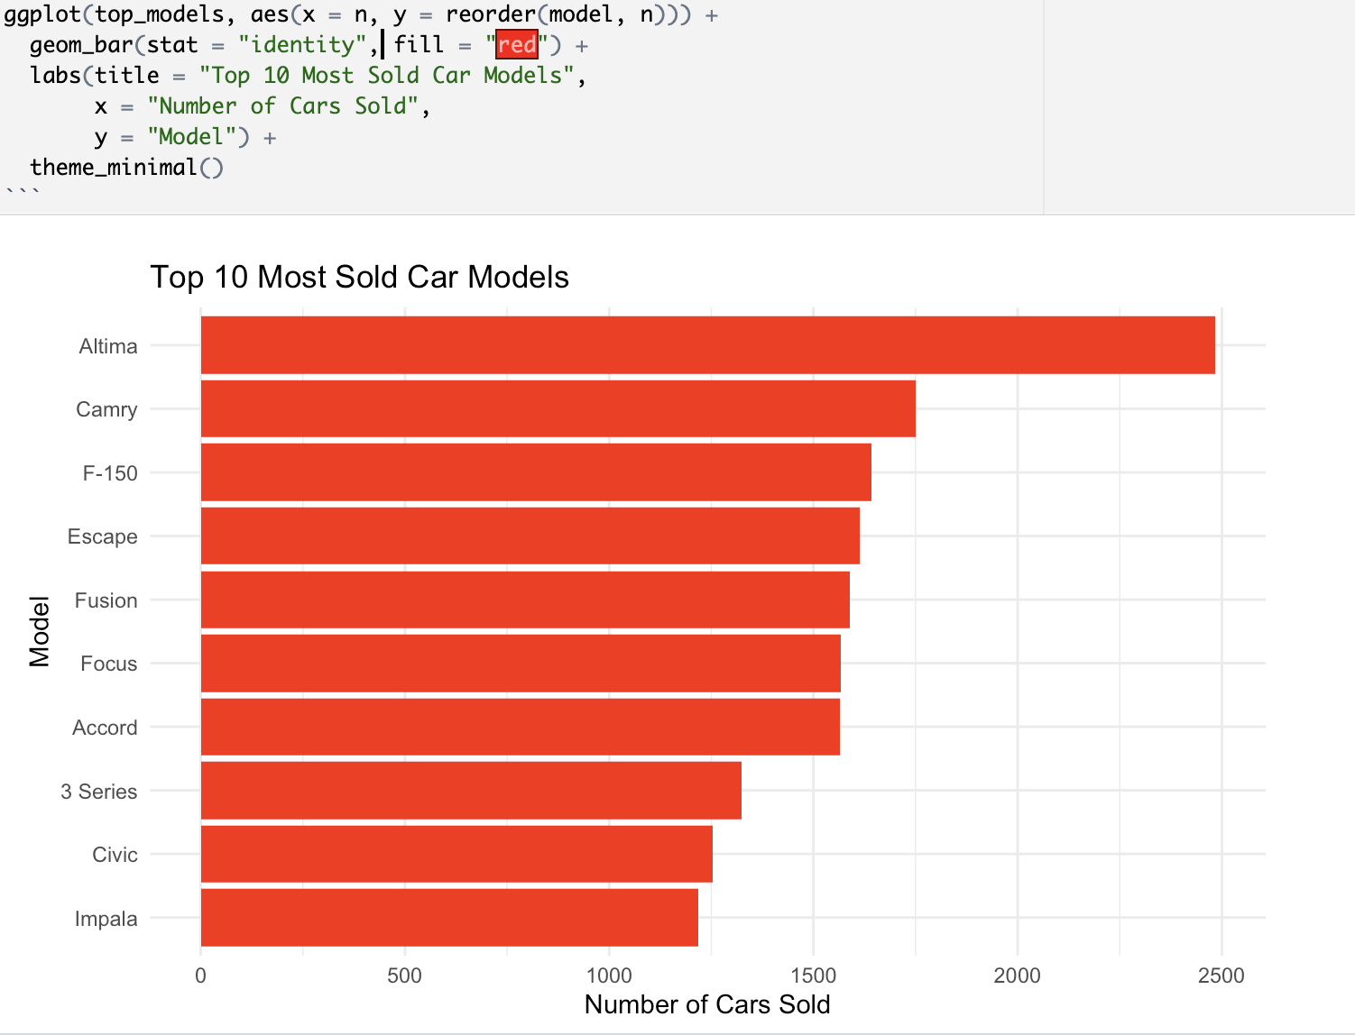

Slide 11
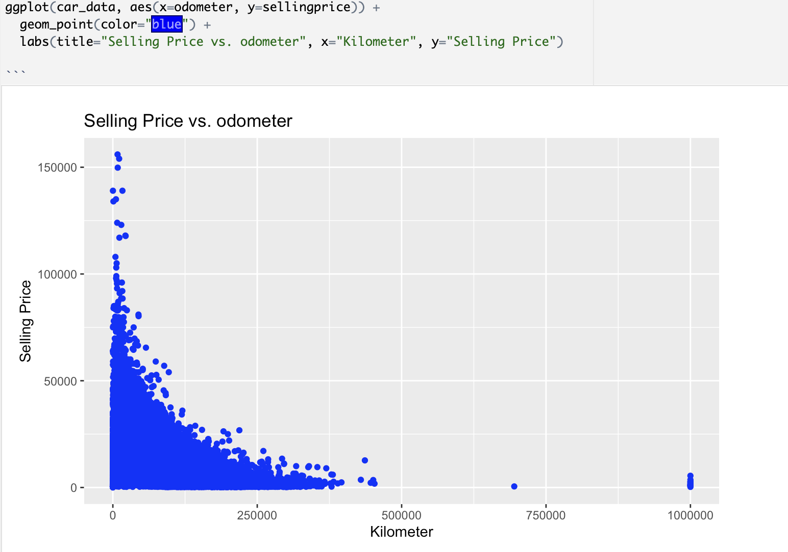

Slide 12
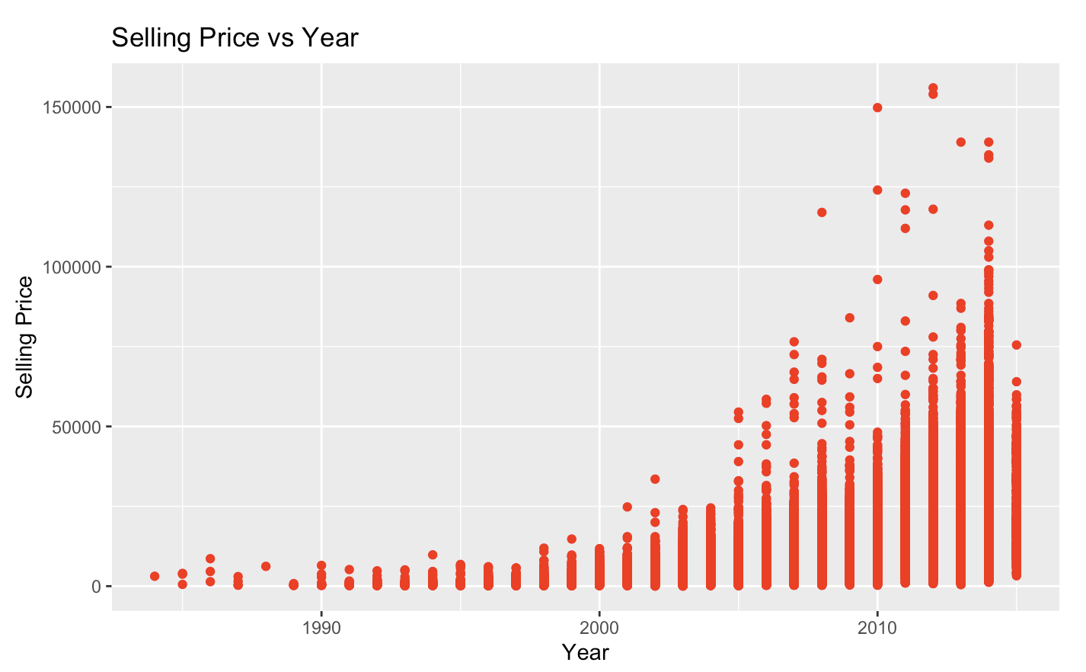

Slide 13
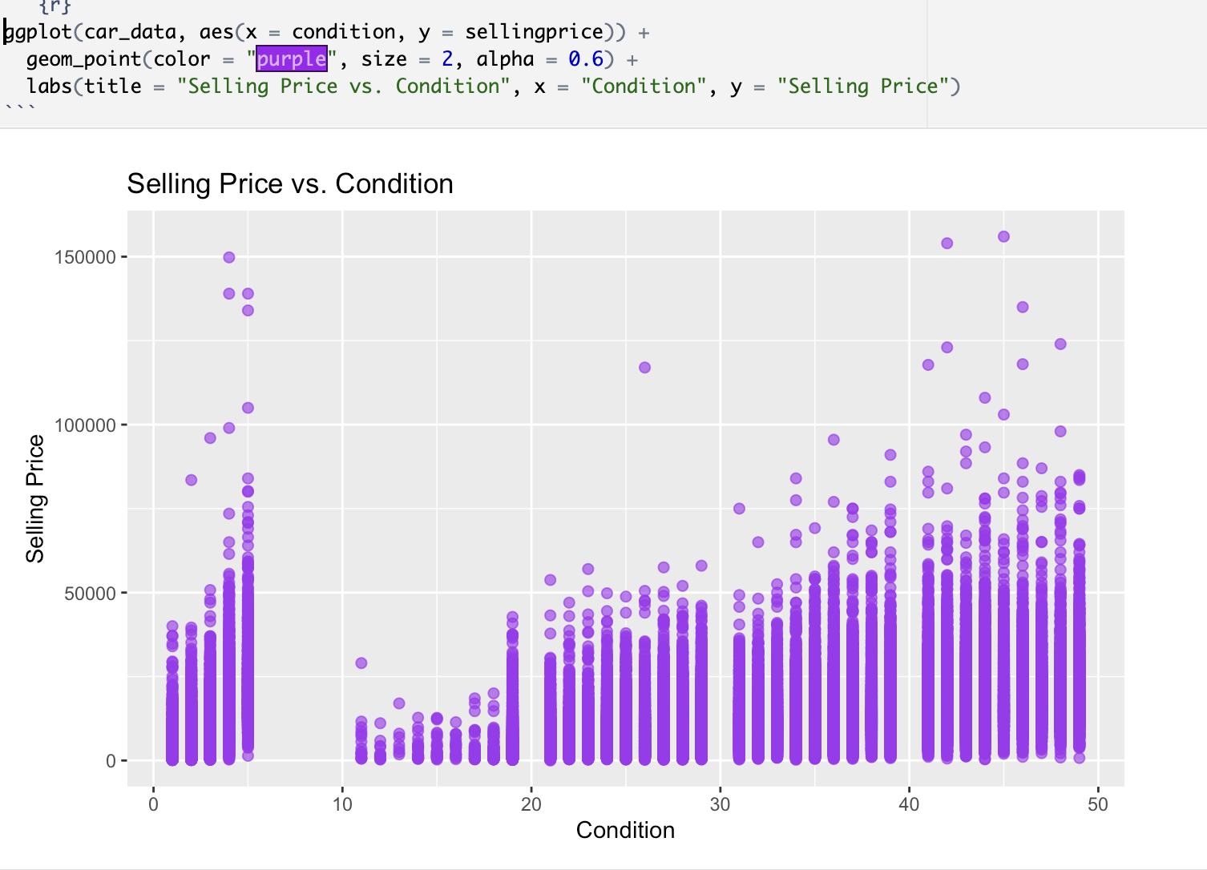

Slide 14
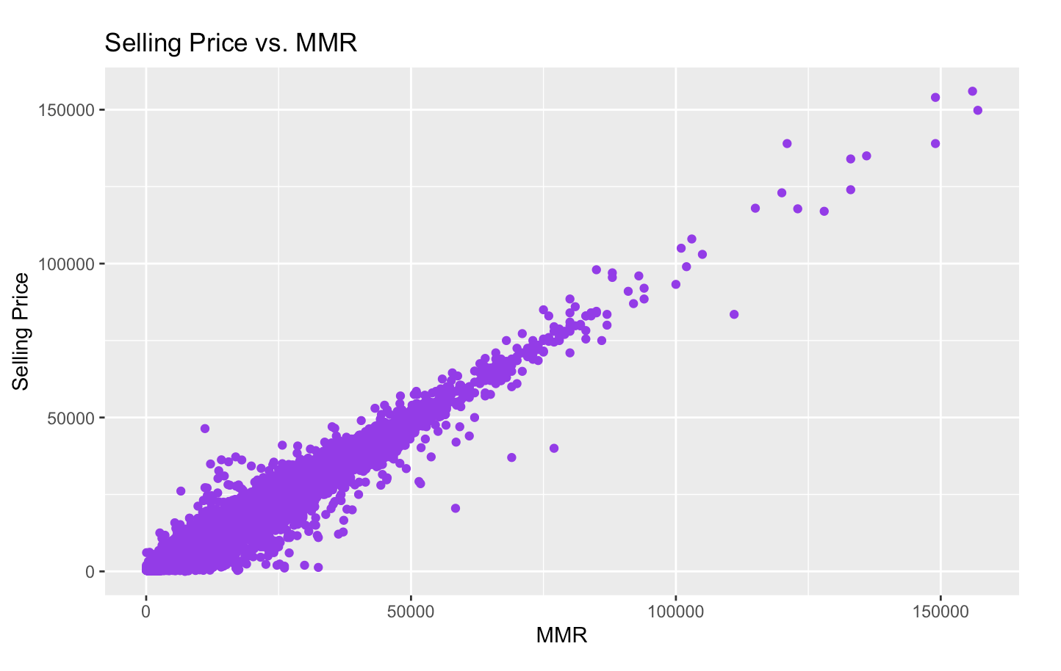

Slide 15
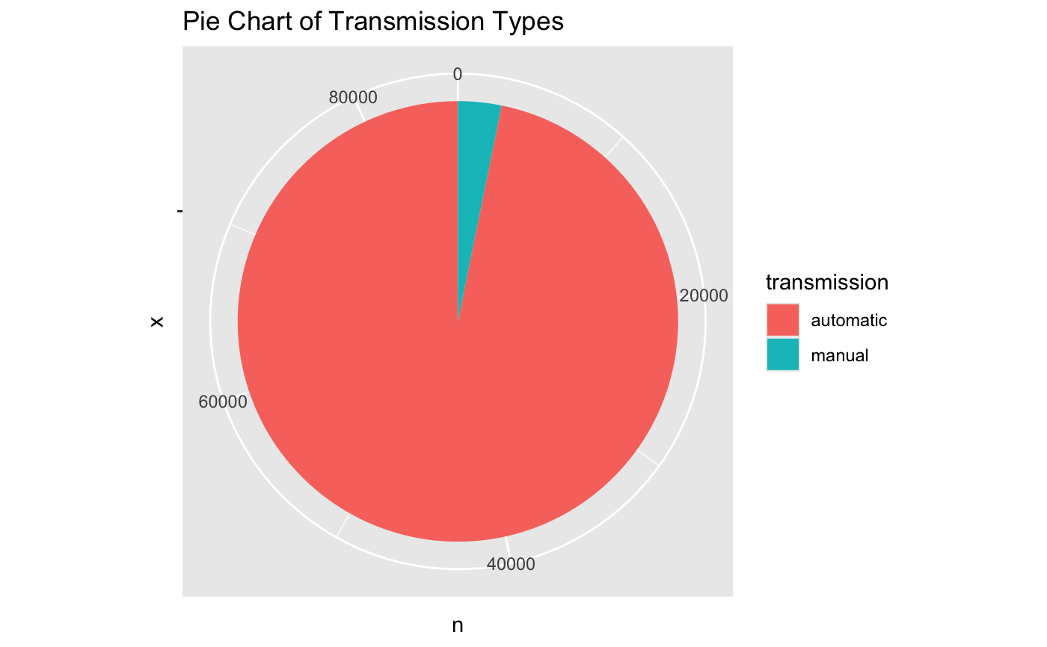
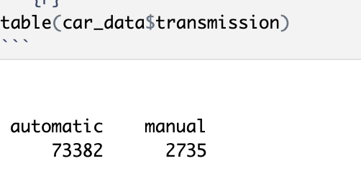
Distribution of Transmission

Slide 16
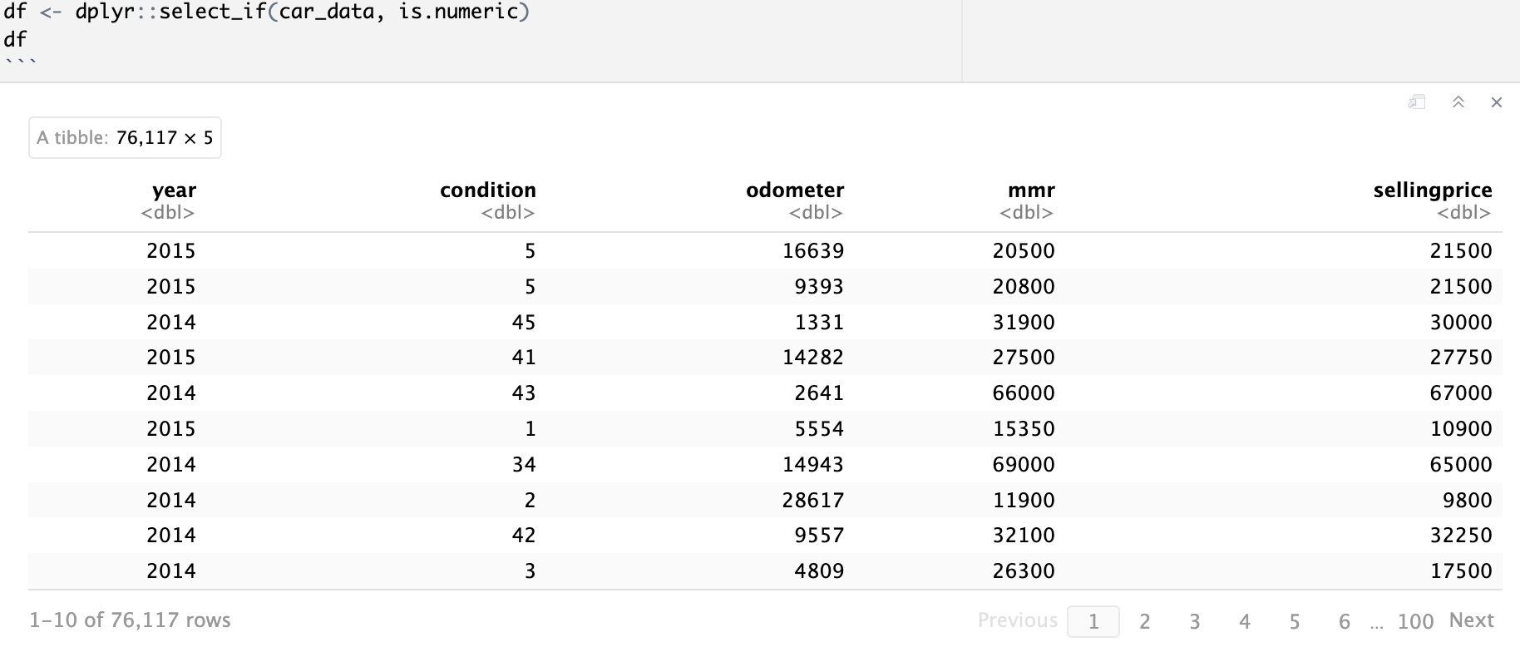
Preparing of Correlation Plots
#selecting only the numeric variables

Slide 17
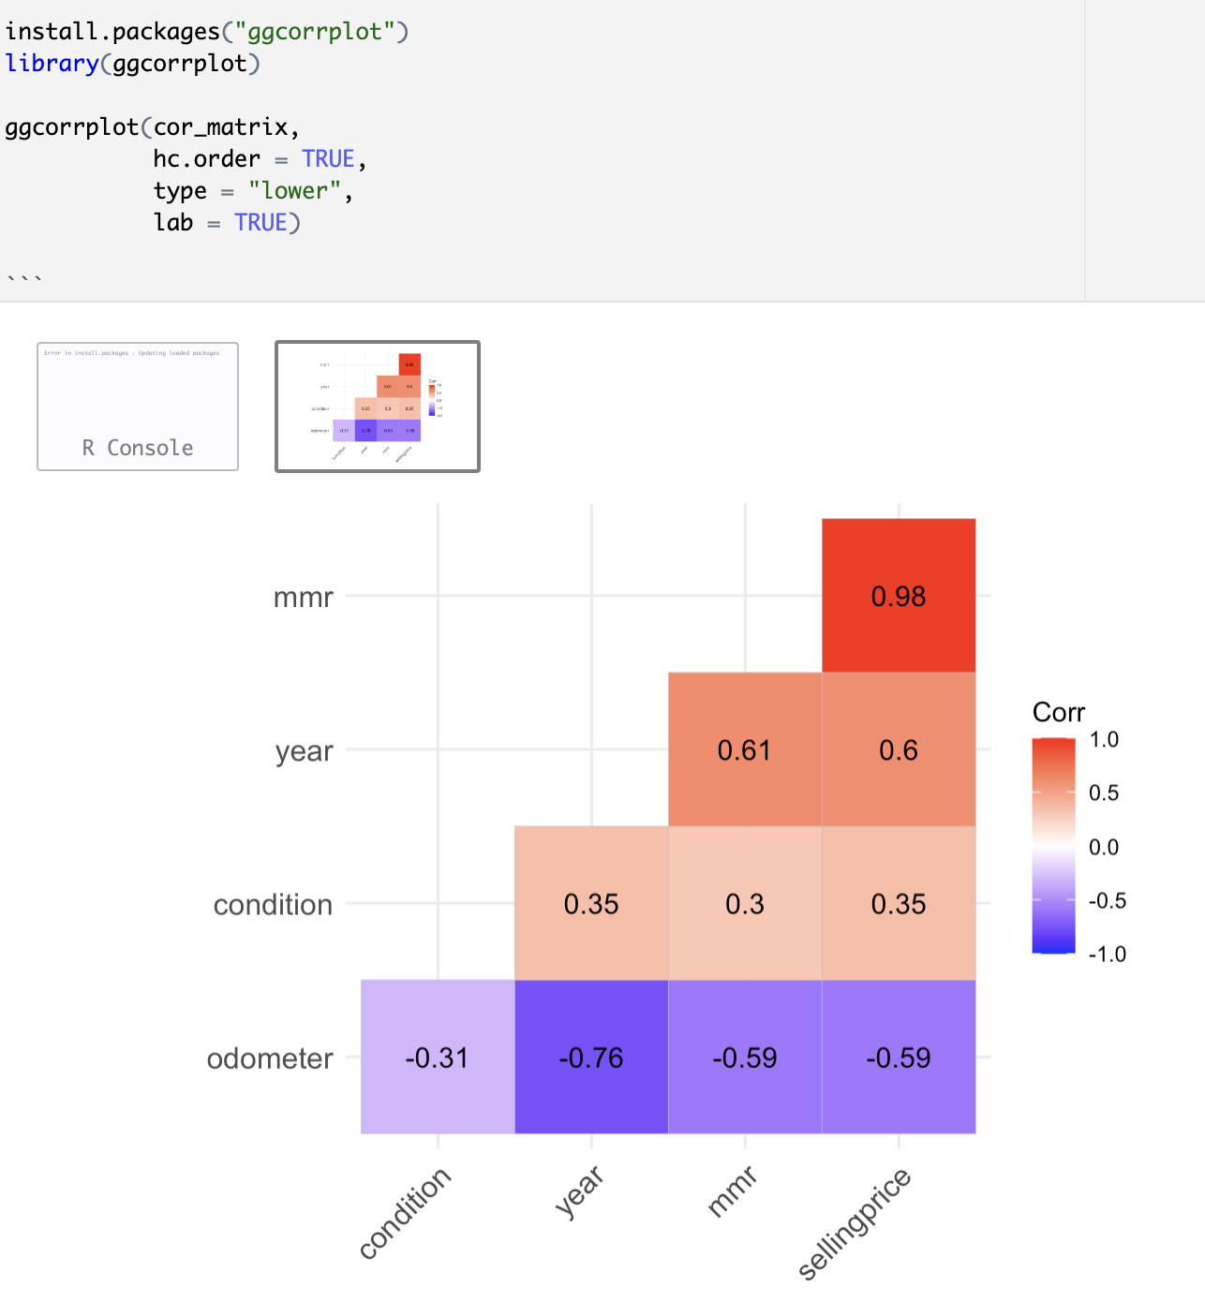
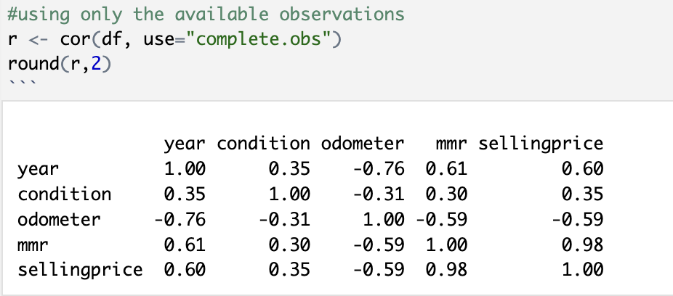
Correlation Plots
Predictive Modelling
Library: ggcorrplot

Slide 18
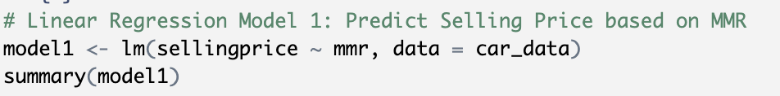
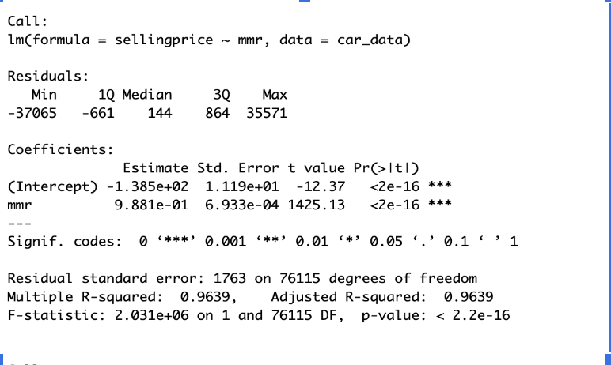
Linear Regression Model 1
Model-1 shows that the MMR (Manheim Market Report) value can explain about 96.39% of the variation in car selling prices

Slide 19
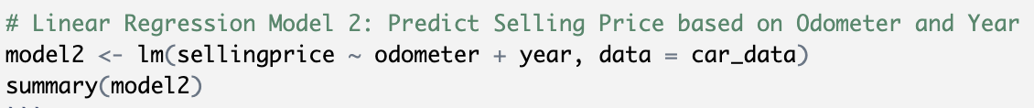
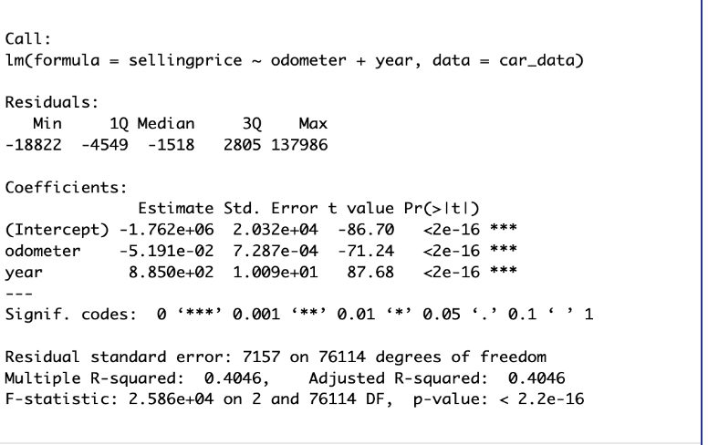
Linear Regression Model 2
Model -2
Model-2 shows that the odometer and the year together explain only about 40.46% of the variation in selling prices.

Slide 20
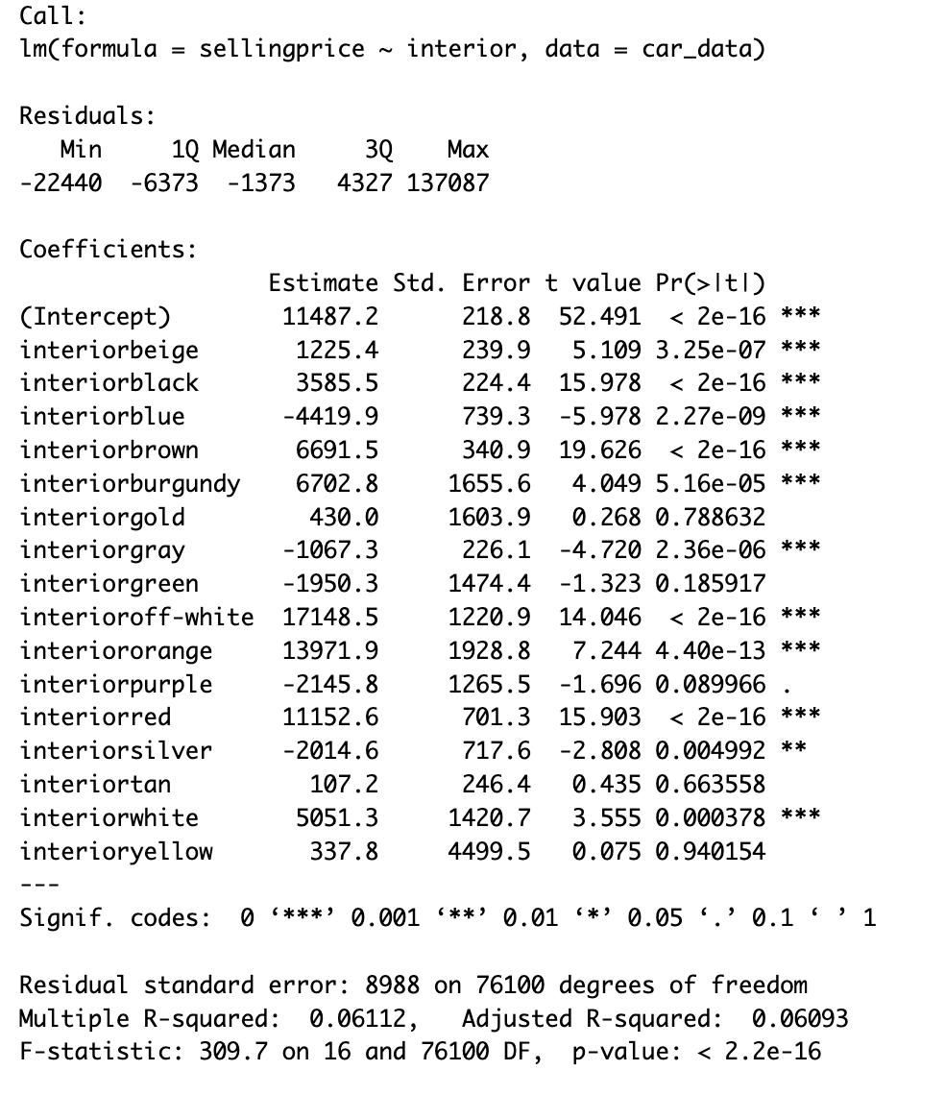
Linear Regression Model 3
Interior color is not very affecting variable for the Selling price.

Slide 21
Conclusion
Model 1 works better than Model 2 and 3.
Model 1, which predicts the Selling Price based on MMR, can be considered the best model.
A high R-squared value like 0,9639 means that MMR is a very strong factor in predicting how much a car will sell for.
Interior color (Model 3) is not effective on selling price.

Slide 22
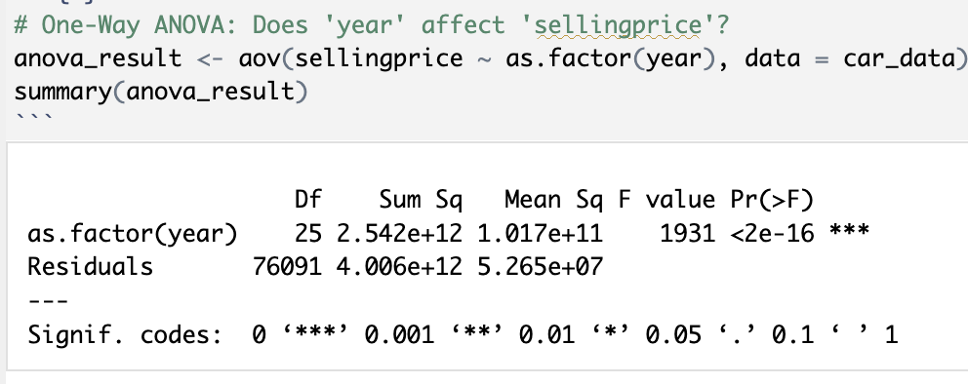
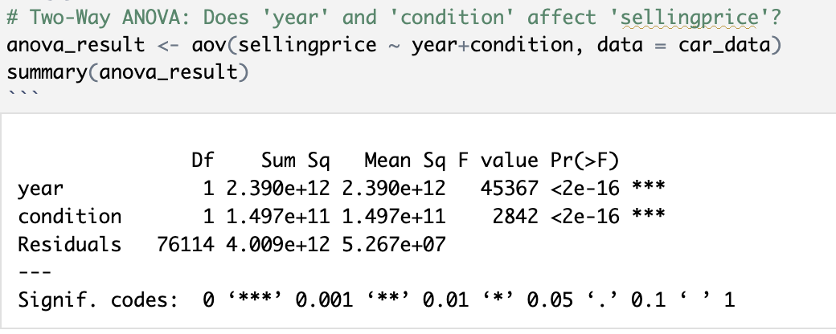
ANOVA Models

Slide 23
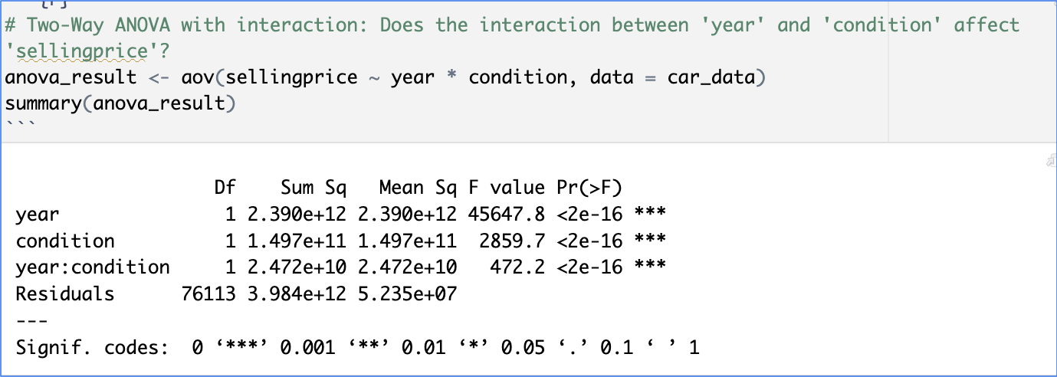

Slide 24
