Slide 1

Accelerating Insights Through Car Data
Done By:
Chidvilas

Slide 2
Objective
The main aim of this analysis is to explore and interpret patterns within the car market dataset by analyzing crucial factors such as price, customer ratings, specifications, and market preferences. It focuses on identifying top-performing models, classifying vehicles based on pricing segments, evaluating performance indicators like engine power and torque, and examining the connection between customer feedback (ratings and reviews) and product characteristics (fuel type, transmission, and body type). The overall objective is to deliver actionable insights that support effective product positioning, marketing decisions, and inventory strategies, while also uncovering potential areas for high-value and performance-oriented vehicle opportunities.
01

Slide 3
Analysis
This analysis leverages the Cars database to deliver actionable insights on market preferences, pricing dynamics, and performance trends. It identifies the most popular and highest-rated models, segments the market by price range, and compares fuel and transmission preferences. Technical metrics highlight top-performing engines, efficiency patterns, and body type–specific specifications, while opportunity mapping reveals value-for-money models, premium performance offerings, and high-torque off-road options. These insights provide a clear foundation for strategic product positioning, targeted marketing, and informed portfolio planning.
02

Slide 4


What Is Sql
SQL (Structured Query Language) is used to manage and manipulate relational databases.
It lets you create, read, update, and delete data (CRUD operations).
Core commands include SELECT, INSERT, UPDATE, DELETE, and CREATE.
You can filter results with WHERE and join multiple tables using JOIN.
It’s widely used in data analysis, application backends, and reporting.
03

Slide 5
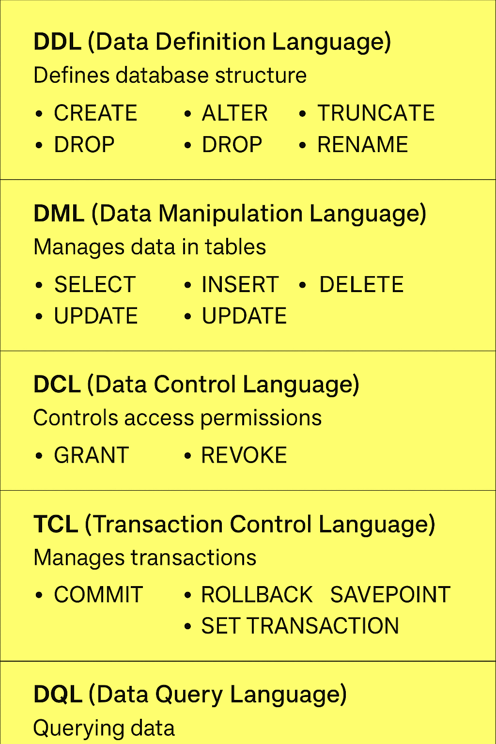
SQL commands are generally grouped into five main categories
1. DDL (Data Definition Language) – defines database structure:
CREATE, ALTER, DROP, TRUNCATE, RENAME
2. DML (Data Manipulation Language) – manages data in tables:
SELECT, INSERT, UPDATE, DELETE
3. DCL (Data Control Language) – controls access permissions:
GRANT, REVOKE
4. TCL (Transaction Control Language) – manages transactions:
COMMIT, ROLLBACK, SAVEPOINT, SET TRANSACTION
5. DQL (Data Query Language) – queries data:
SELECT (sometimes separated from DML)
04

Slide 6
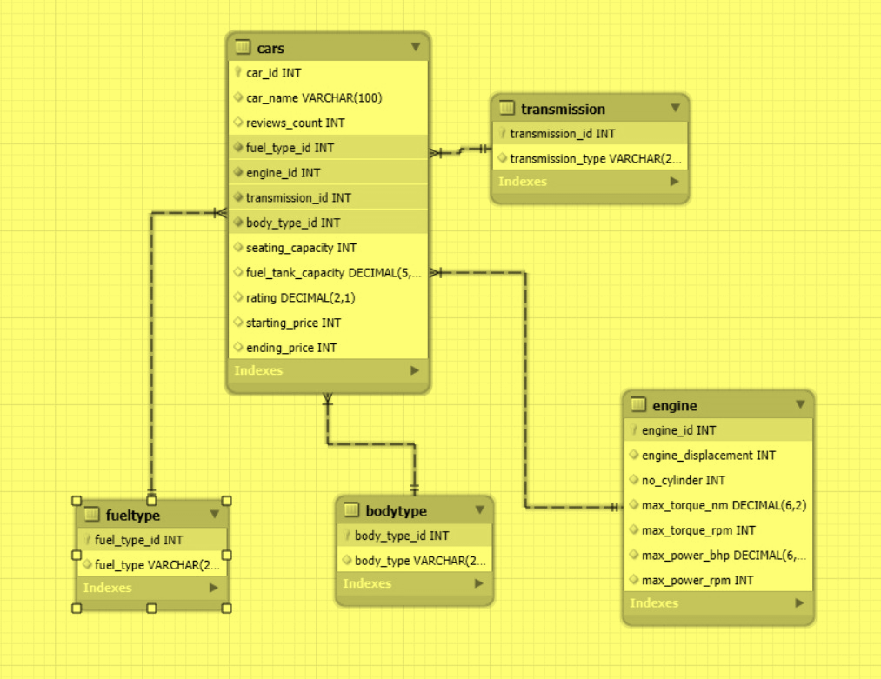
Analysis of Car Data base Entity–Relationship diagram
Main table: cars — contains core details of each car (name, price, seating capacity, ratings, etc.).
Foreign keys in cars:
Fuel_type_id → fuel type table (maps to fuel type name).
Engine_id → engine table (stores engine specifications).
Transmission_id → transmission table (defines transmission type).
Body_type_id → body type table (defines car body style).
Normalization:
Repeated categorical data (fuel types, transmissions, body types) is stored in separate tables to reduce redundancy.
Engine details are separated into their own table for better scalability.
Relationships:
All linked by one-to-many relationships from lookup tables to cars (one fuel type can be used in many cars, etc.).
05

Slide 7

Create schema
In database terms, a schema is the blueprint or structure that defines how your database is organized.
It includes:
Tables (with columns and data types)
06

Slide 8
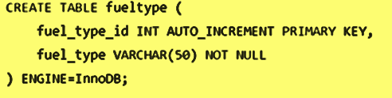
Create Table For Car Data base
The CREATE TABLE statement in SQL is used to define a new table in a database — specifying its name, columns, data types, and constraints.
Example :
07

Slide 9
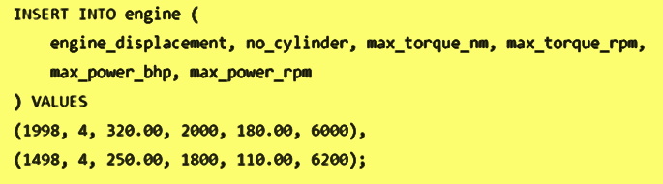
Insert Table For Car Data Base
The INSERT statement in SQL is used to add new rows of data into a table.
Example:
08

Slide 10
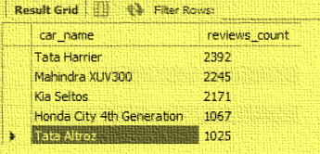
My Analysis On The Car Data Base With the Query
What is Query ?
A query is simply a request to the database asking it to do something — usually to retrieve, insert, update, or delete data.
My analysis on the car data base
1 Top 5 Most Reviewed Cars
Query
SELECT car_name, reviews_count FROM Cars ORDER BY reviews_count DESC LIMIT 5;
Result ;
NOTE: 5 Rows Returned
09

Slide 11
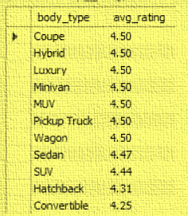
2 Average Rating by Body Type
Query:
SELECT
b.body_type,
ROUND(AVG(c.rating), 2) AS avg_rating
FROM Cars c
JOIN BodyType b ON c.body_type_id = b.body_type_id
GROUP BY b.body_type
ORDER BY avg_rating DESC;
Result:
NOTE: 11 Rows Returned
10

Slide 12
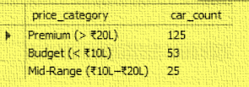
3 Cars by Price Range
Query:
SELECT
CASE
WHEN starting_price < 1000000 THEN 'Budget (< ₹10L)'
WHEN starting_price BETWEEN 1000000 AND 2000000 THEN 'Mid-Range (₹10L–₹20L)'
ELSE 'Premium (> ₹20L)'
END AS price_category,
COUNT(*) AS car_count
FROM Cars
GROUP BY price_category
ORDER BY car_count DESC;
Result:
NOTE: 3 Rows Returned
11

Slide 13
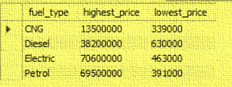
4 Highest and Lowest Priced Cars per Fuel Type
Query:
Result :
SELECT
f.fuel_type,
MAX(c.starting_price) AS highest_price,
MIN(c.starting_price) AS lowest_price
FROM Cars c
JOIN FuelType f ON c.fuel_type_id = f.fuel_type_id
GROUP BY f.fuel_type;
NOTE: 4 Rows Returned
12

Slide 14
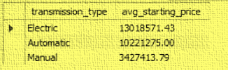
5 Average Starting Price by Transmission Type
Query:
SELECT
t.transmission_type,
ROUND(AVG(c.starting_price), 2) AS avg_starting_price
FROM Cars c
JOIN Transmission t ON c.transmission_id = t.transmission_id
GROUP BY t.transmission_type
ORDER BY avg_starting_price DESC;
Result :
NOTE: 4 Rows Returned
13

Slide 15
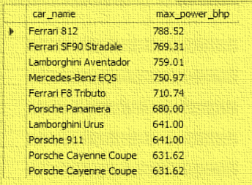
6 Most Powerful Engines
Query:
Result :
SELECT
c.car_name,
e.max_power_bhp
FROM Cars c
JOIN Engine e ON c.engine_id = e.engine_id
ORDER BY e.max_power_bhp DESC
LIMIT 10;
NOTE: 10 Rows Returned
14

Slide 16
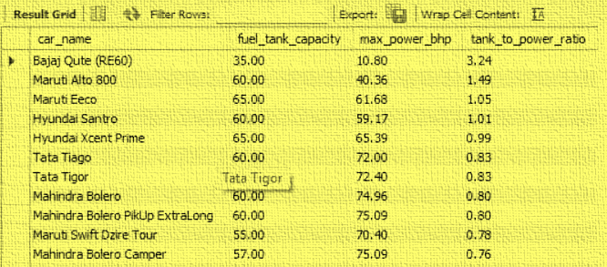
7 Fuel Efficiency Proxy
Query:
Result :
SELECT
c.car_name,
c.fuel_tank_capacity,
e.max_power_bhp,
ROUND(c.fuel_tank_capacity / e.max_power_bhp, 2) AS tank_to_power_ratio
FROM Cars c
JOIN Engine e ON c.engine_id = e.engine_id
ORDER BY tank_to_power_ratio DESC;
NOTE: 203 Rows Returned
15

Slide 17
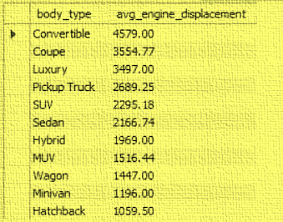
8 Average Engine Displacement by Body Type
Query:
Result :
SELECT
b.body_type,
ROUND(AVG(e.engine_displacement), 2) AS avg_engine_displacement
FROM Cars c
JOIN BodyType b ON c.body_type_id = b.body_type_id
JOIN Engine e ON c.engine_id = e.engine_id
GROUP BY b.body_type
ORDER BY avg_engine_displacement DESC;
NOTE: 11 Rows Returned
16

Slide 18
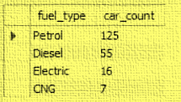
9 Most Popular Fuel Type
Query:
Result :
SELECT
f.fuel_type,
COUNT(*) AS car_count
FROM Cars c
JOIN FuelType f ON c.fuel_type_id = f.fuel_type_id
GROUP BY f.fuel_type
ORDER BY car_count DESC;
NOTE: 4 Rows Returned
17

Slide 19
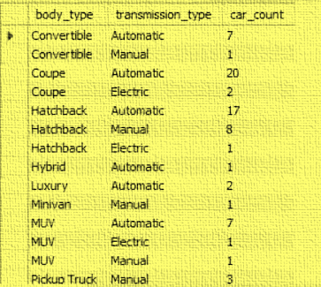
10 Transmission Preference by Body Type
Query:
Result :
SELECT
b.body_type,
t.transmission_type,
COUNT(*) AS car_count
FROM Cars c
JOIN BodyType b ON c.body_type_id = b.body_type_id
JOIN Transmission t ON c.transmission_id = t.transmission_id
GROUP BY b.body_type, t.transmission_type
ORDER BY b.body_type, car_count DESC;
NOTE: 23 Rows Returned
18

Slide 20
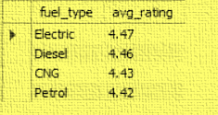
11 Ratings by Fuel Type
Query:
Result :
SELECT
f.fuel_type,
ROUND(AVG(c.rating), 2) AS avg_rating
FROM Cars c
JOIN FuelType f ON c.fuel_type_id = f.fuel_type_id
GROUP BY f.fuel_type
ORDER BY avg_rating DESC;
NOTE: 4 Rows Returned
19

Slide 21
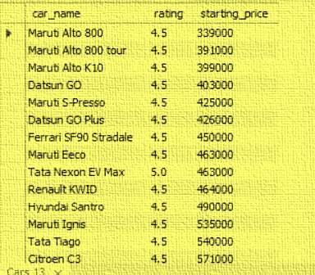
12 Best Value for Money Cars
Query:
Result :
SELECT
car_name,
rating,
starting_price
FROM Cars
WHERE rating >= 4.5
ORDER BY starting_price ASC;
NOTE: 181 Rows Returned
20

Slide 22
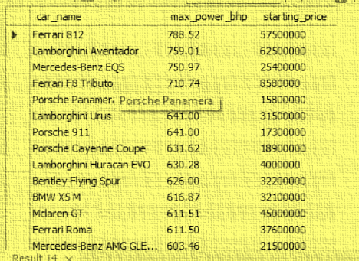
13 Luxury Performance Cars
Query:
Result :
SELECT
c.car_name,
e.max_power_bhp,
c.starting_price
FROM Cars c
JOIN Engine e ON c.engine_id = e.engine_id
WHERE e.max_power_bhp > 200
AND c.starting_price > 3000000
ORDER BY e.max_power_bhp DESC;
NOTE: 87 Rows Returned
21

Slide 23
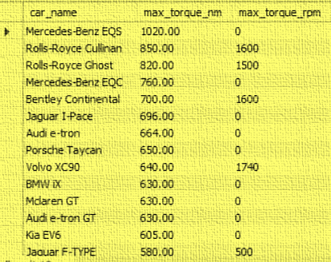
14 High Torque at Low RPM Cars
Query:
Result :
SELECT
c.car_name,
e.max_torque_nm,
e.max_torque_rpm
FROM Cars c
JOIN Engine e ON c.engine_id = e.engine_id
WHERE e.max_torque_rpm < 2000
ORDER BY e.max_torque_nm DESC;
NOTE: 34 Rows Returned
22

Slide 24
Conclusion
This set of SQL analyses provides a comprehensive view of the car market across popularity, performance, pricing, and consumer preferences. By examining trends such as the most-reviewed models, top-rated body types, pricing distribution, fuel and transmission preferences, and performance benchmarks, we gain actionable insights for both manufacturers and buyers. The results highlight clear market segments—from budget-friendly high-value cars to premium performance machines—while also revealing correlations between reviews, ratings, and specifications. Together, these findings offer a data-driven foundation for strategic decision-making in product positioning, marketing, and customer targeting.
23

Slide 25
THANK YOU

