Slide 1

Digital voting system
Secured by Cryptographic Voting with Blockchain
Presented by:

Slide 2
Overview of digital voting system
Traditional voting is prone to fraud, tampering, and lacks auditability
Digital voting without robust security risks vote manipulation and voter impersonation
a secure, deployable classical cryptographic system is essential for today’s
elections.
CONCEPTUAL OBJECTIVES
Define digital voting: casting and counting votes electronically to modernize
elections.
Importance of security, privacy, transparency, and trust in electoral processes.
Project leverages well-established classical cryptographic algorithms (AES, RSA, SHA-256)
to secure votes in a practical system

Slide 3
CONCEPTUAL OBJECTIVES
Implement a secure voting system using classical cryptography only.
Record votes immutably using blockchain technology for transparency and audit.
Provide voter authentication via biometric verification combined with digital cryptography.
Make the system compatible with standard hardware/software for ease of deployment.
Classical Cryptographic Techniques
AES-256-CBC: Symmetric encryption algorithm offering confidentiality by
encrypting vote data with a 256-bit key and random IV (initialization vector).
RSA-204: Asymmetric cryptography used for secure key exchange and creating
digital signatures to guarantee vote authenticity and non-repudiation.
SHA-256: Secure hash function ensures vote and blockchain data integrity.
Explain key generation via CSPRNG and HMAC to ensure randomness and security of cryptographic keys.

Slide 4
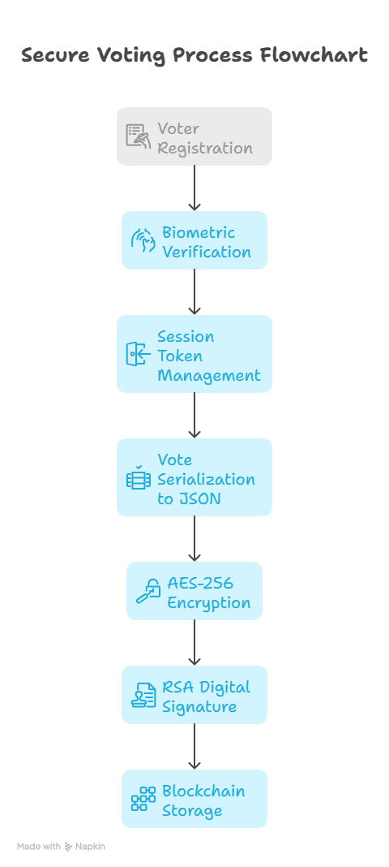
System Architecture
Modular architecture separates concerns: user interfaces (admin and voter),
backend API, cryptographic layers, blockchain ledger, data management.
Flask backend coordinates voter registration, voting processing, encryption,
and result tallying.
Blockchain stores vote hashes immutably to prevent tampering.
JSON-based data store manages voter info, parties, officers, and sessions.
Vote Casting Workflow
Voter registers with biometric verification and credentials.
Session tokens manage active users securely.
Votes serialized to JSON ensure data consistency.
AES-256 encrypts each vote with unique symmetric key.
RSA digital signature authenticates the encrypted vote,
preventing forgery.
Encrypted votes and signatures stored on blockchain
for integrity and audit.

Slide 5
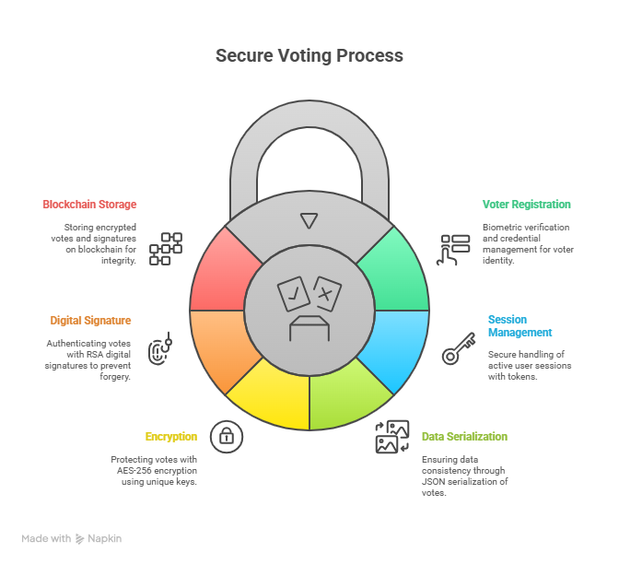
Blockchain for Vote Integrity
Blockchain: sequence of blocks, each containing hashed data and reference
to previous
block’s hash, ensuring immutability.
Mining with proof-of-work (nonce) secures blocks against tampering.
Blockchain validation confirms chain integrity, providing transparent
auditability of votes.
Enables public/verifiable trust without centralized control.
Security Features
End-to-end encryption protects vote confidentiality.
Digital signatures ensure only authorized voters’ encrypted votes are accepted.
Blockchain prevents retroactive vote modifications.
Randomly generated AES keys and secure key exchange thwart cryptanalysis.
Biometric verification adds authentication layer beyond cryptography.

Slide 6
Deployment and Technologies Used
Developed with Python 3 and Flask: lightweight, scalable backend.
Libraries: pycryptodome for AES, cryptography for RSA and hashing.
JSON files provide simple persistent storage for easy maintenance.
System runs on common hardware without specialized quantum infrastructure.
Future Enhancements

Slide 7
Conclusion :
Classical cryptographic algorithms combined with blockchain offer strong, practical security for digital elections today.
System ensures vote confidentiality, integrity, and auditability without relying on emerging quantum technologies.
A viable approach to modernize democratic processes with technology that is deployable and secure

