Slide 1
IoT Hackathon 2017
Smart Doorbell
Janic Wyslich, Flamur Zeqiraj, Sanja Zivkovic

Slide 2



Problem
Standing in front of closed doors makes me unhappy

Slide 3






Solution
No more closed doors

Slide 4






Hard- and software components
Raspberry Pi
Python
Dash Button
IFTTT Services
Smartphone
Gmail Account

Slide 5
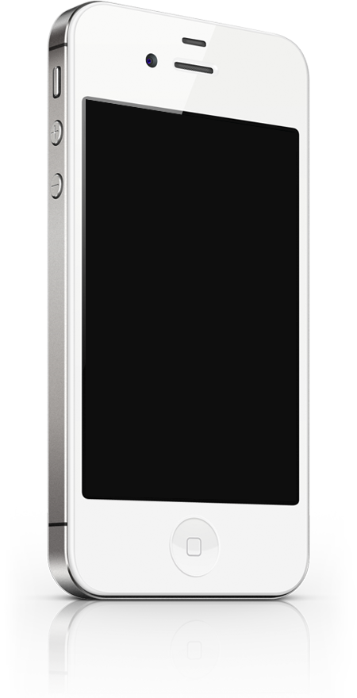
It’s time for a live demo

Slide 6
Thank you for listening!
Repository: https://github.com/chiefblub/IoTHackathon/wiki

