Slide 1
Getting the Most Out of the R Community
Kevin Burke
Brian Fannin
Adam Rich
CAS R Limited Attendance Seminar
December 14-15, 2015
Atlanta, GA

Slide 2
www.r-project.org/mail.html
R-help
The ‘main’ R mailing list, for discussion about problems and solutions using R, announcements
(not covered by ‘R-announce’ or ‘R-packages’, see above), about the availability of new functionality for R
and documentation of R, comparison and compatibility with S-plus, and for the posting of nice examples and
benchmarks. Do read the posting guide before sending anything!
This has become quite an active list with dozens of messages per day.
An alternative is to subscribe and choose daily digests (in plain or MIME format). Use the web interface for information, subscription, archives, etc.
Repeat: Do read the posting guide before sending anything!

Slide 3
Special Interest Groups
Mac Ports of R | R in Finance | R Extension for Mediawiki
Database Interfaces | Geographical data and Mapping | Mixed Effect Models, notably lmer() related
Debian Ports of R | gRaphical models | users and developers of network- or graph-related software within R
Dynamic Simulation Models in R | GUI Development | phylogenetic and comparative methods and analyses
Using R in ecological data analysis | High-Performance Computing | Quality Assurance & Validation
R for epidemiological data analysis | using R in actuarial science and insurance | Robust Statistics
Fedora and Redhat ports of R | Announcements of Jobs where R is used | Teaching Statistics (and more) using R
Development of an "R Wiki"

Slide 4
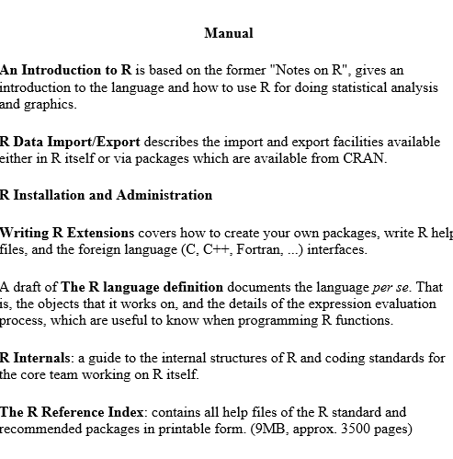
cran.r-project.org/manuals.html

Slide 5
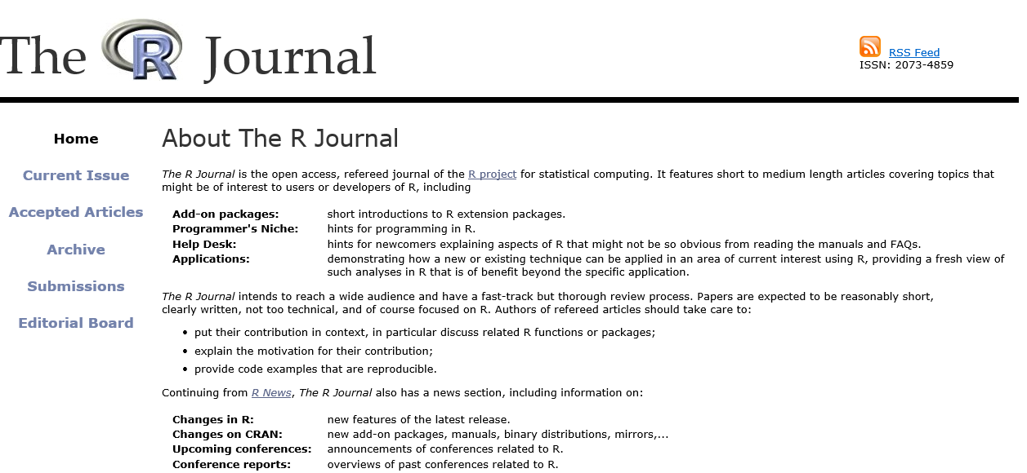
journal.r-project.org/

Slide 6
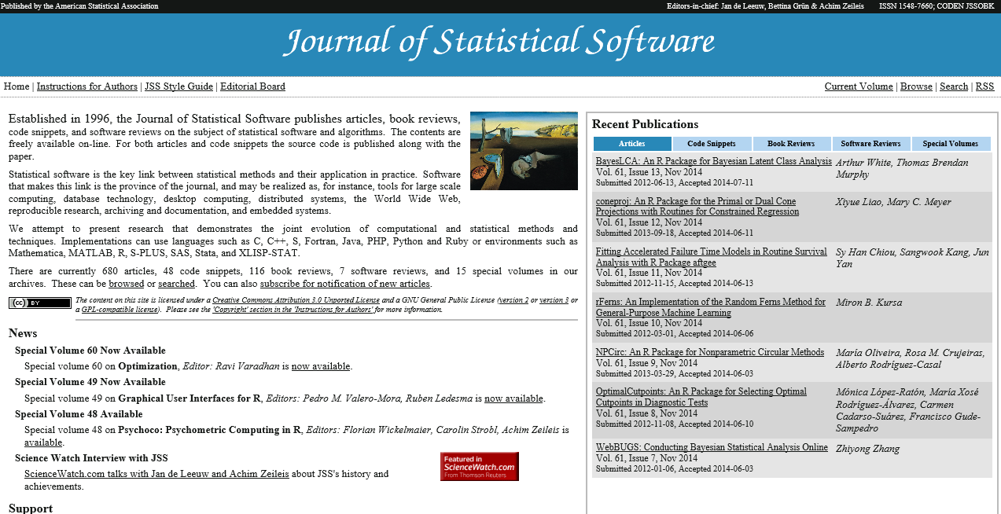
www.jstatsoft.org/

Slide 7
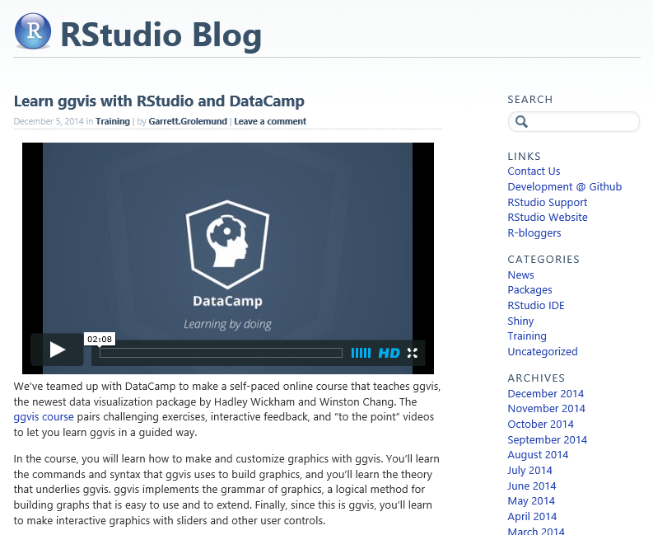
blog.rstudio.org/
Source of videos
Package Announcements

Slide 8
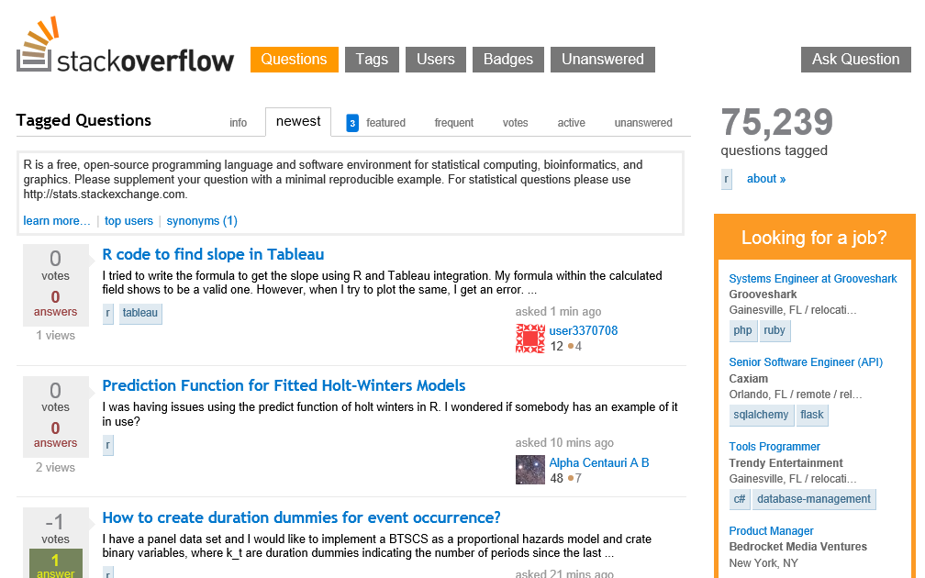
www.Stackoverflow.com

Slide 9
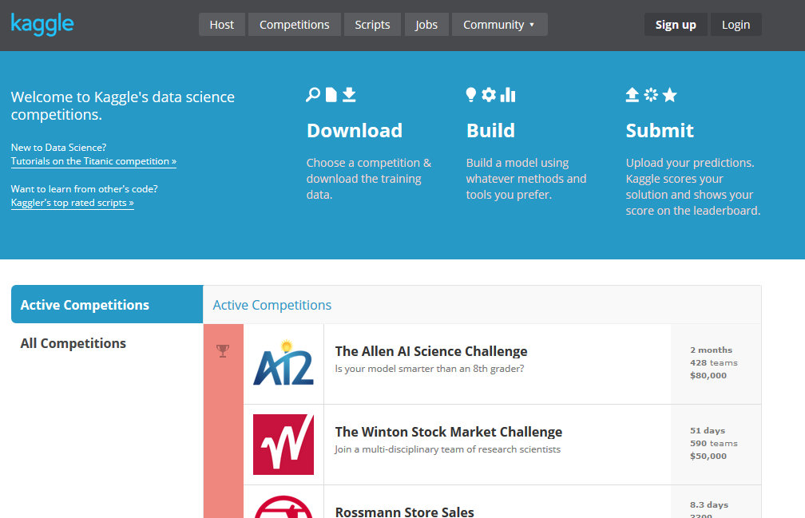
www.kaggle.com
Insurance Competitions
Allstate Purchase Prediction Challenge
Liberty Mutual Group:Fire Peril Loss Cost
AXA Driver Telematics Analysis
Homesite Quote Conversion
Liberty Mutual Group: Property Inspection Prediction
Allstate Claim Prediction Challenge

Slide 10
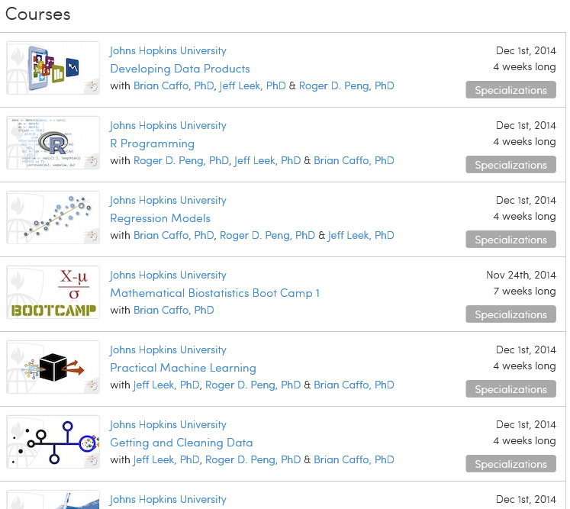
www.coursera.org
Johns Hopkins offers a specialization in Data Science with a certificate
Instructors’ blog is www.simplystatistics.org

Slide 11
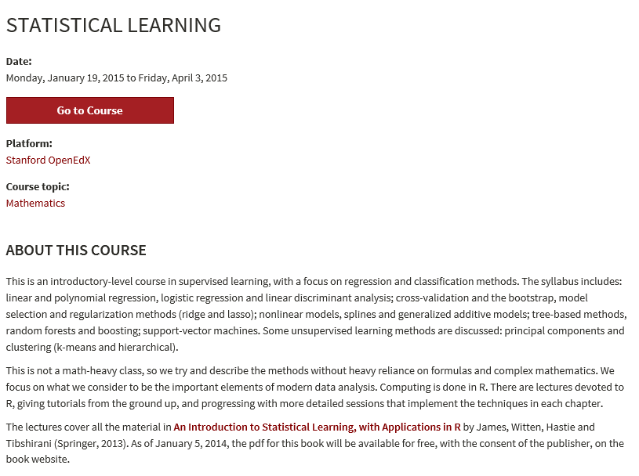
http://online.stanford.edu/openedx
One of the Instructors (Trevor Hastie) is the co-author of the early 90’s book “Statistical Models with S”
Videos are a good source of CE. We had the actuarial department watching them every week.

Slide 12
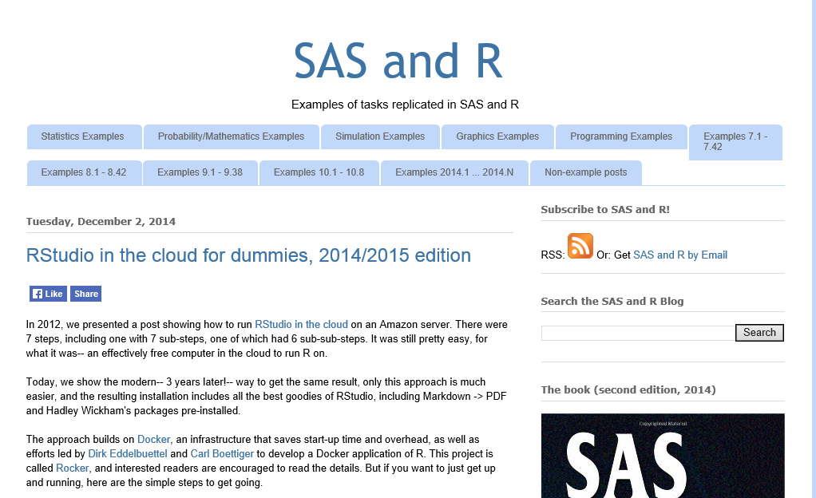
http://sas-and-r.blogspot.com/
Authors of the books:
SAS and R: Data Management, Statistical Analysis, and Graphics
Using SAS for Data Management, Statistical Analysis, and Graphics
Using R for Data Management, Statistical Analysis, and Graphics

Slide 13
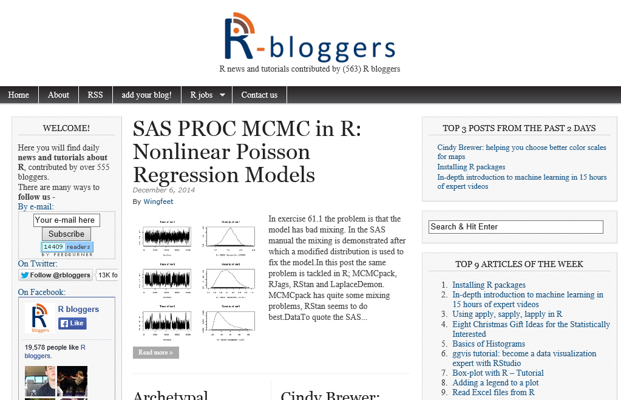
http://www.r-bloggers.com/

Slide 14
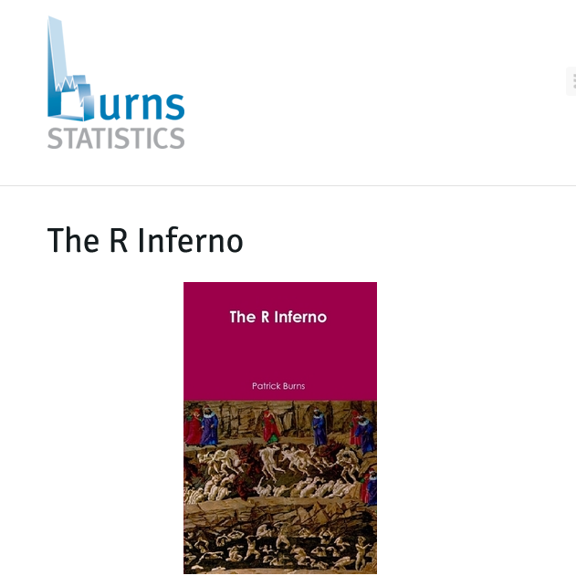
www.burns-stat.com/documents/books/the-r-inferno/
If you are using R and you think you’re in hell, this is a map for you.
A book about trouble spots, oddities, traps, glitches in. R

Slide 15

www.revolutionanalytics.com

Slide 16
Twitter
@hadleywickham – author of numerous R packages
@rstudiotips – weekly R studio tips
@Rbloggers – companion to site mentioned earlier
@baseballRstats – authors of “Analyzing Baseball Data with R”

