Slide 1
R Community
Dan Murphy
Brian Fannin
Adam Rich
CAS R Bootcamp
August 21, 2017
Boston, Mass.

Slide 2
If you have a question…
Did you google it?
Yahoo it?
Bing it?

Slide 3
Have an R Buddy
It is so much easier to learn a new language when you have someone to speak it with.
If there are others at your company using R, get together to discuss what you are doing and learning.
If there is no one at your company who is using R, make some friends while you are here. You can work together over email!
If you are really desperate for a buddy, email me. Or if just moderately desperate email Dan or Brian.
adamleerich@gmail.com
chiefmurphy@gmail.com
captain@pirategrunt.com

Slide 4
Find a User Group
Meetup
Mango Solutions R Groups
Go to another seminar or conference
The learning curve is steep
One week will not be enough!

Slide 5
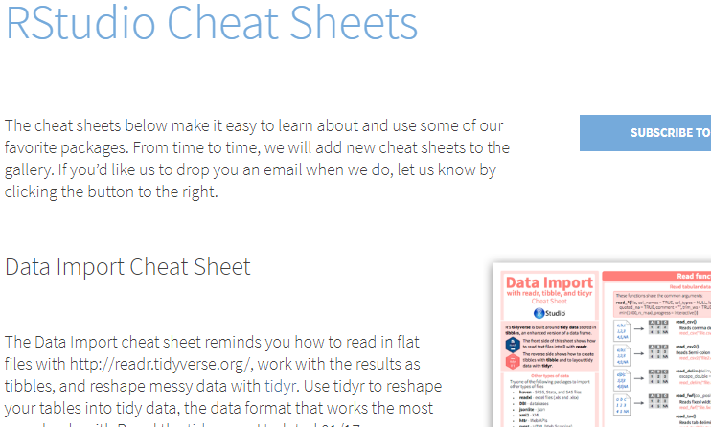
Cheatsheets
These are *indispensable*
https://www.rstudio.com/resources/cheatsheets/

Slide 6
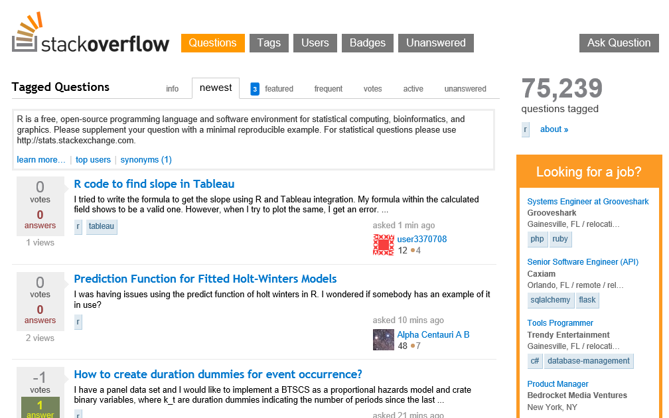
www.Stackoverflow.com

Slide 7
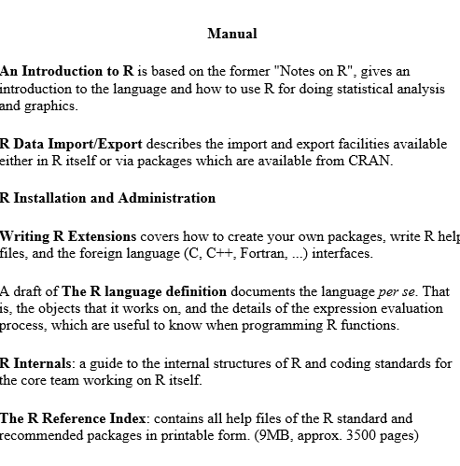
cran.r-project.org/manuals.html

Slide 8
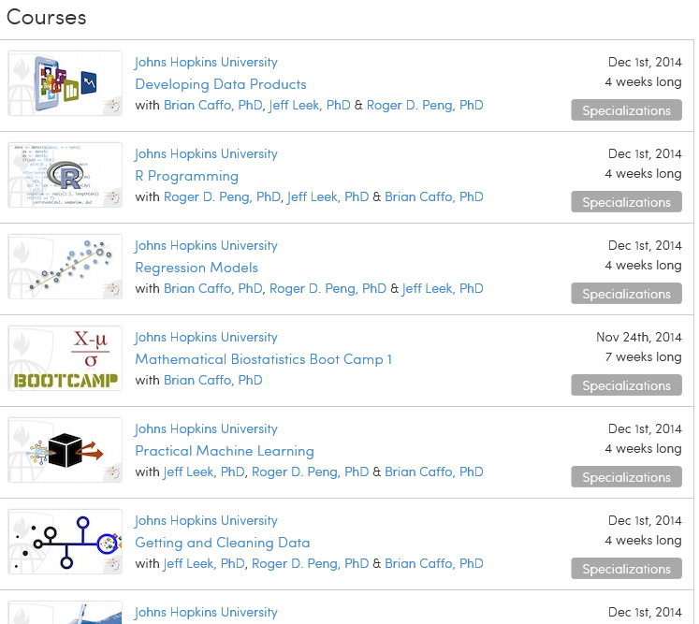
www.coursera.org
Johns Hopkins offers a specialization in Data Science with a certificate
Instructors’ blog is www.simplystatistics.org

Slide 9
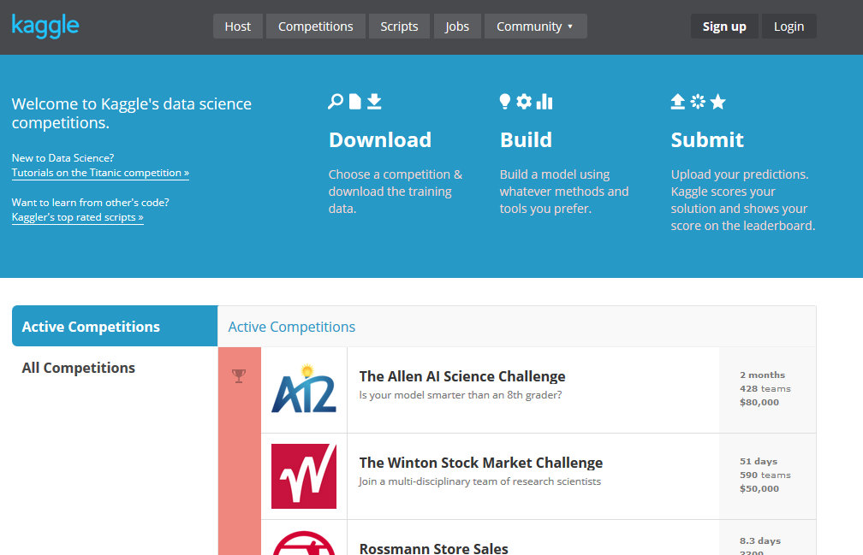
www.kaggle.com
Insurance Competitions
Allstate Purchase Prediction Challenge
Liberty Mutual Group:Fire Peril Loss Cost
AXA Driver Telematics Analysis
Homesite Quote Conversion
Liberty Mutual Group: Property Inspection Prediction
Allstate Claim Prediction Challenge

Slide 10
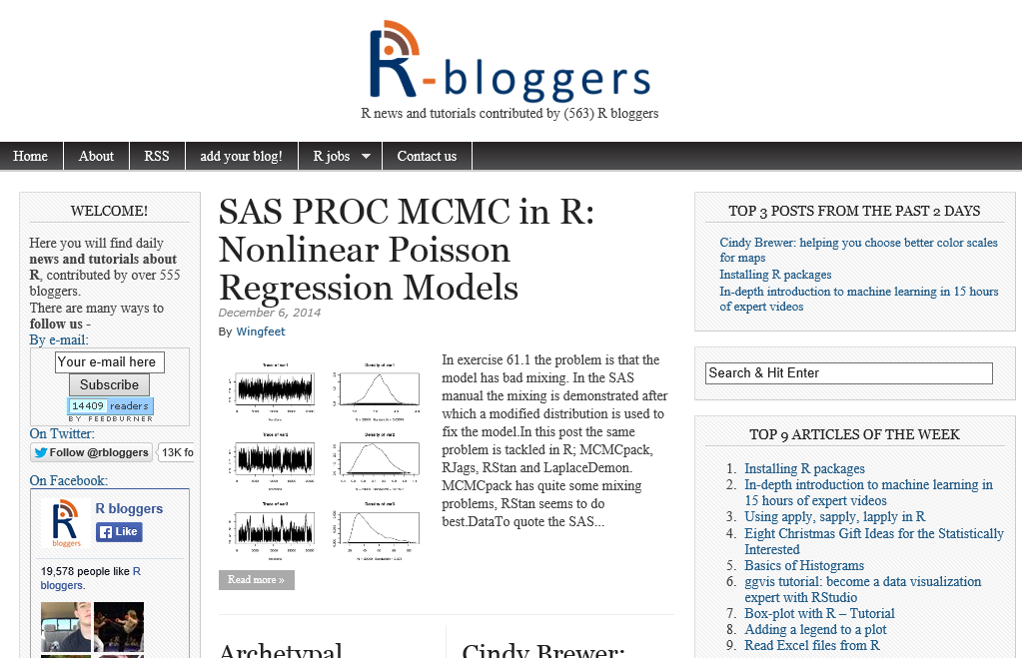
http://www.r-bloggers.com/

