Slide 1
R Community
Dan Murphy
Brian Fannin
Adam Rich
CAS R Bootcamp
August 21, 2017
Boston, Mass.

Slide 2
If you have a question…
Did you google it?
Yahoo it?
Bing it? (or is the past participle “bang”?)
Duck-duck-go it?

Slide 3
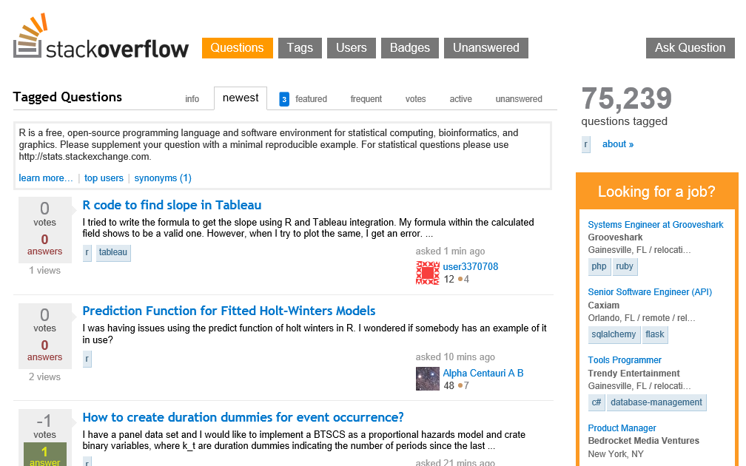
www.Stackoverflow.com

Slide 4
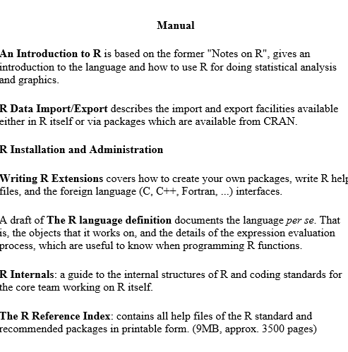
cran.r-project.org/manuals.html

Slide 5
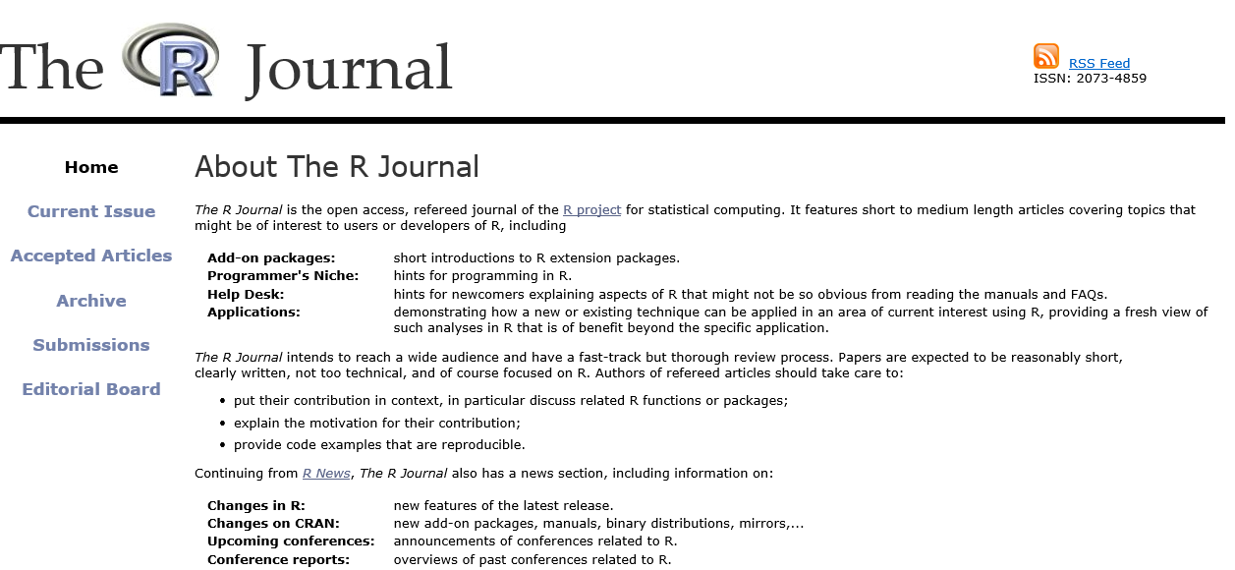
journal.r-project.org/

Slide 6
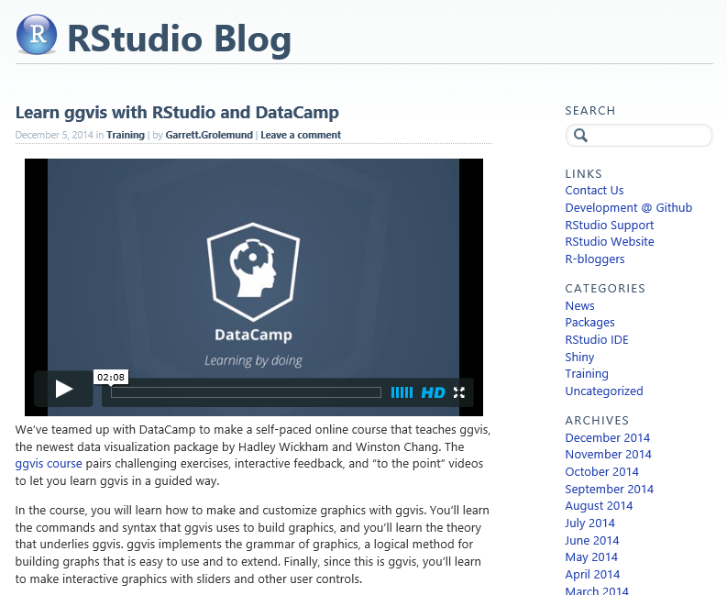
blog.rstudio.org/
Source of videos
Package Announcements

Slide 7
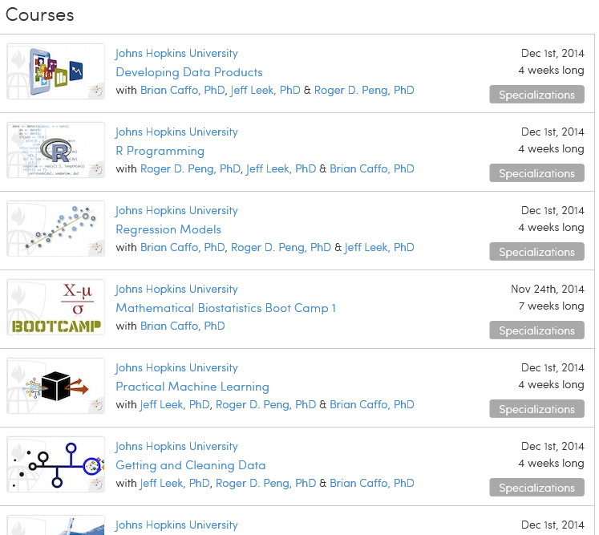
www.coursera.org
Johns Hopkins offers a specialization in Data Science with a certificate
Instructors’ blog is www.simplystatistics.org

Slide 8
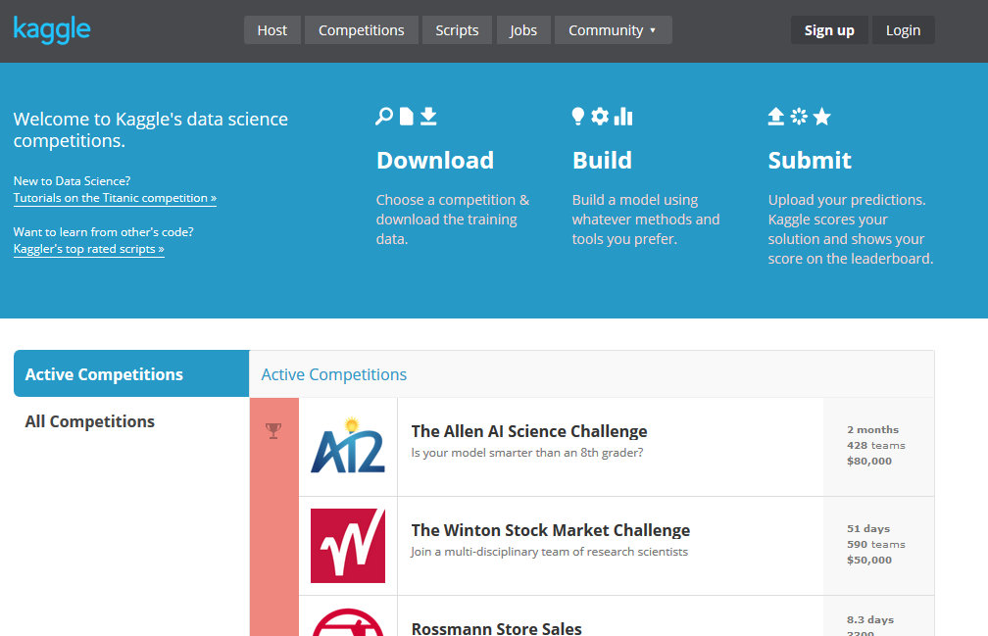
www.kaggle.com
Insurance Competitions
Allstate Purchase Prediction Challenge
Liberty Mutual Group:Fire Peril Loss Cost
AXA Driver Telematics Analysis
Homesite Quote Conversion
Liberty Mutual Group: Property Inspection Prediction
Allstate Claim Prediction Challenge

Slide 9
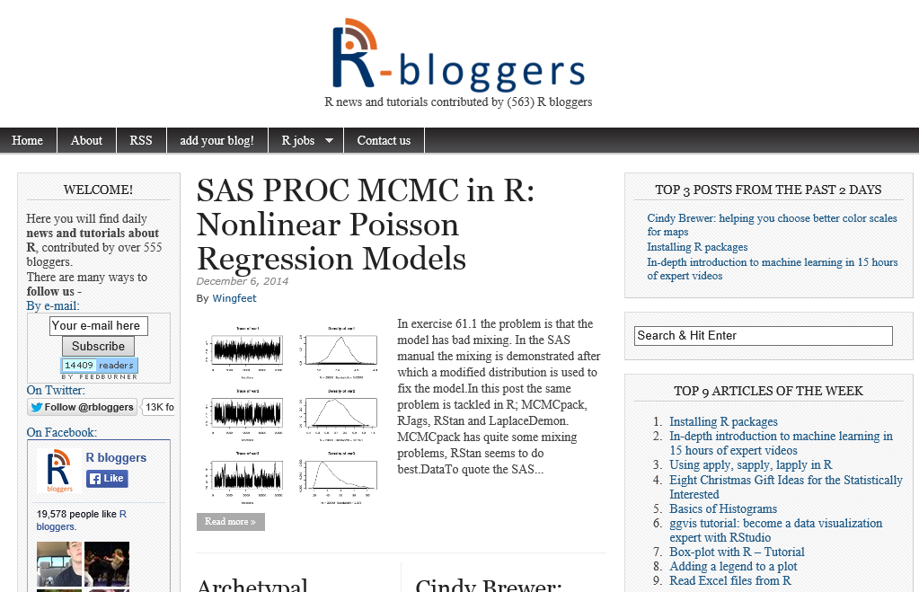
http://www.r-bloggers.com/

