Slide 1
The Analyzer
Stock trend during pandemics
Shawn Saltsman
Alex Garcia
Subash Sunku

Slide 2


Is there a stock trend leading and during a pandemic?
H1N1
COVID-19
COVID19
H1N1
Active 12/2019-Present
Take data sample from 2015-2019 and during
Active 2009-2010
Take data samples from 2005-2008 and during

Slide 3
The Overview
Containerization
Data Sets
Analysis and Programming
Docker Cluster
All-in-one package
Using a master-worker framework via docker-compose
Kaggle
Data Science Community
All kinds of dataset for research and competition
Stock-Market-DataSet
Python/Xming/Putty
Analysis Trends
X11 forwarding to display results

Slide 4
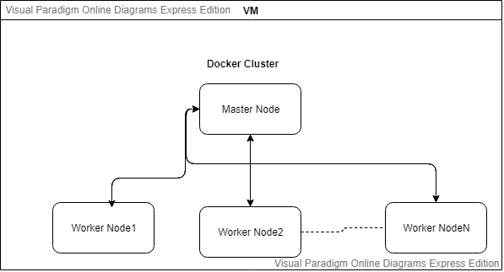
The Docker Cluster
Virtualization
Containerization
Analysis and Programming
Self-contained solution
Dockfile
Ubuntu
Ssh
Kaggle
Python3 scipy, matplotlib
Yml File
Master
VM access via volume
Distributes Work
Displays Results
Network - Bridge
Hostfile

Slide 5
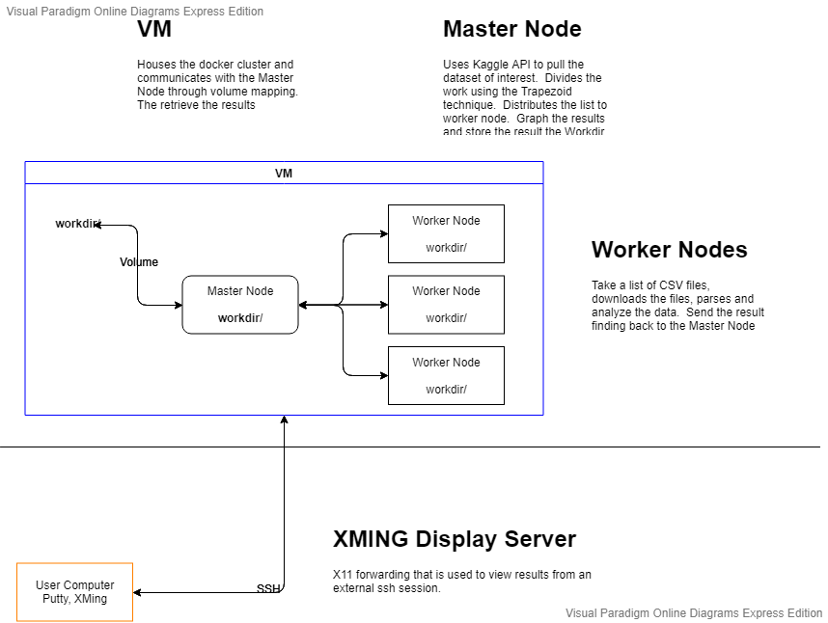
Program Flow
Containerization
Analysis and Programming

Slide 6
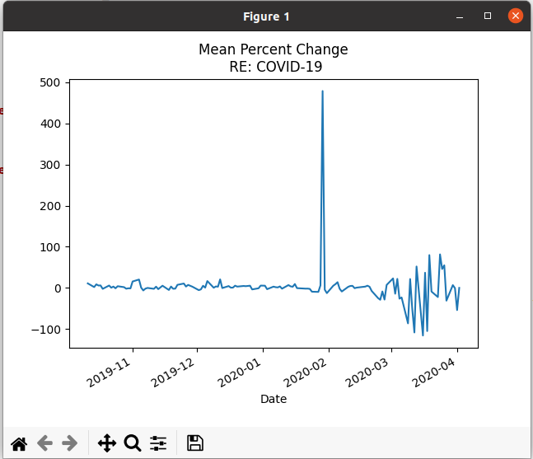
Programming
The Analysis
Virtualization
Containerization
Analysis and Programming
Kaggle API
Create JSON
Api - download datasets, files
Pandas
DataFrames
Drop, rename, transpose
Matplotlib
Plot - line, bar graphs
MPI4PY
Communicate - send, recv
% changes
XMing - Display plots
Covid-19

Slide 7
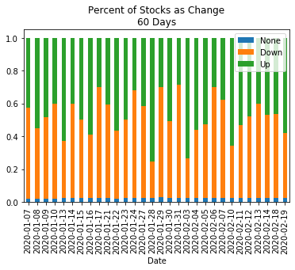
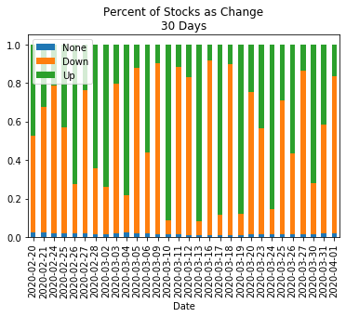
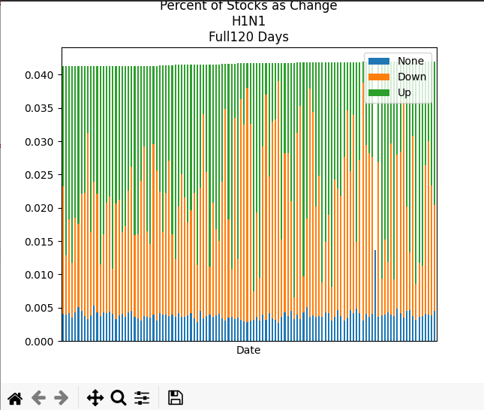
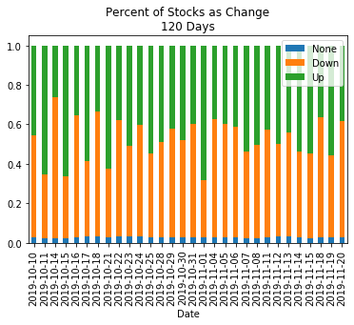
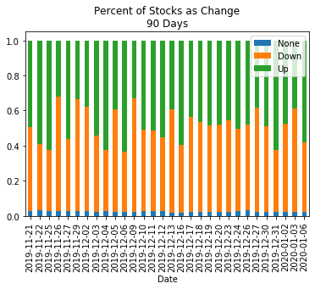
Covid-19 Results
Virtualization
Containerization
Analysis and Programming

Slide 8
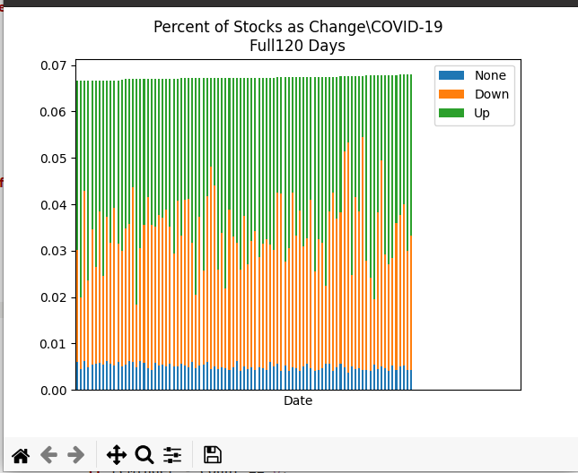
H1N1
COVID-19
Virtualization
Containerization
Analysis and Programming

Slide 9
THANK
YOU!
max rowth

