Slide 1

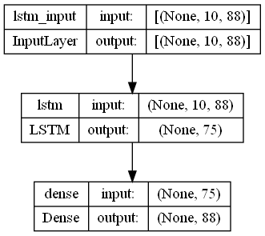
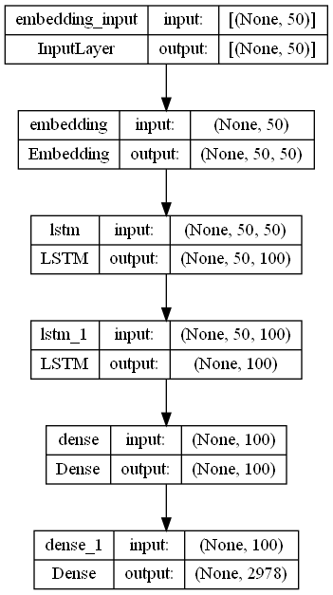
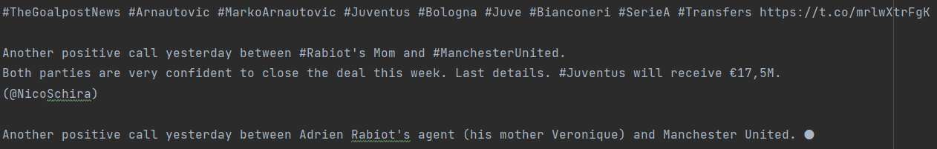
Juventus Word Text Generation Tweets
Emanuel Monzon
Juventus Intro and Why I picked this for my topic
Methods for generation
Visualization of model input and output
Results
Juventus is the most successful Football Club in Italy. With a total of 36 Scudettos (League titles) which is the most of any other team in the league. The club history started in 1897, and the club was the house for legends in the game such as Zinedine Zidane, Gianluigi Buffon, Andrea Pirlo, etc.
I’m a big supporter of the club, and so choosing this as my topic for this project felt like a natural choice.
1: The first step is to gather the data from Twitter which is done by first installing the Tweepy library Python. It is important to remove the retweets since we don’t want those.
2: Clean the tweets since our models won’t be effective if these aren’t cleaned. Since part of the project is to also be able to generate Hashtags, words that start with # won’t be omitted. However, we want to omit links, Unicode characters such as emojis. Doing so, our data will only contain ASCII characters.
3: Use the models as shown in Tutorials 1-3 to use the character generation model and the word generation model.
Character Base Model
Examples of Tweets generated:
-Juventus are getting closer to an agreement on personal terms with Juventus. He is now waiting for Juventus are getting closer to an agreement on pers
-Zidane come back to the proors and is a ready with the #Barcelona #Juventus #Juve #FinoAlleFine #Juventus #Juve #FinoAlleFine #Juventus #Juve #FinoAll
Word Base Model
Examples of Tweets generated:
-prepared best to nightmares this best dimaria acmilan acmilan do ronaldo want to say man with the return
-of verona version newcomer fans video nikola euronext manchester united sporting director john murtough and juventus midfielder kostic
Visualization of the Character model input/output
Objectives
The purpose for this project is to generate 20 tweets by using both a Character-based language model and a Word-based language model as shown in the tutorials.
Conclusion
The Character Base Model gave a 77% accuracy while the word base Model gave a 62% accuracy. Based on these results, the Character Base Model seems to do better when it comes to generating tweets and this seems to be the case since the tweets generated by the Character base are more coherent than the ones generated by the Word Base Model.
Example Tweets that we get from Twitter
Visualization of the Word model input/output

