Slide 1
The emission/absorption spectrum of atomic hydrogen is related to the transition between two electronic quantum states.
(quantum states of the electron)
Of course, there is no rotation nor vibration motion for atomic hydrogen.

Slide 2
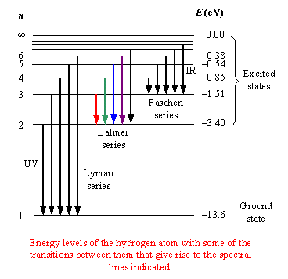
eilat.sci.brooklyn.cuny.edu

Slide 3
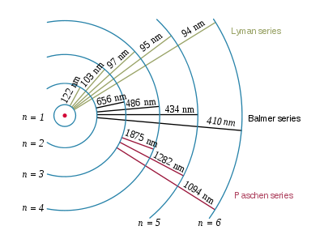
A very simplified model
wiki

Slide 4
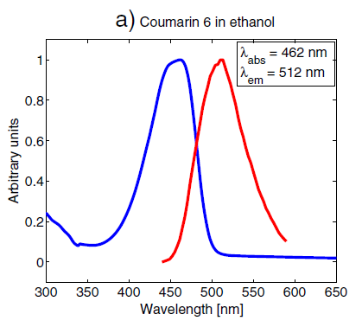
The emission/absorption spectrum of a molecule in UV/Vis region is often related to the transition between electronic quantum states.
J Fluoresc (2014) 24:1015–1024
DOI 10.1007/s10895-014-1368-1

Slide 5

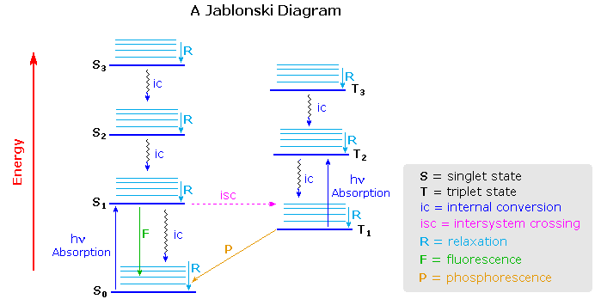
Fluorescence and Phosphorescence
In solution,
Almost no rotation
Quick vibration relaxation

Slide 6
The emission/absorption spectrum of a molecule in IR region is often related to the transition between vibrational quantum states.

Slide 7
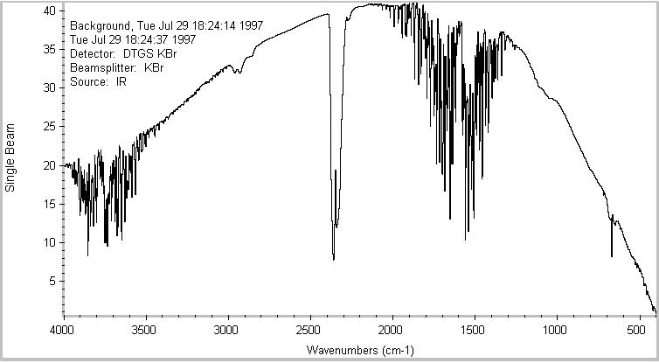
IR absorption of ambient air
You can see CO₂ as the strong doublet at around 2300 cm⁻¹, and water as the "spiky" peaks in the 3800 and 1600 cm⁻¹. The "bell curve" shape of the spectrum reflects the output spectrum of the source: strong in the middle, but falling off at the ends.
https://chemistry.oregonstate.edu/courses/ch361-464/ch362/irinstrs.htm

Slide 8
Why N₂ and O₂ have no IR absorption?
Light is EM wave.
How a matter interacts with EM wave?
A matter may consist of positive and negative charges.
The magnetic interaction is often much weaker.
How about a neutral molecule?
A neutral molecule may consist of positive and negative charges and may be dipolar.

Slide 9
dipole moment
When a proton & electron 100 pm apart, the dipole moment is 4.80D (Debye). For example,
carbon dioxide: 0
carbon monoxide: 0.112 D
ozone: 0.53 D
phosgene: 1.17 D
water vapor: 1.85 D
hydrogen cyanide: 2.98 D
potassium bromide: 10.41 D
Wiki

Slide 10
Size of a typical molecule: 10⁻¹⁰~10⁻⁹ m
Wavelength of typical IR light: 10⁻⁶~10⁻⁴ m
∴A molecule sees a uniform E field which oscillates with time.
No charge, no interaction with E field.
Uniform charge, very very weak interaction with E field.
Non-uniform charge, interaction with E field is possible.

Slide 11
Dipole (dipole moment)
Dipole interaction with EM wave is the most common type of interaction. Others are like monopole, quadrupole, …

Slide 12
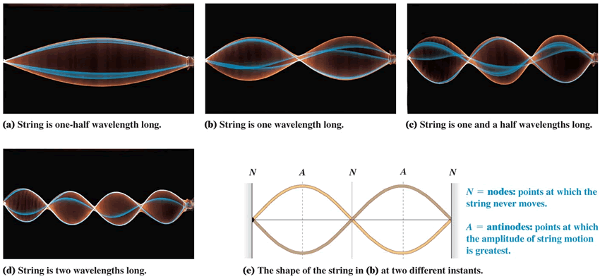
Resonance Criterion of interaction with wave
Resonance phenomena are very common. e.g., musical instruments
http://sdsu-physics.org/physics180/physics180A/units/unit3/mechanical_waves.html

Slide 13
Vibrating Dipole
E field

Slide 14
When matching to the natural frequency, the interaction can be greatly enhanced.
Vibrating dipolar moment in
AC Electric Field
In a quantum system, the resonance between EM wave and Molecule also satisfies energy conservation ΔE = hν.

Slide 15
Summary:
To absorb/emit photon, there are two basic conditions.
1. Interaction:
dipole interaction is very common.
2. Resonance:
frequency match; energy conservation

Slide 16
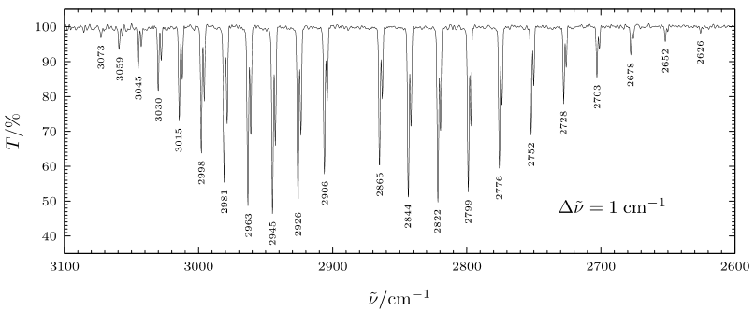
HCl (v”=0, J”) + hν → HCl (v’=1, J’=J”± 1)
Wikimedia Commons

Slide 17
HCl (v”=0, J”) + hν → HCl (v’=1, J’)
E = E_{vib} + E_{rot}
E(v”=0, J”) = E_{v=0} + B”J”(J”+1)
E(v’=1, J’) = E_{v=1} + B’J’(J’+1)
J” = 0, 1, 2, 3, …; J’ = 0, 1, 2, 3, …
Selection Rule: J’ = J” ± 1
(conservation of angular momentum)

Slide 18
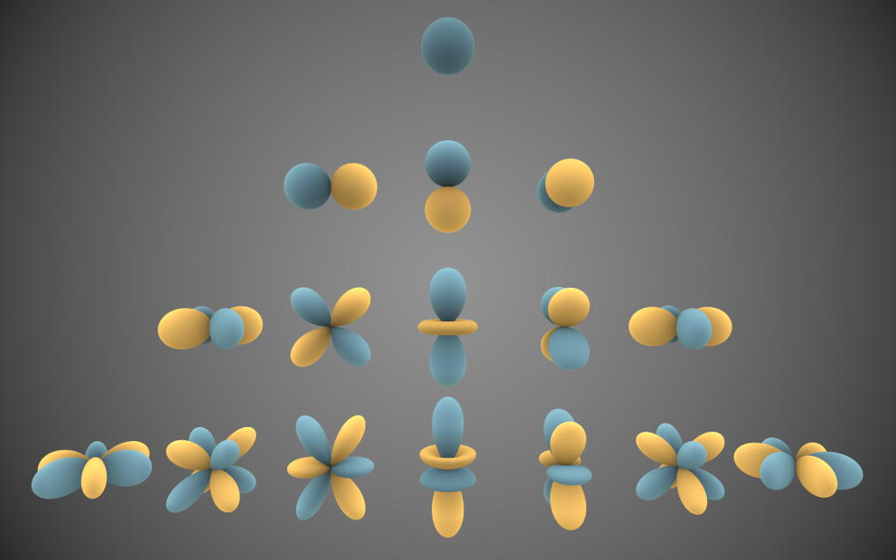
Particle on a spherical shell
Number of nodal planes
J = 0
1
2
By Inigo.quilez - Own work, CC BY-SA 3.0, https://commons.wikimedia.org/w/index.php?curid=32782753

