Slide 1
TA hour PPT
(from last week till 20180514)

Slide 2
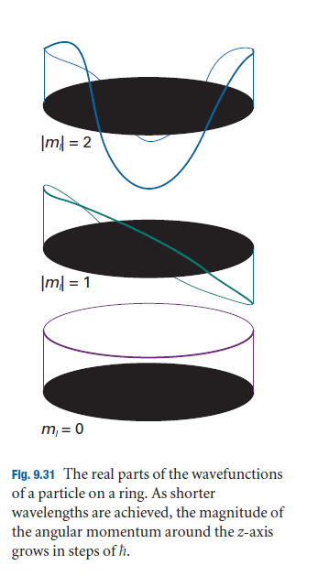
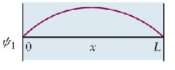
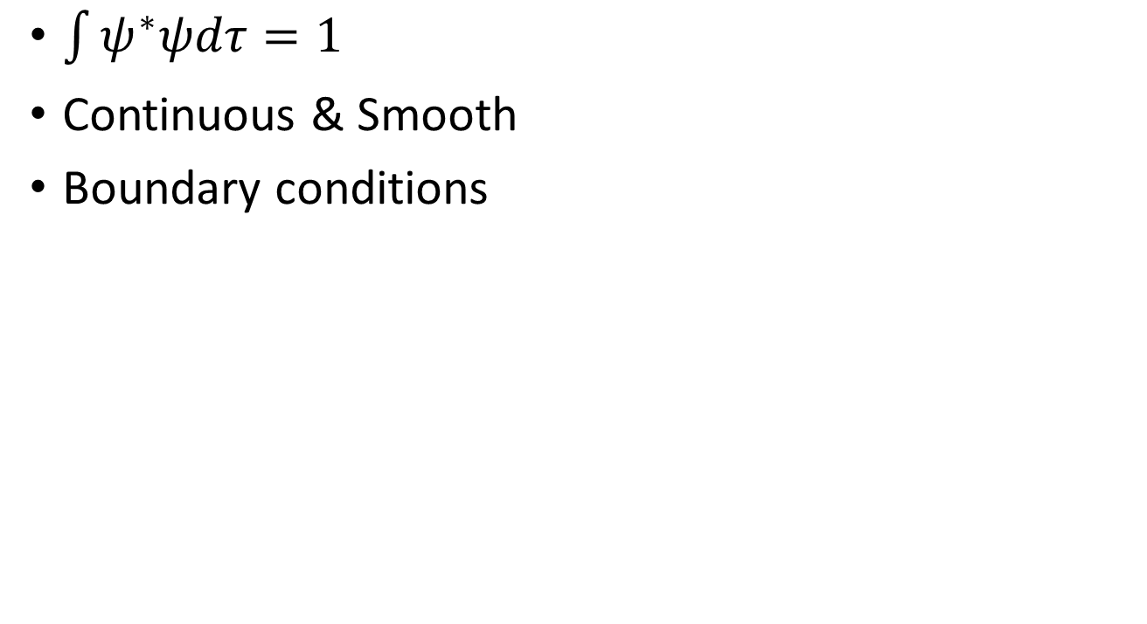



Wave function $ψ$
$$ψ\left(0\right)=ψ\left(2π\right)$$
$$ψ′\left(0\right)=ψ′\left(2π\right)$$
$\int{ψ^{∗}ψdτ}=1$
Continuous & Smooth
Boundary conditions
$$ψ\left(0\right)=ψ\left(L\right)=0$$

Slide 3
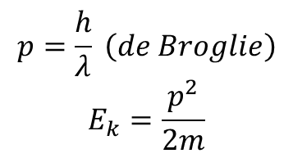
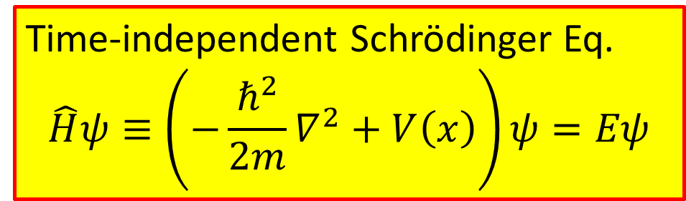
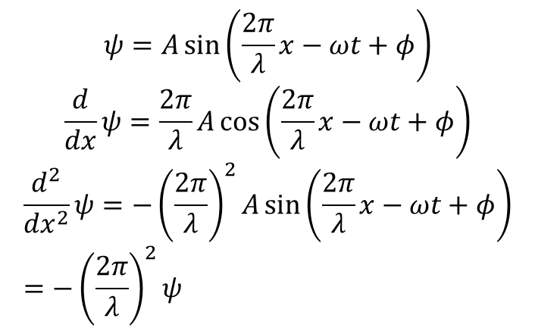
Simplest waveform— Sine wave
$$ψ=A\sin\left(\frac{2π}{λ}x−ωt+φ\right)$$
$$\frac{d}{dx}ψ=\frac{2π}{λ}A\cos\left(\frac{2π}{λ}x−ωt+φ\right)$$
$$\frac{d^{2}}{{dx}^{2}}ψ=−{\left(\frac{2π}{λ}\right)}^{2}A\sin\left(\frac{2π}{λ}x−ωt+φ\right) \\ =−{\left(\frac{2π}{λ}\right)}^{2}ψ$$
$$p=\frac{h}{λ} \left(de Broglie\right)$$
$$E_{k}=\frac{p^{2}}{2m}$$
More general (consider potential energy) :
Time-independent Schrödinger Eq. $$\hat{H}ψ≡\left(−\frac{ℏ^{2}}{2m}∇^{2}+V\left(x\right)\right)ψ=Eψ$$

Slide 4
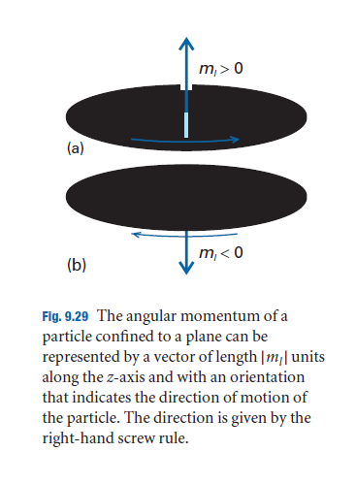

Slide 5
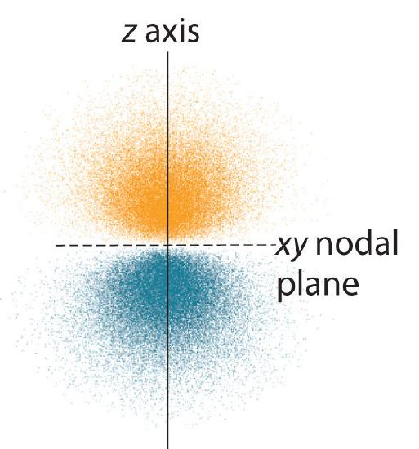

Slide 6
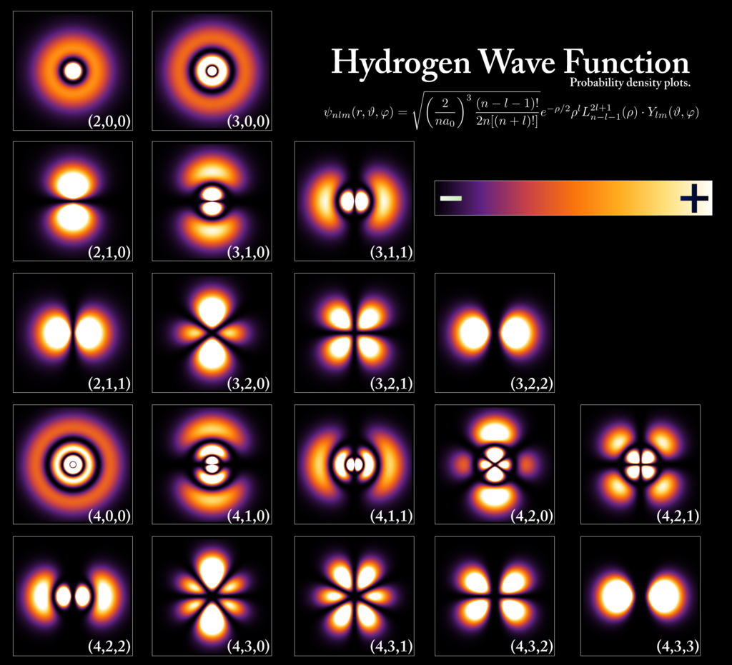
Cross sectional view
By PoorLeno https://commons.wikimedia.org/w/index.php?curid=5854697

Slide 7
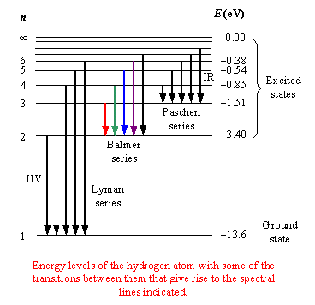
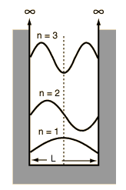
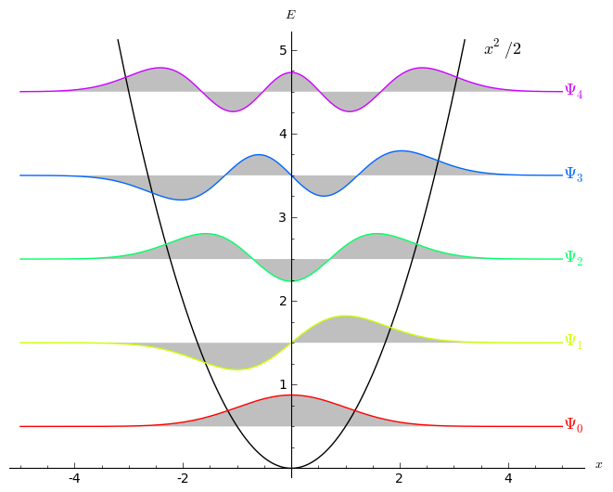
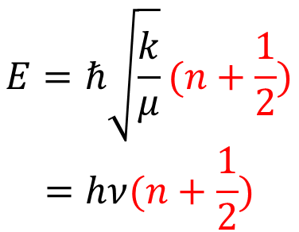
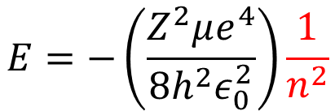
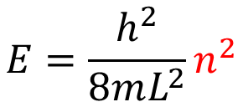
$$E=ℏ\sqrt{\frac{k}{μ}}(n+\frac{1}{2})$$
$$=hν(n+\frac{1}{2})$$
$$E=\frac{h^{2}}{8mL^{2}}n^{2}$$
$$E=−\left(\frac{Z^{2}μe^{4}}{8h^{2}ε_{0}^{2}}\right)\frac{1}{n^{2}}$$
Hydrogen-like atom (coulomb potential)
Harmonic oscillator
Particle-in-a-box

Slide 8
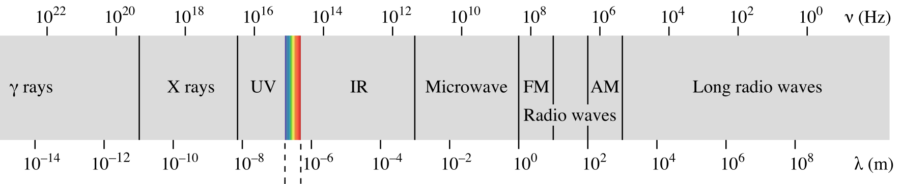
Spectrum
Electronic
Vibration
Rotation
Nuclear Spin

Slide 9
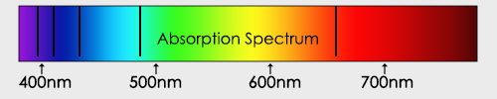
Electronic State of H atom
Narrow line
eilat.sci.brooklyn.cuny.edu

Slide 10
Vibration of a molecule
Wikimedia Commons
Author Darekk2

Slide 11
Vibrational state
Approx. to parabolic potential
@ low vibrational energy
e.g. Harmonic oscillator

Slide 12
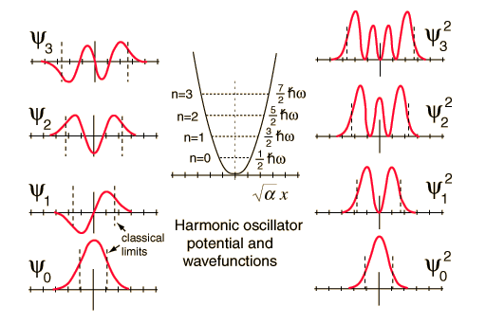
Vibration of a molecule
Number of nodes
λ

Slide 13
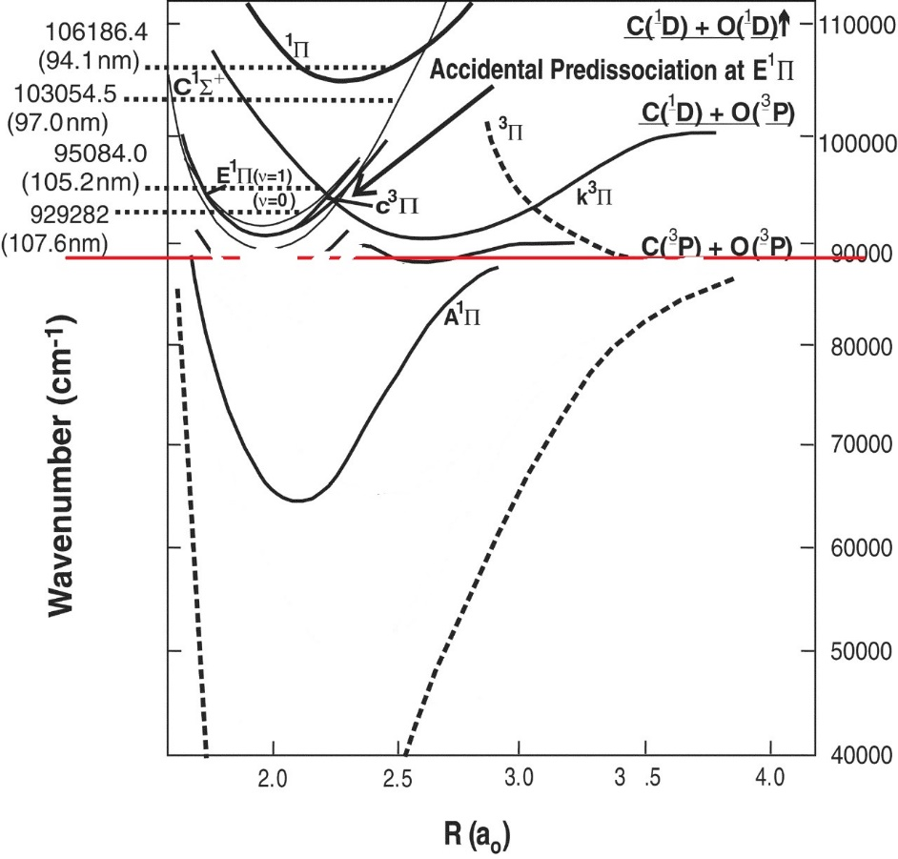
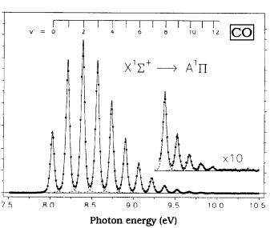

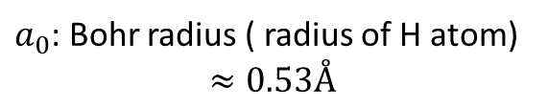
~8 eV
Adapted from: Subrata Chakraborty et al. Science 2008;321:1328-1331
$a_{0}$: Bohr radius ( radius of H atom) $$≈0.53Å$$

Slide 15
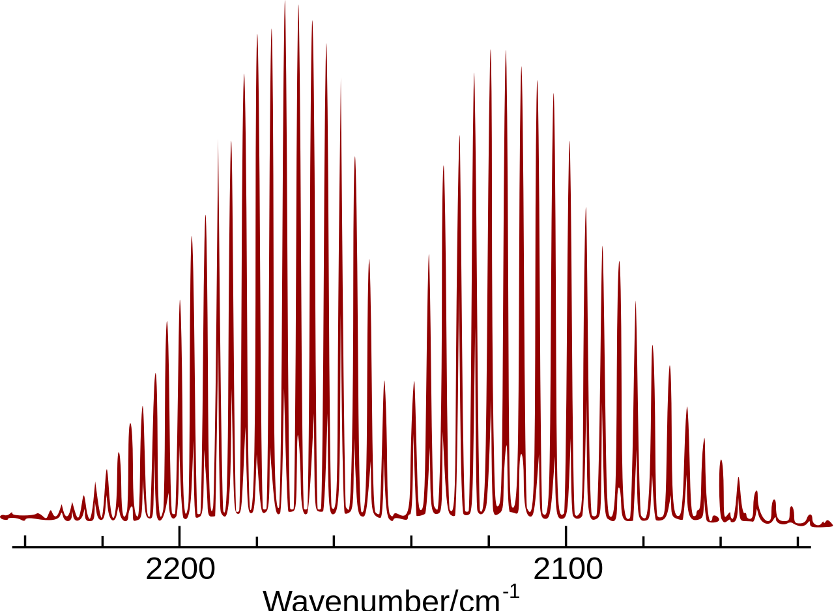
Infrared spec. Rotational–vibrational coupling

Slide 16
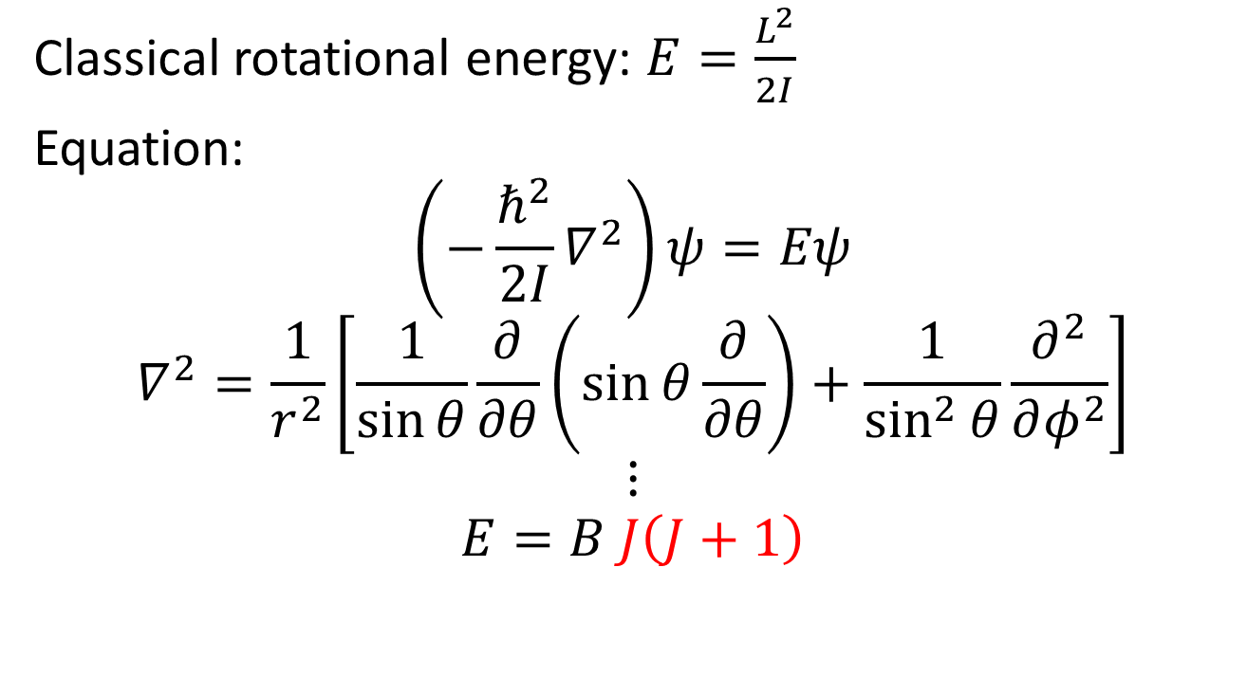
Rotational State
Classical rotational energy: $E=\frac{L^{2}}{2I}$
Equation:
$$\left(−\frac{ℏ^{2}}{2I}∇^{2}\right)ψ=Eψ$$
$$∇^{2}=\frac{1}{r^{2}}\left[\frac{1}{\sin{θ}}\frac{∂}{∂θ}\left(\sin{θ}\frac{∂}{∂θ}\right)+\frac{1}{\sin^{2}{θ}}\frac{∂^{2}}{∂φ^{2}}\right]$$
$$⋮$$
$$E=B J\left(J+1\right)$$
Notes:
https://chem.libretexts.org/Core/Physical_and_Theoretical_Chemistry/Quantum_Mechanics/07._Angular_Momentum/7.5%3A_Rigid_Rotor

Slide 17
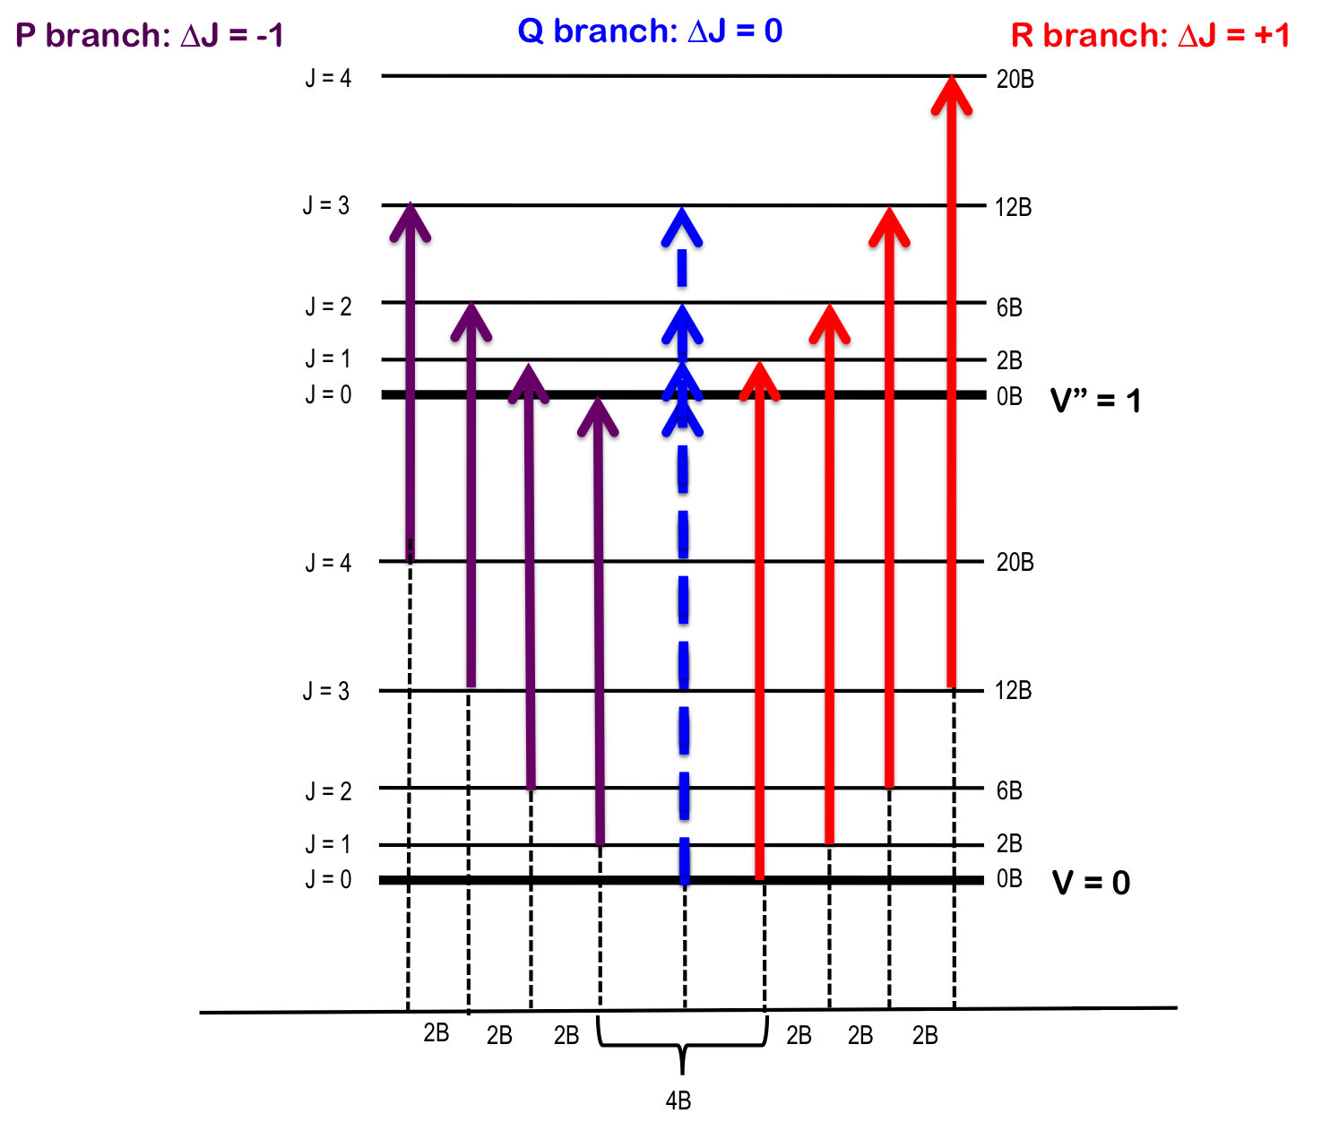

Slide 18
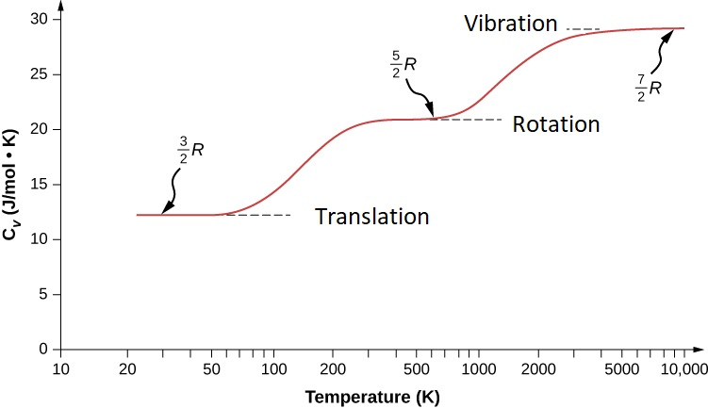
H₂

Slide 19
Motion of Diatomic Molecule
移動
Translation
轉動
Rotation
振動
Vibration
Courtesy: YT Lee

Slide 20
The vibrational frequency can be estimated by classical mechanics (harmonic-oscillator model)
k is force constant, x is the displacement

Slide 21
Spectrum

Slide 22
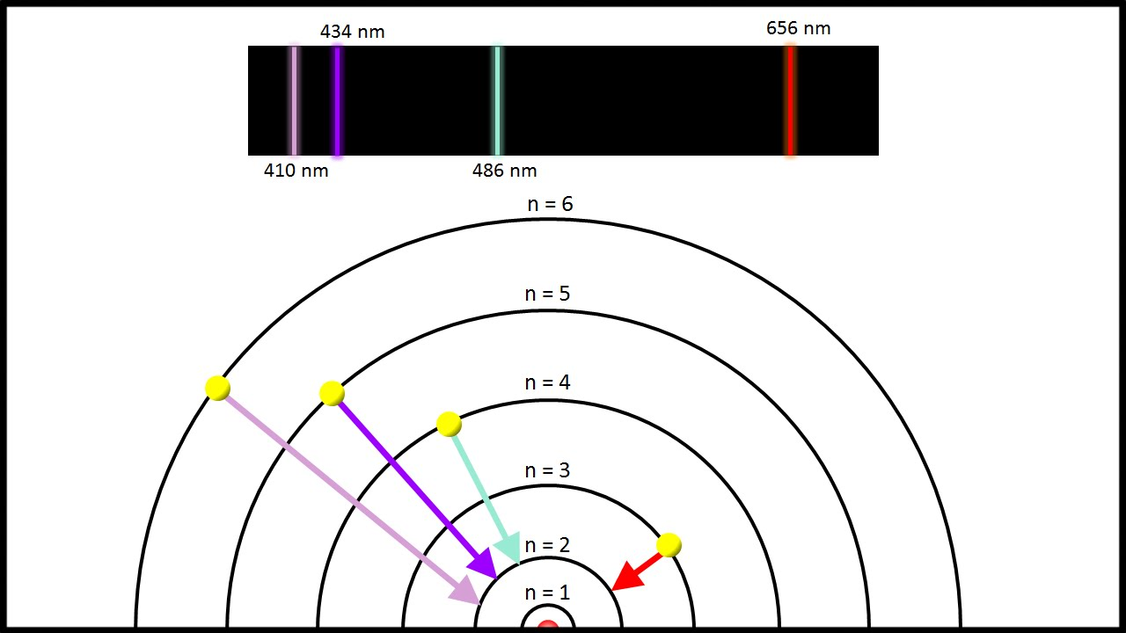
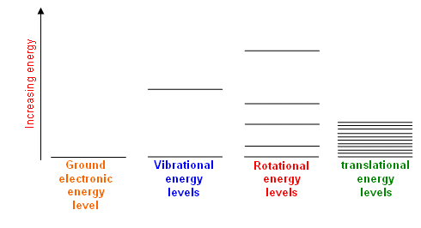

Slide 23
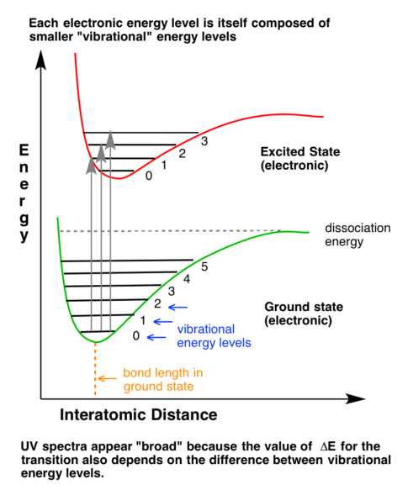
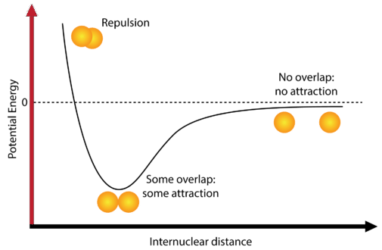

Slide 24
Vibrational Modes

Slide 25
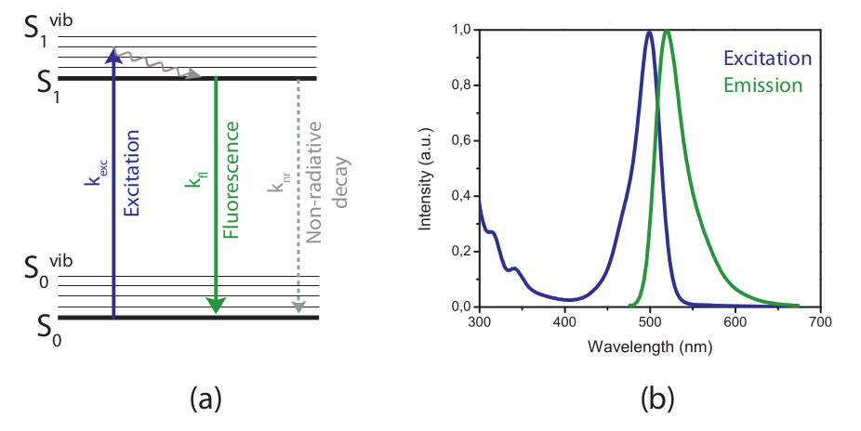

Slide 26
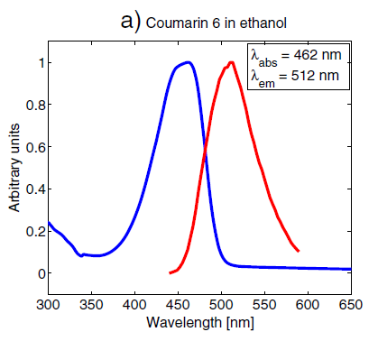
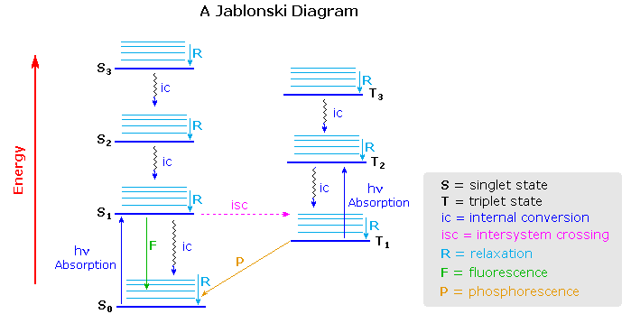

Slide 27
Homework (8~10)

Slide 28
(8) For 3H₂ + N₂ ⇌ 2NH_{3(g)} at 298 K,
(8a) Find the D_{f}Hº and Sº the related species from https://webbook.nist.gov/chemistry/ and calculate the reaction free energy at the standard state. Note: conventionally, the energy is per mol of consumed N₂.
 | N₂ | H₂ | NH₃
Δ_{f}Hº / KJ/mol | 0 | 0 | −45.9
Sº / J/(mol*K) | 191.6 | 130.7 | 192.8

Slide 29
(8b) If P_{H2} = 30 bar; P_{N2} = 10 bar, estimate P_{NH3} at room temperature.

Slide 30
(8c) If P_{H2} = 30 bar; P_{N2} = 10 bar, estimate P_{NH3} at 1000 K.

Slide 31
(9) For N₂O_{4(g)} ⇌ 2NO_{2(g)},
(9a) if P_{total} = P_{N2O4} + P_{NO2} = 0.01 bar, what is the ratio of P_{NO2}/P_{N2O4}? If one hope to have P_{N2O4}/P_{NO2} = 10⁻³, what P_{total} is required?
 | NO₂ | N₂O₄
Δ_{f}Hº / KJ/mol | 33.1 | 9.08
Sº / J/(mol*K) | 240.0 | 304.4

Slide 33
(10) For NH₄Cl_{(s)} ⇌ NH_{3(g)} + HCl_{(g)} at 298 K,
(10a) Find the values of D_{f}Hº and Sº for the related species from https://webbook.nist.gov/chemistry/.
 | NH₄Cl | HCl | NH₃
Δ_{f}Hº / KJ/mol | −314.6 | −92.3 | −45.9
Sº / J/(mol*K) | 94.9 | 186.9 | 192.8
(10b) Estimate DGº_{RXN} and K_{eq}.

Slide 34
(10c) Estimate the equilibrium pressure of NH_{3(g)} if one starts from NH₄Cl_{(s)}.
NH₄Cl_{(s)} ⇌ NH_{3(g)} + HCl_{(g)}
1-x
x
x

Slide 35
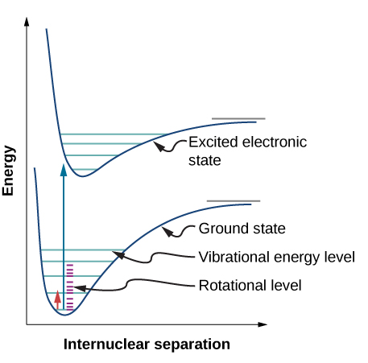

Slide 36
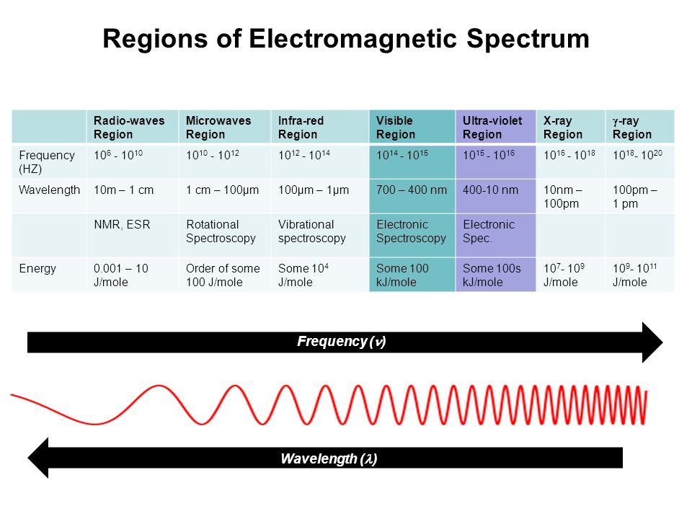

Slide 37
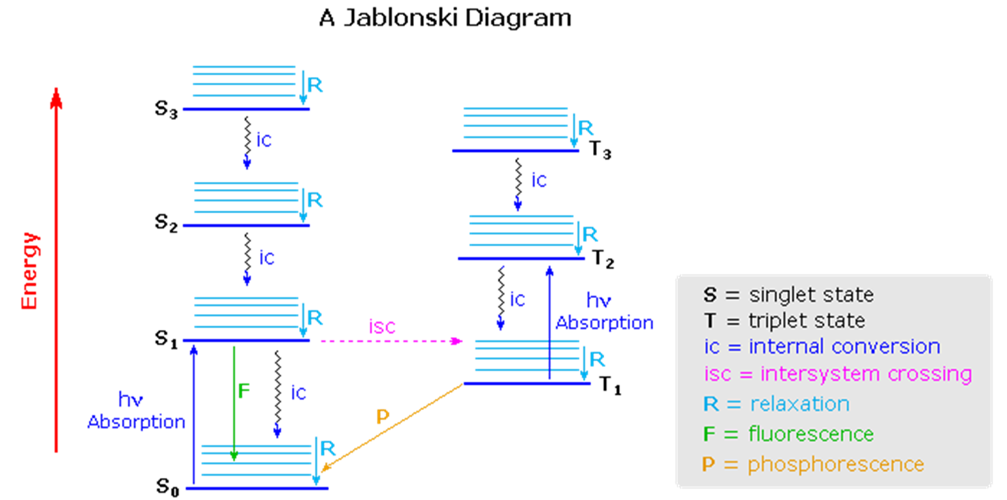

Slide 38
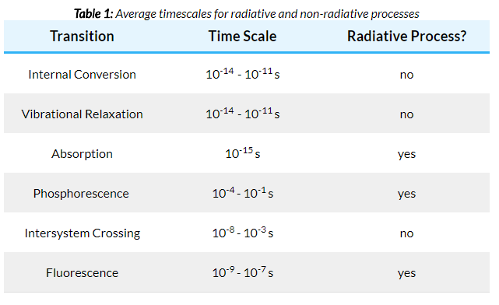

Slide 39
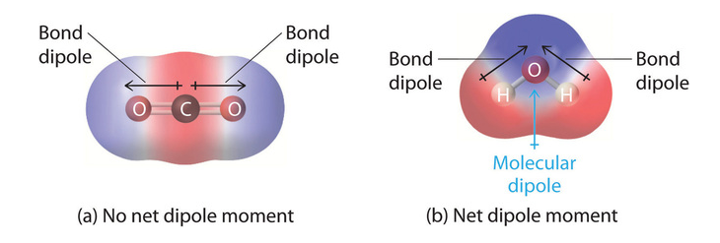
Dipole moment
atoms in a molecule share electrons unequally

Slide 40
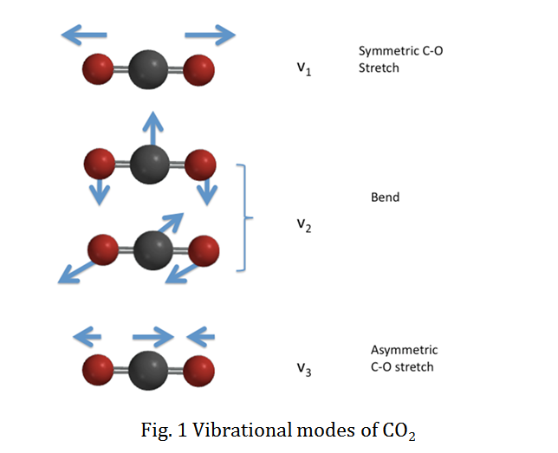

Slide 41
PIB (Particle In a Box) system wavefunction proof

Slide 42
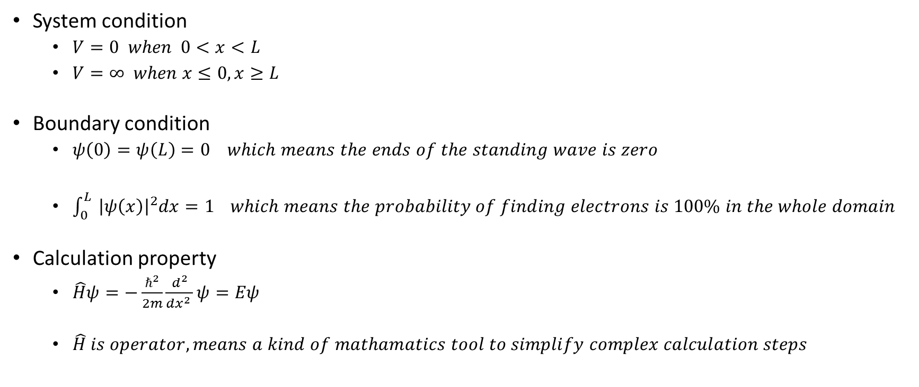
Wavefunction in PIB
System condition
$V=0 when 0<x<L$
$V=∞ when x≤0, x≥L$
Boundary condition
$ψ\left(0\right)=ψ\left(L\right)=0 which means the ends of the standing wave is zero$
$\int_{0}^{L}{ {\left|ψ\left(x\right)\right|}^{2}dx=1} which means the probability of finding electrons is 100\% in the whole domain$
Calculation property
$\hat{H}ψ=−\frac{ℏ^{2}}{2m}\frac{d^{2}}{dx^{2 }}ψ=Eψ$
$\hat{H} is operator, means a kind of mathamatics tool to simplify complex calculation steps$

Slide 43
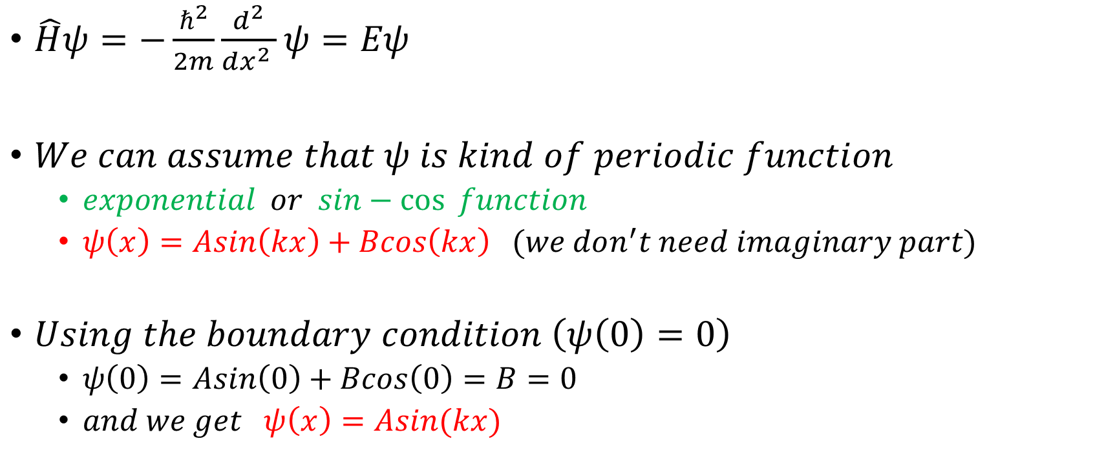
Calculation
$\hat{H}ψ=−\frac{ℏ^{2}}{2m}\frac{d^{2}}{dx^{2 }}ψ=Eψ$
$We can assume that ψ is kind of periodic function$
$exponential or sin−\cos{function}$
$ψ\left(x\right)=Asin\left(kx\right)+Bcos\left(kx\right) (we don^{′}t need imaginary part)$
$Using the boundary condition \left(ψ\left(0\right)=0\right)$
$ψ\left(0\right)=Asin\left(0\right)+Bcos\left(0\right)=B=0$
$and we get ψ\left(x\right)=Asin(kx)$

Slide 44
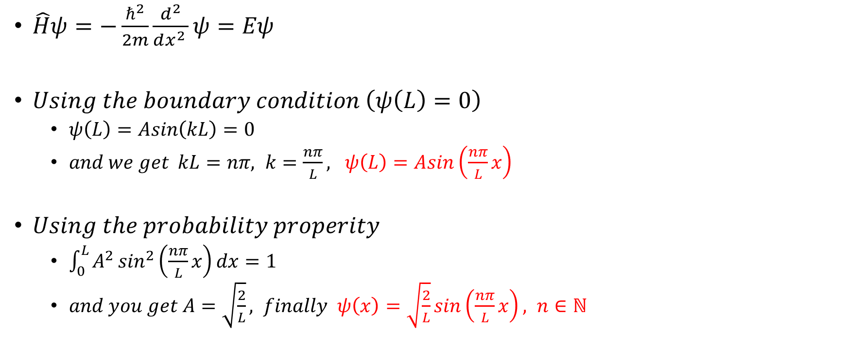
Calculation
$\hat{H}ψ=−\frac{ℏ^{2}}{2m}\frac{d^{2}}{dx^{2 }}ψ=Eψ$
$Using the boundary condition \left(ψ\left(L\right)=0\right)$
$ψ\left(L\right)=Asin\left(kL\right)=0$
$and we get kL=nπ, k=\frac{nπ}{L}, ψ\left(L\right)=Asin\left(\frac{nπ}{L}x\right)$
$Using the probability properity$
$\int_{0}^{L}{A^{2}\sin^{2}\left(\frac{nπ}{L}x\right)dx=1}$
$and you get A=\sqrt{\frac{2}{L}}, finally ψ\left(x\right)=\sqrt{\frac{2}{L}}sin\left(\frac{nπ}{L}x\right), n∈ℕ$

Slide 45
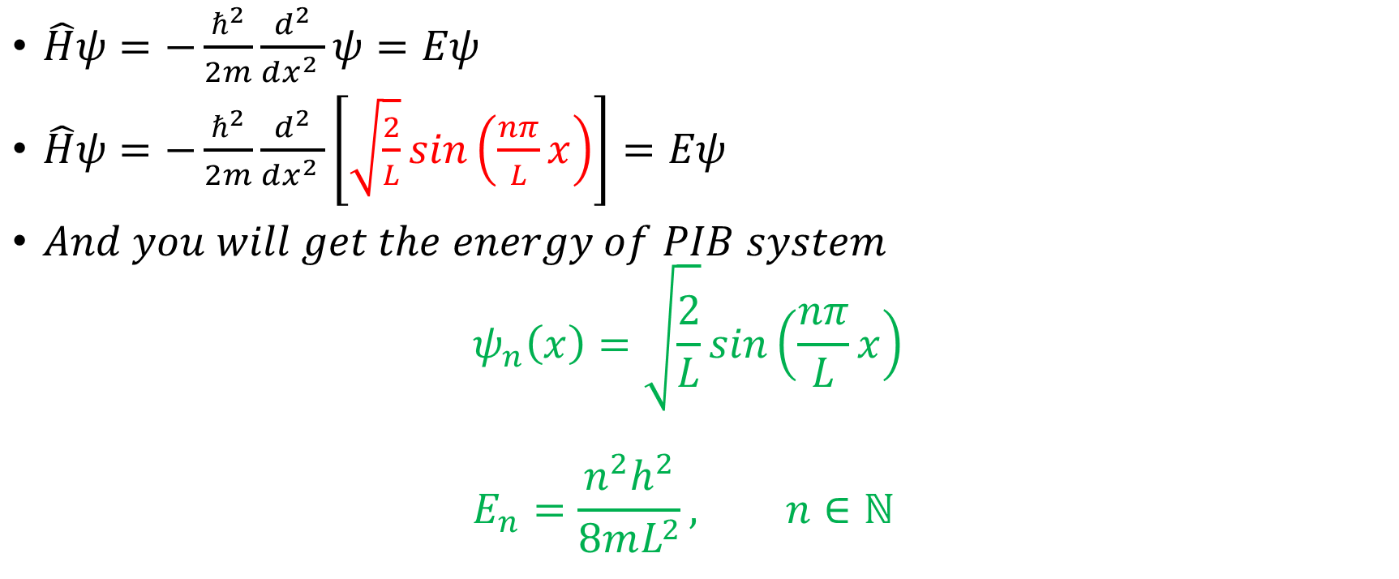
Deviation
$\hat{H}ψ=−\frac{ℏ^{2}}{2m}\frac{d^{2}}{dx^{2 }}ψ=Eψ$
$\hat{H}ψ=−\frac{ℏ^{2}}{2m}\frac{d^{2}}{dx^{2 }}\left[\sqrt{\frac{2}{L}}sin\left(\frac{nπ}{L}x\right)\right]=Eψ$
$And you will get the energy of PIB system$ $ψ_{n}\left(x\right)=\sqrt{\frac{2}{L}}sin\left(\frac{nπ}{L}x\right)$ $E_{n}=\frac{n^{2}h^{2}}{8mL^{2}}, n∈ℕ$

