Slide 1
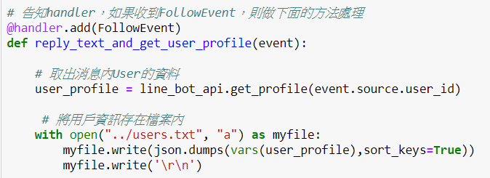
Line@ BOT (message API)
Flask server by Python
Follow Event
取個資
存到本地檔案
用戶綁定menu
回應訊息
LINE
ngrok
接口
驗證channel secret
non-Message event
Follow/Unfollow
Join/Leave group
Postback
Handler
(handle event)
Event
Message event
TextMessage (client)
TextSendMessage (server)
ImageMessage(client)
ImageSendMessge(sever)
user
程式區塊大綱
Flask server 設置
Handler / Line bot API 產生實例
Flask 定義接口 (丟給handler驗證)
定義各種event回覆要用的文字/圖片(連接資料庫)
寫程式: handler各種event的回覆的邏輯
客戶行為
Follow (取得個資/綁定)
點選menu/發送文字訊息
Line bot API
封包Header
加上access token

Slide 2
Line@ BOT --Create Menu
Menu_1
Id : xxyy
4.
一般客戶
X
5.
VIP客戶
LINE
3.
1.
2.
JSON file to LINE
Create menu and return id
Upload image to menu
Bond menu to customer
Unbond
JSON
設定檔
IMG
(from line bot designer)

