Slide 1
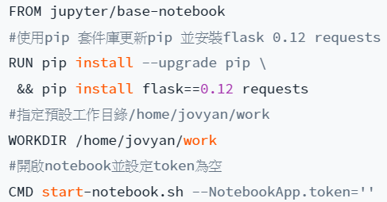
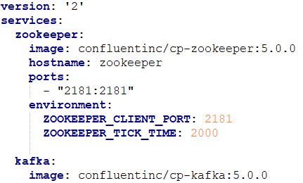
Docker
Docker
Hub
Portable
(to .tar)
pull
load <
push
save -o
Docker
file
docker bulid
Image
file
docker run -p -v --link
Container
environment
docker images
docker tag
docker rmi -f
docker ps
docker (re)start
docker stop
docker kill
docker exec –it [name] /bin/bash
Docker-compose
YAML file
docker-compose -f [name] up –d
docker-compose [name] down
docker-conpose exec [service] [cmd]

