Slide 1
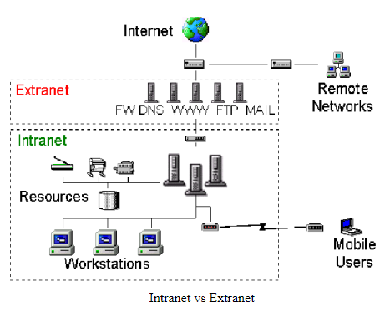
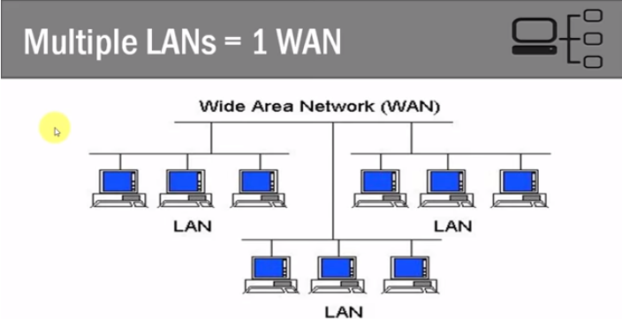
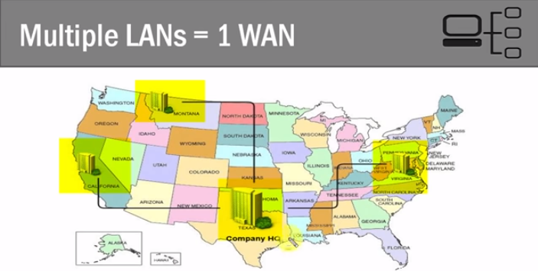
Network Structure
LAN (Local) => one site (one physical network topography)
Classroom is an example of LAN, connecting computers together
WAN (Wide) => multiple sites (need employ router/link)
Internet is an example of WAN, connecting lots of LAN together
Mostly used service is LAN
我們從家中連上Internet, 也是先連上ISP的LAN
Extranet: outer public subnet
Intranet: inner private subnet

Slide 2
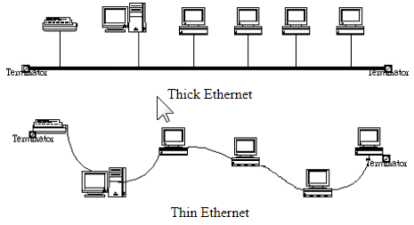
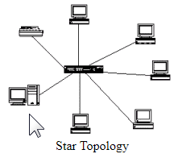
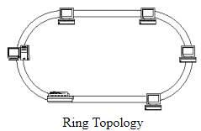
Network Topography (2 types)
Physical Topography => describe the real network connection configuration between nodes (連線部屬的配置)
Bus : no Hub, packet are transmitted through node to node (一節點壞掉會影響其他節點, 除錯困難)
Star : hub in center to control transmit. Use different port in hub to connect (傳送/除錯/佈線皆方便)
Ring : no Terminator (佈線困難)
Logical Topography => describe how data message are transmitted (訊息傳送的方式)
Ethernet : broadcast message and every node will check destination to read or deliver (同時廣播會碰撞)
Token Ring : token packet dedicated, token will authorized node to send message (拿到token packet才可以講話)
Combination of Physical / Logical Topography
Bus / Ethernet : mostly used for LAN
Star / Token Ring

Slide 3
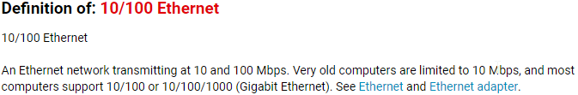
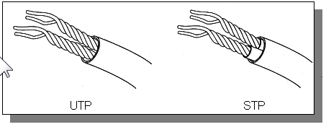
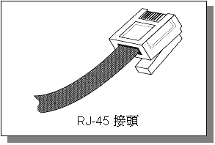
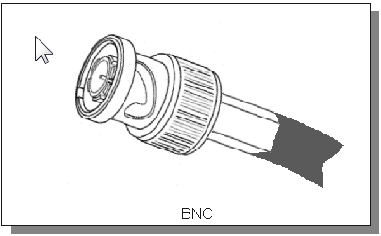
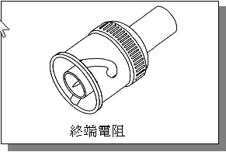
Hardware
Network Interface Controller, NIC (網路卡)
Different logical topography require different NIC (e.g. 10/100 Ethernet)
Each NIC contains 48bits NIC MAC address to recognize (網卡IP位址)
Cable and Head (網線/接頭)
Twisted Pair Cable and RJ45 head (雙絞線/RJ45接頭): commonly used
Coaxial Cable and BNC (同軸線/BNC接頭)
Fiber Optic Cable

Slide 4
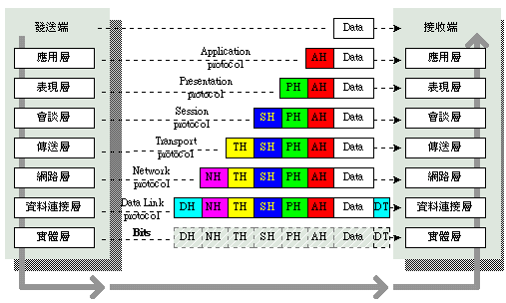
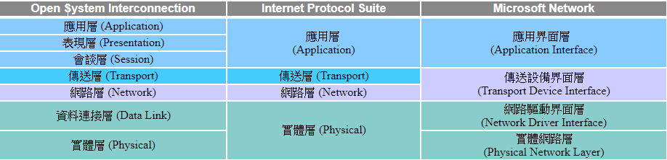
TCP/IP and OSI model
TCP: connection and reliable transmission
UDP: connectionless but faster
TCP/IP (Transmission Control Protocol and Internet Protocol)
Protocol that connected different network system together
Based on OSI model with 7 distributed layers with separated function
Physical: 傳送訊號的硬體配置(裝置, 佈線, 網路型態), 配置不同 (Ethernet or Token Ring), 實體層就不同
Data Link: 基本的傳送訊號單位(frame), with MAC address, 制定傳送規則(配合不同實體層)與錯誤檢測來確保物理傳輸順利
Network: 分析起迄節點IP, 依交通狀況決定路徑 (流量控制)
Transport: 將資料切割成小封包(單位傳輸量有限), 制定傳輸順序/檢測方法, 目的地節點才能正確讀取 (決定用TCP or UDP)
Session: 建立連線請求/結束請求
Presentation: 針對不同的節點中的硬體架構做字元編碼/資料型態轉換, 方便應用程式讀取
Application: 針對應用程式的不同需求(htp/htp/ssh.etc) 進行檔案格式轉換
Data Transmitting (封裝 -> 傳送 ->拆裝)
Each layer will process separately by adding header

Slide 5
Encapsulation (封裝) and Decapsulation (拆裝) 1. Data message begins from application layer, e.g. FTP/mail/http.etc request 2. As going through layers, Each layer will append header message (Ht/Hn/HI) 3. Intermediate like switch/router will decapsulate and read message according to layers 4. Switch is layer 2 device, only read HI data and generate new HI for next link layer. (網卡IP) 5. Router is layer 3 device, will read Hn (Source/Destination IP) and decide route
Transmission Example (Five layers instance)
source
data
message
M
application
transport
network
link
physical
segment
H_{t}
M
datagram
H_{n}
H_{t}
M
frame
H_{l}
H_{n}
H_{t}
M
header
封裝
變大
H_{l}
H_{n}
H_{t}
M
link
physical
H_{l}
H_{n}
H_{t}
M
Data from different layers
Application => Message (最初的data, reliable 不容許遺失)
Transport => segment (header Ht => TCP/IP hand-shaking message)
Network => datagram (考慮 Source/Destination, Hn => ip 32 bits addr)
Link => frame (考慮node to node, HI => node to node 網卡ip 48bits)
拆裝變小
讀header message
封裝
新的Link
新的HI
switch
Switch => layer 2
destination
H_{n}
H_{t}
M
network
link
physical
H_{n}
H_{t}
M
data
H_{l}
H_{n}
H_{t}
M
H_{l}
H_{n}
H_{t}
M
M
application
transport
network
link
physical
H_{t}
M
H_{n}
H_{t}
M
H_{l}
H_{n}
H_{t}
M
router
Router => layer 3

Slide 6
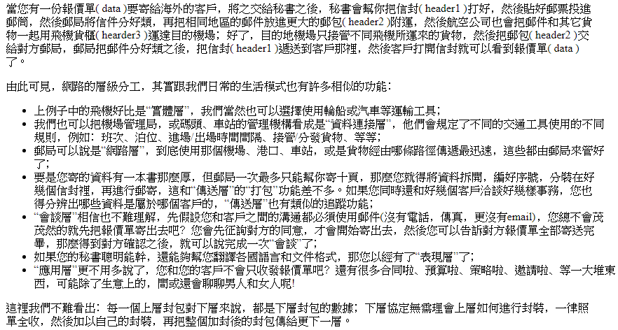
Transmission Example (Post system example)
http://www.pcnet.idv.tw/pcnet/network/network_ip_model.htm

Slide 7
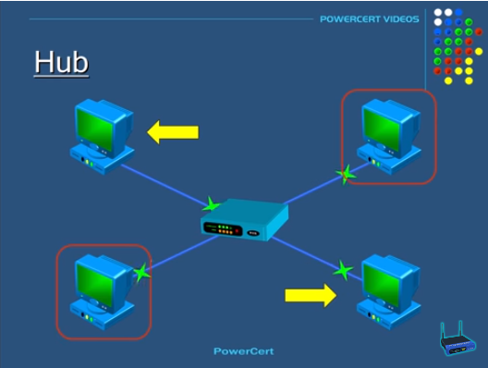
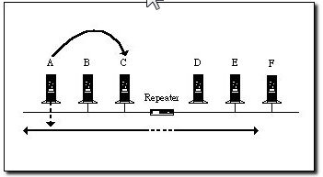
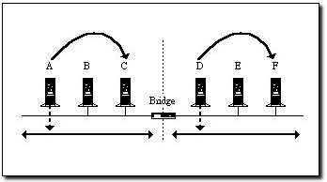
Internetworking equipment (Connecting LANs)
Layer 1 Devices ( Physical layer : with no directory function)
Repeater (增益器): to repeat and enlarge signal from loss during long distance transmission (bus topography)
Hub (集線器): hub in center as connection service main node and repeater (broadcasting in star topography)
Layer 2 Devices (Link layer : check MAC address)
Bridge (橋接器): filter function (receive -> check -> decide if send to another segment) (bus topography)
Switch (交換器): filter function (center receive -> check -> send to target node) (star topography)
Layer 3 Devices (Network layer : check IPs)
Router (橋接器): with source / destination IPs, connecting LANs and routing decision. (Gateway service)
LANs
Internet

Slide 8
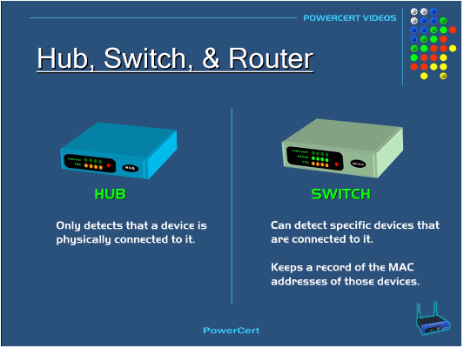
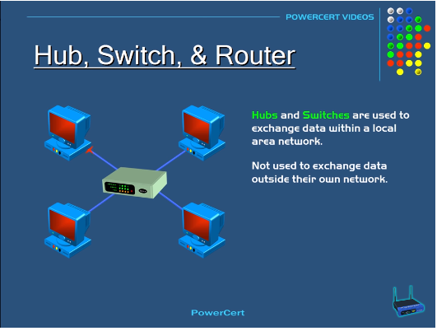
LAN and Internetworking
Hub (layer1) with no directory function only broadcast the received packet data ( cause extra traffic loss)
Switch (layer2), based on MAC address, will send the received packet data to target node in LAN
https://www.youtube.com/watch?v=1z0ULvg_pW8&t=187s

Slide 9
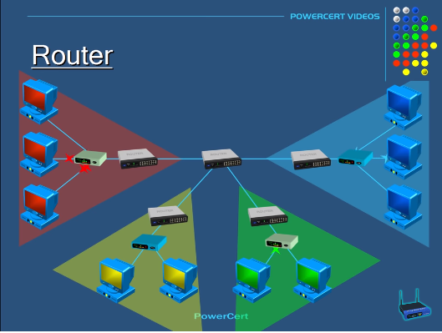
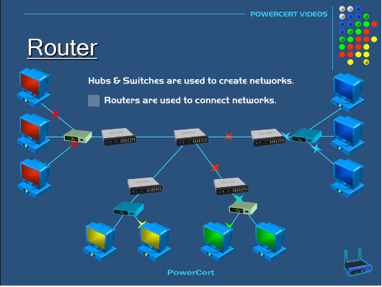
LAN and Internetworking
Router (layer 3) will recognize IP and decide the route to send packet to the other LAN
In LAN transmission, packets are usually handled by layer2 switch
Network transmission need Router to involve (sometimes layer3 switch)
https://www.youtube.com/watch?v=1z0ULvg_pW8&t=187s

Slide 10
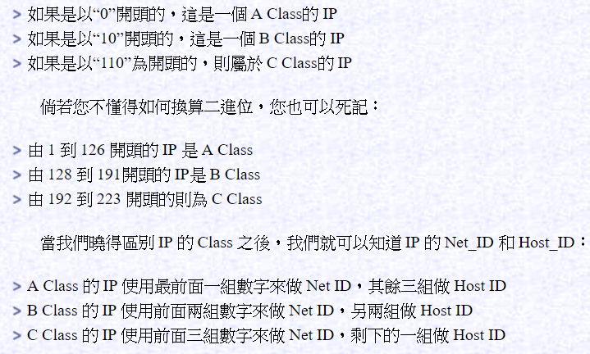
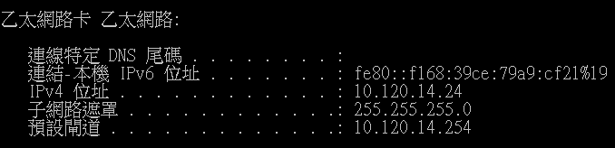
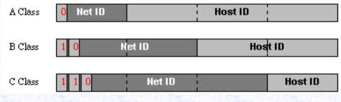
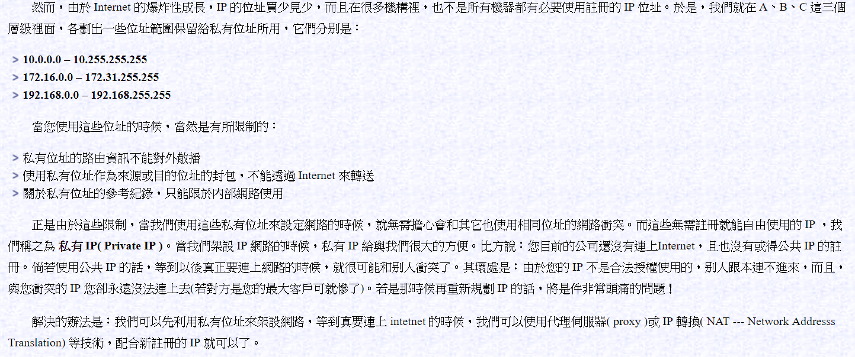
IP => 32bits binary code
Class (A,B,C)
127: for local test
127.0.0.1 => localhost

Slide 11
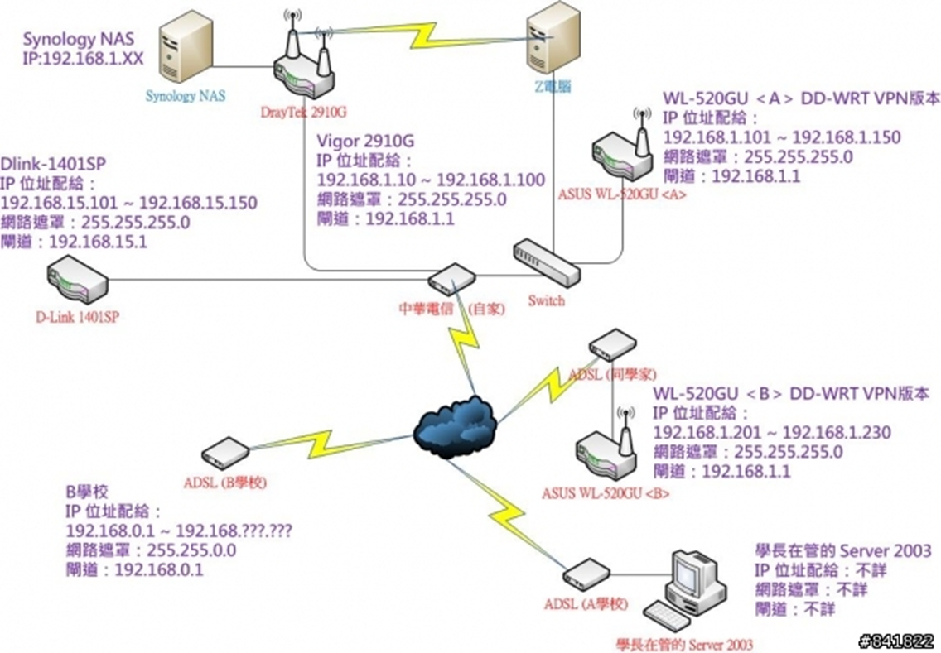

Slide 12

SSH (secure shell)
ssh remote connection
with user name / passwd
with keys
Public key (鎖頭, 放在server的路徑:~/.ssh/authorized_key)
Private key (鑰匙, 本機保留)
Connection with private key : ssh –i (私鑰位置) ec2-user@ip4
Connection without private key : 要把私鑰放到正確路徑, 讓系統自動抓取
路徑 : 本地端: ~/.ssh
可以自動抓取的名字 : identity/id_rsa/id_dsa
Need to check folder accessibility: chmod 700 ~/.ssh
localhost
server

Slide 13
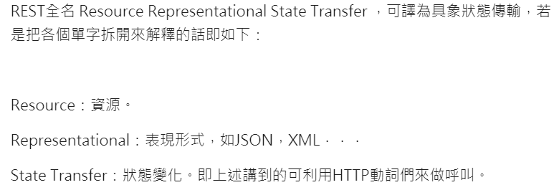
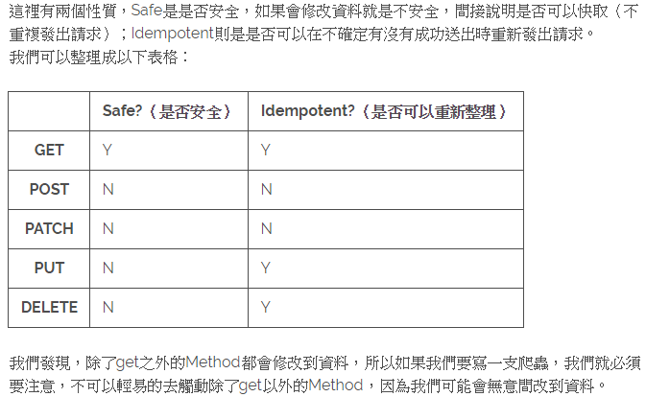
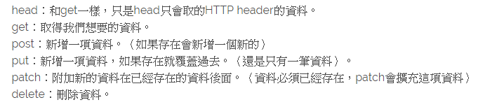
HTTP – method
網站訪問協定 (port 80)
Client / Server (request/response)
Stateless (each transaction is independent) => Use cookie and session to track
Application layer (HTTP sitting on the top of OSI 7 layers)
HTTP action (GET/POST/PUT/DELETE/PATCH): different action will trigger server to do different things
Server codes (2xx成功/3xx重導/4xx請求錯誤/5xx伺服器錯誤)
Headers (message included in request and response for special claim) 夾帶header訊息來達成不同要求(e.g.資料格式)
Web Server 實作 RestfulAPI=> 定義(接口)如何監聽/開放何種action/各種action相對應伺服器的操作/錯誤例外訊息
Restful API => 按照rest架構(Resource Representational State Transfer)去設計的API
Linux 測試 web server 功能常用 curl –X [GET|POST|PUT|DELETE|…] 測試restful API 功能
以GET方法取得的HTML資料因為固定,常存cache
依照每個方法特性，設計Web API/爬蟲
遵守協定來設計可以避免不必要的麻煩

Slide 14
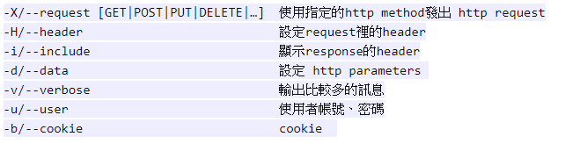
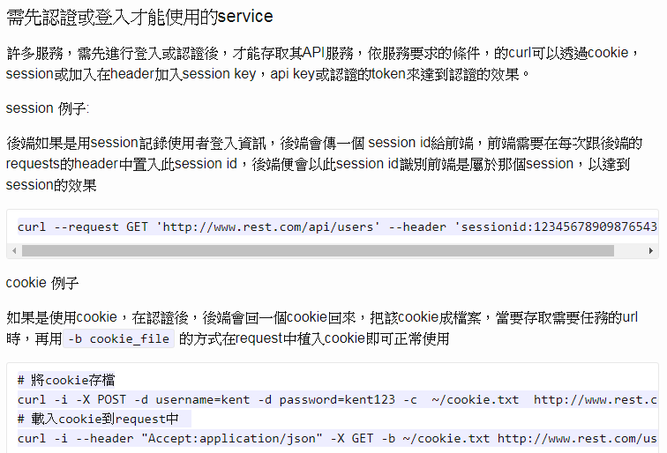

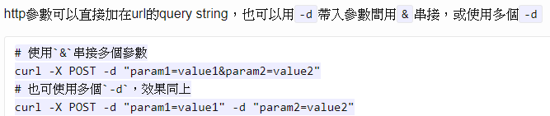
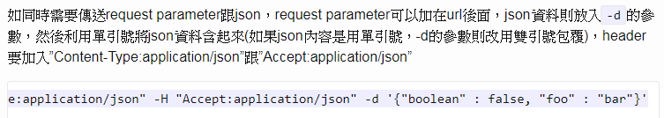
curl -X (client url) testing

Slide 15
Cookie and Session
用來解決HTTP stateless問題, 讓造訪網站具備記憶使用者認證紀錄的功能
Cookie / Session : 網路伺服器後端實作(php/Java/js)
Cookie => 瀏覽器程式存在用戶本地端硬碟中的文檔, 用來保存認證/瀏覽紀錄, 再次訪問的時候夾帶再heade裡面即可
建立 cookie的設計埋藏於web server api => 可以定義要傳回包含哪些參數的cookie (過期時間/domain/接口/加密)
Cookie 文檔檔內容常以(key, value)格式存在
Cookie 以文檔格式在訪問網站時同時傳輸, 檔案太大會有傳輸問題
因為是(key, value)文檔, 有被竄改的安全風險, 發展出Signed cookie (加入hash過的長字串當作認證)
Session => 認證存在Server端 : session (會發session_id傳給客戶端供再次造訪時使用)
傳送方法1: session_id 埋在cooki裡面, 再次訪問時用cookie辨認 (此方法依賴cookie服務, 如果cookie關掉就不能用)
傳送方法2: seesion_id 加在URL後面當作參數, 再次訪問的時候會用把id加在URL後面的方式來供辨認
1.
2.
3.
client
server
以POST夾帶使用者認證data(-d) 訪問
認證成功Server回傳cookie/session當作依據
再次造訪時, 將session id / cookie文檔夾帶header當中

