Slide 1
Time Series Analysis Results
Battery Supply Chain Team
Chiemi Kato
November 2019

Slide 2
Parameters
Number of Lags
Moving Avg Length
Time Unit
Lag Length
Days
Weeks
Months
10 lags
10 lags
10 lags
2 weeks
1 month
1 month
2 months
1 month
2 weeks
3 weeks
4 weeks

Slide 3
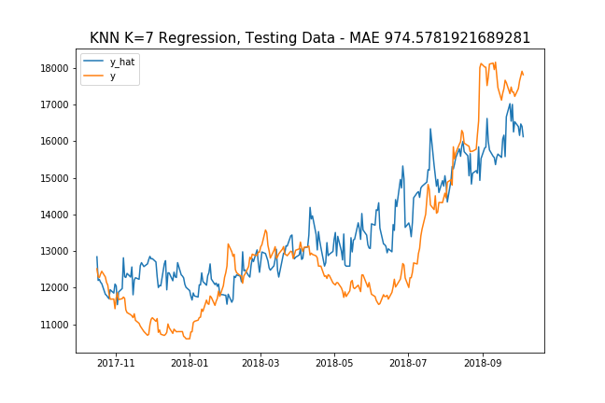
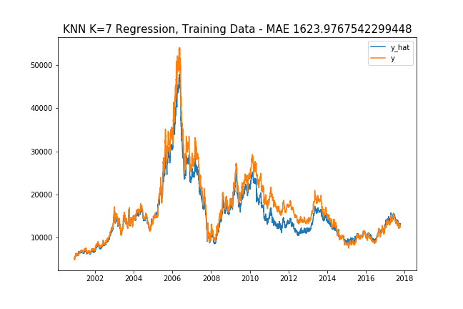
Selected Result Graphs… Below is graph of 10 lags, lag length = 4 weeks, rolling window length = 4 weeks

Slide 4
MAE RESULTS (1 year gap from y Target)
Model | Time Unit | # Lags | Lag Length | Rollavg Win. | Parameters | MAE
KNN | Busi. Day | 10 | 1 month | 8 weeks | K=2 | $1199.13270
Polynomial | Busi. Day | 10 | 1 month | 8 weeks | Deg=3 | $1173.80122
Adaboost | Busi. Day | 10 | 1 month | 8 weeks | {'learning_rate': 0.0001, 'n_estimators': 150} | $1841.94740
KNN | Busi. Day | 10 | 1 month | 2 weeks | K=7 | $1253.4538
Polynomial | Busi. Day | 10 | 1 month | 2 weeks | Deg=3 | $1264.15163
Adaboost | Busi. Day | 10 | 1 month | 2 weeks | {'learning_rate': 0.0001, 'n_estimators': 50} | $1364.1369
KNN | Busi. Day | 10 | 2 week | 3 weeks | K=6 | $1045.21761
Polynomial | Busi. Day | 10 | 2 week | 3 weeks | Deg=3 | $1301.42426
Adaboost | Busi. Day | 10 | 2 week | 3 weeks | {'learning_rate': 0.0001, 'n_estimators': 50} | $1336.64916
KNN | Busi. Day | 10 | 1 month | 4 weeks | K=7 | $974.02
Polynomial | Busi. Day | 10 | 1 month | 4 weeks | Deg=3 | $1417.294
Adaboost | Busi. Day | 10 | 1 month | 4 weeks | {'learning_rate': 0.0001, 'n_estimators': 50} | $1401.205

Slide 5
Turning Time Series into Supervised Learning

Slide 6
References
TIME SERIES ANALYSIS training testing:
https://stats.stackexchange.com/questions/346907/splitting-time-series-data-into-train-test-validation-sets
About “Day Forward Chaining”
https://towardsdatascience.com/time-series-nested-cross-validation-76adba623eb9
Good KNN Explanation:
https://towardsdatascience.com/machine-learning-basics-with-the-k-nearest-neighbors-algorithm-6a6e71d01761

Slide 7
