Slide 1
Time Series Analysis Results
Battery Supply Chain Team
Chiemi Kato
November 2019

Slide 2
Parameters
Number of Lags
Moving Avg Length
Time Unit
Lag Length
Days
Weeks
Months
10 lags
10 lags
10 lags
2 weeks
1 month
1 month
2 months
1 month
2 weeks
3 weeks
4 weeks

Slide 3
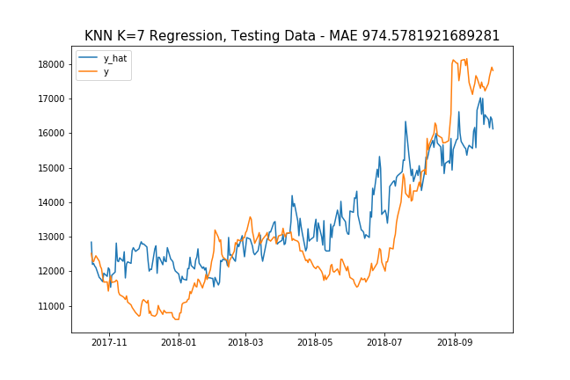
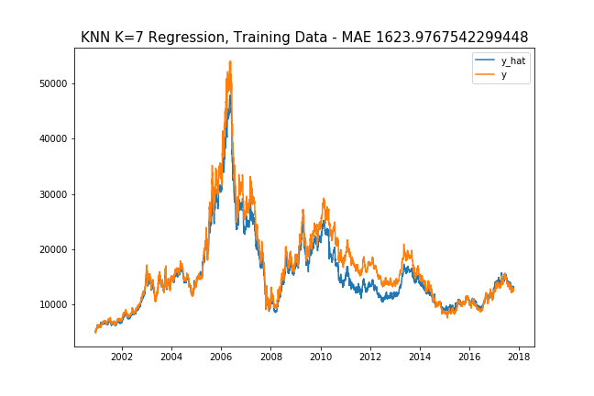
Selected Result Graphs… Below is graph of 10 lags, lag length = 4 weeks, rolling window length = 4 weeks

Slide 4
Additional / Exogenous Variables
China GDP
GDP per Capita
GDP per Capita Growth
China Overall Consumption
Consumption Expenditure
Consumption Expenditure (by GDP)
Time
Days of Month
Both
Weeks of Year
Global Nickel Production
Global Nickel Prod.
week of year, global nickel prod, consumption div gdp CHINA, no gdp!

Slide 5
MAE RESULTS (1 year gap from y Target)
Model | Time Unit | # Lags | Lag Length | Rollavg Win. | Parameters | MAE
KNN | Busi. Day | 10 | 1 month | 8 weeks | K=2 | $1199.13270
Polynomial | Busi. Day | 10 | 1 month | 8 weeks | Deg=3 | $1173.80122
Adaboost | Busi. Day | 10 | 1 month | 8 weeks | {'learning_rate': 0.0001, 'n_estimators': 150} | $1841.94740
KNN | Busi. Day | 10 | 1 month | 2 weeks | K=7 | $1253.4538
Polynomial | Busi. Day | 10 | 1 month | 2 weeks | Deg=3 | $1264.15163
Adaboost | Busi. Day | 10 | 1 month | 2 weeks | {'learning_rate': 0.0001, 'n_estimators': 50} | $1364.1369
KNN | Busi. Day | 10 | 2 week | 3 weeks | K=6 | $1045.21761
Polynomial | Busi. Day | 10 | 2 week | 3 weeks | Deg=3 | $1301.42426
Adaboost | Busi. Day | 10 | 2 week | 3 weeks | {'learning_rate': 0.0001, 'n_estimators': 50} | $1336.64916
KNN | Busi. Day | 10 | 1 month | 4 weeks | K=7 | $974.02
Polynomial | Busi. Day | 10 | 1 month | 4 weeks | Deg=3 | $1417.294
Adaboost | Busi. Day | 10 | 1 month | 4 weeks | {'learning_rate': 0.0001, 'n_estimators': 50} | $1401.205

Slide 6
Turning Time Series into Supervised Learning

Slide 7
References
TIME SERIES ANALYSIS training testing:
https://stats.stackexchange.com/questions/346907/splitting-time-series-data-into-train-test-validation-sets
About “Day Forward Chaining”
https://towardsdatascience.com/time-series-nested-cross-validation-76adba623eb9
Good KNN Explanation:
https://towardsdatascience.com/machine-learning-basics-with-the-k-nearest-neighbors-algorithm-6a6e71d01761

Slide 8
