Slide 1
Time Series Analysis Results
Oct 24, 2019
Chiemi Kato

Slide 2
Parameters
NOTE: Focused on Days, since at a glance it performed much stronger
Number of Lags
Lag Length
Moving Avg Length
Time Unit
Days
Weeks
Months
10 lags
10 lags
10 lags
2 weeks
1 month
1 month
2 months
1 month
2 weeks
3 weeks
4 weeks

Slide 3
Turning time series into supervised learning

Slide 4
MAE Results (all 1 year gap from y target)
Model | Time Unit | # Lags | Lag Length | Rollavg Window | Parameters | MAE
KNN | Busi. Day | 10 | 1 month | 8 weeks | K=2 | $1199.13270
Polynomial | Busi. Day | 10 | 1 month | 8 weeks | Deg=3 | $1173.80122
Adaboost | Busi. Day | 10 | 1 month | 8 weeks | {'learning_rate': 0.0001, 'n_estimators': 150} | $1841.94740
KNN | Busi. Day | 10 | 1 month | 2 weeks | K=7 | $1253.4538
Polynomial | Busi. Day | 10 | 1 month | 2 weeks | Deg=3 | $1264.15163
Adaboost | Busi. Day | 10 | 1 month | 2 weeks | {'learning_rate': 0.0001, 'n_estimators': 50} | $1364.1369
KNN | Busi. Day | 10 | 2 week | 3 weeks | K=6 | $1045.21761
Polynomial | Busi. Day | 10 | 2 week | 3 weeks | Deg=3 | $1301.42426
Adaboost | Busi. Day | 10 | 2 week | 3 weeks | {'learning_rate': 0.0001, 'n_estimators': 50} | $1336.64916
KNN | Busi. Day | 10 | 1 month | 4 weeks | K=7 | $974.02
Polynomial | Busi. Day | 10 | 1 month | 4 weeks | Deg=3 | $1417.294
Adaboost | Busi. Day | 10 | 1 month | 4 weeks | {'learning_rate': 0.0001, 'n_estimators': 50} | $1401.205

Slide 5
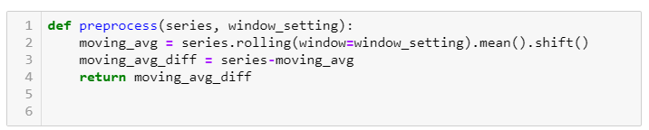
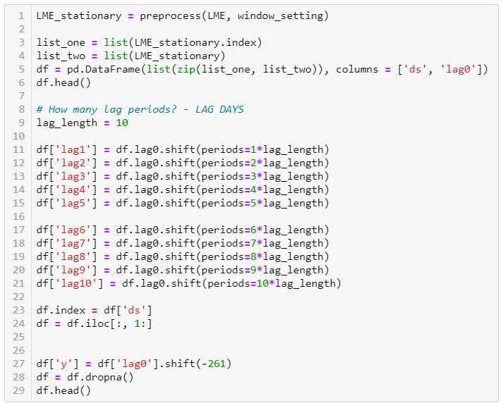
Preprocessing Methods
NOTE: window_setting refers to the rolling mean window column in results table

Slide 6
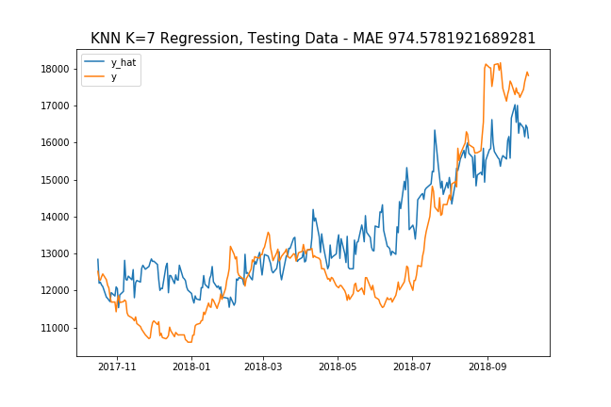
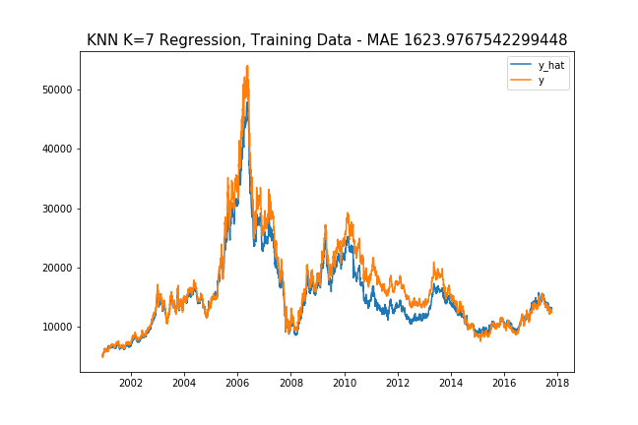
Selected Result Graphs…
Below is graph of 10 lags, lag length = 4 weeks, rolling window length = 4 weeks

Slide 7
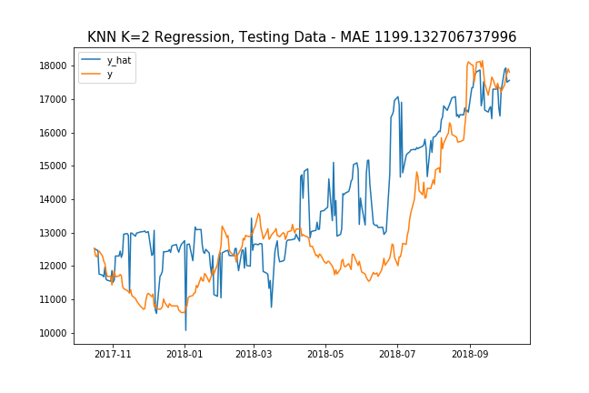
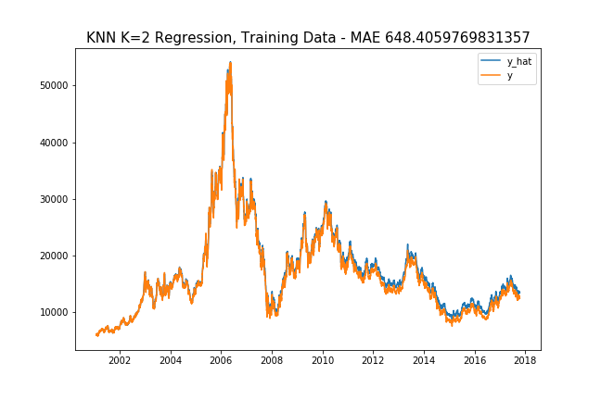
Graph of 10 lags, lag length = 4 weeks, rolling window length = 8 weeks

Slide 8
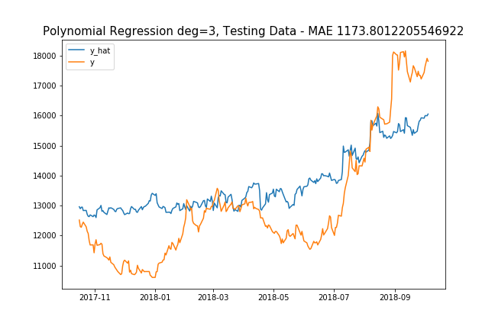
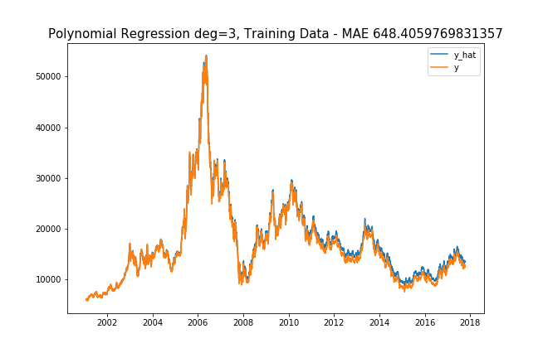
Graph of 10 lags, lag length = 4 weeks, rolling window length = 8 weeks

Slide 9
Graph of 10 lags, lag length = 4 weeks, rolling window length = 8 weeks

Slide 10
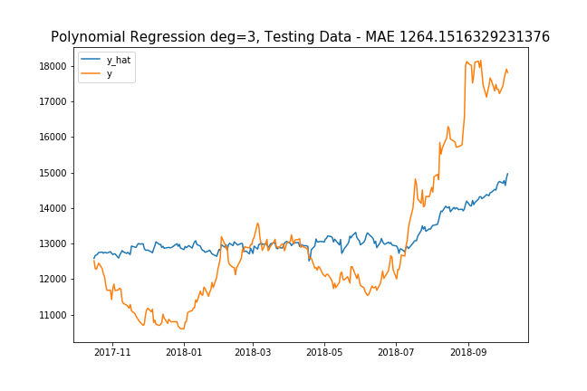
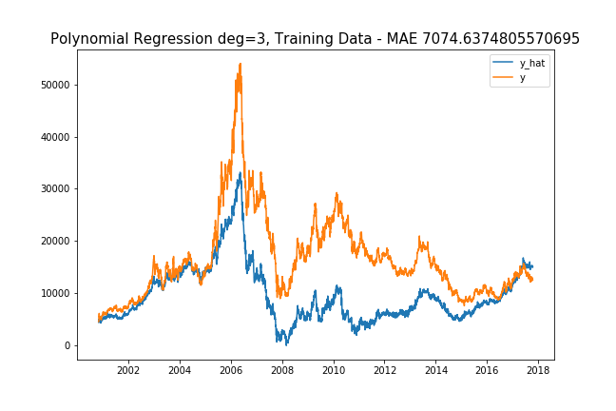
Graph of 10 lags, lag length = 4 weeks, rolling window length = 2 weeks

Slide 11
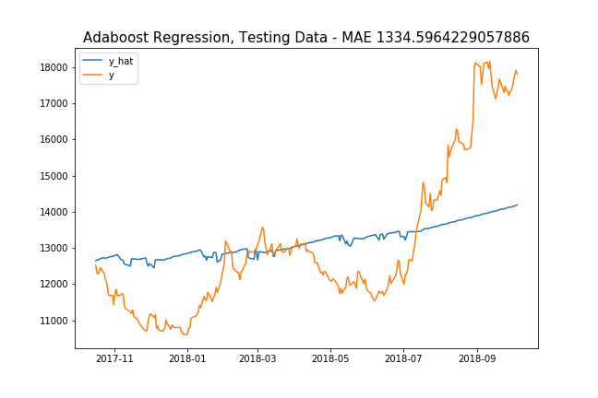
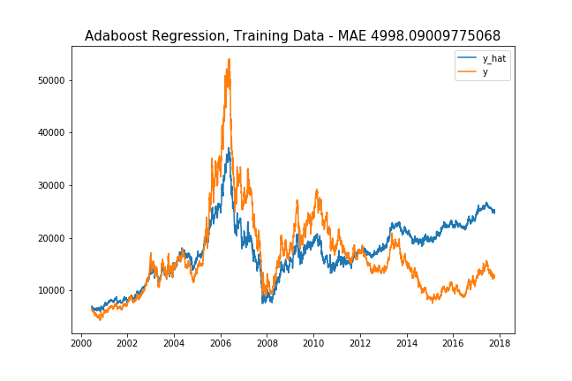
Graph of 10 lags, lag length = 2 weeks, rolling window length = 2 weeks

Slide 12
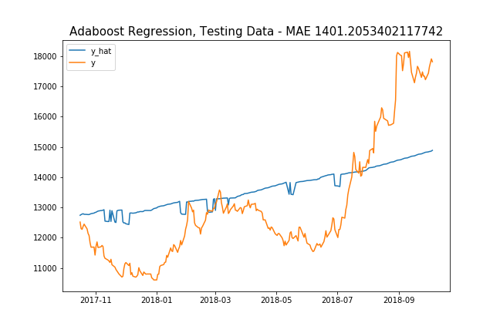

Graph of 10 lags, lag length = 4 weeks, rolling window length = 4 weeks

