Slide 1
ECE1895 ASSIGNMENT3
POTENTIAL IMPLEMENTATION OF SUBWAY SAFETY DOOR

Slide 2
ECE1895 ASSIGNMENT3
Contents
Pseudo Circuit Schematics
  Original Design
  Modified Design
Interests and Operations
  Original Design
  Modified Design
Altium Implementations
  Original Design
  Modified Design

Slide 3
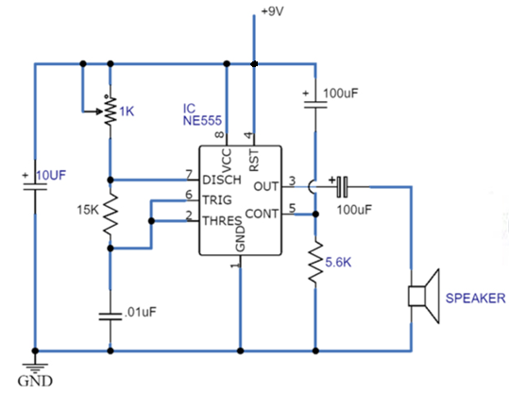
ECE1895 ASSIGNMENT3
Pseudo Circuit Schematics – Original Design

Slide 4
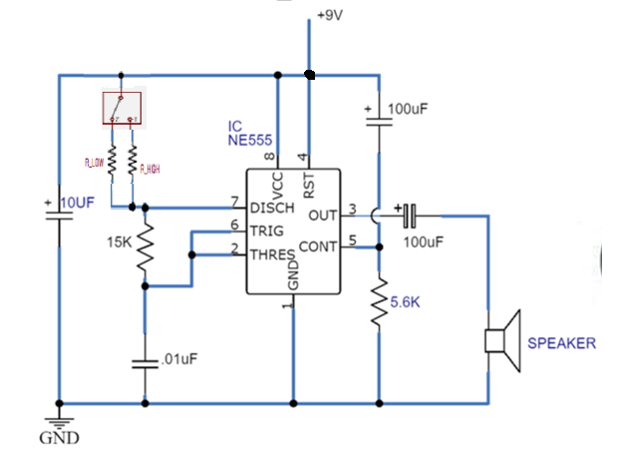
ECE1895 ASSIGNMENT3
Pseudo Circuit Schematics – Modified Design

Slide 5

ECE1895 ASSIGNMENT3
Interests and Operations -
Original Design
Buzzer with Adjustable Frequency
  Simple Circuits
  Applicable in Many Fields
  Low Cost
  Durable Instruments
Reference
  https://www.circuits-diy.com/simple-buzzer-circuit-with-ne555-ic/

Slide 6
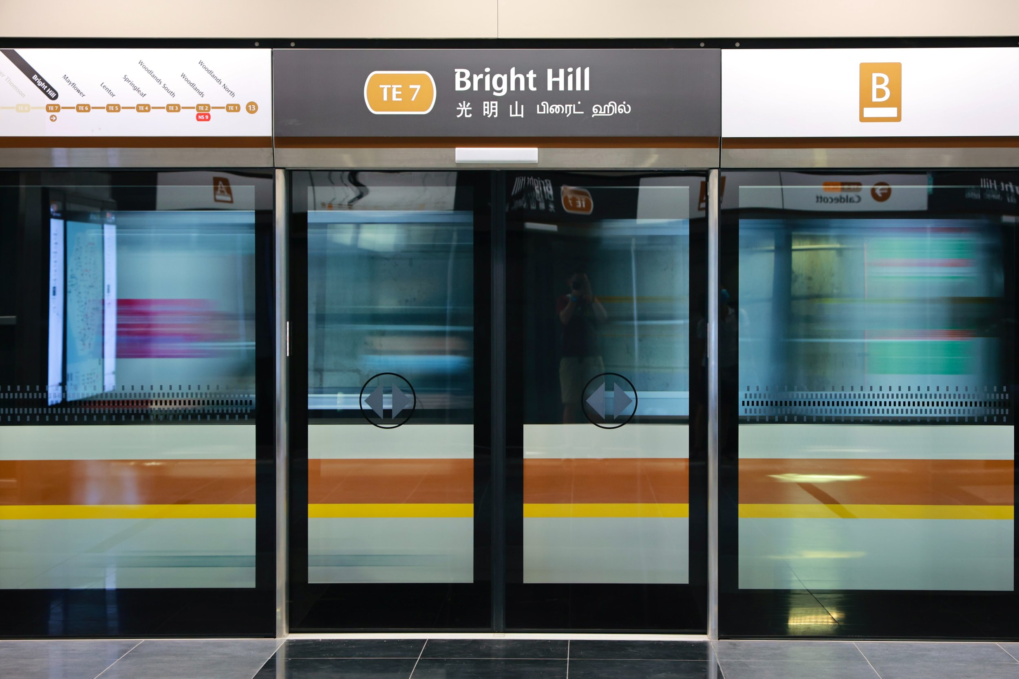
ECE1895 ASSIGNMENT3
Interests and Operations -
Modified Design
Buzzer with Adjustable Frequency
  Simple Circuits
  Applicable in Many Fields
  Low Cost
  Durable Instruments
After adding a Switch
  Application-- Subway Safety Door
  Two States :
    OPEN: SWITCH ON , FREQ LOW
    CLOSE: SWITCH OFF , FREQ HIGH

Slide 7
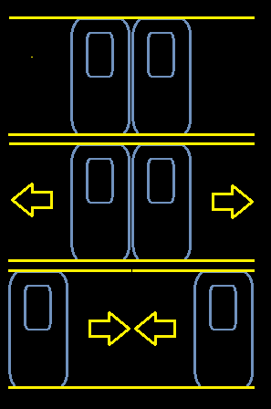
ECE1895 ASSIGNMENT3
Interests and Operations - Modified Design
Two States :
  OPEN: SWITCH ON , FREQ LOW →
  CLOSE: SWITCH OFF , FREQ HIGH →

Slide 8
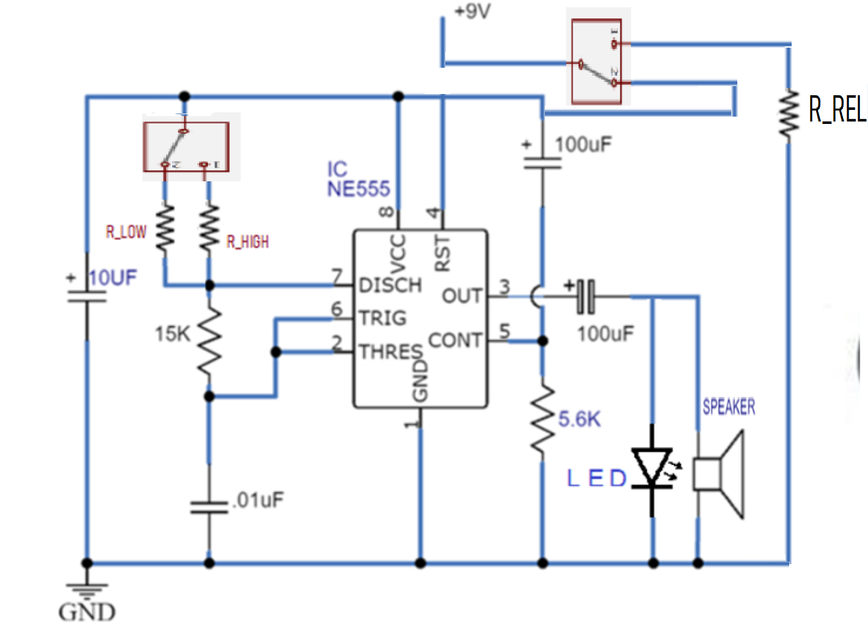
ECE1895 ASSIGNMENT3
Interests and Operations - Modified Design
Values for R_LOW and R_HIGH are indeterminant for this iteration !
  IS IT
    R_LOW -> FREQ HIGH
    R_HIGH -> FREQ LOW
  OR
    R_LOW -> FREQ HIGH
    R_HIGH -> FREQ LOW
  Will be determined after next iteration

Slide 9
ECE1895 ASSIGNMENT3
Reference
https://www.circuits-diy.com/simple-buzzer-circuit-with-ne555-ic/
https://www.samschwartz.com/staff-reflections/2022/3/31/advance-screening-platform-screen-doors-on-the-nyc-subway

