Slide 1
ECE1895 ASSIGNMENT3
POTENTIAL IMPLEMENTATION OF SUBWAY SAFETY DOOR

Slide 2
ECE1895 ASSIGNMENT3 Contents
Pseudo Circuit Schematics
Original Design
Modified Design
Interests and Operations
Original Design
Modified Design
Altium Implementations
Original Design
Modified Design

Slide 3
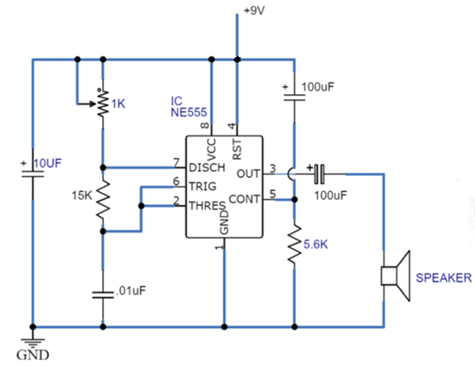
ECE1895 ASSIGNMENT3 Pseudo Circuit Schematics – Original Design

Slide 4
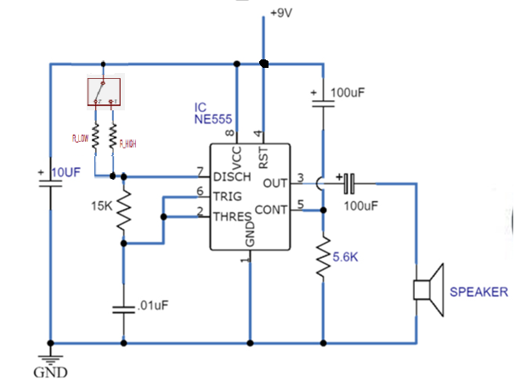
ECE1895 ASSIGNMENT3 Pseudo Circuit Schematics – Modified Design

Slide 5

ECE1895 ASSIGNMENT3 Interests and Operations - Original Design
Buzzer with Adjustable Frequency
Simple Circuits
Applicable in Many Fields
Low Cost
Durable Instruments
Reference
https://www.circuits-diy.com/simple-buzzer-circuit-with-ne555-ic/

Slide 6
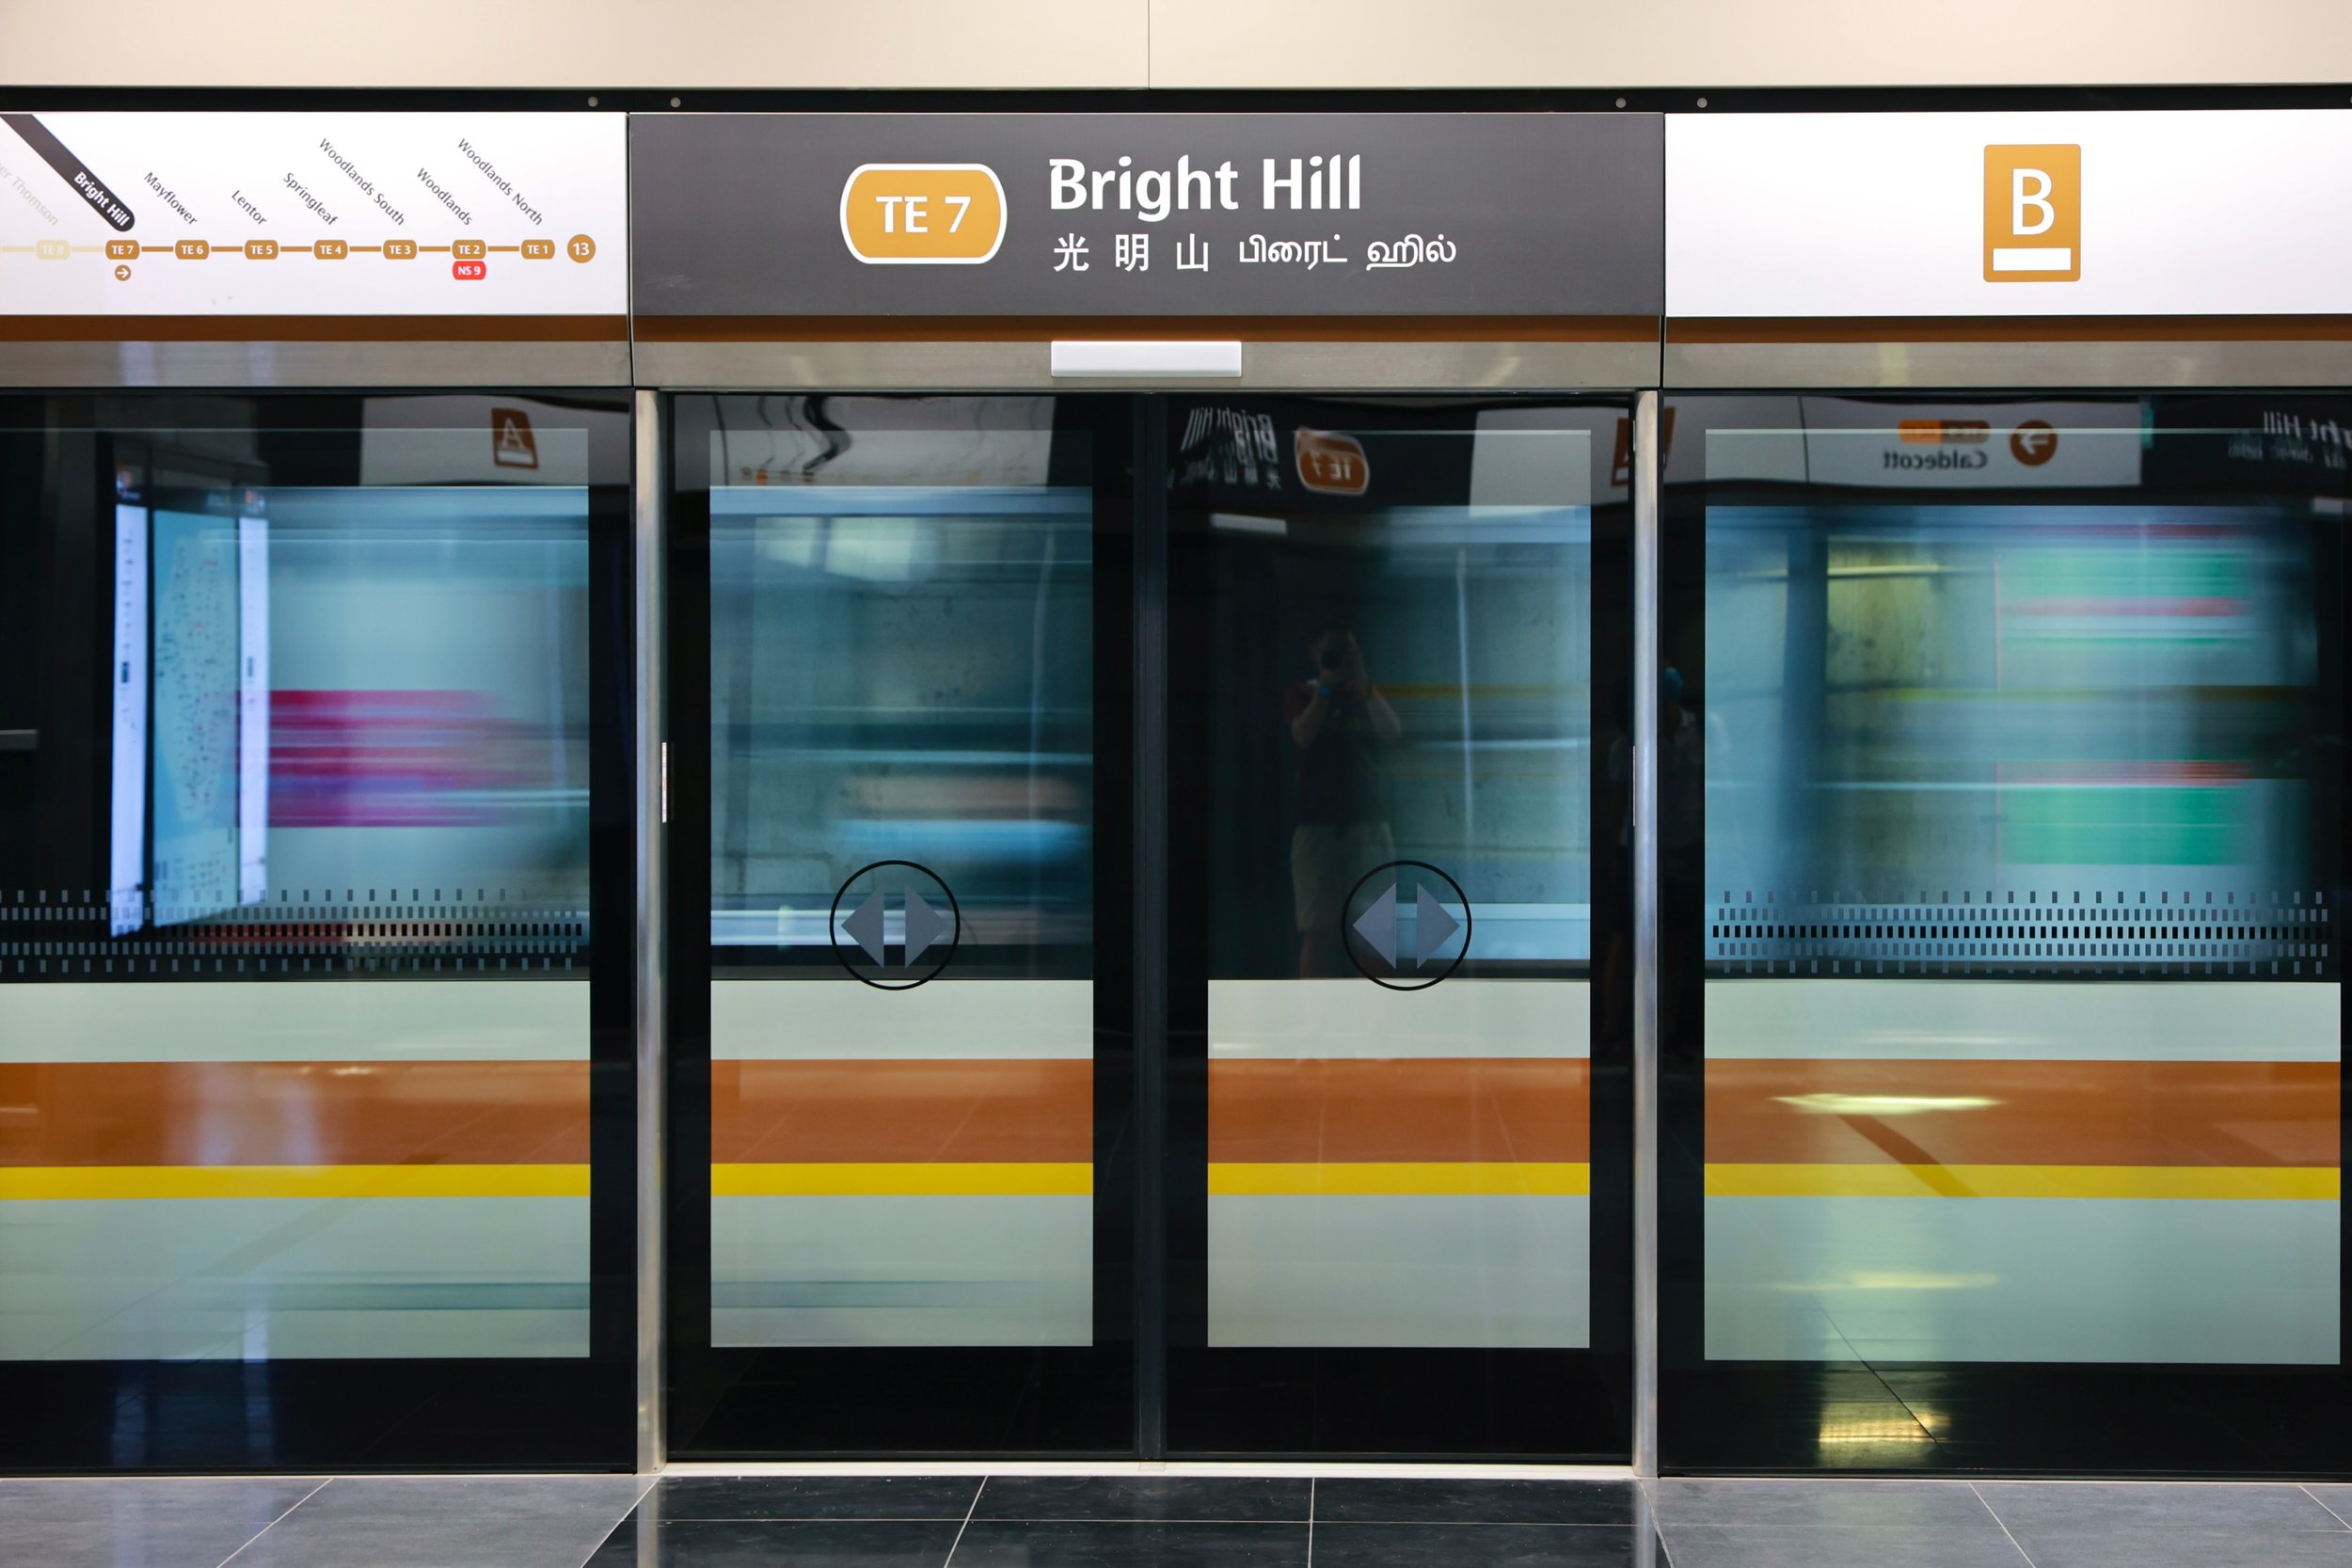
ECE1895 ASSIGNMENT3 Interests and Operations - Modified Design
Buzzer with Adjustable Frequency
Simple Circuits
Applicable in Many Fields
Low Cost
Durable Instruments
After adding a Switch
Application-- Subway Safety Door
Two States :
OPEN: SWITCH ON , FREQ LOW
CLOSE: SWITCH OFF , FREQ HIGH

Slide 7
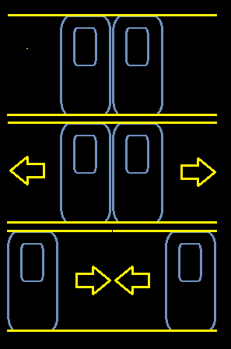
ECE1895 ASSIGNMENT3 Interests and Operations - Modified Design
Two States :
OPEN: SWITCH ON , FREQ LOW →
CLOSE: SWITCH OFF , FREQ HIGH →

Slide 8
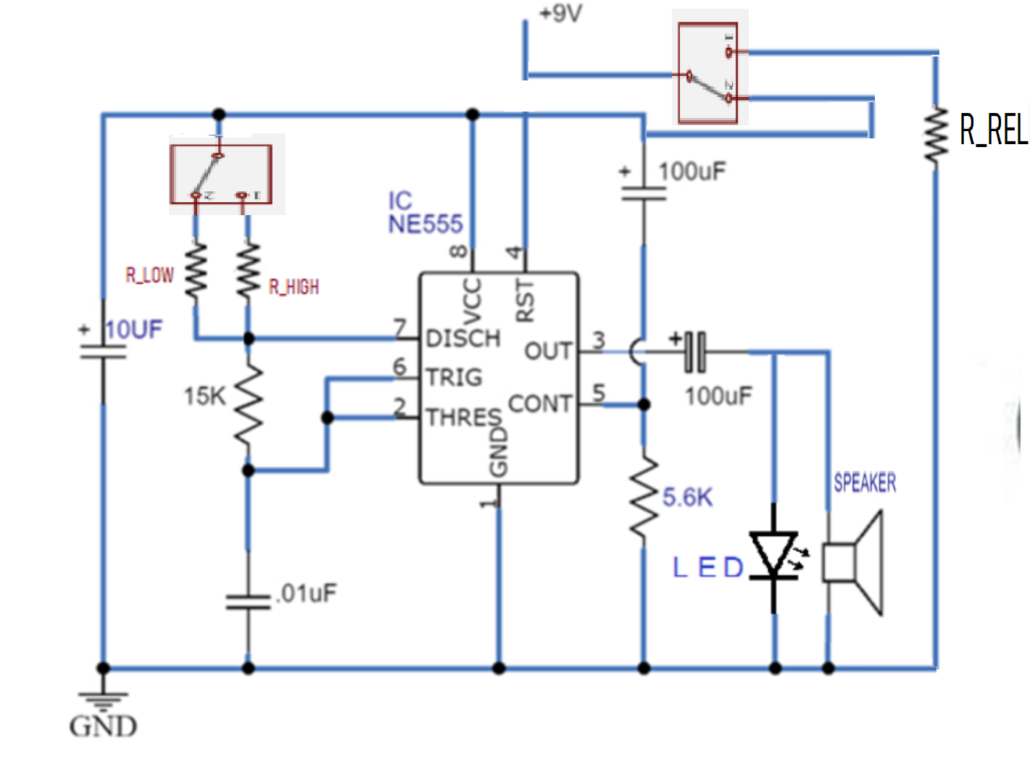
ECE1895 ASSIGNMENT3 Interests and Operations - Modified Design
Values for R_LOW and R_HIGH are indeterminant for this iteration !
IS IT
R_LOW -> FREQ HIGH
R_HIGH -> FREQ LOW
OR
R_LOW -> FREQ HIGH
R_HIGH -> FREQ LOW
Will be determined after next iteration

Slide 9
ECE1895 ASSIGNMENT3
Reference
https://www.circuits-diy.com/simple-buzzer-circuit-with-ne555-ic/
https://www.samschwartz.com/staff-reflections/2022/3/31/advance-screening-platform-screen-doors-on-the-nyc-subway

