Slide 1
Total Weighted Tardiness
310706028詹前駒, 310706034吳啟玄, 310706010林郁蓁

Slide 2
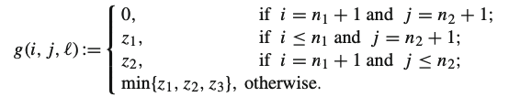
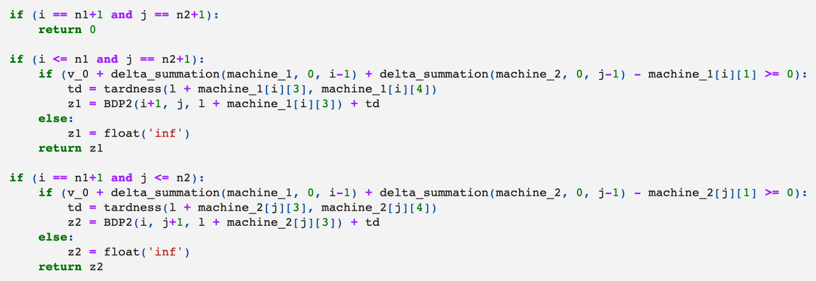

Slide 3
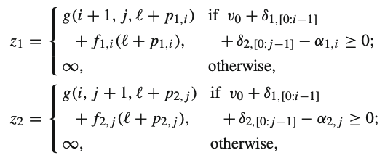
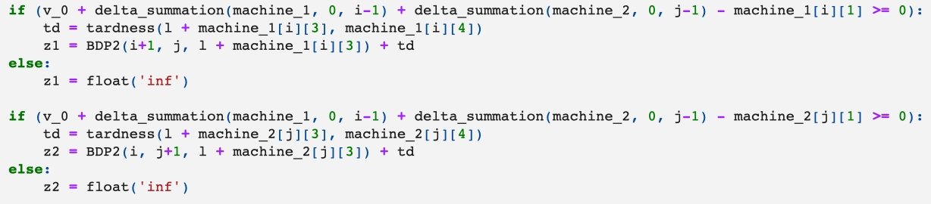

Slide 4
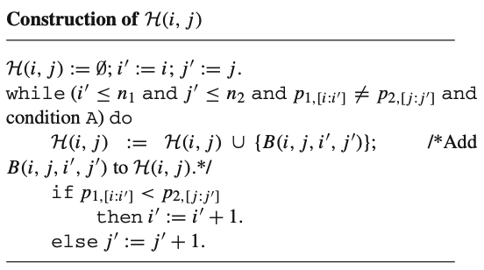
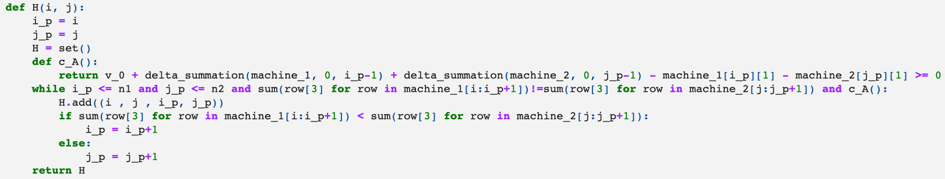

Slide 5
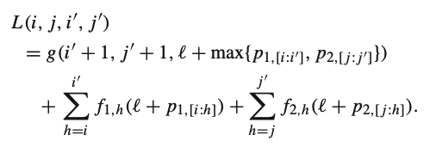
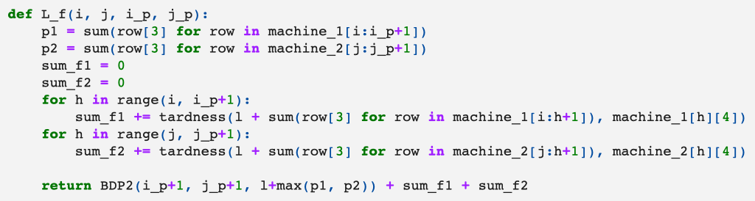

Slide 6
Result
Job | Tardiness
20 | 964
40 | inf
50 | 4522

Slide 7
Thank You!

