Slide 1
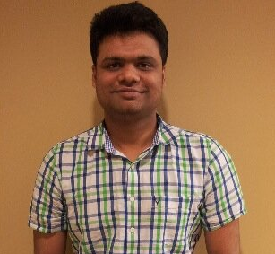
Meta-unsupervised-learning: A model of unsupervised learning applicable to humans and computers
Vikas Garg – MIT Adam Tauman Kalai – MSR
Notes:
7:47

Slide 2


Human Computation Theories
H+M
Models of computational systems that combine humans + machines
Models that fit human computation and machine computation

Slide 3

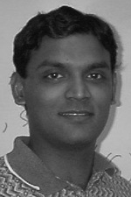
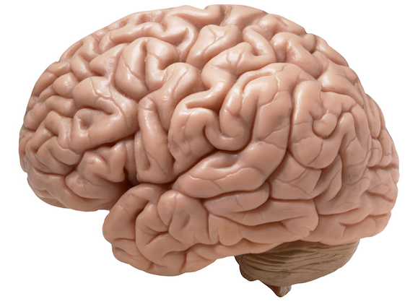
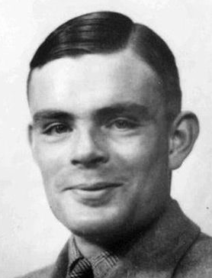
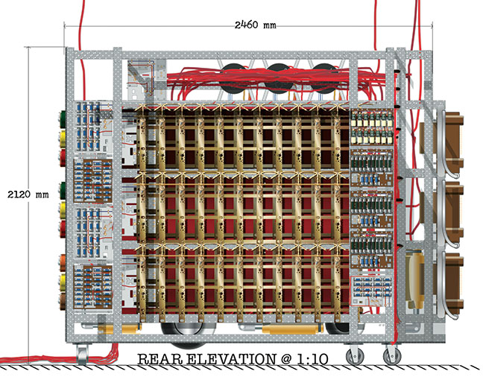
Blum-Vempala HUM (2015) Turing Machine (1936)
Common characteristics
Time-space-accuracy tradeoffs
Easier to check than to solve
Reductions, parallelization, …

Slide 4
Unsupervised learning
Finding structure in unlabeled data via:
Clustering
Dimensionality reduction
Dictionary learning
Topic modeling
Manifold learning

Slide 5
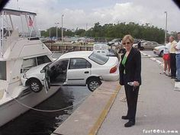
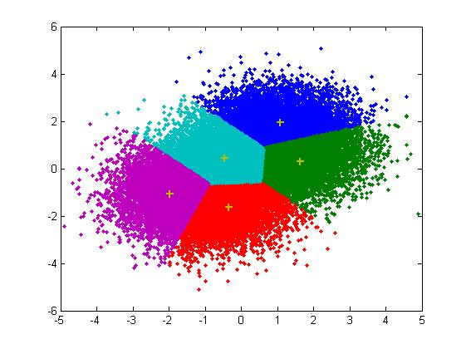
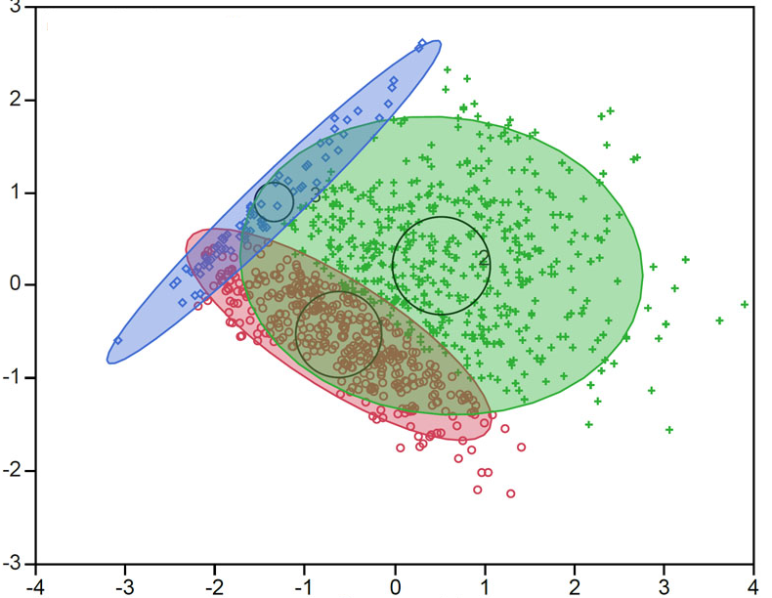
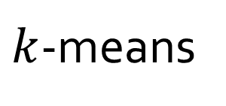
Geometry of clustering
$k$-means
Gaussian mixture model

Slide 6
Human vs. Machine Clustering
The class was great!
Waste of time ADAM I HOPE YOU DIE.
The class was great!
The class was boring.
The class was boring.
The class was terrible!
Best course I have taken in a long time.
The class was terrible!
Best course I have taken in a long time.
Waste of time ADAM I HOPE YOU DIE.
I slept the whole time.
I slept the whole time.
idea: use prior data

Slide 7
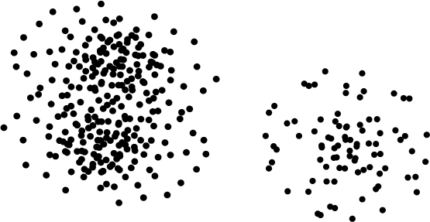
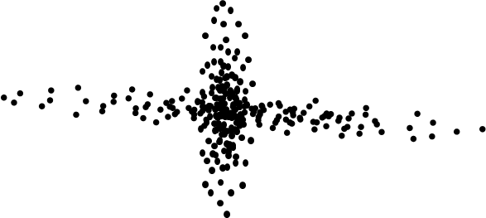
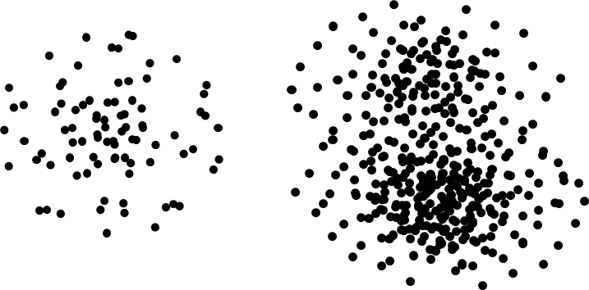
Clustering with prior labeled data

Slide 8
Clustering with prior labeled data

Slide 9
Clustering with prior labeled data

Slide 10
Meta-MODEL

Slide 11
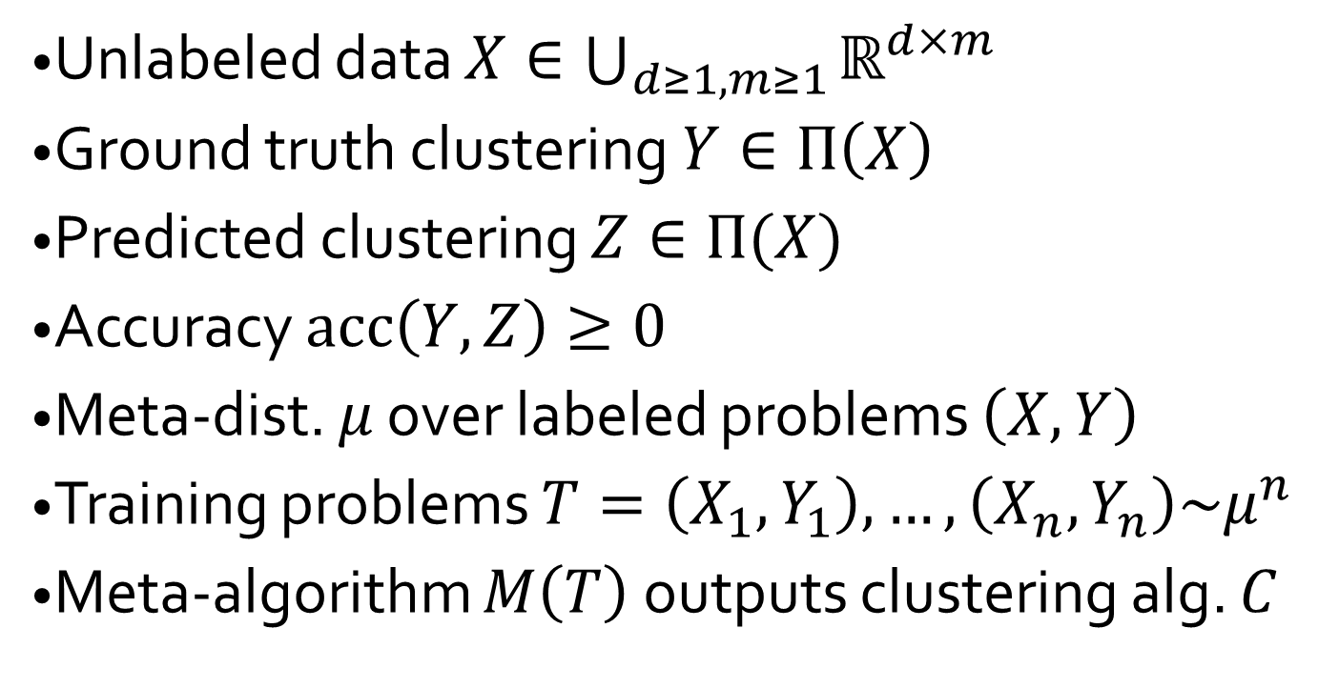
Meta-clustering
#dim
#data
Unlabeled data $X∈\bigcup_{d≥1,m≥1}{ℝ^{d×m}}$
Ground truth clustering $Y∈Π\left(X\right)$
Predicted clustering $Z∈Π(X)$
Accuracy $acc\left(Y,Z\right)≥0$
Meta-dist. $μ$ over labeled problems $\left(X,Y\right)$
Training problems $T=\left(X_{1},Y_{1}\right),…,\left(X_{n},Y_{n}\right)\sim μ^{n}$
Meta-algorithm $M\left(T\right)$ outputs clustering alg. $C$

Slide 12
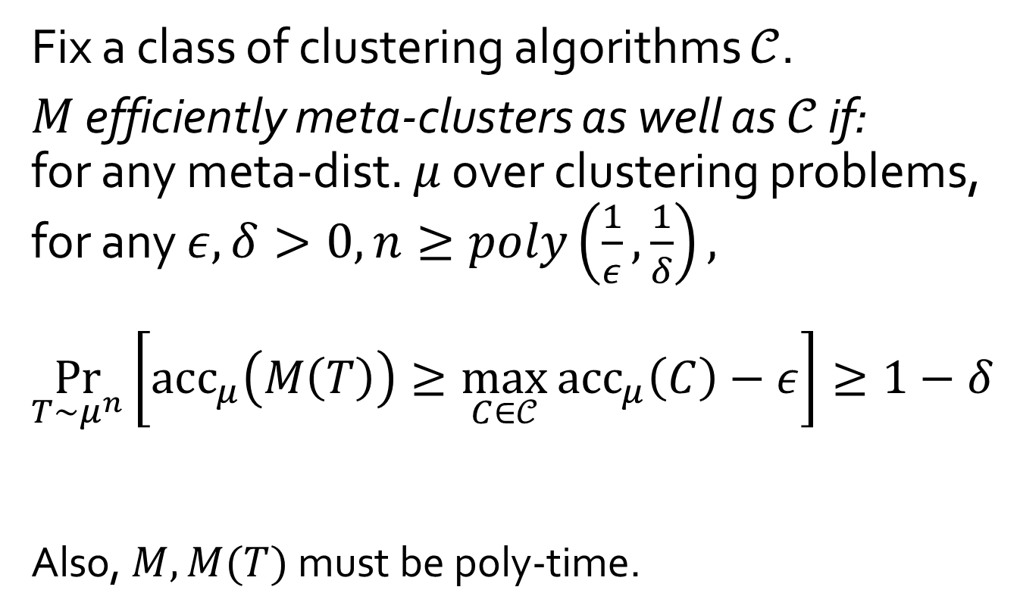

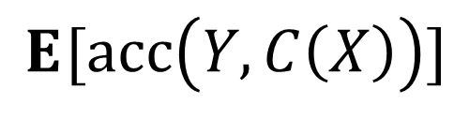
Def: Efficient meta-clustering
Fix a class of clustering algorithms $𝒞$.
$M$ efficiently meta-clusters as well as $𝒞$ if: for any meta-dist. $μ$ over clustering problems, for any $ε,δ>0, n≥poly\left(\frac{1}{ε},\frac{1}{δ}\right),$
$$\underset{T\sim μ^{n}}{Pr}\left[acc_{μ}\left(M\left(T\right)\right)≥\max_{C∈𝒞}{{acc}_{μ}\left(C\right)−ε}\right]≥1−δ$$
Also, $M, M(T)$ must be poly-time.
$$\underset{}{E}{[acc\left(Y,C\left(X\right)\right)]}$$
$$\left(X,Y\right)\sim μ$$

Slide 13
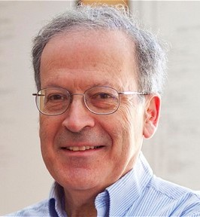
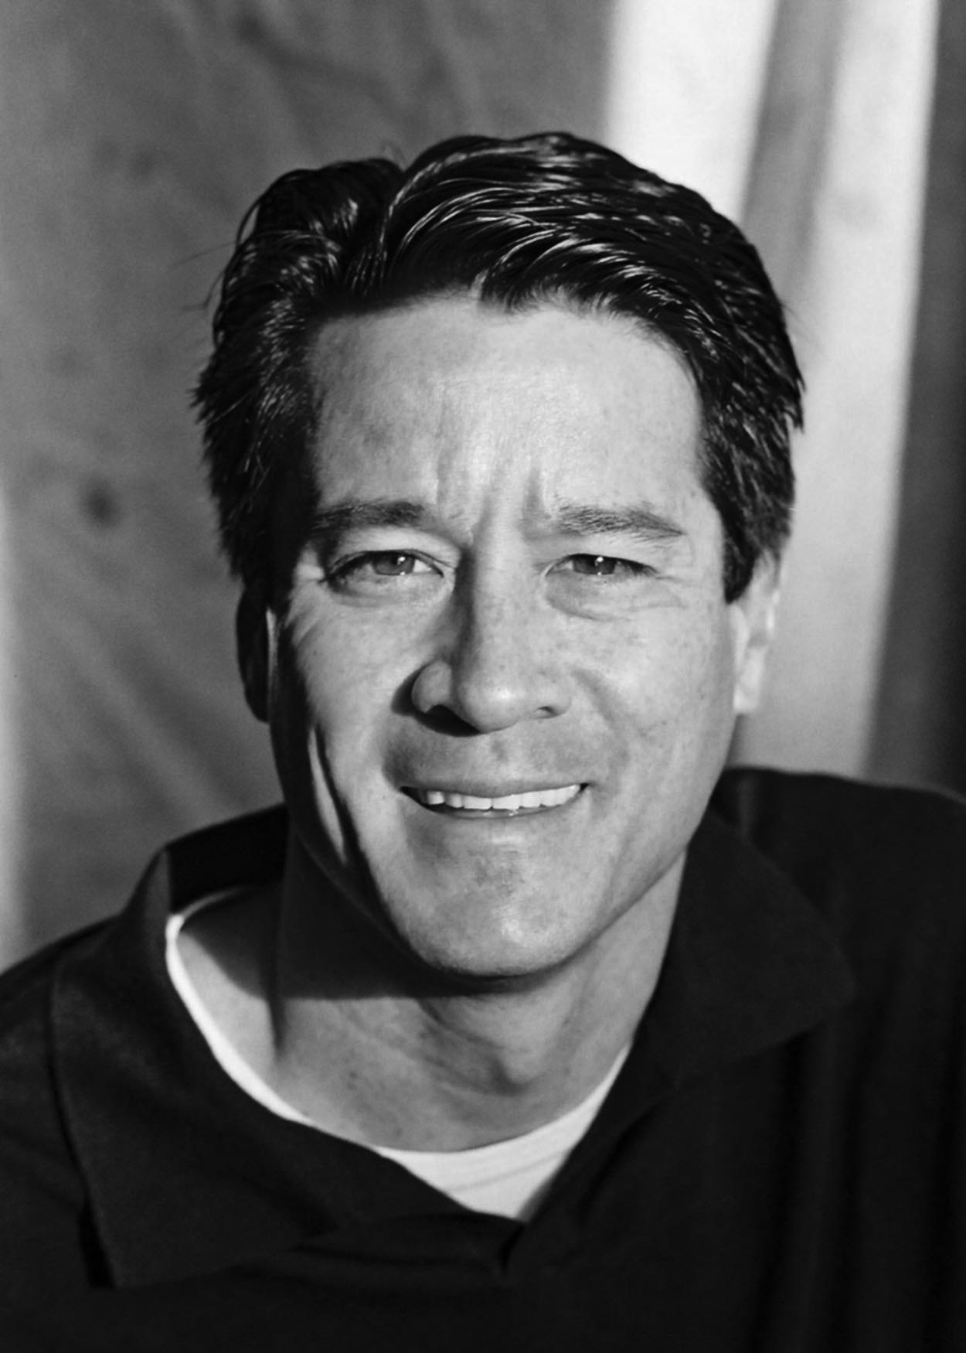
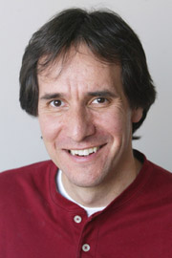
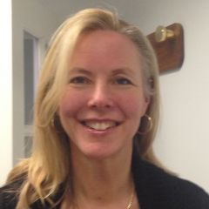
Meta-unsupervised learning
Similar to theory of supervised learning:
PAC (Valiant 84) Agnostic (Kearns, Schapire, Sellie 94)
Notes:
Difference: (x,y) examples are now whole problems

Slide 14
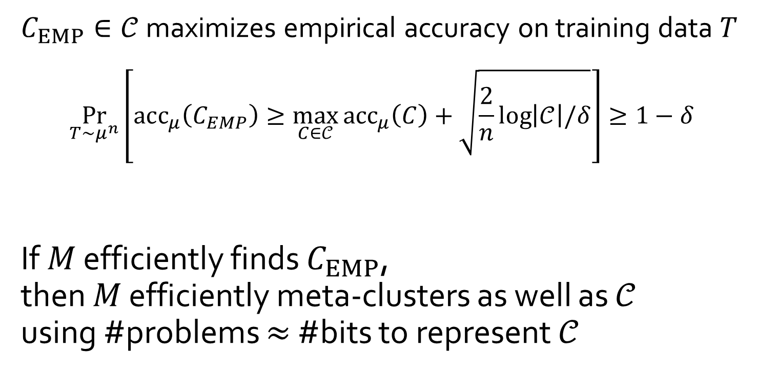
Meta-clustering Occam bound
$C_{EMP}∈𝒞$ maximizes empirical accuracy on training data $T$
$$\underset{T\sim μ^{n}}{Pr}\left[acc_{μ}\left(C_{EMP}\right)≥\max_{C∈𝒞}{acc_{μ}\left(C\right)+\sqrt{\frac{2}{n}\log\left|𝒞\right|/δ}}\right]≥1−δ$$
If $M$ efficiently finds $C_{EMP}$, then $M$ efficiently meta-clusters as well as $𝒞$ using #problems $≈$ #bits to represent $𝒞$
#bits

Slide 15
Experimental Evaluation
Silhouette heuristic (intrinsic clustering quality)
Rand Index (accuracy metric w.r.t. ground-truth/gold-standard)

Slide 16
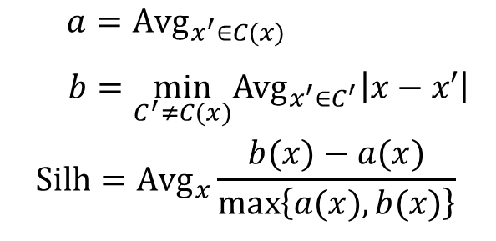
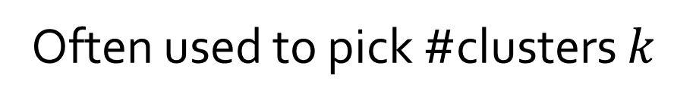
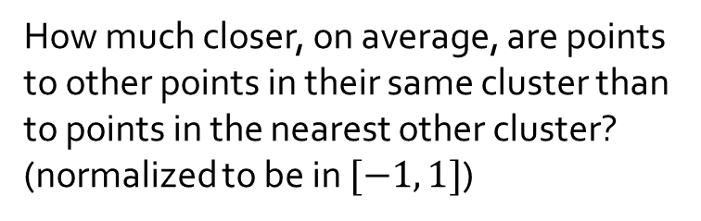
Silhouette clustering quality heuristic
How much closer, on average, are points to other points in their same cluster than to points in the nearest other cluster? (normalized to be in $[−1, 1]$)
$a=Avg_{x^{′}∈C(x)}$
$$b=\min_{C^{′}≠C(x)}Avg_{x^{′}∈C^{′}}\left|x−x′\right|$$
$$Silh=Avg_{x}\frac{b(x)−a(x)}{\max\left\{a(x),b(x)\right\}}$$
Often used to pick #clusters $k$

Slide 17
Rand Index: ground truth accuracy
Ground truth
Fraction of edge/non-edge agreement pairs
Adjusted Rand Index (ARI)
Corrects for random chance
Common empirical clustering accuracy metric

Slide 18
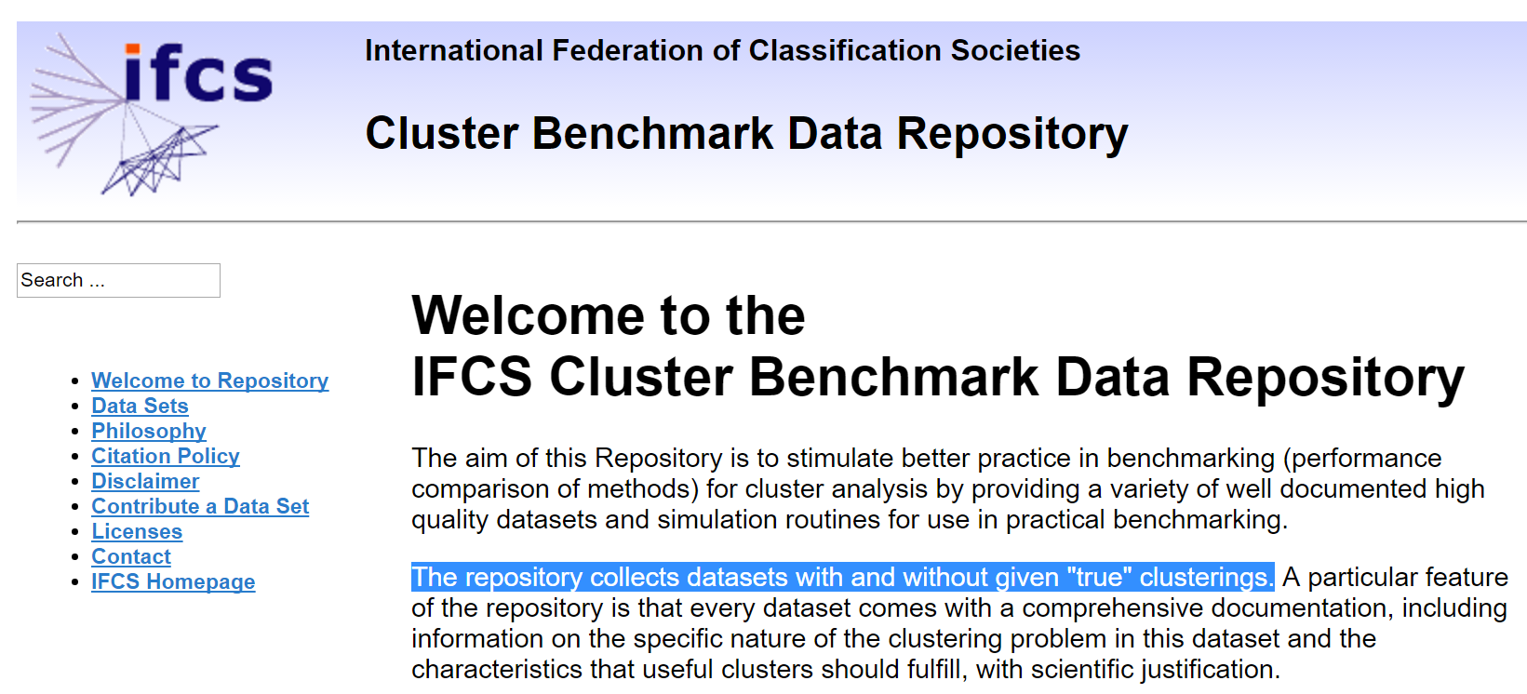
Currently < 10 datasets

Slide 19
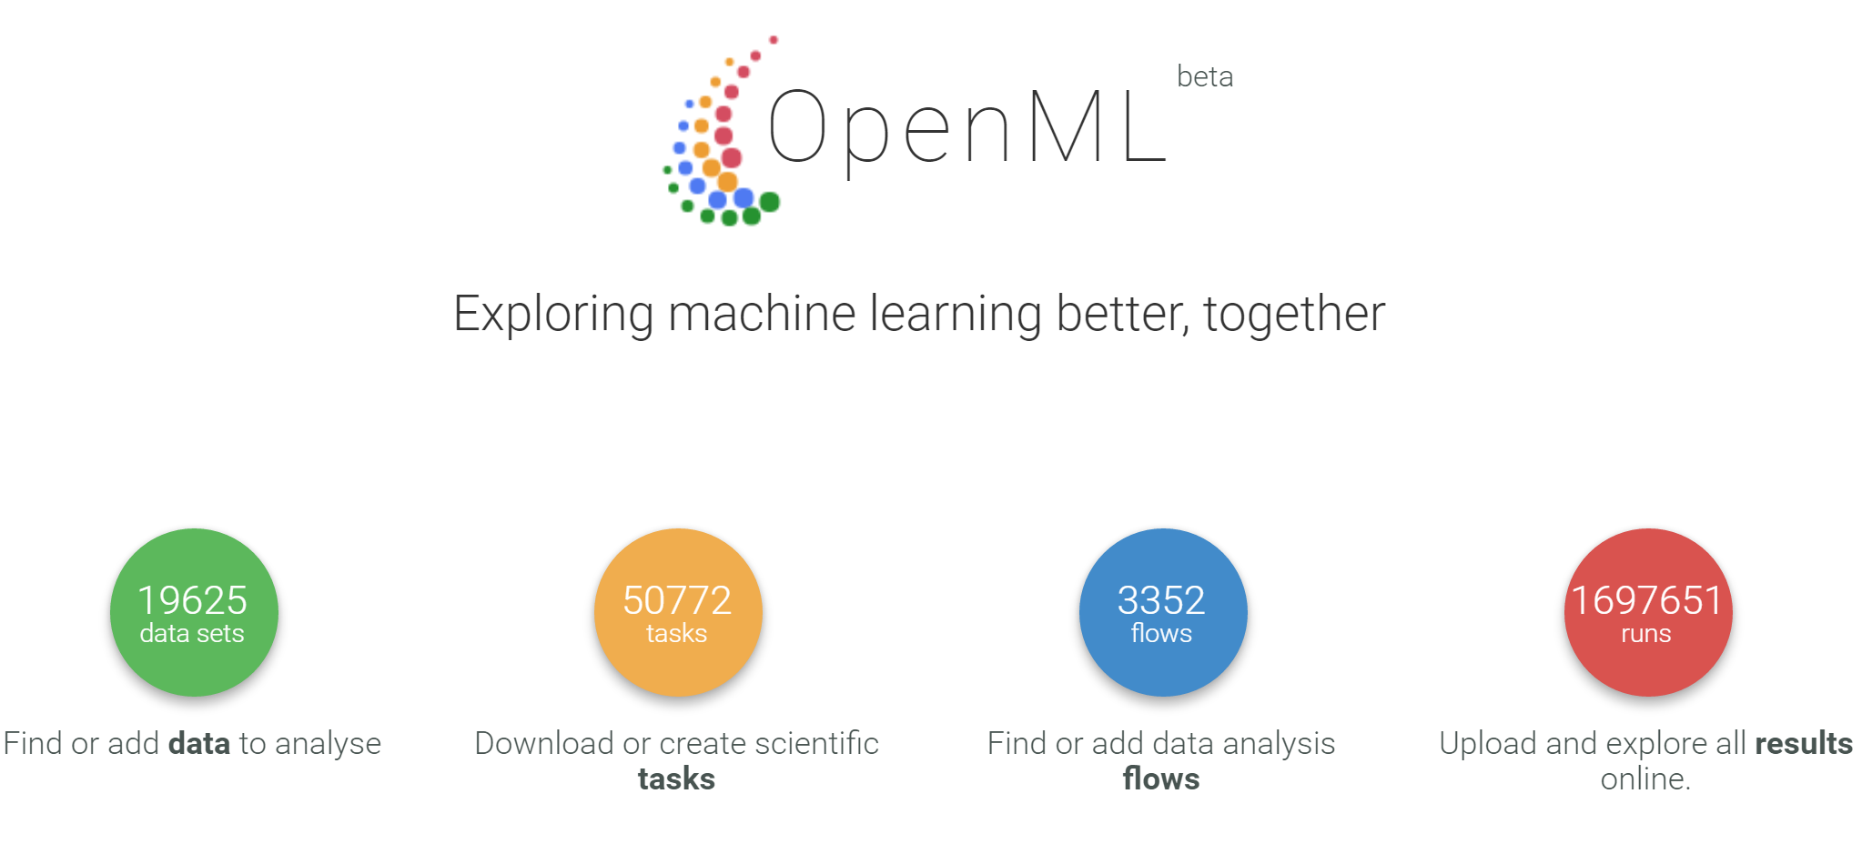

Slide 20
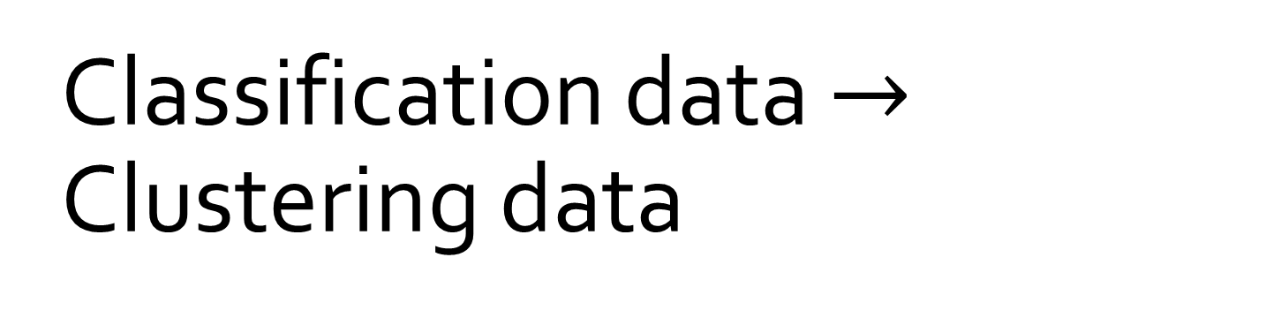
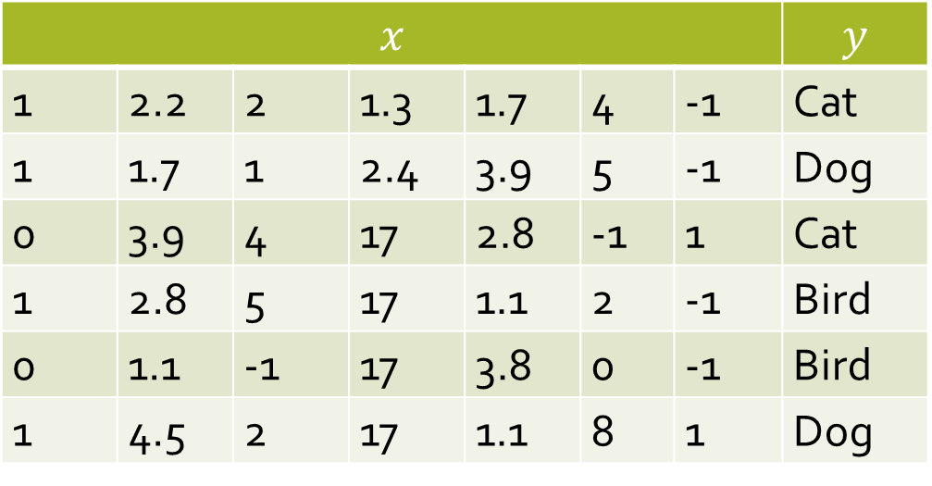
Classification data $→$ Clustering data
$$x$$ |  |  |  |  |  |  | $$y$$
1 | 2.2 | 2 | 1.3 | 1.7 | 4 | -1 | Cat
1 | 1.7 | 1 | 2.4 | 3.9 | 5 | -1 | Dog
0 | 3.9 | 4 | 17 | 2.8 | -1 | 1 | Cat
1 | 2.8 | 5 | 17 | 1.1 | 2 | -1 | Bird
0 | 1.1 | -1 | 17 | 3.8 | 0 | -1 | Bird
1 | 4.5 | 2 | 17 | 1.1 | 8 | 1 | Dog

Slide 21
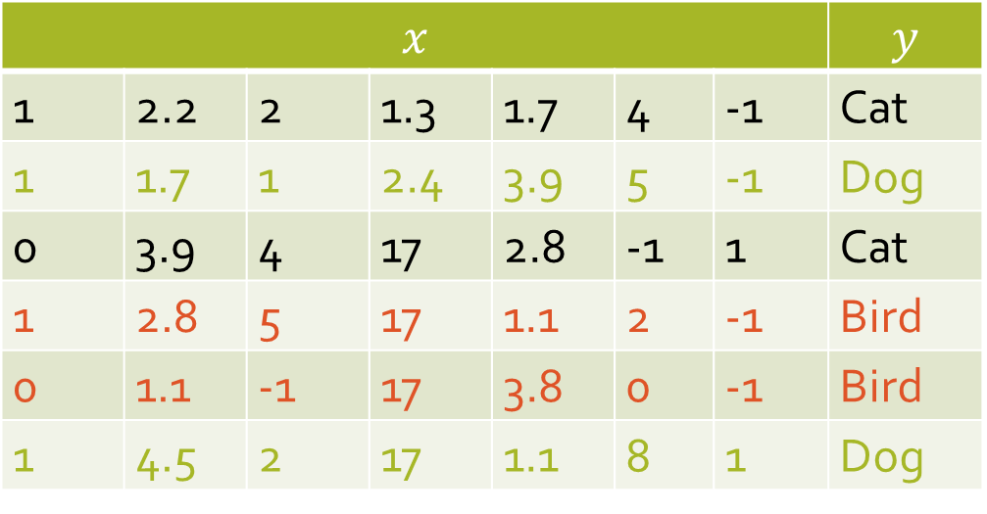
Classification data $→$ Clustering data
$$x$$ |  |  |  |  |  |  | $$y$$
1 | 2.2 | 2 | 1.3 | 1.7 | 4 | -1 | Cat
1 | 1.7 | 1 | 2.4 | 3.9 | 5 | -1 | Dog
0 | 3.9 | 4 | 17 | 2.8 | -1 | 1 | Cat
1 | 2.8 | 5 | 17 | 1.1 | 2 | -1 | Bird
0 | 1.1 | -1 | 17 | 3.8 | 0 | -1 | Bird
1 | 4.5 | 2 | 17 | 1.1 | 8 | 1 | Dog
Cluster
Cluster
Cluster

Slide 22
Which Algorithm?

Slide 23
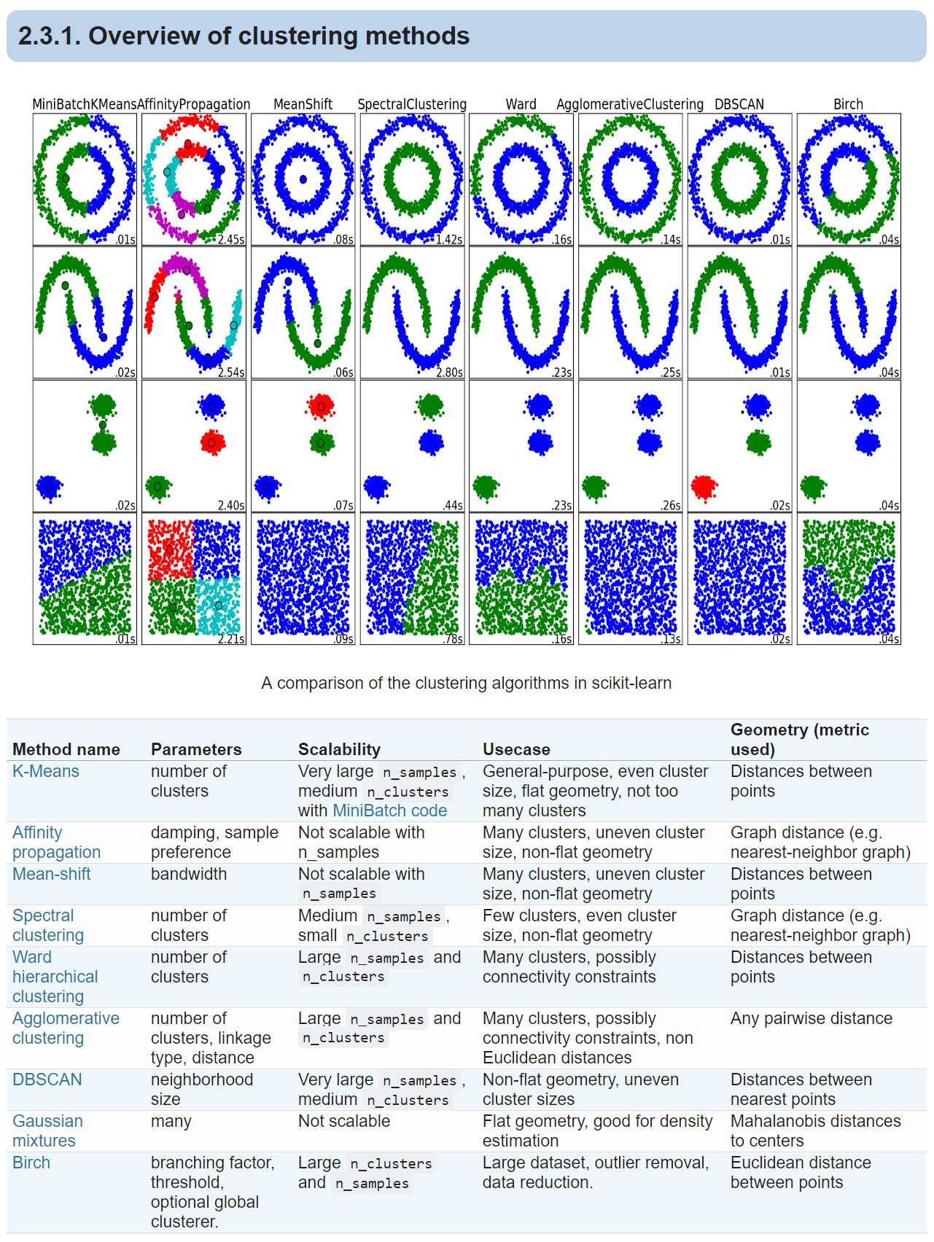

Slide 25
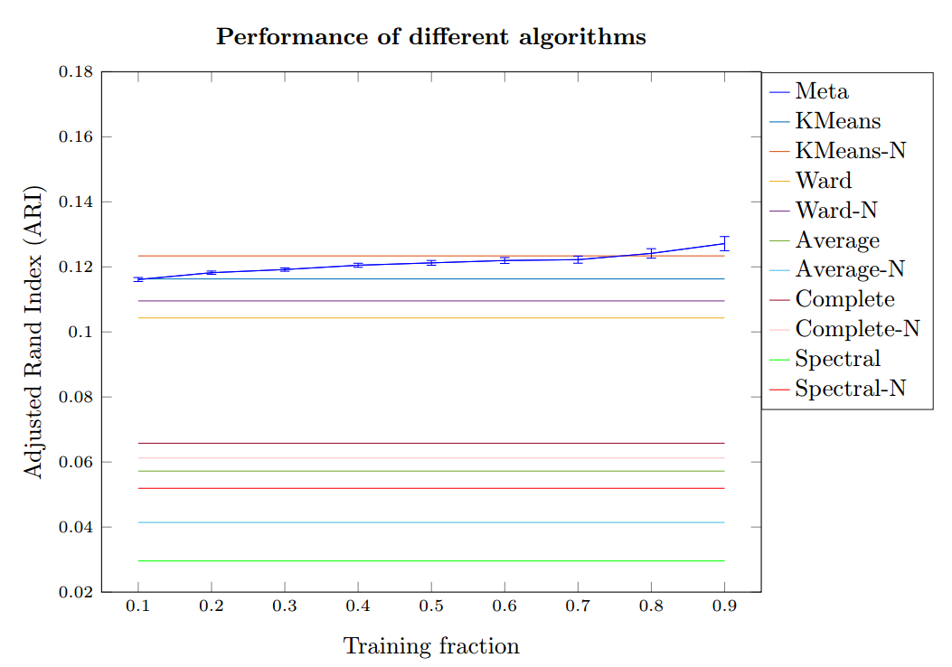
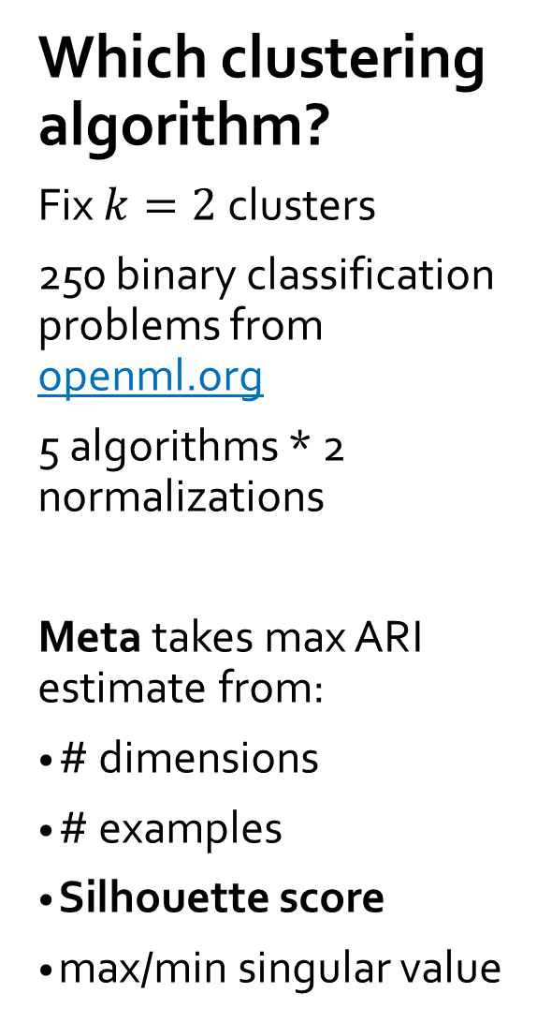
Which clustering algorithm?
Fix $k=2$clusters
250 binary classification problems from openml.org
5 algorithms * 2 normalizations
Meta takes max ARI estimate from:
# dimensions
# examples
Silhouette score
max/min singular value

Slide 26
How many clusters?

Slide 27

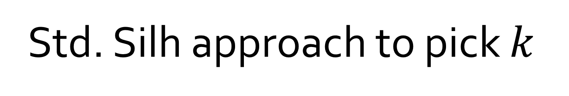
Std. Silh approach to pick $k$
Given new clustering problem, run $k$-means for $k=2,…,10$ and compute $Silh_{2}, …,Silh_{10}$
Take $k$ to maximize $Silh_{k}$

Slide 28
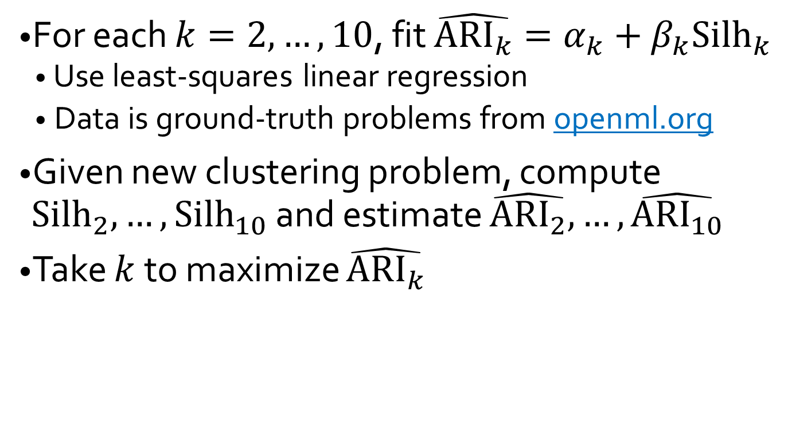
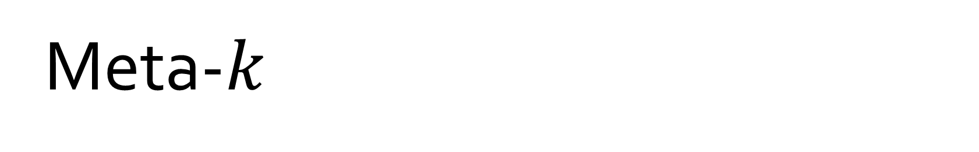
Meta-$k$
For each $k=2,…,10$, fit $\hat{{ARI}_{k}}=α_{k}+β_{k}{Silh}_{k}$
Use least-squares linear regression
Data is ground-truth problems from openml.org
Given new clustering problem, compute $Silh_{2}, …,Silh_{10}$ and estimate $\hat{{ARI}_{2}},…,\hat{{ARI}_{10}}$
Take $k$ to maximize $\hat{{ARI}_{k}}$

Slide 29
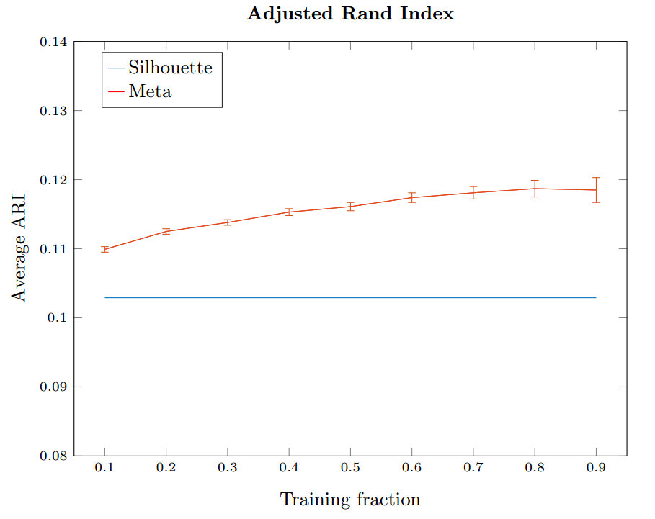
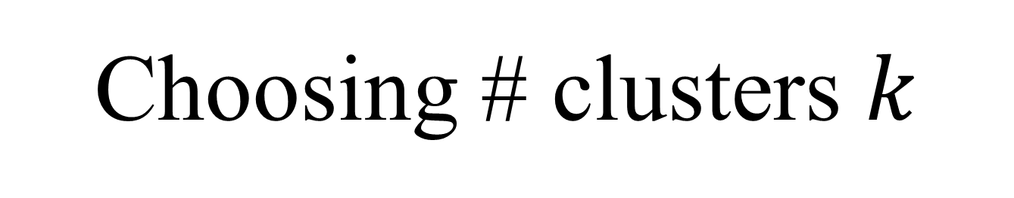
Choosing # clusters $k$

Slide 30
Meta-Outlier-Removal

Slide 31
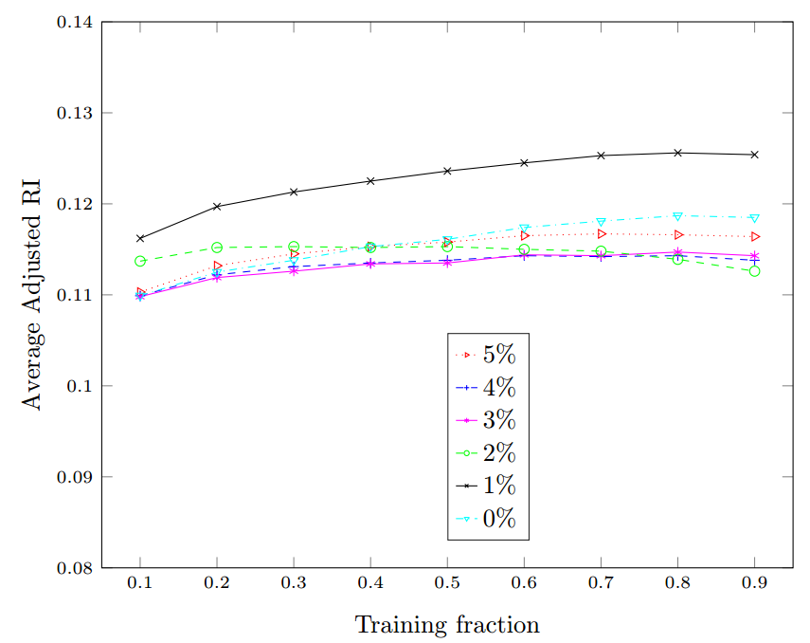

Slide 32
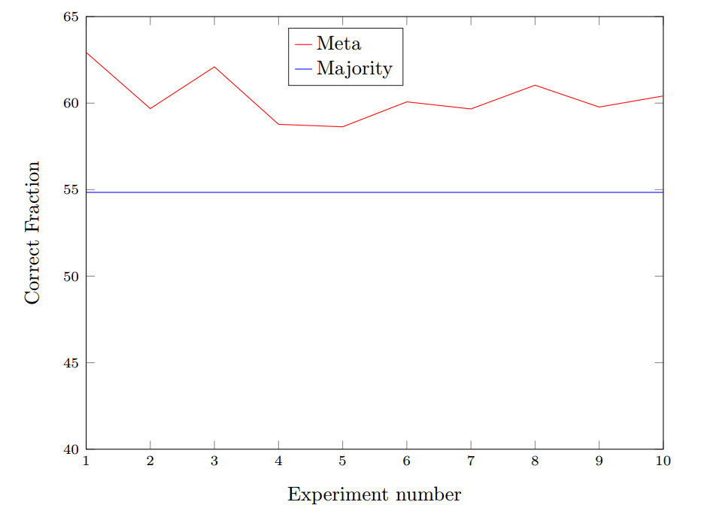
Meta-neural-network-unsupervised-learning
Lots of little data makes big data

Slide 33
Human Experiments?

Slide 34
Cluster this
The class was great!
Waste of time ADAM I HOPE YOU DIE.
The class was boring.
Best course I have taken in a long time.
The class was terrible!
I slept the whole time.

Slide 35
Cluster this
The class was great!
Waste of time ADAM I HOPE YOU DIE.
The class was boring.
Best course I have taken in a long time.
The class was terrible!
I slept the whole time.

Slide 36
Cluster this
The class was great!
Waste of time ADAM I HOPE YOU DIE.
The class was boring.
Best course I have taken in a long time.
The class was terrible!
I slept the whole time.

Slide 37
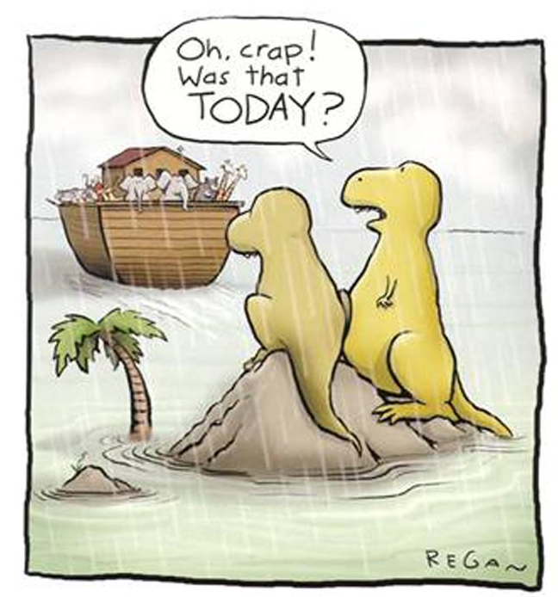
Summary
dear
Don’t miss the meta-boat
Meta-clustering
Meta-topic-modeling
Meta-feature-selection
Meta-classification
Meta-algorithms
theories that apply to Humans & Machines

Slide 38
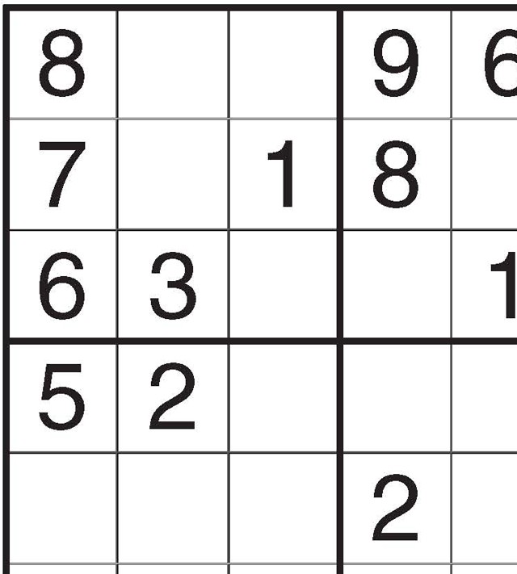
An open meta-problem
Humans solve problems, write programs, come up with and improve strategies
How can computers do the same?

Slide 39
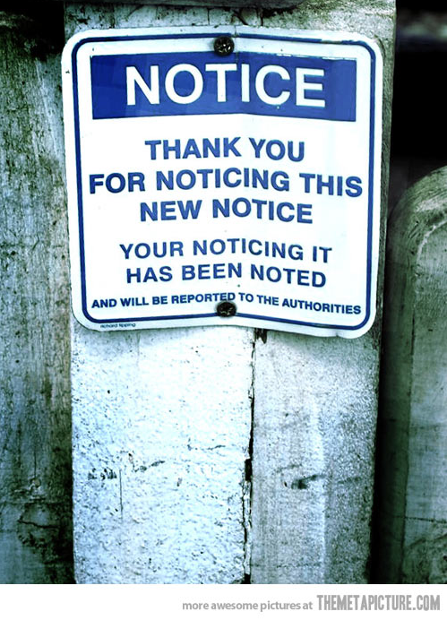
Meta-thank-you

