Slide 1
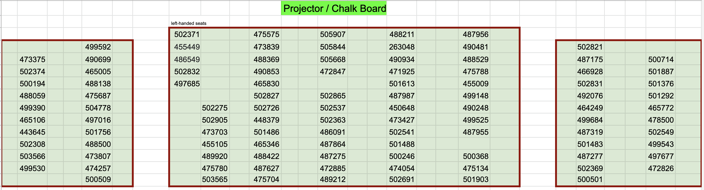
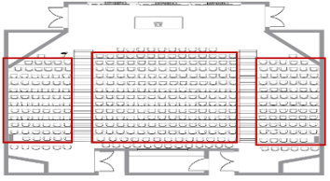
Stay in the seats during the exam
Raise your hand if you have questions or want to turn in the exam early.
When time is up, stop writing but do not leave the seats. We’ll start to collect exam papers once everyone stops writing.
Please don’t turn in exam papers within 5 minutes before the exam ends.
By default, I don’t clarify questions individually.

Slide 2
Exam Start Time:
Exam End Time:
Logistics
Stay in the seats during the exam
Raise your hand if you have questions or want to turn in the exam early.
When time is up, stop writing but do not leave the seats. We’ll start to collect exam papers once everyone stops writing.
Please don’t turn in exam papers within 5 minutes before the exam ends.
By default, I don’t clarify questions individually.

