Slide 1
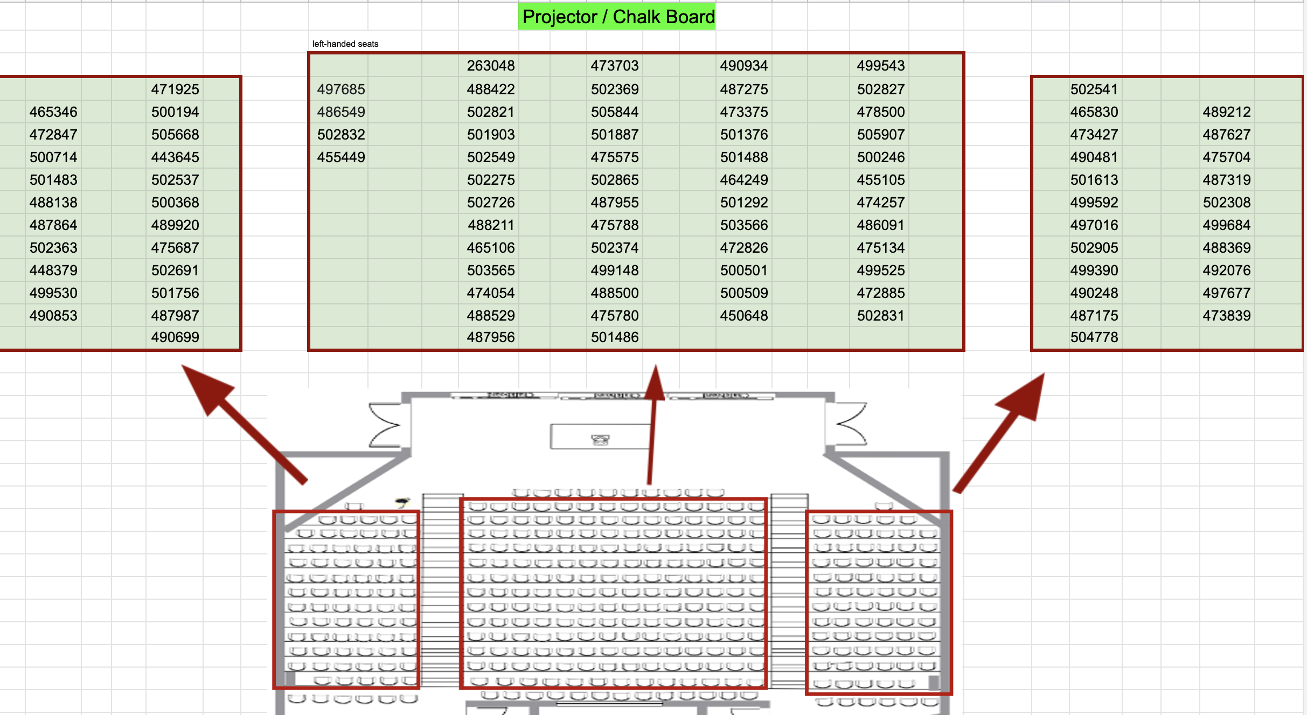

Slide 2
Exam Start Time:
Exam End Time:
During the exam, if you have a question or if you finish before time is up:
Do not get up
Raise your hand and I will come to you
I most likely will not answer questions to individual students
But I’ll give clarifications to everyone if multiple students ask the same question
When time is called:
Stop writing; Do not get up
We will come around and collect your exam

