Slide 1
Logistics: Project Milestone 2
Milestone 2: Due Nov 4
Summarize your progress
Should make enough progress to know whether the project is feasible
Last chance to convert a research project to an extensive literature survey

Slide 2
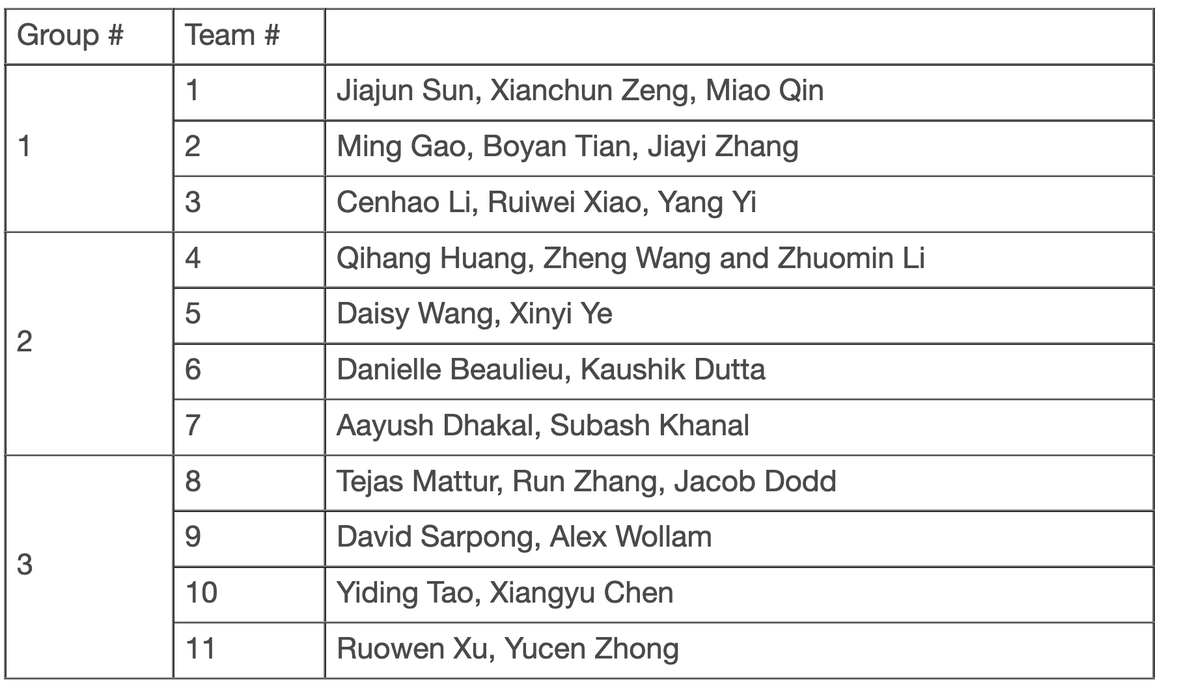
Today’s Schedule
Spotlight presentation
Data collection
Kaushik Dutta, Danni Beaulieu
Ruiwei Xiao, Yi Yang, Claude Li
Run Zhang, Tejas Mattur, Jacob Dodd
Group discussion

