Slide 1
Human Perception Of Fairness in AI
Presented by:
Subash Khanal, Aayush Dhakal

Slide 2
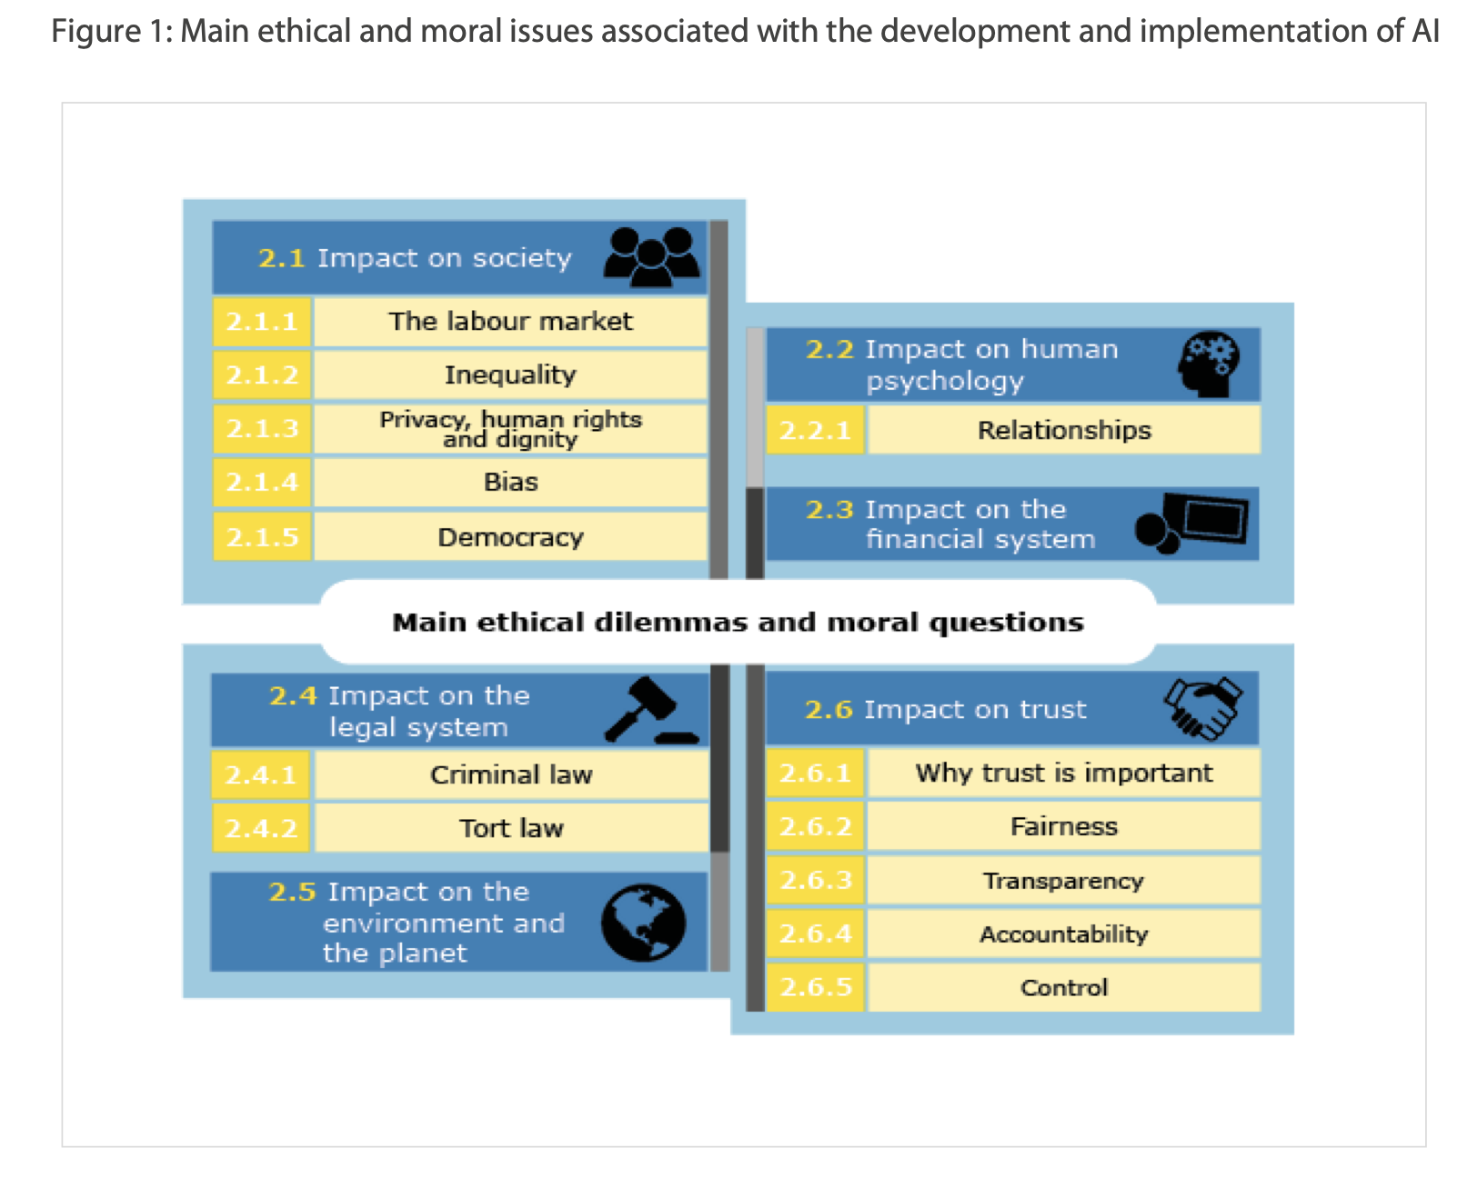
https://www.europarl.europa.eu/RegData/etudes/STUD/2020/634452/EPRS_STU(2020)634452_EN.pdf

Slide 3
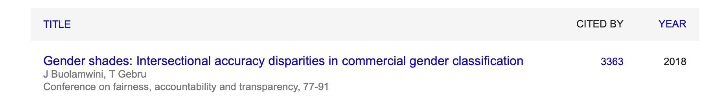
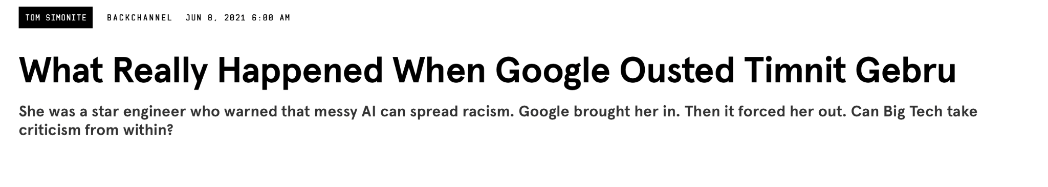

Slide 4
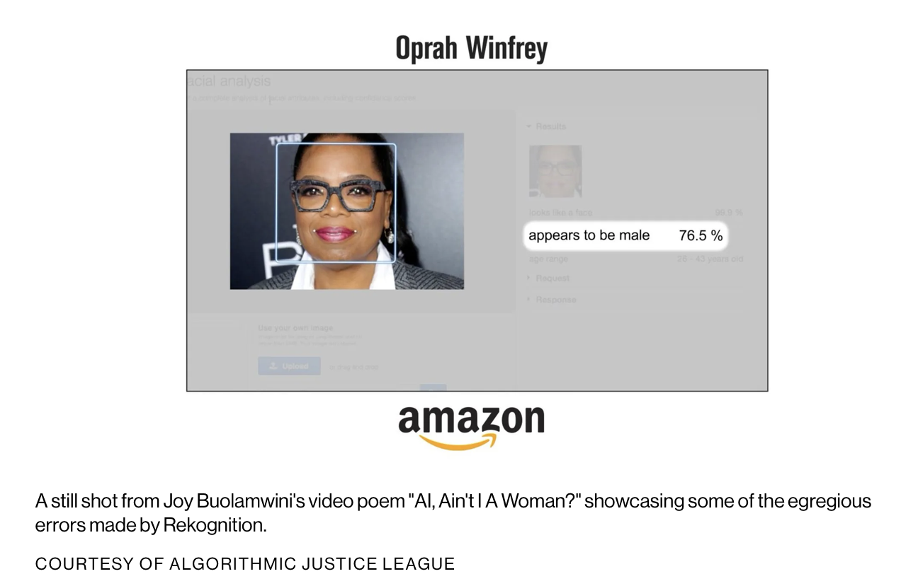

Slide 5
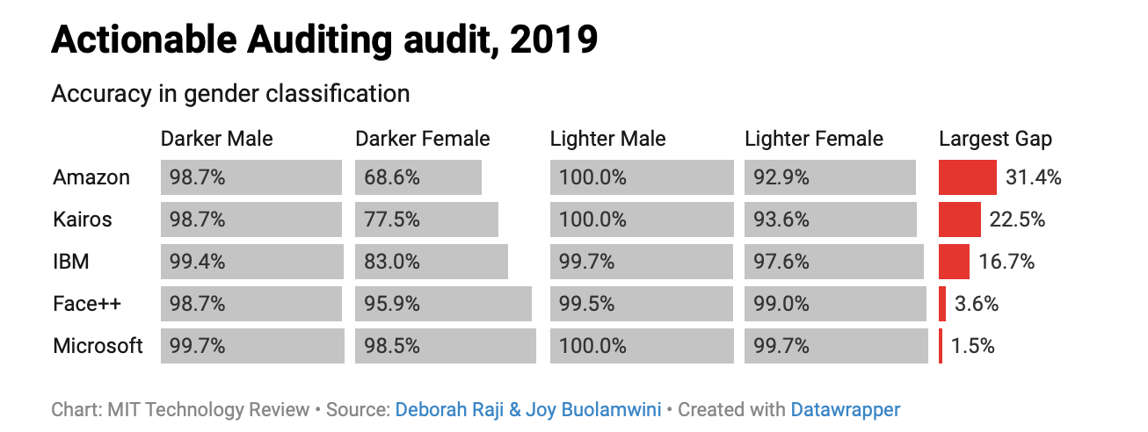

Slide 6
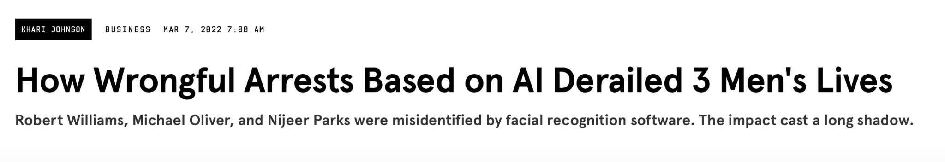
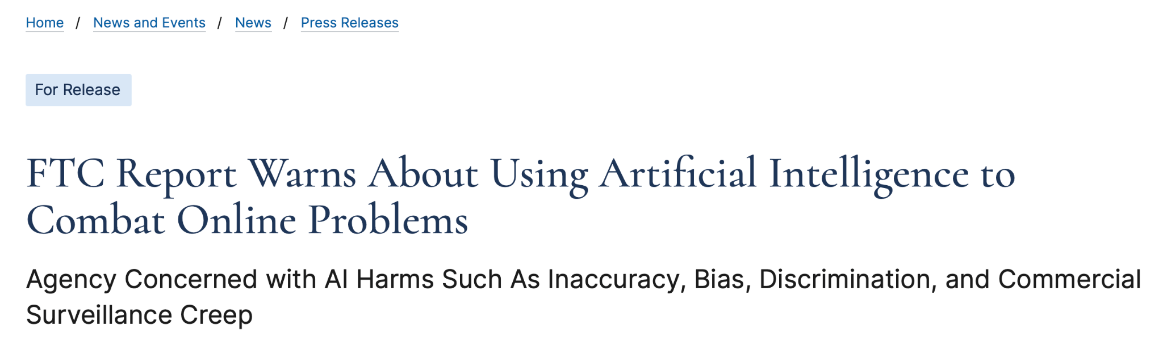
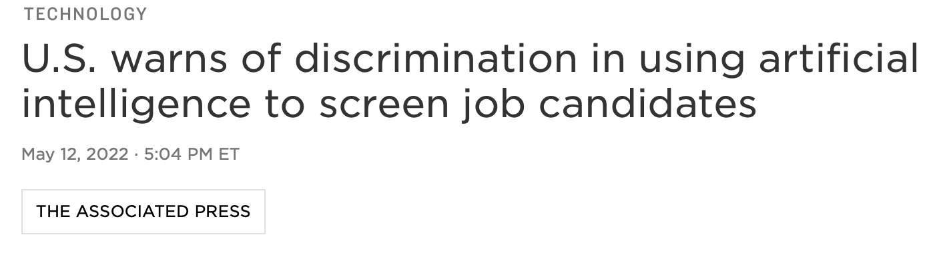

Slide 7
Quantifying Fairness in AI
Require a particular metric {which quantifies benefit or harm} to be equal/fair across different groups
How to define benefit metric?

Slide 8
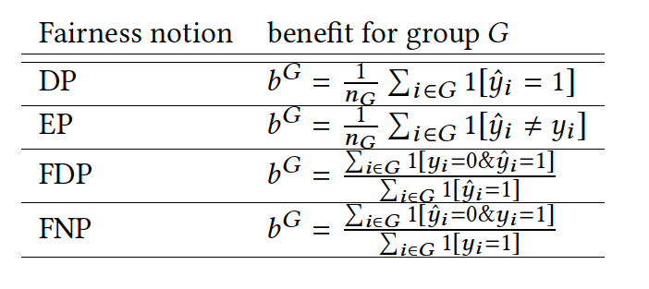
Quantifying Fairness in AI
FPR = False Positive Rate
FNR = False Negative Rate
FDP = False Discovery Parity
FNP = False Negative Parity
DP = Demographic Parity
EP = Error Parity

Slide 9
What is the most appropriate notion of fairness?
Fairness is context-dependent ideal
Determine the most suitable notion of fairness for a given context
Identify the mathematical notion of fairness that most closely matches lay people’s perception of fairness

Slide 10
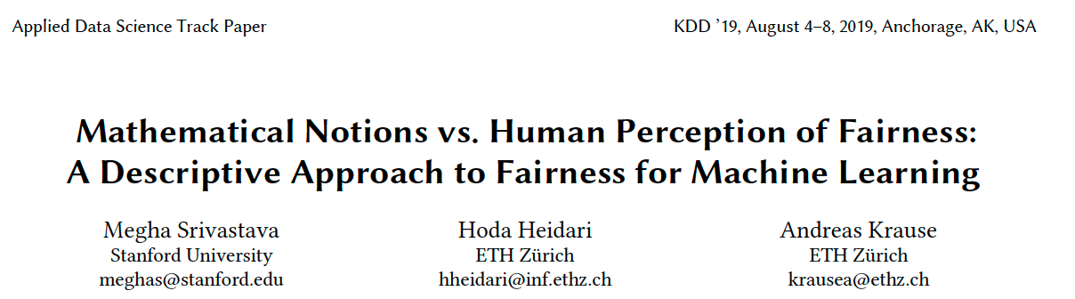

Slide 11
Discussion Time
Choose and justify from given 3 hypothetical algorithms on following scenarios:
Gender classification
College admission
Medical doctor eligibility for hiring
School teacher eligibility for hiring
Algorithm | Accuracy | Female acc | Male acc
A1 | 93% | 87% | 99%
A2 | 91% | 92% | 90%
A3 | 86% | 86% | 86%

Slide 12
Hypotheses
H1: Recidivism risk assessment: equality of FPR/FNR across groups matters
H2: Medical predictions: equality of accuracy across groups matters
H3: When the decision-making stakes are high: more sensitive to accuracy as opposed to equality

Slide 13
Experimental setup:
Each participant is required to answer a series of at most 20 adaptively chosen tests chosen by an active learning algorithm.
Run experiments on AMT and report the percentage of participants whose choices match each mathematical notion of fairness.

Slide 14
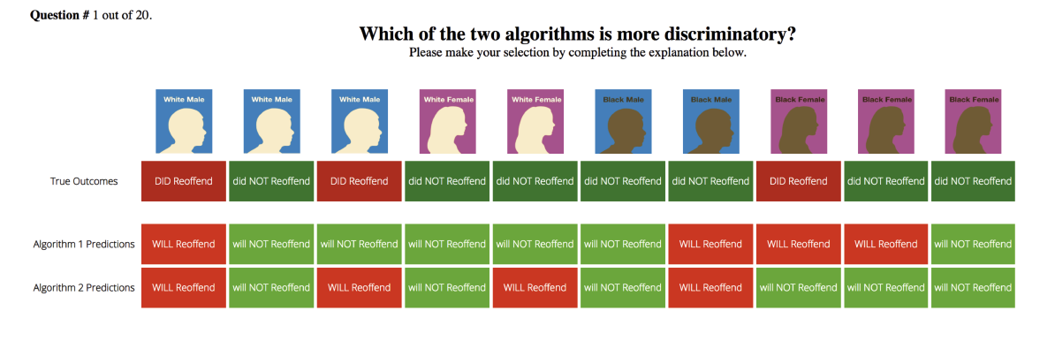

Slide 15
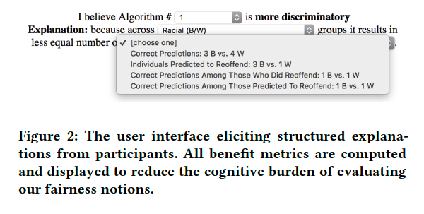

Slide 16
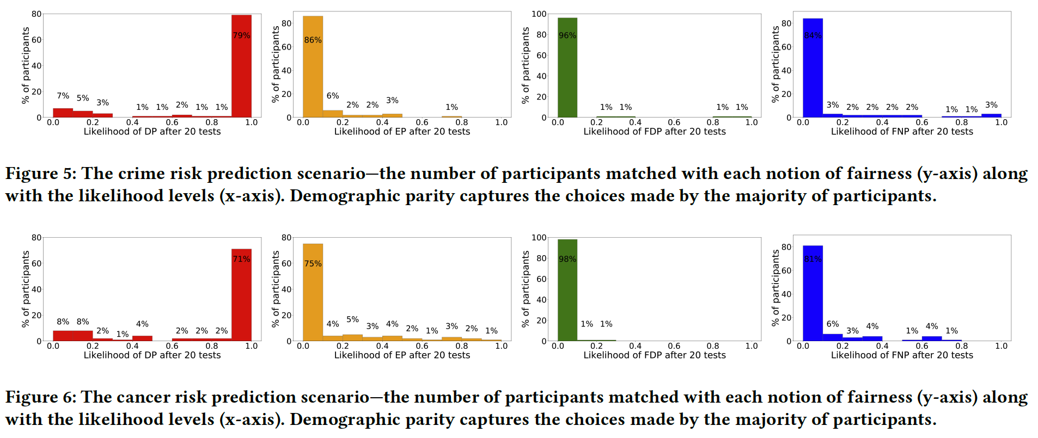
Results: H1 and H2

Slide 17
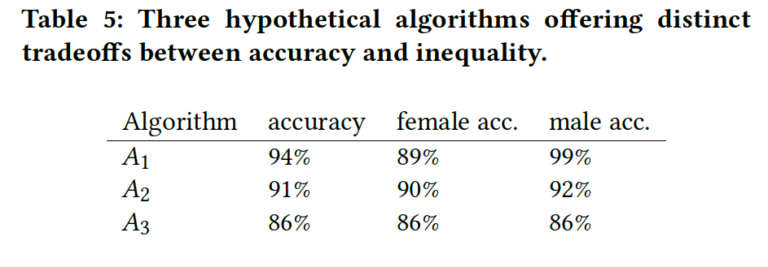
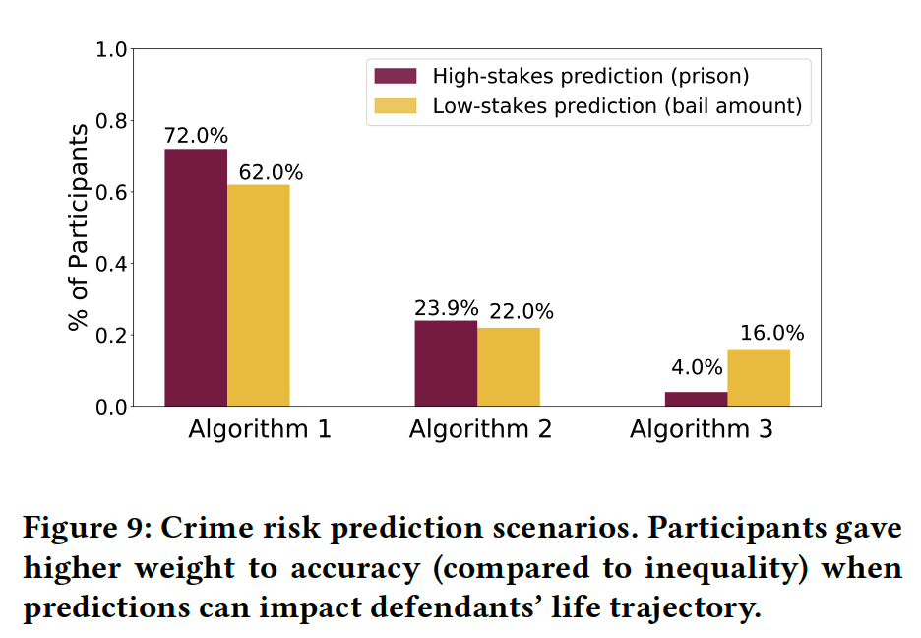
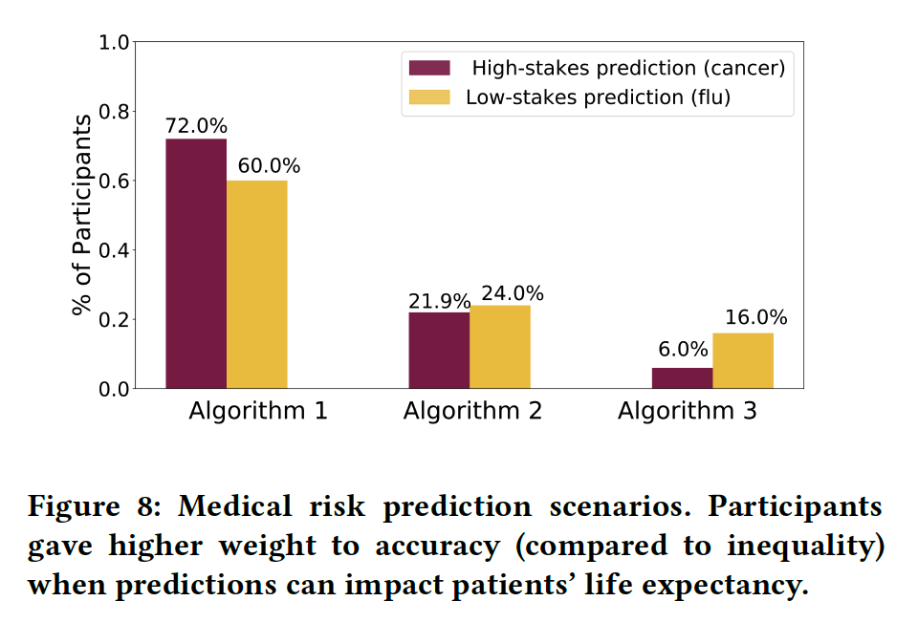
Results: H3

Slide 18
Human Perceptions of Fairness in Algorithmic Decision Making: A Case Study of Criminal Risk Prediction

Slide 19
Overview
Algorithms are increasingly used to make decisions that have drastic impact on people’s lives
Most studies of algorithmic fairness take a normative approach i.e. assume there is a societal consensus on what constitutes fair decision making
Perceptions of fairness are multi-dimensional and context-dependent
They attempt to understand how people make judgements about fairness of using individual features in decision making
Is it fair to use a feature (F) in a given decision making scenario (S)?

Slide 20
Main Contributions
The authors asked participants to assess the fairness of using different features that are input of COMPAS
They propose a set of eight latent properties to model the factors that drives participants fairness judgements
Majority of respondents judged that half of the features in COMPAS are unfair to use
One interesting find is that the latent properties considered by respondents were mostly unrelated to discrimination

Slide 21
Latent Properties for Model Features
Reliability
Relevance
Privacy
Volitionality
Causes Outcome
Causes Vicious Cycle
Causes Disparity in Outcomes
Caused by Sensitive Group Membership

Slide 22
Latent Properties for Model Features
Reliability: Fairness judgements might be influenced by potential for reliably assessing the feature.
Relevance: Fairness judgements might be influenced by a feature’s relevance to the decision making scenario
Causes Vicious Cycle: Fairness judgements might be influenced by weather a feature is likely to trap people in a vicious cycle of increasingly risky behaviour

Slide 23
Discussion Time
One of the questions in COMPAS is “Do you think that a hungry person has a right to steal?”. Based on the Reliability property, do you think this is a question to use? Justify.
Another question in COMPAS is “Did you use heroin, cocaine, crack, or meth as a juvenile?”. Based on the Privacy property, do you think this is a fair question to use? Would your fairness decision change if the question was asking about a more aggressive crime like arson, armed robbery, or assault instead of drug abuse?

Slide 24
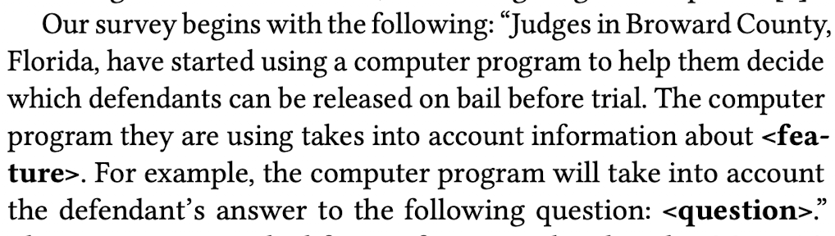
Methodology
They consider the COMPAS system, which analyzes defendant’s answer to predict risk of criminal activity.

Slide 25
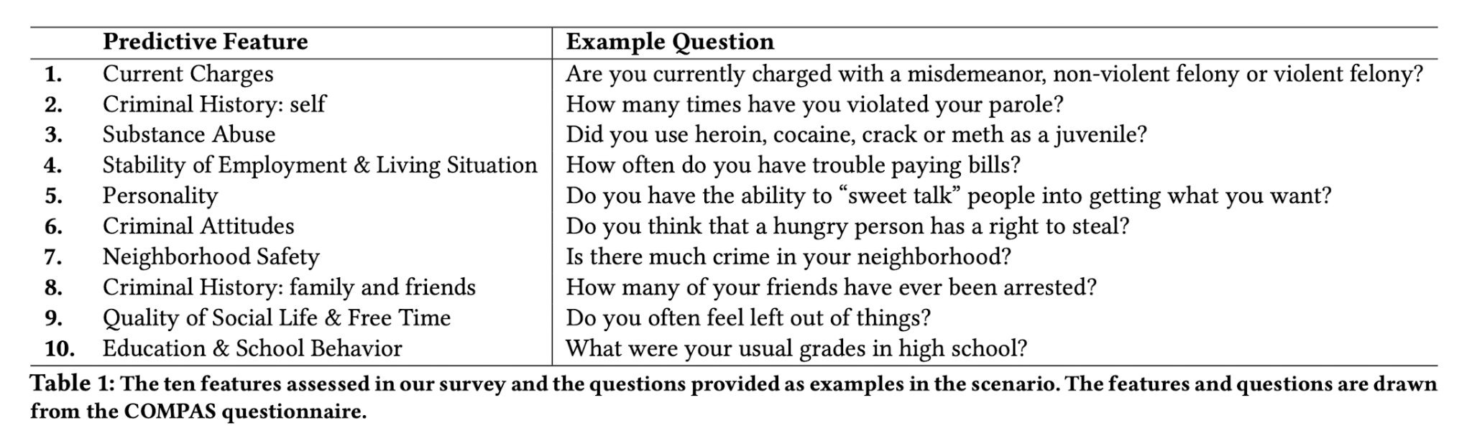

Slide 26
Surveys
In the first survey, they sought to learn whether respondents found the above scenario fair and why they felt it was fair or unfair
In the second survey they explored how people evaluate the latent properties of features without asking any fairness-related questions
In the Main survey, they tried to evaluate if people’s judgement about the latent properties of features were relevant to their fairness judgements

Slide 27
Observations
The eight properties are sufficient and necessary to explain fairness judgements of users in the survey to a large extent.
Accurate prediction of a user’s fairness judgement is possible based only on their assessment of the latent properties
The list of latent properties captures a diverse set of unfairness concerns with algorithmic decision making that go beyond discrimination.
The lack of consensus in fairness judgements can be attributed to disagreements in how people assess the latent properties of the features
Notes:
Specifically only less than 3% of the surveyed users reported using a property outside of the list in arriving in their judgements. Also each property was used by atleast 15% of the users during their fairness judgements
They found that the eight properties are not only sufficient to make predictions with high accuracy, but six of the eight are also statistically significant (or necessary) for predicting the fairness judgement
As a matter of fact, the two properties that were not deemed to be statistically significant were Causing Disparity in Outcomes and Caused by Sensitive Group Membership which are both features with a potential to cause discrimination

Slide 28
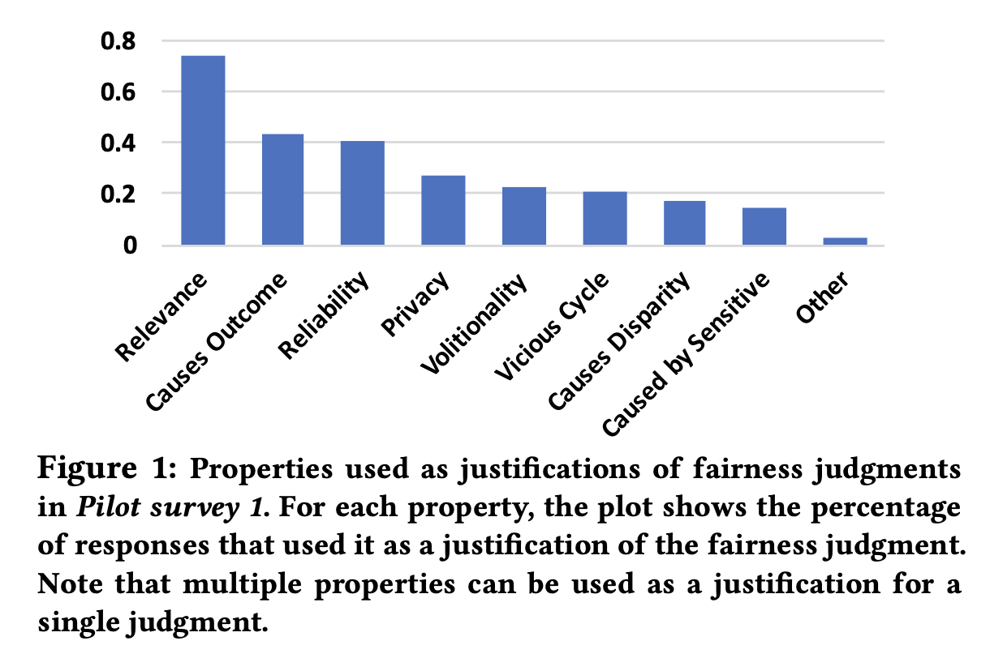

Slide 29
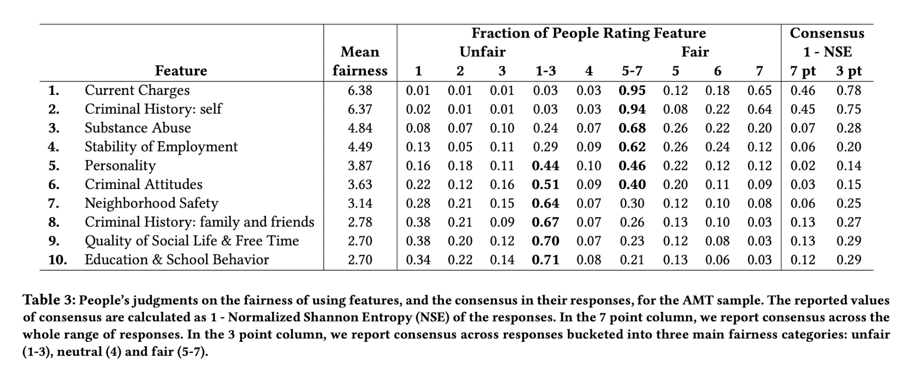

Slide 30
Discussion Time
Justify if the given features are fair or unfair to use to determine if someone qualifies for bail. Why did you make the decision (doesn’t necessarily need to be from one of the 8 latent features)?
Reliability | Relevance | Privacy | Volitionality | Causes Outcome | Causes Vicious Cycle | Causes Disparity in Outcomes | Caused by Sensitive Group Membership
Feature | Question
Personality | Do you have the ability to “sweet talk” people into getting what you want?
Quality of Social Life & Free Time | Do you often feel left out of things?
Education & School Behavior | What were your usual grades in high school?
Criminal History: Others | Has your father or mother ever been arrested?

Slide 31
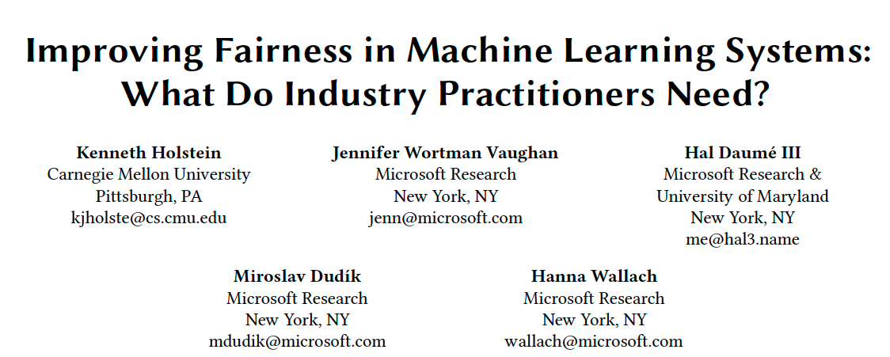

Slide 32
Fair ML tools
Should be driven by real-world needs rather than just availability of methods.
Be informed by an understanding of practitioners’ actual challenges and needs for support.

Slide 33
Interviews
First round with 6 PMs to identify board sense of challenges and need
Second round of semi-structured with 29 ML practitioners.
“Some contacts revealed a general distrust of researchers,citing cases where researchers have benefited by publicly critiquing companies’ products from the outside instead of engaging to help them improve their products”

Slide 34
Survey
To validate findings of interviews: Anonymous online survey data from 267 respondents analysed.

Slide 35
Discussion Time
At this point we are all aware of different scenarios where AI models can be unfair {for example, in cases like recidivism prediction, automatic hiring, face recognition, etc}. What in your opinion might be underlying causes of such unfairness?
Suggest some approaches towards solving those challenges.

Slide 36
Discussions
Fairness-aware Data Collection
Challenges Due to Blind Spots
Needs for More Proactive Auditing Processes
Needs for More Holistic Auditing Methods
Addressing Detected Issues
Biases in the Humans in the Loop
Notes:
There is not really a thought process surrounding..” Should we ingest this data in? ..If it is available to us, we ingest in. 79% indicated that tools to facilitate communication between model developers and data collectors would be very or extremely useful.; Fairness aware test-set design.
How do you know the unknowns that you’re being unfair towards. You just have to put your model out there and then you’ll know if there’s fairness issues if someone raises hell online. No one person in team has expertise in all types of bias
Current fairness auditing processes are reactive with efforts tightly focused around specific customer complaints in contrast to their teams’ proactive approaches for detecting potential security tasks. Also need for domain-specific auditing processes.
applications involving richer, complex interactions between the user and the system—such as chatbots, automated writing evaluation, adaptive tutoring and mentoring, and web search—brought up needs for more holistic, system-level auditing methods.
Fairness of fairness interventions: How to handle the situations.
Biases prevalent in the humans in the loop of ML pipeline, maybe crowdworker, ML designer, etc.

Slide 37
Discussions
Fairness-aware Data Collection
Should we ingest this data in? : If it is available to us, we ingest in.
“79% indicated that tools to facilitate communication between model developers and data collectors would be very or extremely useful.”
Challenges Due to Blind Spots
How do you know the unknowns that you’re being unfair?
“You just have to put your model out there and then you’ll know if there’s fairness issues if someone raises hell online.”
“No one person in team has expertise in all types of bias”
Notes:
There is not really a thought process surrounding..” Should we ingest this data in? ..If it is available to us, we ingest in. 79% indicated that tools to facilitate communication between model developers and data collectors would be very or extremely useful.; Fairness aware test-set design.
How do you know the unknowns that you’re being unfair towards. You just have to put your model out there and then you’ll know if there’s fairness issues if someone raises hell online. No one person in team has expertise in all types of bias

Slide 38
Discussions
3. Needs for More Proactive Auditing Processes
Reactive vs. Proactive Auditing
Domain-specific Auditing Process
4. Needs for More Holistic Auditing Methods
For applications involving richer, complex interactions between the user and the system
Notes:
Current fairness auditing processes are reactive with efforts tightly focused around specific customer complaints in contrast to their teams’ proactive approaches for detecting potential security tasks. Also need for domain-specific auditing processes.
applications involving richer, complex interactions between the user and the system—such as chatbots, automated writing evaluation, adaptive tutoring and mentoring, and web search—brought up needs for more holistic, system-level auditing methods.

Slide 39
Discussions
5. Addressing Detected Issues
6. Biases in the Humans in the Loop

Slide 40
Thank you!

