Slide 1

INDONESIA
VS
JAPAN
MACHINE LEARNING PREDICTION
Created by Chiesa Kurnia Satya
image source: varia banten

Slide 2
BACKGROUND
The soccer match between the Indonesia and Japan national teams in the 2026 world cup qualifier on November 15 will be an eye-catching match for both Asian and global soccer fans. The two teams have different styles of play, with Japan known as a disciplined, fast and organized team, while Indonesia, despite its great potential, is often faced with challenges in terms of consistency and strategy.
Predicting the score of a soccer match, especially between two teams with different qualities such as Indonesia and Japan, is a complex problem as many factors can affect the final result, such as player performance, formation, coach's strategy, players' physical condition, as well as external factors such as weather and field conditions. Therefore, using machine learning methods to predict soccer match scores is an interesting and relevant approach.
Among the various machine learning algorithms that can be used to predict match results with taking 6 historical match between indonesia and japan. Then, using Random Forest, Logistic Regression, and Long Short-Term Memory (LSTM) are three methods that have their own advantages and can provide valuable insights in such prediction efforts.

Slide 3
GOALS
This study aims to compare the effectiveness of various machine learning algorithms-Random Forest, Logistic Regression, and LSTM-in predicting the score of a soccer match between Indonesia and Japan. By utilizing historical match data, player performance, and other factors, this research is expected to provide a clearer picture of the potential accuracy of each algorithm in predicting match results that are often influenced by many variables.
Through this research, it is hoped that useful insights can be gained for the data analysis team, football fans, and interested parties in utilizing machine learning technology to analyze and predict the outcome of football matches more objectively and measurably.
Then, popularize the use of machine learning techniques, particularly in soccer match prediction analysis, as an effective tool in improving understanding of match dynamics and assisting more informed decision-making for fans, coaches, and related parties in the world of soccer.

Slide 4
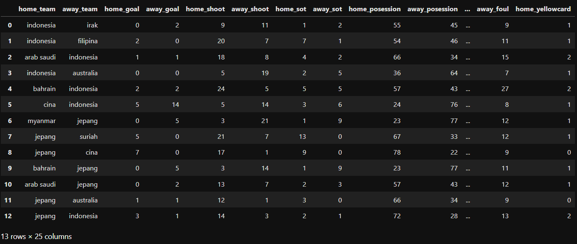
ABOUT DATASET
Data Resource: google.com

Slide 5
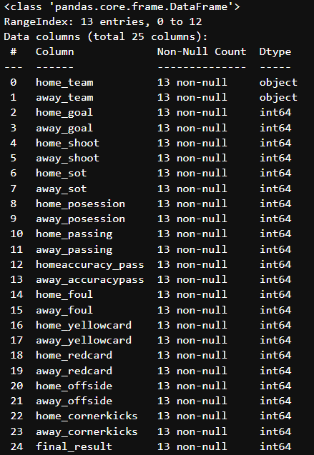
DATASET
Team = Home and Away Team Name
Goals = Data from the number of goals successfully entered
Shoot = Data from the number of shoots
Sot = shoot on target / shots that hit the target target (goal)
Posession = how long a team has the ball during the match.
Passing = Data from the number of passes made by each team
Accuracy Pass = to measure the accuracy of passing in making passes.
Foul = Data from the number of fouls committed by a team
Yellow Card = the number of yellow cards issued by the referee to each individual on a team.
Red Card = the number of red cards issued by the referee to each individual on a team.
Offside = offside offenses of each team
CornerKicks = the number of corner kicks from each team.
Final Result = The final result of the match

Slide 6
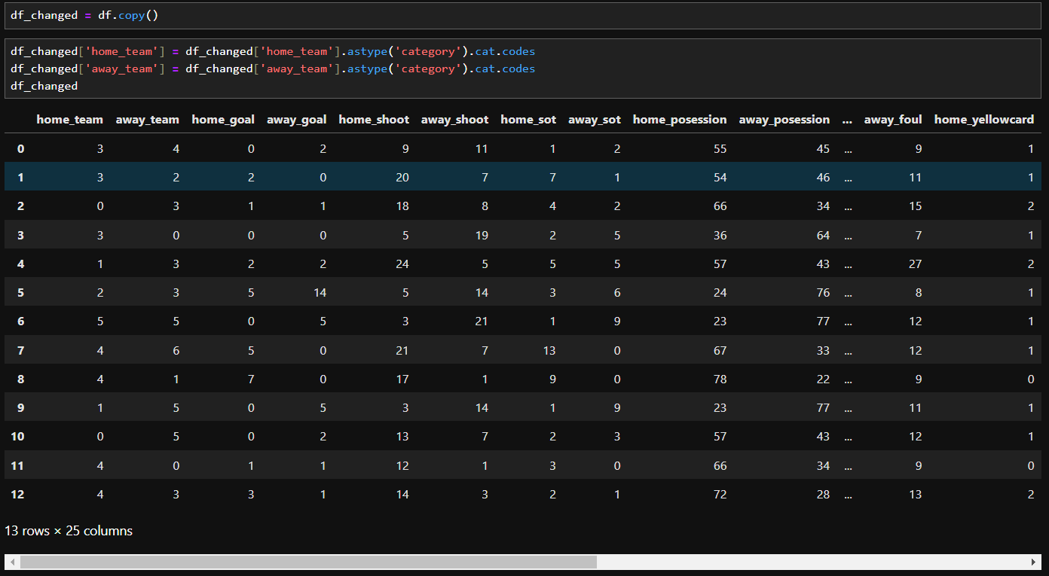
DATA PREPARATION
Convert categorical data into numerical data, this is done because there are some machine learning that cannot use categorical data in making prediction.

Slide 7
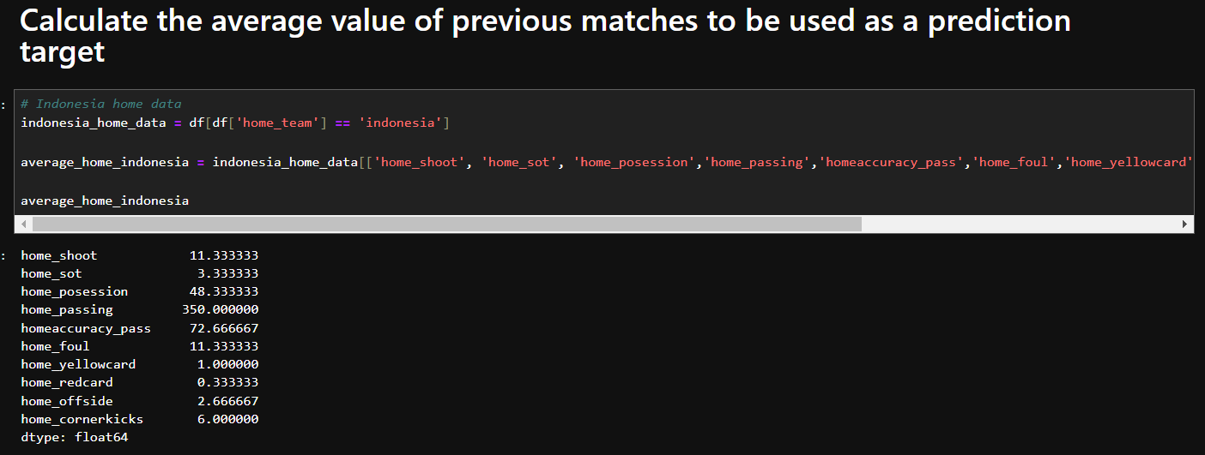
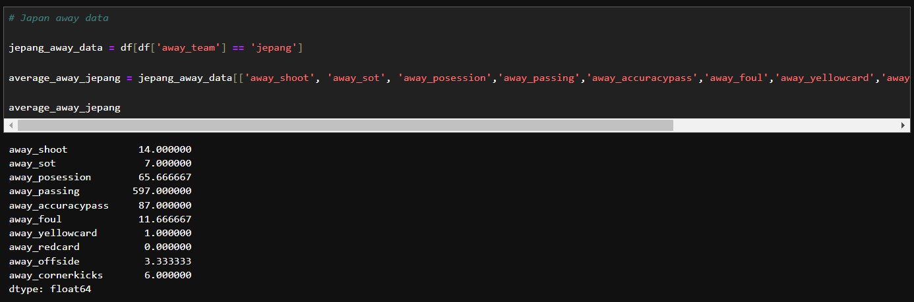
DATA PREPARATION
Find the average value of the performance of the two teams when they are home, and away

Slide 8
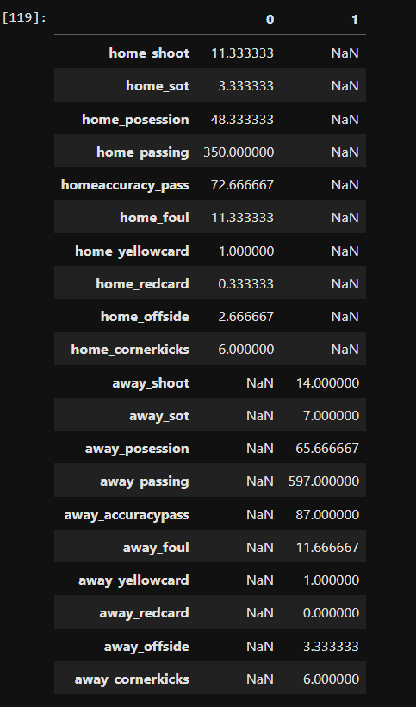
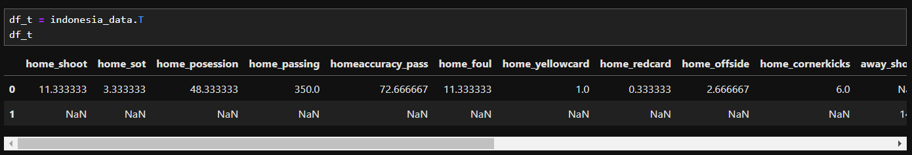
DATA PREPARATION
THEN COMBINES THE AVERAGE VALUES OF THE TWO TEAMS. IN THE TABLE, THE VALUE 0 IS THE IMPLEMENTATION OF THE AVERAGE VALUE OF THE INDONESIAN TEAM AS THE HOME TEAM. MEANWHILE, THE VALUE OF 1 IS THE IMPLEMENTATION OF THE AVERAGE VALUE OF THE JAPANESE TEAM AS AN AWAY TEAM. THEN AFTER THAT TRANSPOSE IT TO FORM A TABLE THAT CAN BE ANALYZED AT THE NEXT STAGE

Slide 9
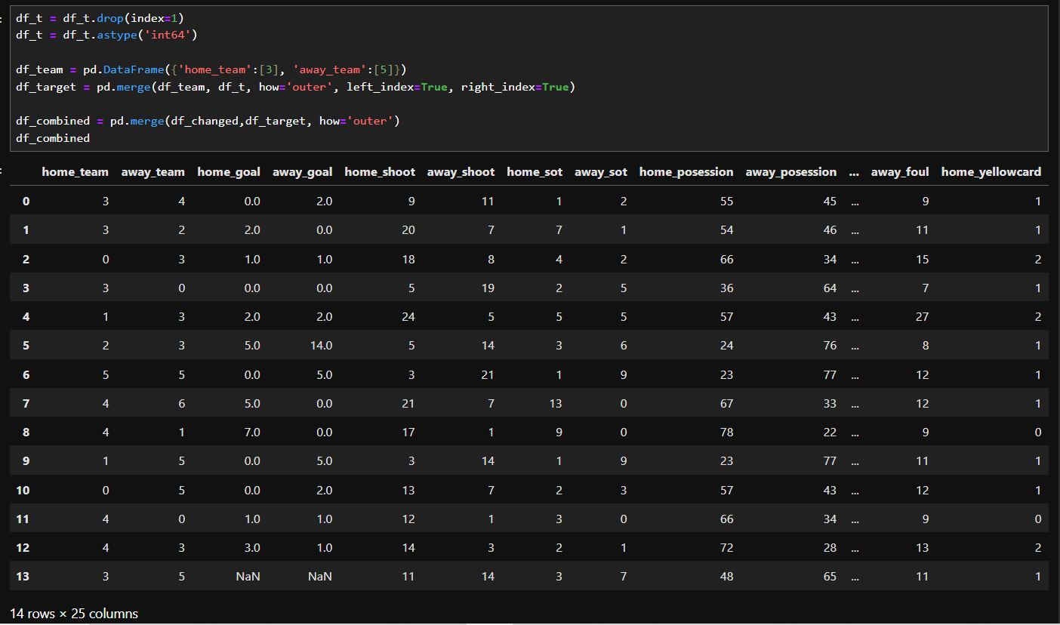
DATA PREPARATION
COMBINE THE RESULTS OF THE AVERAGE VALUE INTO A TABLE TO ANALYZE THE SCORE RESULTS OF THE TWO TEAMS WITH MACHINE LEARNING ALGORITHMS.

Slide 10
DATA PREPARATION
COMBINE THE RESULTS OF THE AVERAGE VALUE INTO A TABLE TO ANALYZE THE SCORE RESULTS OF THE TWO TEAMS WITH MACHINE LEARNING ALGORITHMS.

Slide 11
DATA PREPROCESSING
An important stage in data analysis, especially in the context of machine learning, which aims to clean and prepare raw data to be used for model building. This process includes a series of steps needed to improve data quality, reduce noise, and ensure that the data conforms to the format required by machine learning algorithms.
Data received in raw form is often imperfect. There are many things that need to be cleaned and adjusted in order to be used properly by machine learning algorithms. This process includes various steps that focus on cleaning and adjusting the data to make it more understandable to the model.
These steps not only aim to “clean” the data, but also to ensure that the data is in a consistent and structured form. Thus, data preprocessing plays a role in improving the quality of the data and the performance of the model to be built.

Slide 12
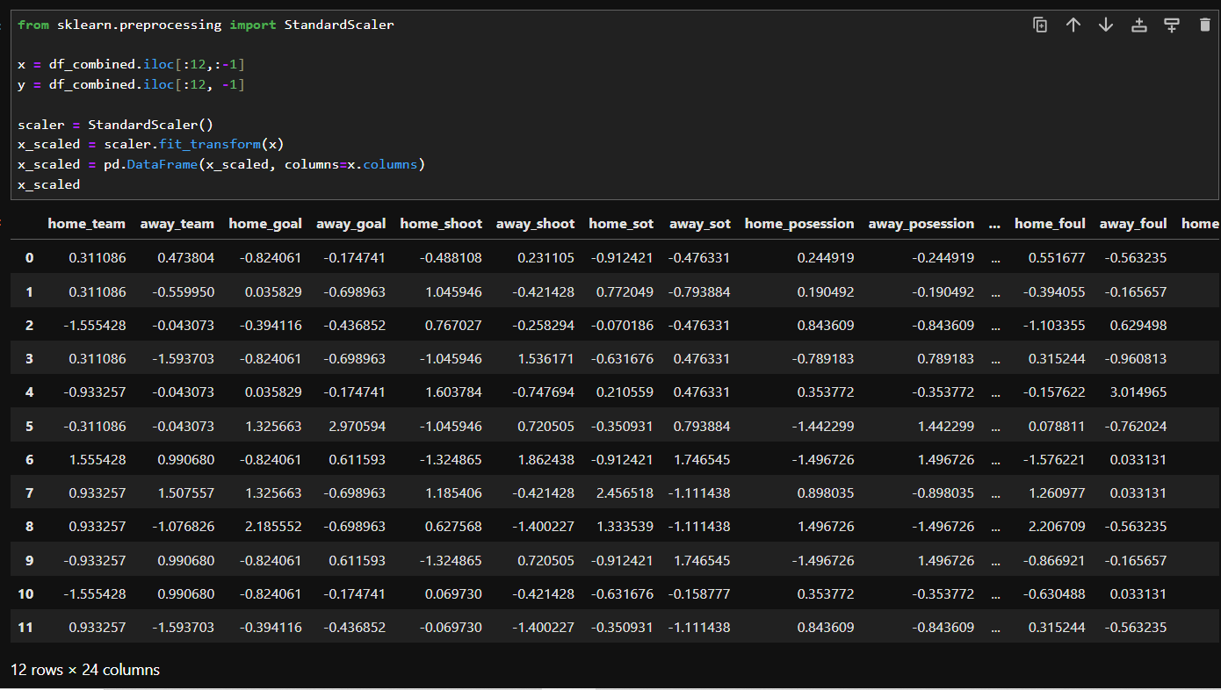
DATA PREPROCESSING
StandardScaler is one of the data normalization techniques used in machine learning to transform features in a dataset into a uniform scale. This technique is useful so that the built model can learn better and is not affected by the scale difference between the features in the dataset.
Change the data by using Standardscaler which is to avoid outliers when analyzing data.

Slide 13
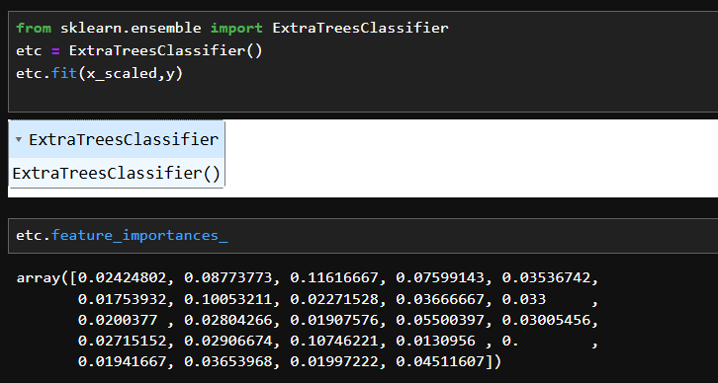
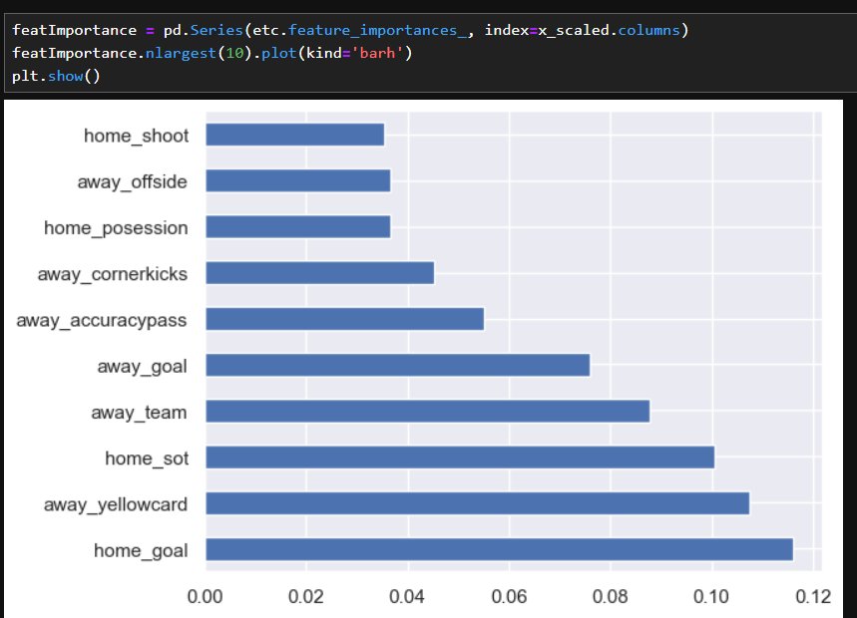
DATA PREPROCESSING
Looking for feature importance in the dataset, feature importance refers to a technique in machine learning to determine how much each feature (variable) in the model contributes to the resulting prediction. In other words, feature importance measures the extent to which each feature affects the output or decision made by the model.

Slide 14
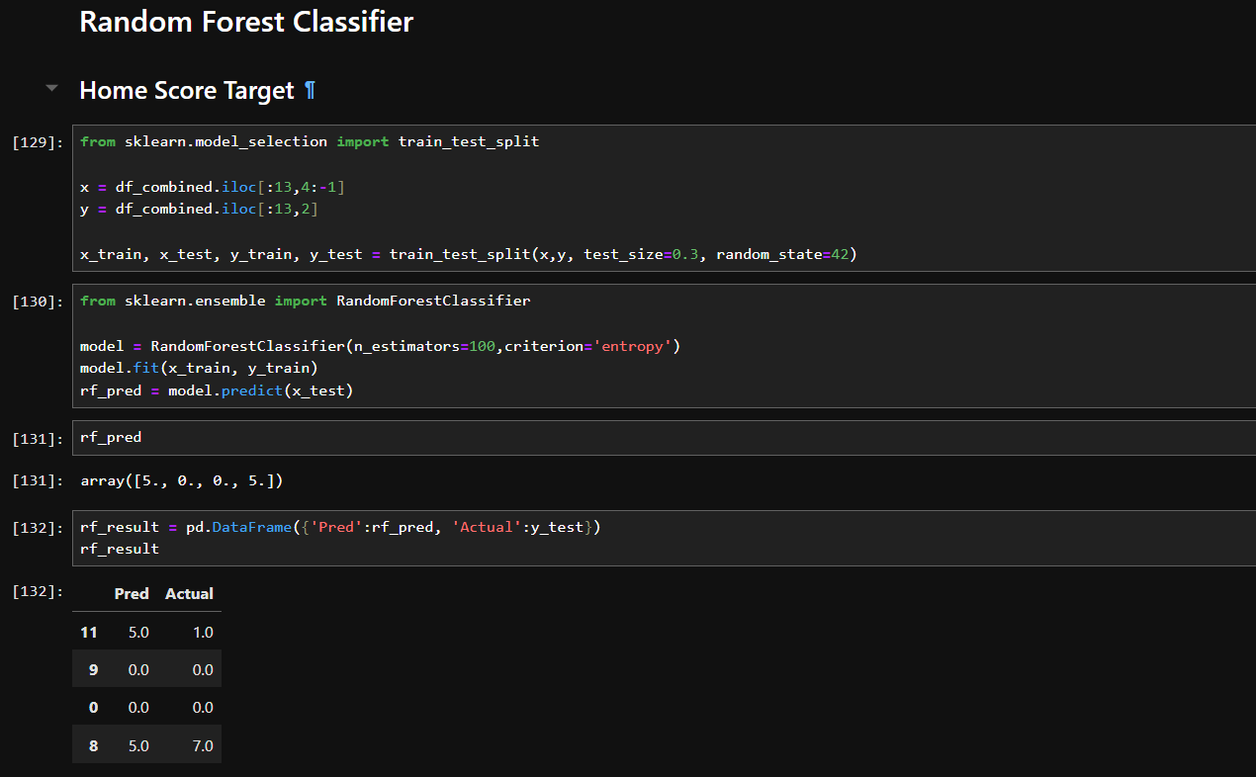
DATA MODELING WITH RANDOM FOREST
Random Forest is an ensemble-based machine learning algorithm that combines many decision tree models to make more accurate and robust predictions. This algorithm is very popular in classification and regression tasks because of its ability to overcome overfitting, improve accuracy, and handle complex data well.
In this case, the first thing we look for or predict is the Home Score of the total matches. In the model, we divide the data into train and test. While in random forest we use n_estimator = 100 as the number of decisions we make and criterion entropy.

Slide 15
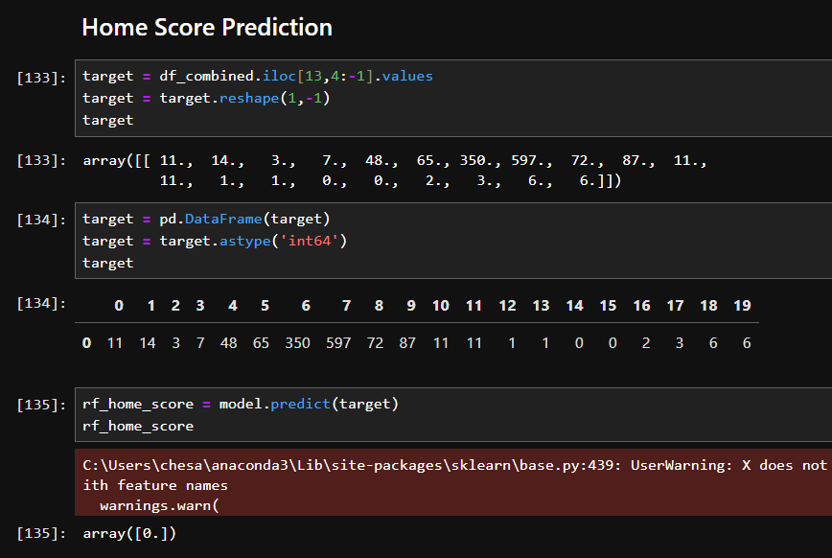
DATA MODELING
From the results of the random forest algorithm that we have created, we find the Home Score Prediction by using the average value of the Indonesian matches that we have made before.
In the results, we get a prediction result predicted using Random Forest that Indonesia will score 0 goals as the home team.

Slide 16
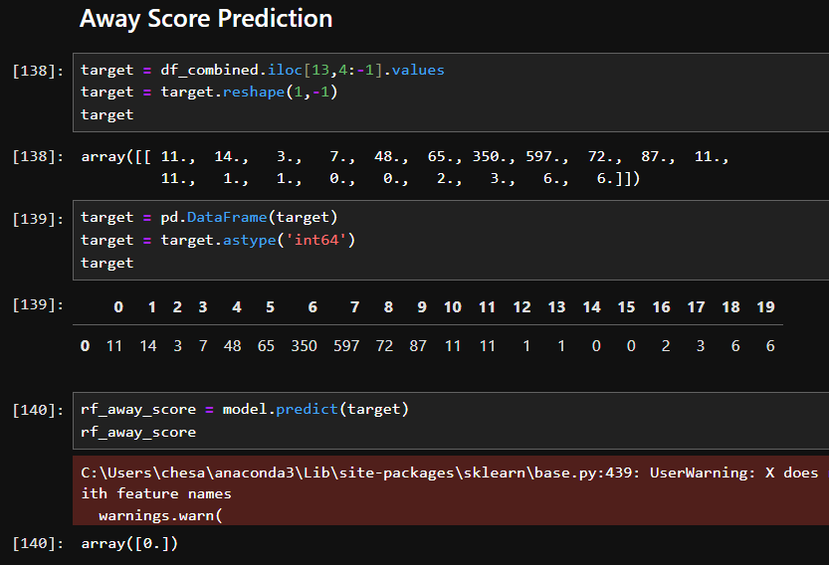
DATA MODELING
From the results of the random forest algorithm that we have created with the same algorithm, we look for Away Score Prediction by using the average value of the Japan match that we have created before.
In the result, we get a prediction result predicted by using Random Forest that Japan will score 0 goals as the home team.

Slide 17
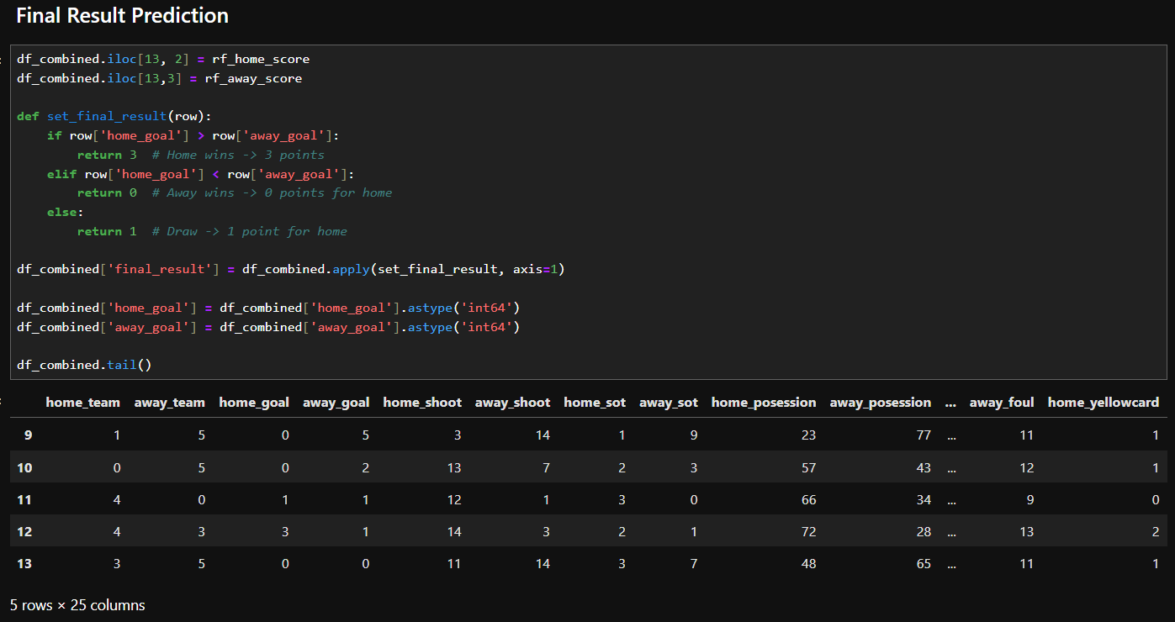
DATA MODELING
This is the final result of the prediction of the match between Indonesia vs Japan using Random Forest. In these results can be seen in the 13th index line, that Indonesia as the host must hold a draw score against Japan later with a score of 0-0.

Slide 18
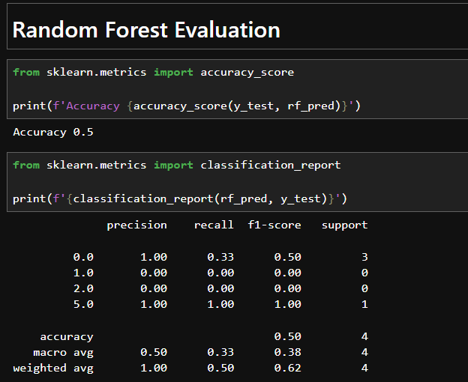
DATA MODELING
Then, in the evaluation metrics we can see we get an accuracy value of 0.5 or 50% in prediction with the Random Forest model. And also in the macro avg of the precision, recall, and f1-score values we get a value of 0.33 - 0.5. Meanwhile, in the weighted avg of the three values we get a range of 0.5 - 1.00.

Slide 19
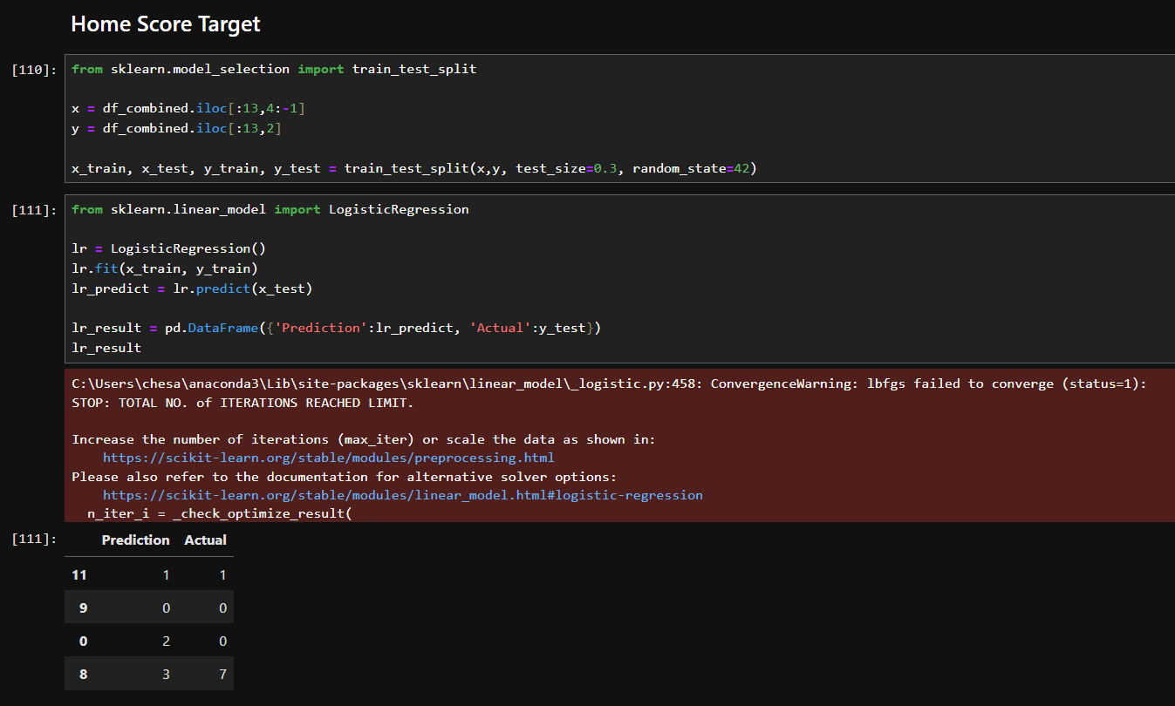
DATA MODELING WITH LOGISTIC REGRESSION
Logistic regression is a machine learning algorithm used for binary classification, which is to predict two different classes or categories. In the case of soccer match result prediction, we can convert the problem into two classes, namely “win” or “lose”, considering the draw as a separate category if necessary.
The logistic regression algorithm estimates the probability of the match outcome using a logistic function, which produces an output value between 0 and 1. This probability can then be interpreted as the likelihood of a team winning, losing, or drawing.

Slide 20
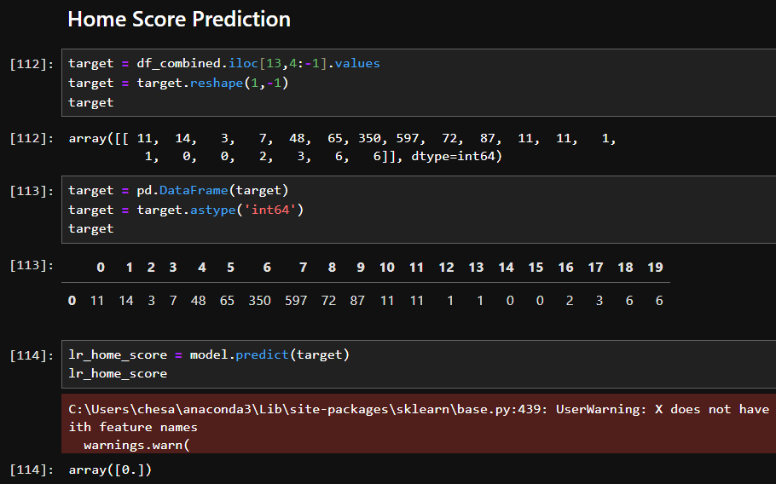
DATA MODELING
From the results of the Logistic Regression algorithm that we have created, we find the Home Score Prediction by using the average value of the Indonesian matches that we have made before.
In the results, we get a prediction result predicted using Logistic Regression that Indonesia will score 0 goals as the home team.

Slide 21
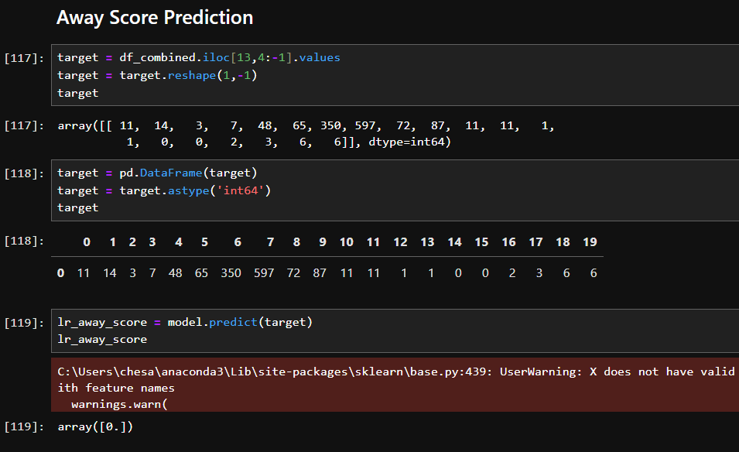
DATA MODELING
From the results of the Logistic Regression algorithm that we have created, we find the Home Score Prediction by using the average value of the Indonesian matches that we have made before.
In the results, we get a prediction result predicted using Logistic Regression that Japan will score 0 goals as the away team.

Slide 22
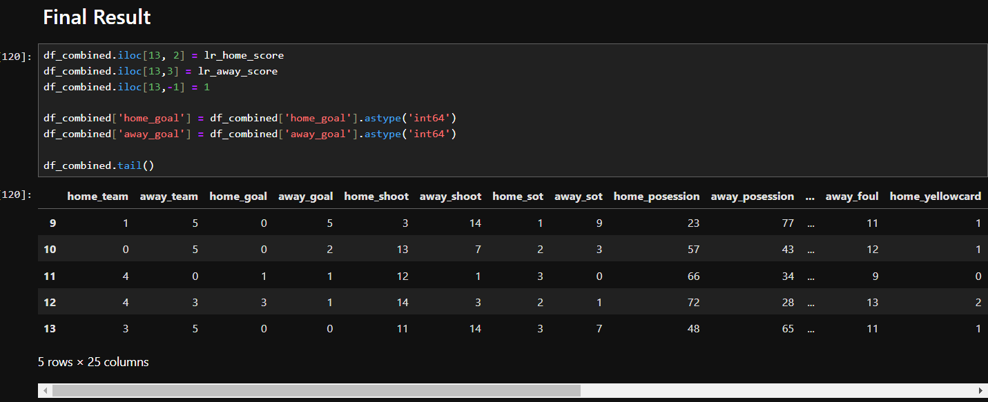
DATA MODELING
This is the final result of the prediction of the match between Indonesia vs Japan using Logistic Regression. In these results can be seen in the 13th index line, that Indonesia as the host must hold a draw score against Japan later with a score of 0-0.

Slide 23
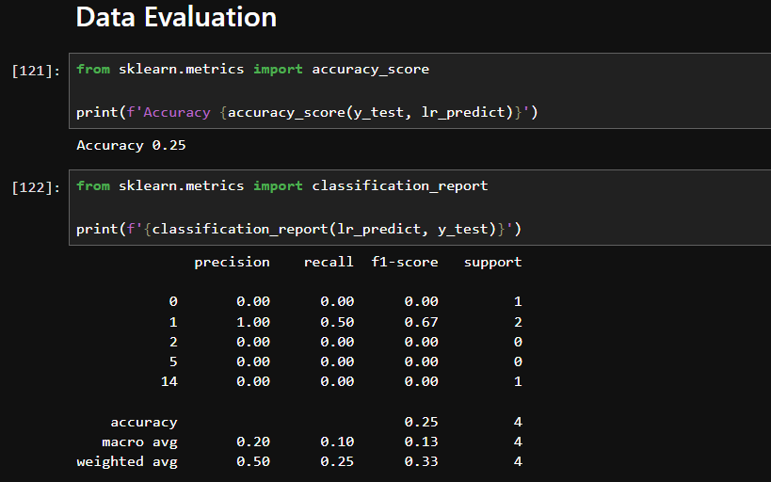
DATA MODELING
Then, in the evaluation metrics we can see we get an accuracy value of 0.25 or 25% in prediction with the Logistic Regression model. And also in the macro avg of the precision, recall, and f1-score values we get a value of 0.1 - 0.2. Meanwhile, in the weighted avg of the three values we get a range of 0.25 - 0.5.

Slide 24
DATA MODELING WITH LSTM
LSTM is a neural network model designed to solve problems in processing sequential data. LSTMs have the advantage of remembering information in sequential data for longer than regular RNNs, which often struggle with vanishing gradient problems. LSTMs use a gates mechanism that controls the flow of information through the network, allowing the model to “memorize” relevant information over a long period of time and forget less important information.
In the context of soccer match result prediction, LSTM is used to identify patterns in a sequence of matches that have occurred previously, both in terms of team performance (such as wins, losses, or draws), as well as match statistics (such as ball possession, shots on goal, and goals scored).
Therefore, by using Long Short-Term Memory (LSTM), we can utilize historical sequence data from previous matches to predict the outcome of the match between Indonesia and Japan. LSTM excels at identifying temporal patterns in data, which is particularly important in the world of sports where team performance is often influenced by time dynamics and previous match trends. With this model, we can obtain more accurate and data-driven predictions to aid pre-match analysis and planning.

Slide 25
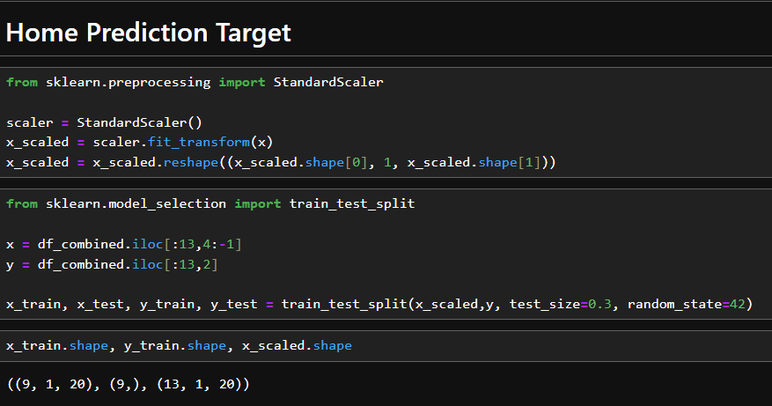
DATA MODELING
Before we model the neural network using LSTM. We do preprocessing on the data that we want to analyze. In this case for Home Prediction target, we convert the data into Standardscaler and then we split the data into train and test sets with a ratio of 70% train set and 30% test set.

Slide 26
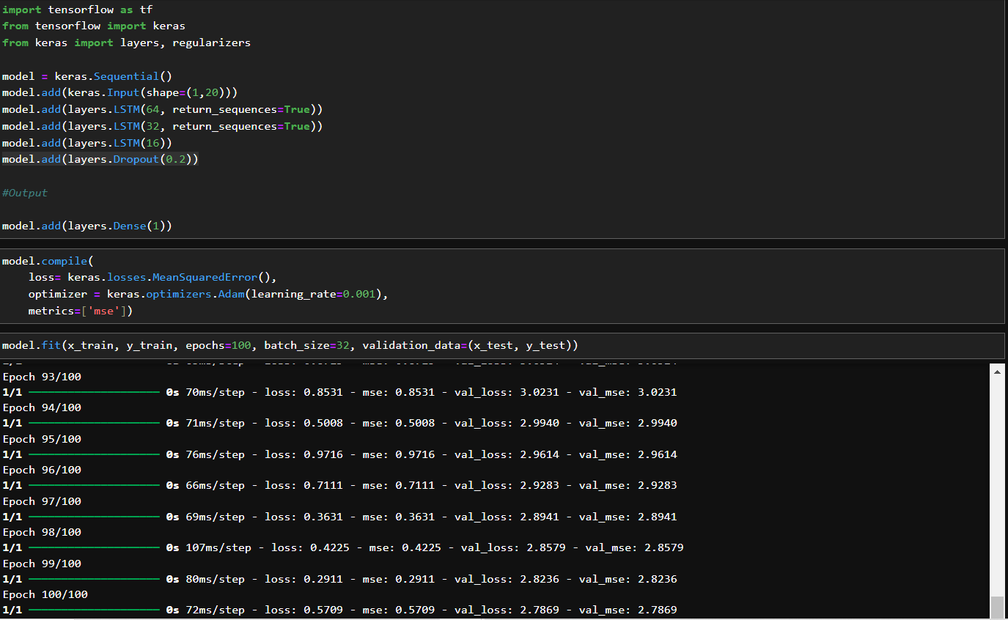
DATA MODELING
The LSTM model uses Sequential API as its model with an input layer of (1, 20) timesteps. Then, in the layer there are 3 layers consisting of 64, 32, 16 units where there is also a return_sequence which means that the output of each timestep is retained and not the final result. And finally the final layer with only 1 neuron is the output. In the model also uses Dropout which is to avoid overfitting when modeling the data.
The compile model uses Mean Squared Error which is commonly used in regression. Then, using Adam's optimizer with lr=0.001. Then, the metrics use MSE.
As for model training using the test set as data and train set as validation data with epochs 100 which means that the model will be trained 100 times and a batch size of 32 which is used as a sample.

Slide 27
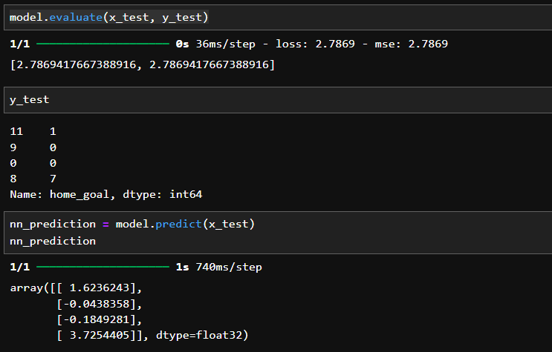
DATA MODELING
Loss is a value that indicates how good or bad the model prediction is compared to the true (target) value. In the context of regression, MSE is calculated by measuring the average square of the difference between the predicted value and the actual value (ground truth).
In this case, loss: 2.7869 means that the average squared error of the model prediction on the test dataset is 2.7869. This value indicates how far the model's prediction is from the actual value. The smaller the loss value, the better the model is at predicting the correct output.

Slide 28
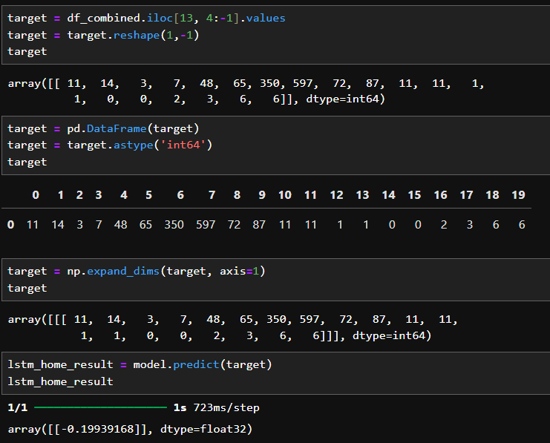
DATA MODELING
Furthermore, by using the above model that has been made, it aims to determine the prediction of score results for Home (Indonesia) from the average value of the Indonesian Team's performance when conducting Home matches.
As for the results of the LSTM model that we made, we get that Indonesia has a result of -0.19939 or which means 0.

Slide 29
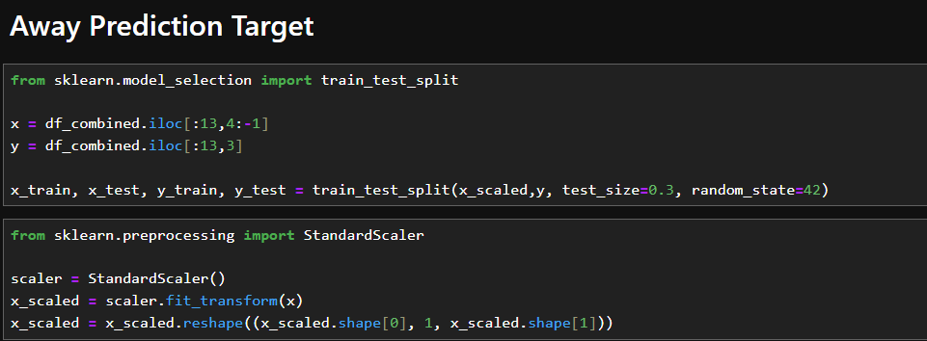
DATA MODELING
Before we model the neural network using LSTM. We do preprocessing on the data that we want to analyze. In this case for Away Prediction Target, we convert the data into Standardscaler and then we split the data into train and test sets with a ratio of 70% train set and 30% test set.

Slide 30
DATA MODELING
The LSTM model uses the same Sequential API for Away as for Home as its model with an input layer of (1, 20) timesteps. Then, within the layer there are 3 layers consisting of 64, 32, 16 units where there is also a return_sequence which means that the output of each timestep is retained and is not the final result. And finally the last layer with only 1 neuron is the output. The model also uses Dropout which avoids overfitting when modeling data.
The model is constructed using Mean Squared Error which is commonly used in regression. Then, using Adam's optimizer with lr=0.001. Then, the metric uses MSE.
As for model training using the test set as data and train set as validation data with epochs 100 which means the model will be trained 100 times and batch size 32 used as samples.

Slide 31
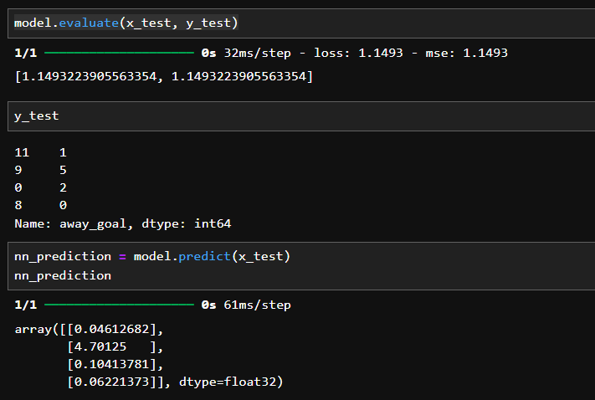
DATA MODELING
Loss is a value that indicates how good or bad the model prediction is compared to the true (target) value. In the context of regression, MSE is calculated by measuring the average square of the difference between the predicted value and the actual value (ground truth).
In this case, loss: 1.1493 means that the average squared error of the model prediction on the test dataset is 1.1493. This value indicates how far the model's prediction is from the actual value. The smaller the loss value, the better the model is at predicting the correct output.

Slide 32
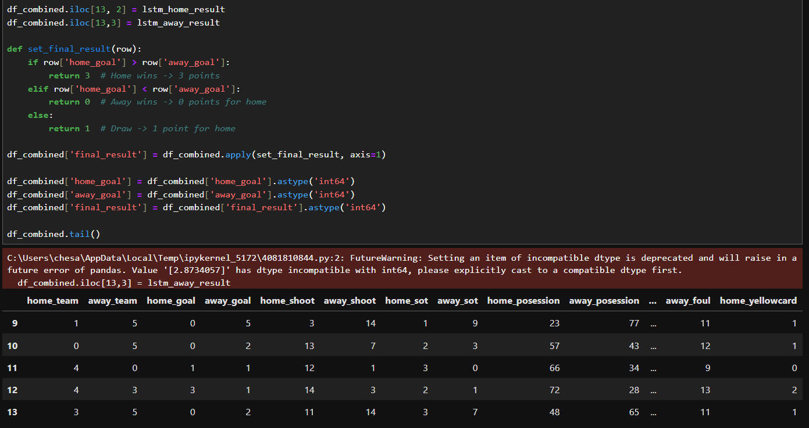
DATA MODELING
At the final stage, we have got the final result of the score prediction between Indonesia vs Japan which will be held on November 15, 2024 using LSTM with a result of 0 - 2. Which means that in that match Indonesia must lose 2 goals from Japan.

Slide 33
CONCLUSION
Predicting a Draw (0 - 0) from Random Forest and Logistic Regression may indicate that the two teams have equal performance in the given data, or there may not be a factor strong enough to significantly differentiate the two teams.
The Japan (0 - 2) Win Prediction from LSTM shows that the model successfully identifies factors that give Japan an edge in the match, be it from match history, team performance statistics, or other factors.
The difference in results between these three algorithms shows the importance of data in the world of sports as well. It is also in choosing the appropriate model based on the nature of the data available and the model's ability to capture relevant patterns in the context of sports prediction.
The disclaimer of the results is only a mere prediction using Machine Learning algorithms based on the data collected. Therefore, the more data collected in modeling will be more accurate.

Slide 34

TERIMA
KASIH
Atas Perhatiannya
Semoga informasi yang telah disampaikan bermanfaat bagi kita semua.

