Slide 1
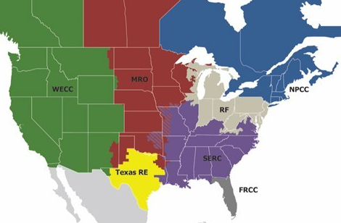



RMN
YZV
YQT
YUY
NWC
NWI
DLH
NPCC
FAR
YSB
YQB
NVW
YOW
YUL
YFC
MRO
MSP
GRB
PWM
YHZ
WECC
YYZ
PBG
BTW
RMN
MSN
MKE
RST
UCA
ALB
CON
DTW
BUF
SYR
ORH
BOS
OMA
ORD
CLE
BDL
BDR
PVD
RF
PIT
NYC
HID
PHL
NCV
HID
ICT
MCI
STL
BWI
SPP
SDF
CRW
NCC
SCI
BNA
ECG
AMA
OKC
LIT
CLT
SCC
SCV
SCV
DSW
SERC
ATL
SCC
TXN
CHS
ERCOT
GAI
TXE
TFW
TXW
TNC
JAX
TSC
MSY
TXS
TXC
TXS
MIA

Slide 2


YZV
YUY
NPCC
YQT
E7I
YQB
E7C
YSB
YUL
YFC
YOW
E6I
E6C
PWM
YHZ
YYZ
PBG
BTV
E5I
RST
UCA
CON
BUF
SYR
ALB
ORH
BOS
E5B
BDL
BDR
PVD
E5C
JFK
E4C

Slide 3


DLH
MKE
DTW
ORD
CLE
RF
PIT
PHL
BWI
CRW

Slide 4

STL
SDF
BNA
ECG
LIT
CLT
ATL
SERC
TXN
SPS
CHS
ERCOT
GAI
MGM
TXE
TYR
TFW
MAF
TXW
ABI
TNC
DFW
JAX
TSC
AUS
MSY
TXC
IAH
TXS
SAT
TPA
TXS
CRP
MIA

Slide 5




RMN
NWC
NWI
DLH
FAR
NVW
MRO
MSP
GRB
WECC
RMN
MSN
OMA
HID
HID
ICT
MCI
NCV
SPP
NCC
SCI
AMA
OKC
SCC
SCV
SCV
DSW
SCC
TXC
TXS
MIA

